Slide 1
Forward dosimetry modeling of cigarette smoke HPHCs in humans using open-source PBPK modeling
Zhang, J. ⁽¹⁾, Hines, D. ^{(2*)}, Cook, B. ^{(2*)}, Bell, S. ^{(2*)},
Lee, K.M. ⁽¹⁾
¹ Altria Client Services LLC, Center for Research and Technology,
Richmond, VA 23219
² Integrated Laboratory Systems, Morrisville, NC
* Former Employees
TSRC 2022
September 14, 2022

Slide 2
Background
Understanding and quantitating the biologically relevant dose is one of the keys in toxicological risk assessment.
Chemicals of interest: harmful and potentially harmful constituents (HPHCs) ¹
Better established methods for quantitation
Increased accuracy and relevance for risk assessment
Amount at absorption barrier (G.I. / Respiratory tract) that can be absorbed
Amount that gets past the exchange boundary, and into the blood
Quantitated for very few select chemicals, e.g., nicotine
Can be estimated with defined consumer use scenario
Often quantitated in cigarettes and emerging smoke-free tobacco products
Biologically Effective Dose
Exposure
Potential Dose
Applied Dose
Internal Dose
HPHCs
Organ
Effect
Intake
Uptake
Ingestion Route
Mouth
G.I Tract
Inhalation Route
Nose/Mouth
Lung
¹ https://www.fda.gov/tobacco-products/rules-regulations-and-guidance/harmful-and-potentially-harmful-constituents-tobacco-products-and-tobacco-smoke-established-list
Diagram adopted from: https://www.epa.gov/expobox/exposure-assessment-tools-routes-ingestion
Notes:
Levels are often quantitated in cigarettes and emerging smoke-free tobacco products as a proxy for evaluating the potential toxicity of the product.
However, the internal dose, such as levels of HPHCs in human target tissues is rarely quantitated due to methodological complexities, e.g., high reactivity, low concentrations, and lack of suitable analytical methods.

Slide 3
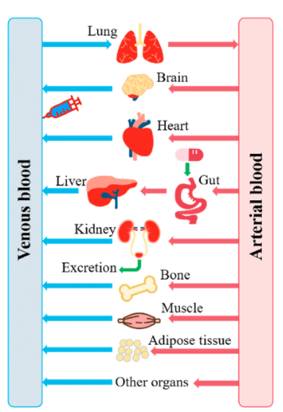
Background
Understanding and quantitating the biologically relevant dose is one of the keys in toxicological risk assessment.
This work used PBPK modeling to estimate human internal exposure to HPHCs with various exposure scenarios.
Clinical
physiologically based pharmacokinetic (PBPK) modeling
HPHCs
Biologically Effective Dose
Exposure
Potential Dose
Applied
Dose
Internal
Dose
NTAs
Chemicals
Organ
Effect
Flavors
Intake
Uptake
New Ingredients/Constituents
Ingestion Route
Mouth
G.I Tract
Inhalation Route
Nose/Mouth
Lung
Diagram adopted from: https://www.epa.gov/expobox/exposure-assessment-tools-routes-ingestion
Kinetic modeling diagram adopted from: Peng Y, Cheng Z, Xie F. Metabolites. 2021; 11(2):75. https://doi.org/10.3390/metabo11020075
Notes:
Levels are often quantitated in cigarettes and emerging smoke-free tobacco products as a proxy for evaluating the potential toxicity of the product.
However, the internal dose, such as levels of HPHCs in human target tissues is rarely quantitated due to methodological complexities, e.g., high reactivity, low concentrations, and lack of suitable analytical methods.
Baby pict

Slide 4
Methods
Select PBPK Models: US EPA’s high-throughput toxicokinetics package (HTTK) ¹
Evaluate the suitability of the model for 93 HPHCs
Obtain parameters for PBPK models
Generic model
Open source
Nine metals and two small molecules (ammonium and hydrazine) are excluded.
The current HTTK models are not suitable for metals and small molecules.
Intrinsic clearance (CLint)
Fraction unbound in the plasma (fu)
Lipophilicity (pKa)
Acidity (pH)
Henry’s Law constant (HL)
Parameters
Verify PBPK models with experimental data (Literature)
Nicotine
Estimate PK profiles and tissue levels
Cmax for repeat-dose via inhalation: 3R4F vs. a heated tobacco product
PK profile for a single dose: inhalation vs. oral ingestion
Supported by database
Compounds amenable = 82
Source: experimental data and QSAR (quantitative structure activity relationship) prediction
NNK
Formaldehyde
Key steps of verification and utilization of a PBPK model for HPHC forward dosimetry
¹ EPA: Environmental Protection Agency
Notes:
Environmental
Metabolites

Slide 5
HTTK Package: Open-Source PBPK Models
EPA’s High-throughput Toxicokinetics (HTTK) Package
A generic PBPK Model
Constant partitioning is applied
Lung, kidney, gut and liver are modeled explicitly, others (e.g., fat, brain, bones) are lumped into “the Rest of Body” compartment
The only ways chemicals “leave” the body are either through metabolism in the liver or excretion by the kidney
Input Parameters
Source: experimental data and QSAR (quantitative structure activity relationship) prediction
Intrinsic clearance (CLint)
Fraction unbound in the plasma (fu)
Lipophilicity (pKa)
Acidity (pH)
Henry’s Law constant (HL)
PBPK model diagram is adopted from: https://www.epa.gov/chemical-research/httk-epas-tool-high-throughput-toxicokinetics
https://pubmed.ncbi.nlm.nih.gov/30220889/

Slide 6
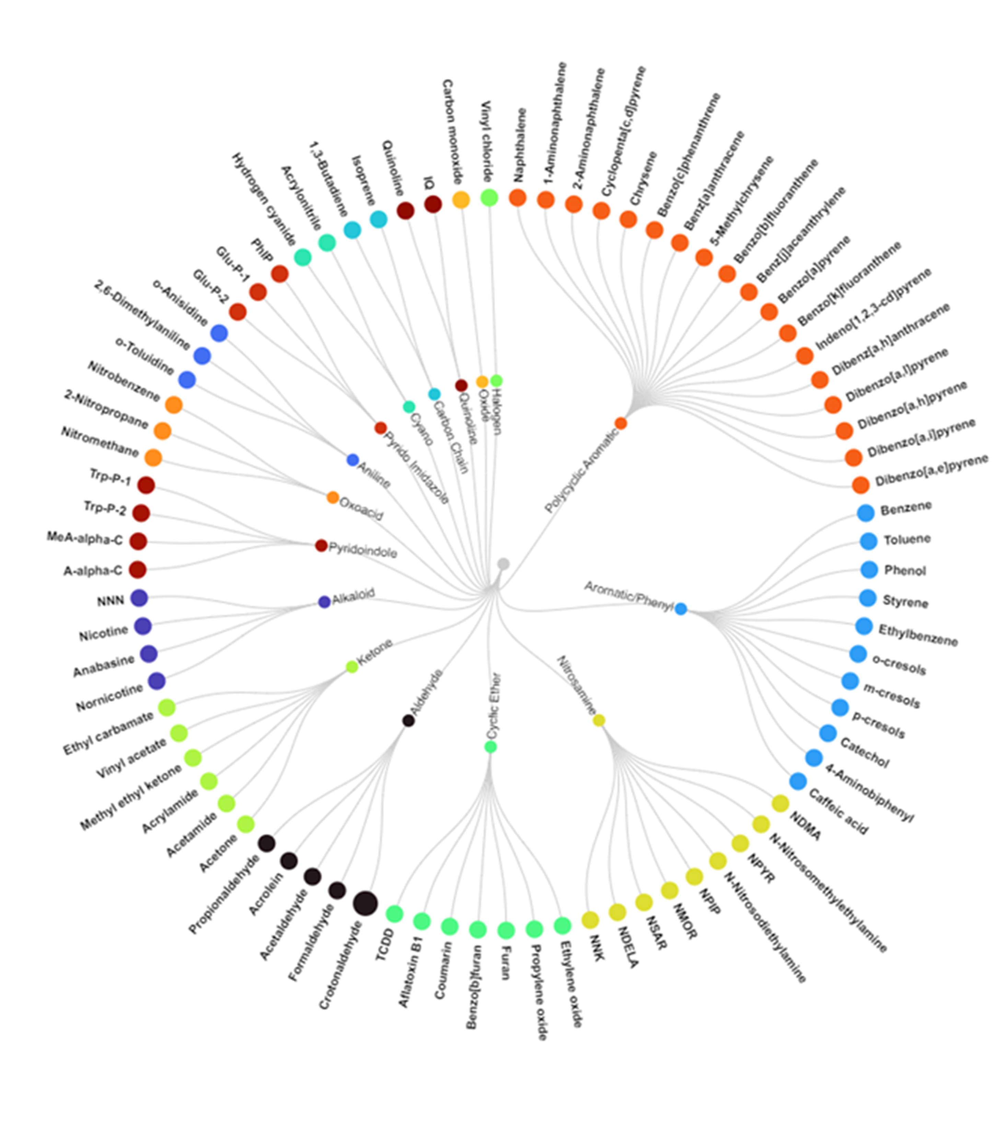
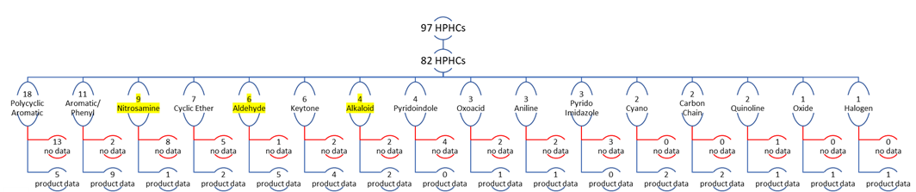
Evaluation of the Model’s Suitability for FDA’s 93 Listed HPHCs
Availability of the input parameters
9 metals and 2 small molecules (ammonium and hydrazine) are excluded
Compounds amenable: 82
Structural grouping of the 82 HPHCs
16 groups based on similar functional groups and molecular descriptors and fingerprints
3 chemicals from three groups were selected for model verification
Availability of the product analytical data: 37 constituents for 3R4F and a heated tobacco product (HTP)
93
Black: Product data not available
Red: Product data available
Notes:
PaDEL needs to be defined
brief

Slide 7
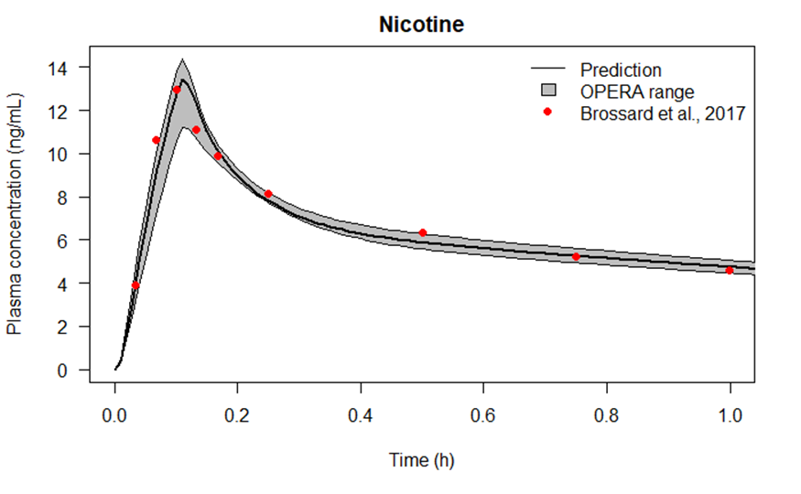
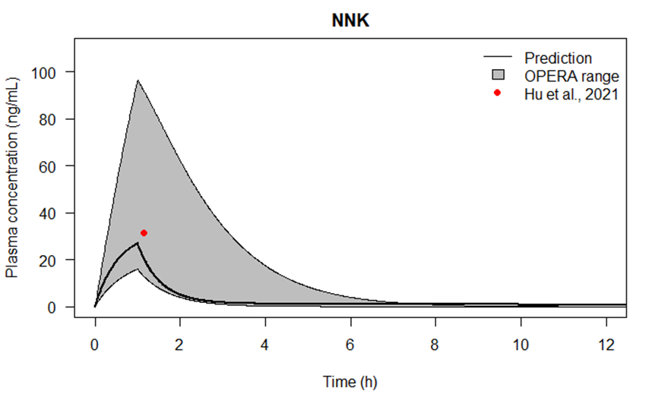
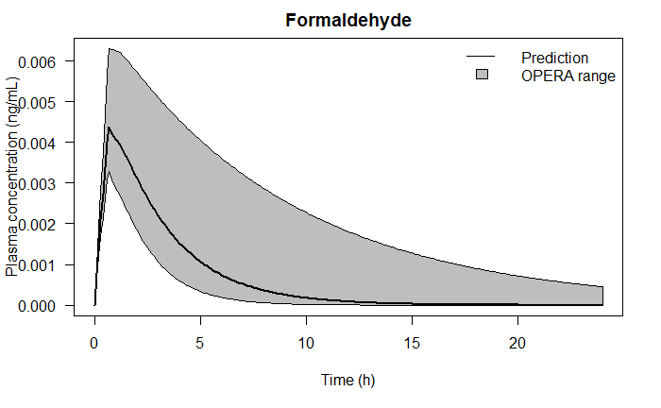
Verification of the PBPK Models with Experimental Measurements
Three HPHCs of varying characteristics and PK data availability are tested.
Model predictions generally matched in vivo data well with the data points falling within the prediction range.
Uncertainty of the prediction is associated with the uncertainty of the parameter prediction with a QSAR tool (OPERA⁴).
Nicotine (Alkaloid)
Brossard et al. (2017) ¹
Clinical study
Exposure: one stick of THS 2.2 reduced risk
The PK profile is compared between the measured and the predicted
NNK (Nitrosamine)
Hu et al. (2021) ²
Non-clinical study in rats
Exposure: 1-hour exposure to 1.7 mg/L NNK in rat
Cmax and Tmax are compared between the measured and the predicted
Formaldehyde (Aldehyde)
Heck et al. (1985) ³
Clinical study
Exposure: 40-min inhalation exposure to 1.9 ppm formaldehyde
No significant accumulation in the blood
¹ Brossard, Patrick, Rolf Weitkunat, Valerie Poux, Nicola Lama, Christelle Haziza, Patrick Picavet, Gizelle Baker, and Frank Lüdicke. 2017. “Nicotine Pharmacokinetic Profiles of the Tobacco Heating System 2.2, Cigarettes and Nicotine Gum in Japanese Smokers.” Regulatory Toxicology and Pharmacology 89: 193–199.
² Hu, Shu-Chieh, Matthew S. Bryant, Estatira Sepehr, Hyun-Ki Kang, Raul Trbojevich, Guy Lagaud, Darshan Mehta, Wei Ding, Roberta A. Mittelstaedt, and Mason G. Pearce. 2021. “Toxicokinetic and Genotoxicity Study of NNK in Male Sprague Dawley Rats Following Nose-Only Inhalation Exposure, Intraperitoneal Injection, and Oral Gavage.” Toxicological Sciences 182 (1): 10–28.
³ Heck, Henry, Mercedes Casanova-Schmitz, Parker B. Dodd, E. Neil Schachter, Theodore J. Witek, and Tarik Tosun. 1985. “Formaldehyde (CH2O) Concentrations in the Blood of Humans and Fischer-344 Rats Exposed to CH2O under Controlled Conditions.” American Industrial Hygiene Association Journal 46 (1): 1–3.
⁴ https://ntp.niehs.nih.gov/whatwestudy/niceatm/comptox/ct-opera/opera.html

Slide 8
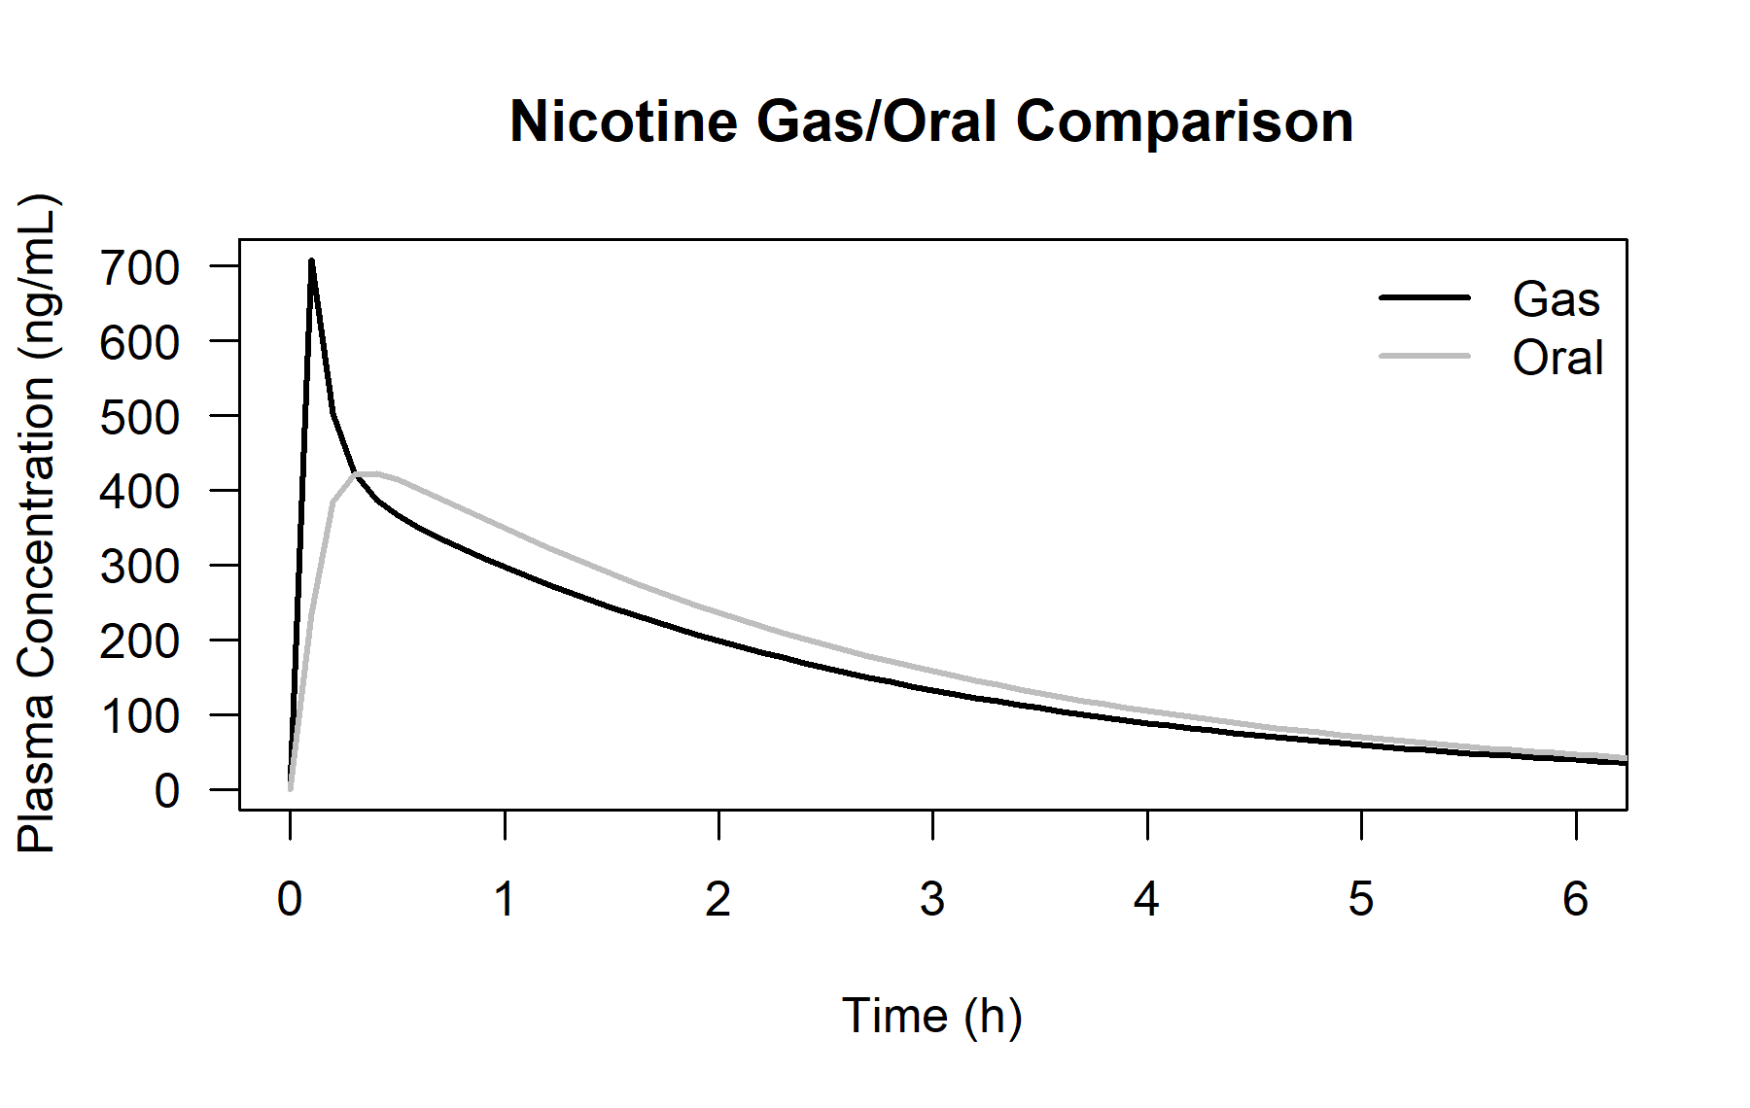
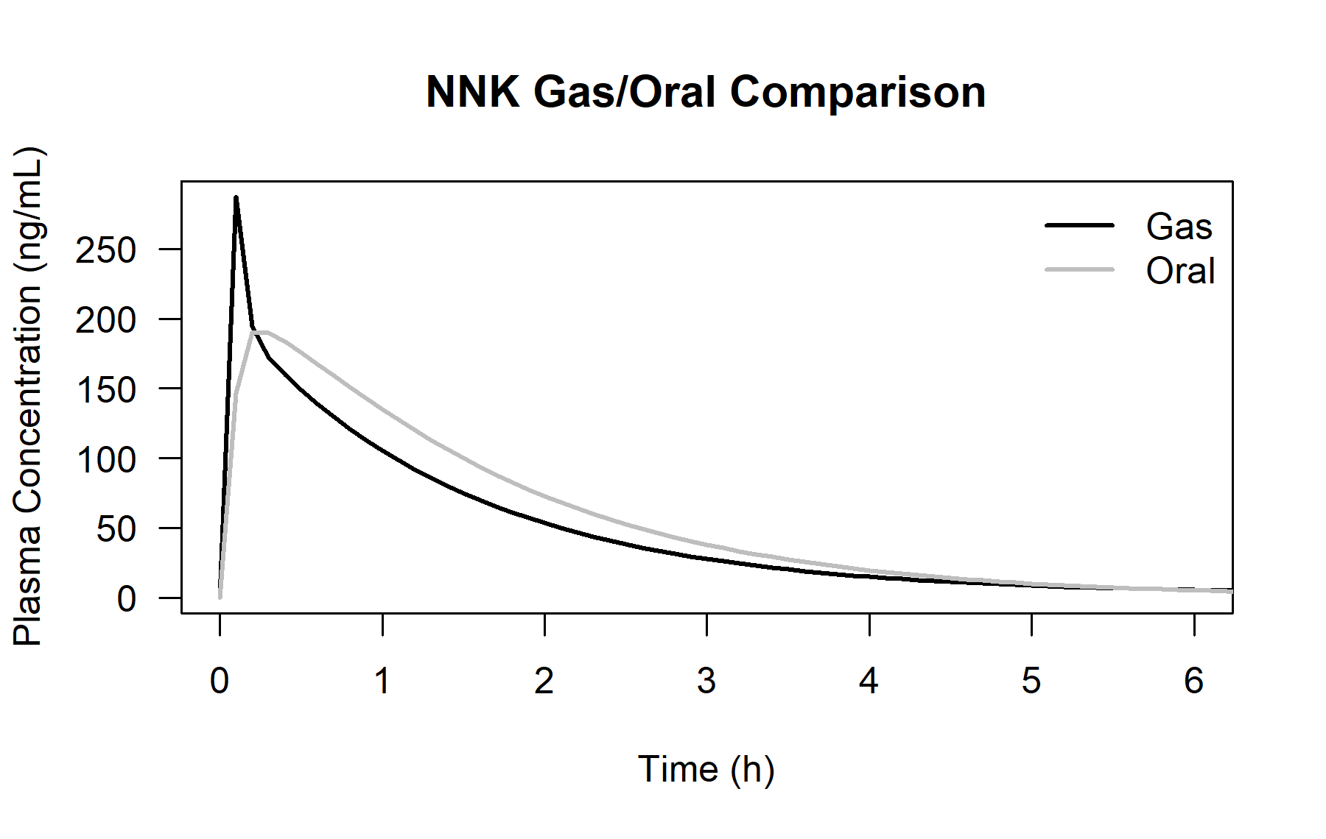
Results: Impact of Route of Exposure on the PK Profiles
Oral ingestion vs. Inhalation (One Single Dose of 1 mg/kg body weight)
The route of exposure has varying impacts on the PK profiles of different compounds as they go through different adsorption, distribution, metabolism and excretion pathways.
Nicotine Inhalation vs. Oral Ingestion
NNK Inhalation vs. Oral Ingestion
Inhalation
Oral Ingestion
Inhalation
Oral Ingestion
Notes:
82
Adjust the x axis on nicotine
Gas to inhalation

Slide 9
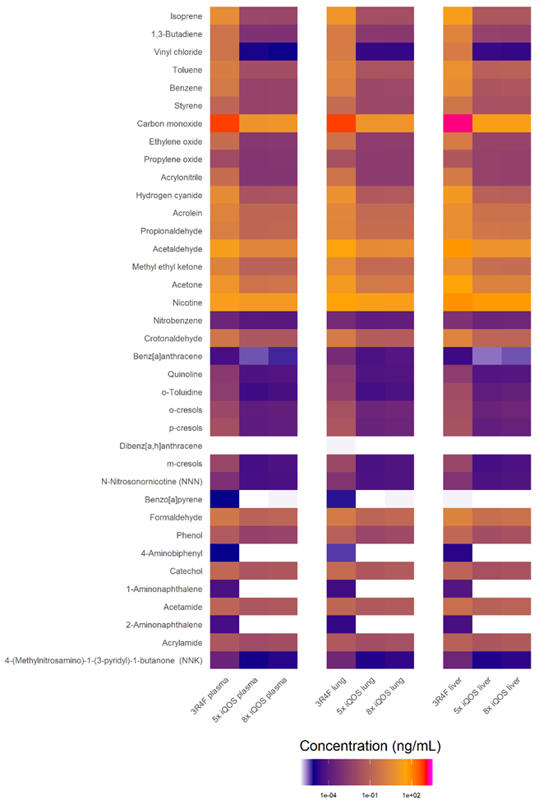
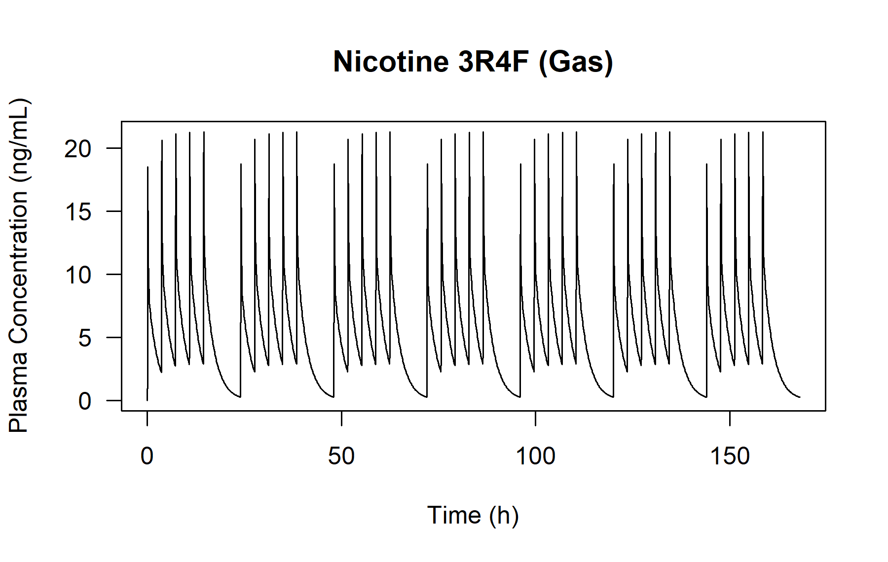
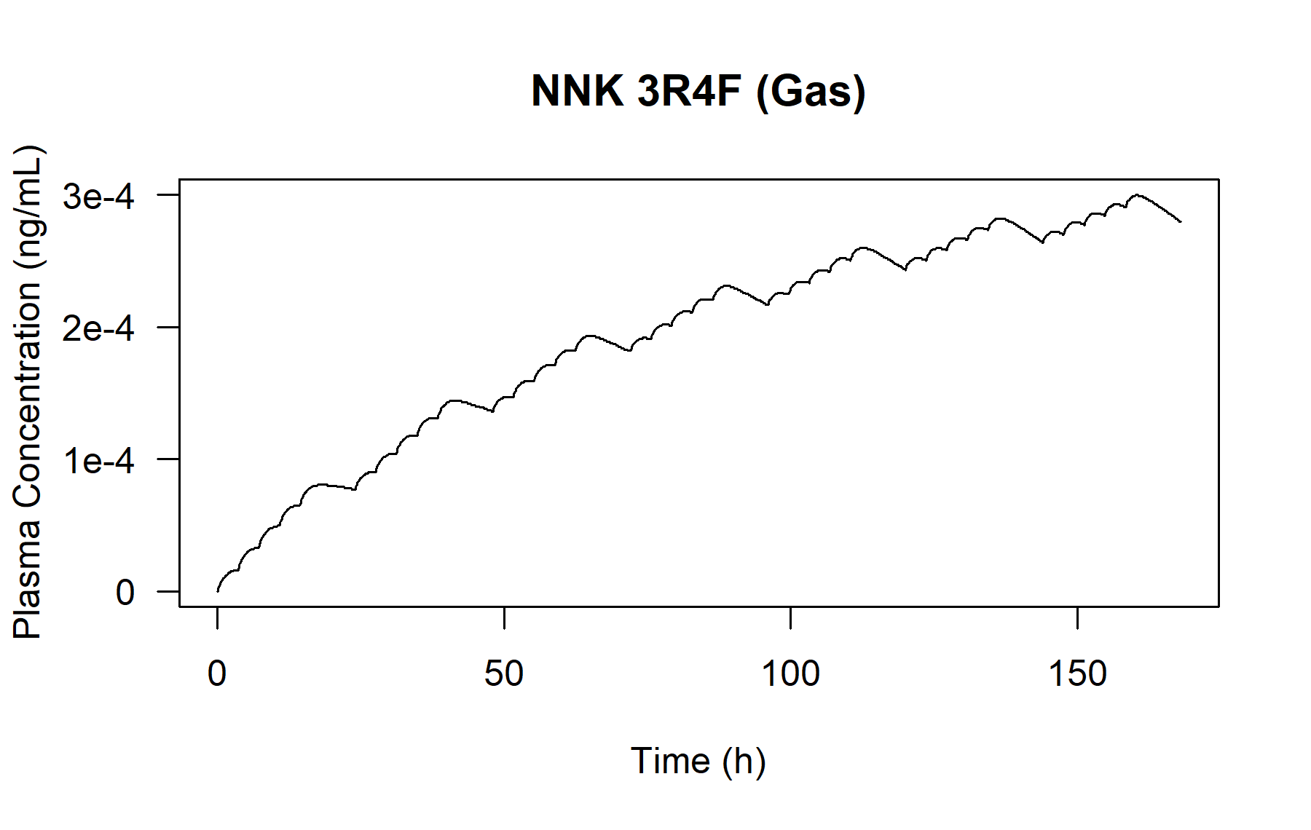
Results: Target Tissue Levels after Repeat Dose
Cigarettes vs. HTP ^{1, 2, 3}
For the selected HPHCs, comparisons of Cmax between plasma and liver showed similar patterns.
Tissue concentrations were reduced in the HTP product compared to the 3R4F as expected due to substantial differences in the exposure levels and were typically in the ng/mL range.
Assumptions of Consumer Use Pattern
Inhalation
Seven consecutive days
Use over 18 hours with six hours of abstinence
Five sticks of 3R4F per day
Five sticks / Eight sticks of HTP per day
Plasma
Liver
¹ Uchiyama, Shigehisa, Mayumi Noguchi, Nao Takagi, Hideki Hayashida, Yohei Inaba, Hironao Ogura, and Naoki Kunugita. 2018. Chemical Research in Toxicology 31 (7): 585–593.
² Www.Pmiscience.Com. June 22, 2022. https://www.pmiscience.com/content/pmiscience/language-master/en/research/product-assessment-approach/platform-development/ths-mainstream-aerosol-compared-to-reference-cigarette-smoke.html.
³ Helen, Gideon St, Peyton Jacob Iii, Natalie Nardone, and Neal L. Benowitz. 2018. Tobacco Control 27 (Suppl 1): s30–s36.
Notes:
Explain the heat map

Slide 10
Summary
We demonstrated the feasibility of using a publicly available, generic PBPK model to estimate the internal dose of selected HPHCs via different routes (inhalation vs. oral ingestion) and from different tobacco products (cigarettes vs. HTPs).
We verified the PBPK model with three select compounds (nicotine, formaldehyde, and NNK) with experimental data from literature and showed consistent results.
We estimated the internal exposure of 82 out of the 93 FDA’s listed HPHCs using a generic PBPK model.
The model results showed the impact of route of exposure on the PK profiles.
With HPHC level data in the products (37 out of 82), the target tissue level (Cmax) can also be estimated and compared for various products and use patterns.
Notes:
Next step: more model verification

Slide 11
Strengths and Limitations
Strengths
The method provides an estimation of the in vivo dosimetry of compounds and is a critical step in the in vitro to in vivo extrapolation (IVIVE).
This is true especially if in vitro data is used for toxicity evaluation for compounds with limited in vivo data.
Limitations
Modeling is a useful tool but the suitability is dependent on the chemical nature of the compounds.
The generic model can be applied to a variety of compounds but may lack the specificity.
Physiological parameters for compounds could be estimated using QSAR prediction tools if experimental data are not available. However, the associated uncertainty needs to be taken into account.

Slide 12
Acknowledgement
Please contact me if you have any questions.
Jingjie Zhang, Principal Scientist (Jingjie.Zhang@altria.com)
Altria Client Services, LLC
601 E. Jackson St., Richmond, VA, 23219
Special acknowledgements to our co-authors, David Hines, Shannon Bell, Bethany Cook, K. Monica Lee, and reviewers, Sucharitha Iyer, Jason Flora, Mingda Zhang, Matt Melvin

