Slide 1
Case Registration and Data Entry for Referring Dementia Practices

Slide 2
User Role Information
  A user may have multiple roles in the study portal.
  *All practices must have an assigned Practice Administrator, Dementia Specialist and a Practice Finance User
Practice Administrator* | Dementia Specialist* | Practice Finance User* | Practice Registrar
- Automatically assigned to the person who initially submits the pre-registration form. - Has complete administrative functionality in the New IDEAS portal. - Responsible for administrative duties associated with site registration and adding practice staff profile accounts. - Has view access to all case report forms and edit/submission access to all forms except pre- and post-PET form. | - Has view, edit and submission access to all case report forms. - Only user role that has edit and submission access to pre- and post-PET forms. | - Only user role that has access to the practice’s finance portal” - Responsible for submission of banking information - Does not have any access to patient case report forms | - Has view access to all case report forms and edit/submission access to all forms except pre- and post-PET form.

Slide 3
Visit 1: Clinical Assessment—Pre-PET Visit
Form/Assessment: | Must be completed by: | Requirements:
Case Registration Form | Administrator, Registrar OR Dementia Specialist | Must be completed after patient consent
Socio-demographic electronic Case Report Form | Administrator, Registrar OR Dementia Specialist | Must be completed within 7 days of case registration AND collected via patient self-reporting interview
Pre-PET electronic Case Report Form (Clinical Assessment) | Dementia Specialist ONLY | Must be completed within 7 days of case registration

Slide 4
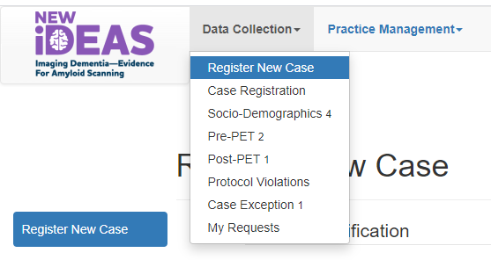
Visit 1: Case Registration Online
Completed by the referring dementia specialist (or an authorized designee who has obtained the registrar role enabling access to the database)
  Login to New IDEAS Portal, https://app.ideas-study.org/.
  Under “Data Collection” select “Register New Case”.
  Complete Cohort Identification and Eligibility Confirmation. Review and Click “Confirm.”
  A unique 5-digit study case number for that patient will be issued.
  A confirmation e-mail will be sent to the dementia specialist practice and the PET facility.

Slide 5
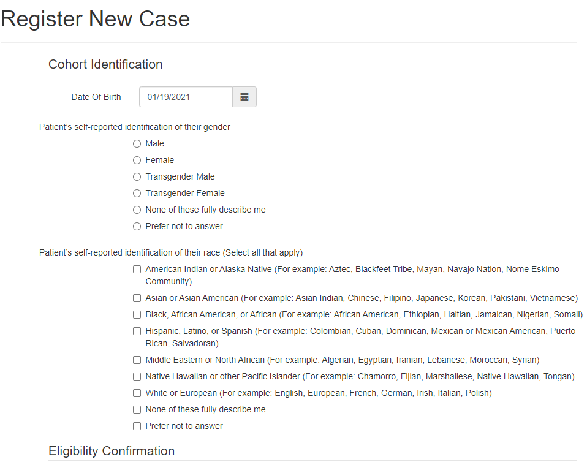
Case Registration Example: Cohort Identification
The participant’s self-identification of their race will be collected as part of the registration process to verify availability within defined cohorts.

Slide 6
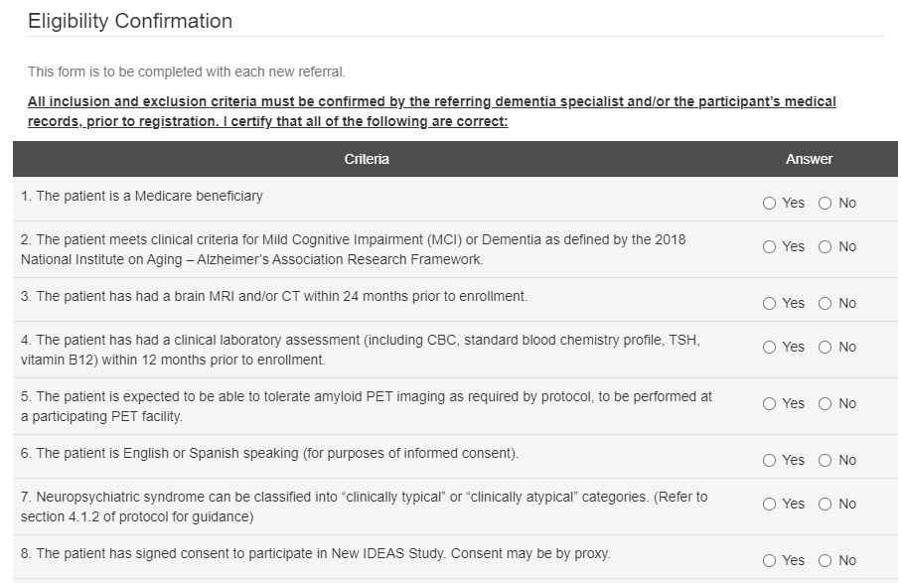
Case Registration Example: Eligibility Confirmation
Inclusion and Exclusion criteria must be confirmed by the referring dementia specialist and/or the participant’s medical records prior to registration.

Slide 7
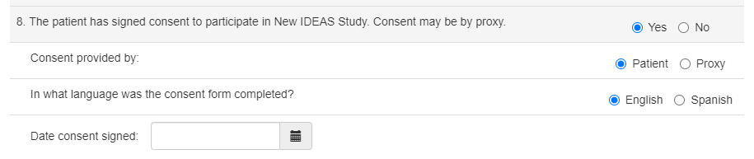
Case Registration Example: Consent Confirmation
The patient consent form must be completed BEFORE case registration is completed.
The fully executed informed consent form (pdf only) must be uploaded to complete the Case Registration Form.

Slide 8
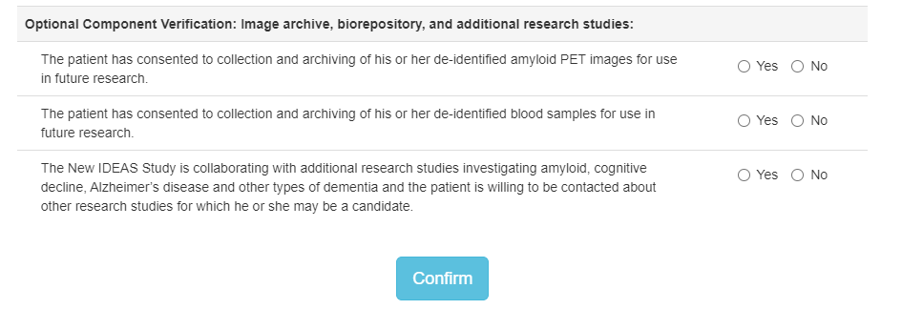
Case Registration Example: Optional Component Verification
Indicate if the patient has consented to the following optional New IDEAS study components.
Click “Confirm” to finish case registration for patient.

Slide 9
Case Registration Example: Finish Case Registration for Eligible Patients
After a patient is registered AND is eligible to participate, the Dementia Specialist or Practice Administrator will be prompted to enter the following information:
  Patient Information (Name, Address, Phone Number, Email, SSN, Medicare ID)
  Upload the fully executed Patient Consent Form (PDF format only , Max File Size 10Mb)
  PET Facility where Amyloid PET has been scheduled
  Person responsible for data on form.
Form must be submitted prior to completion of the sociodemographic form and pre-PET assessment.

Slide 10
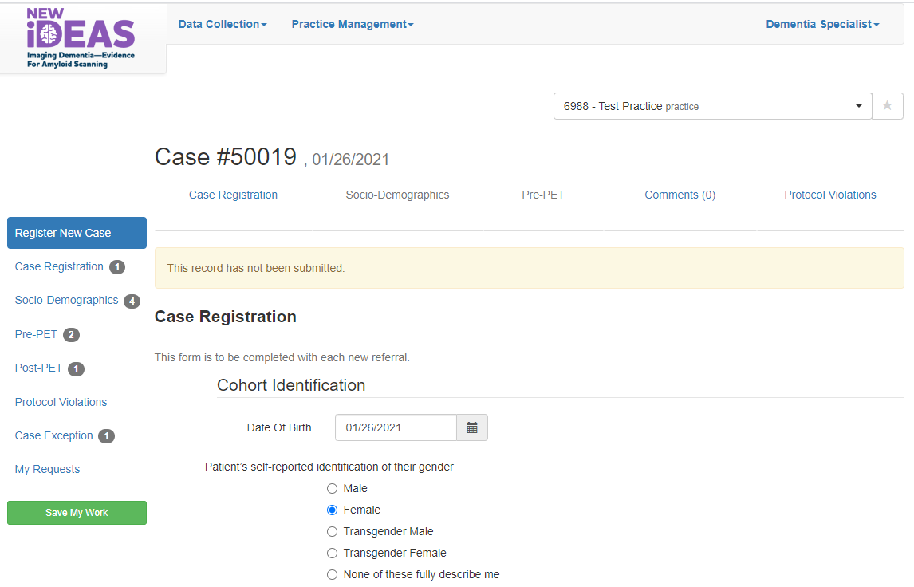

Case Registration Example: Incomplete Forms
Incomplete forms will appear as a number behind the form in the in the portal form list.
In this example, there is 1 incomplete Case Registration Form for practice 6988.

Slide 11
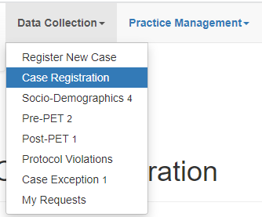

Case Status Overview
View list of registered cases under “Data Collection.” Select “Case Registration.”
Unique 5-digit study case identifier.
Click on this Case # to see patient form status.
A green box indicates the form has been completed.
A blue box indicates the form is available but has not been completed.
A white box indicates that the form is not available yet.

Slide 12

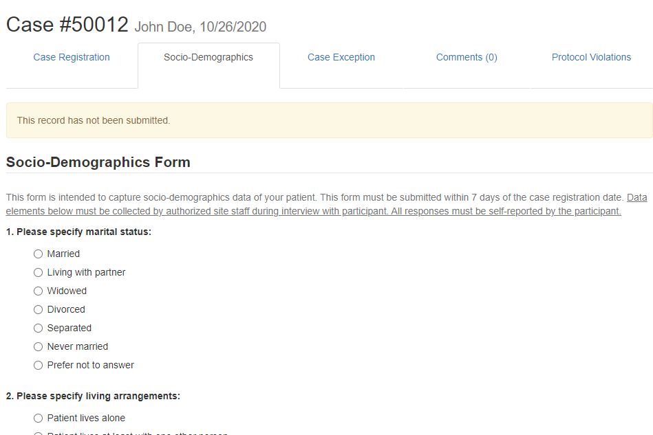
Socio-Demographic Form Example
A green box indicates the form has been completed and the case is registered. A blue box indicates the form is available but has not been completed.
OPEN
Socio-demographic form completed by authorized site staff during interview with participant.
All responses to Socio-Demographic form are self-reported by the participant.
Must be submitted within 7 days of registration date.

Slide 13
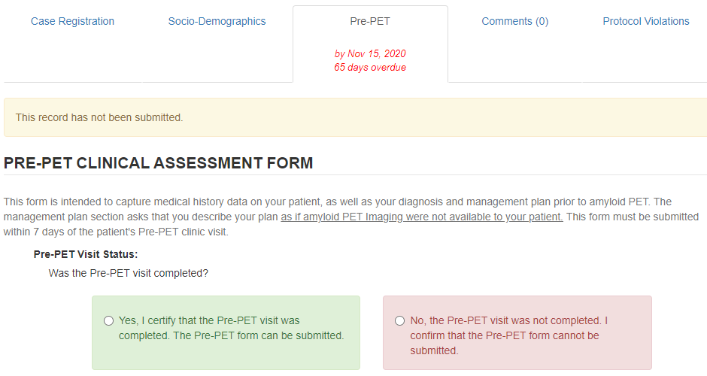
Pre-PET Case Report Form Example
A blue box indicates the Pre-PET Form is available but has not been completed. A white box indicates the Post-PET form is not available yet.
Pre-PET form must be completed by the Dementia Specialist within 7 days after case registration.
Describe your management plan as if amyloid PET Imaging were not available to your patient.

Slide 14

Visit 2: Amyloid PET Scan
The PET facility will receive an e-mail notification when the Pre-PET eCRF has been completed.
The Amyloid PET Scan must be completed within 60 Days after Pre-PET electronic Case Report Form Completion.
  No data entry is required by the dementia practice at this study time point.
Example Case: Patient 50011 has been registered, a Socio-Demographic form has been completed and the Pre-PET form has been completed. Patient is awaiting scan.

Slide 15
Visit 3: Post-PET Office Visit
Must be completed 90 ± 30 Days after amyloid PET scan.
Document actual patient management as reflected by management changes that have been implemented into patient care.
Form/Action Item: | Completed by: | Requirements:
90-day (from day of PET scan) clinical office follow-up | Referring Dementia Specialist* | May occur within a window of 60-120 days post-PET scan date. In office visit (preferred)
Post-PET eCRF | Same Dementia Specialist who completed Pre-PET eCRF | Due within 30 days after 90-day visit.
*Under no circumstances is the dementia specialist permitted to delegate the post-PET contact (in person visit or telephone) to other staff or to another physician.

Slide 16
Post-PET Form Example
The referring Dementia Expert will document:
Diagnostic testing/consultation
Additional imaging
Laboratory or genetic analysis
Referrals and counseling for non-pharmaceutical care
Pharmaceutical treatments
Adverse effects attributed to learning amyloid status
Emergency room visits/hospitalizations during 90-day interval
Follow-up Visit Status
Differential Diagnosis
Management Plan
The blue box indicates that the Post-PET form is available but has not been completed.

Slide 17
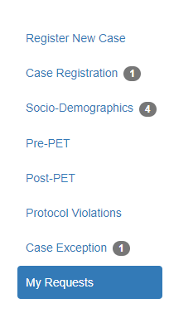
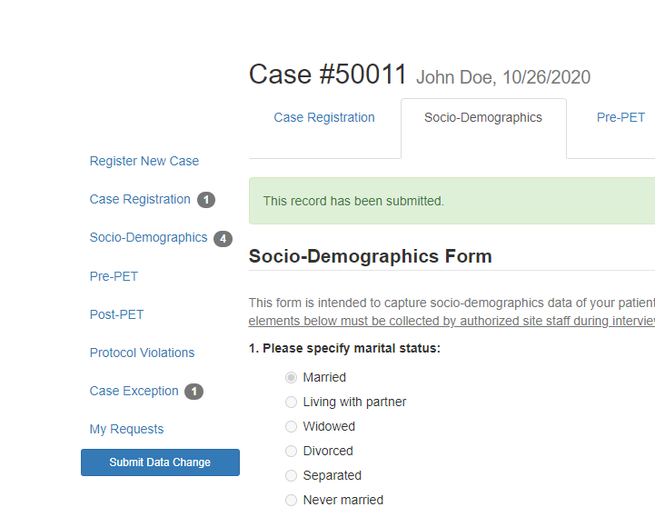
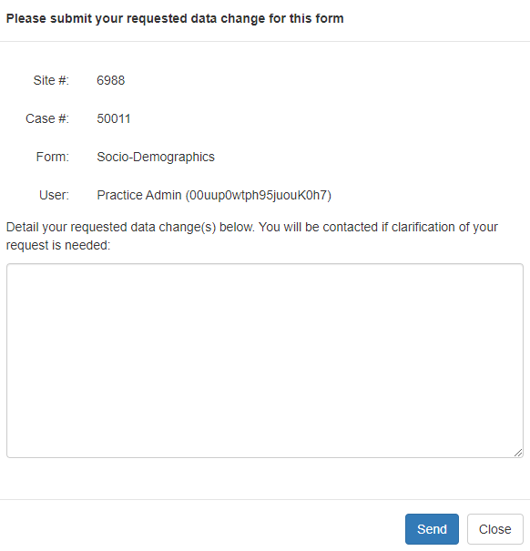
Data Change Re quest Form
Click on the Case # of interest.
Select the completed form you have a data change request for.
Detail your requested data changes in the comment box.
Click “Send.” An email will be sent to ACR New IDEAS staff for review.
View All requests by clicking “My Requests”

Slide 18
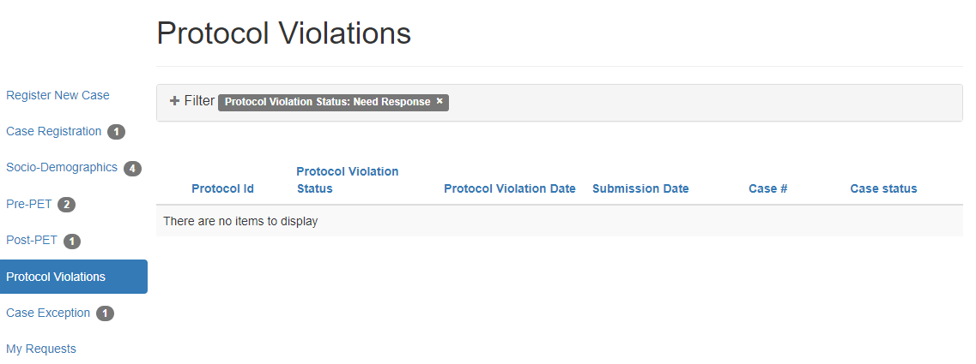
Protocol Violation Form
Protocol Violations can be viewed via the “Protocol Violations” tab.
Protocol Violations are initiated by the New IDEAS Study Team and must be acknowledged by Dementia Practice.

Slide 19
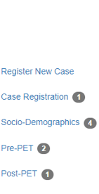
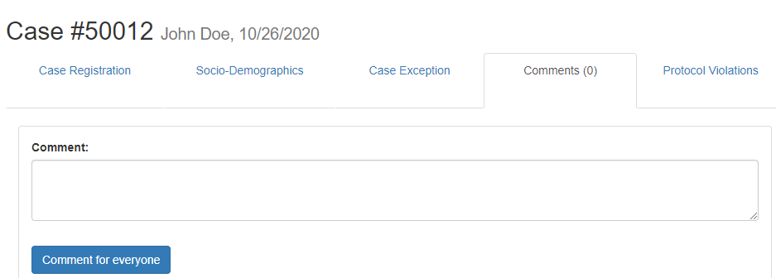

Case Comments Section
Communication about patient cases should only be communicated through the New IDEAS portal, never by email.
  Select “Case Registration”
  Click on the Case # of interest.
  Select “Comments” tab.
  Write patient comment and submit by selecting “Comment for everyone.”

Slide 20
New IDEAS Operations Team
ACR Center for Research and Innovation
^{newideas@acr.org}
^{215-574-3150 ext. 4156}

