Slide 1
Guidance on Advarra Submissions for Referring Dementia Physicians and Practice Staff

Slide 2
Module Overview
Advarra Helpful Tips and Overview: Slides 3-4
Create an Advarra Account: Slide 5
Initial Submission to Advarra: Slides 6-10
Translation of an Informed Consent Form (ICF): Slides 11-12
Responding to Questions from Advarra: Slides 13-15
Modification Submission: Slide 16
Continuing Review Submission: Slides 17-18
Submitting a Protocol Deviation: Slide 19

Slide 3
Helpful Tips for Submitting to Advarra
Section “Informed Consent Documents”
Tip #1:
Tip #2:
Tip #3:
Make sure if you choose to have the ICF translated, that you go back to section “Investigational/Research Location(s) and Subject Recruitment” question #4 and indicate that non-English speakers will be enrolled.
Make sure that the address, phone number, and compensation language of the Consent matches what it put in the Advarra Form.
Please note this is for consents that the site has added their site-specific language. If your site does not add language, please indicate “n/a”.
Make sure question #3 compensation language matches the language in your site-specific protocol.
If the only changes to the ICF are the first page address for site and the compensation section, you do not need to submit to Advarra. They will update this information automatically when you receive approval.
Section “Investigational/Research Location(s) and Subject Recruitment”
Section “Investigator Experience and Qualifications” and “Documentation Attachment Summary”
Tip #4:
Please ensure that you do NOT provide the PET scan location.
This is considered a part of standard of care and not research
Tip #5:
Please ensure that the PI has GCP and Human Protection Trainings from an accredited program (i.e. CITI).

Slide 4

Advarra Overview
Referring physician sites must use Advarra IRB as the IRB of record overseeing their research activity.
Costs of review are covered by the study
  i.e. ACR is invoiced directly by Advarra
If you have a local IRB, an agreement will have to be put in place between the site and Advarra.
  For more information visit: https://www.ideas-study.org/Getting-Started/Institutional-Review-Board

Slide 5
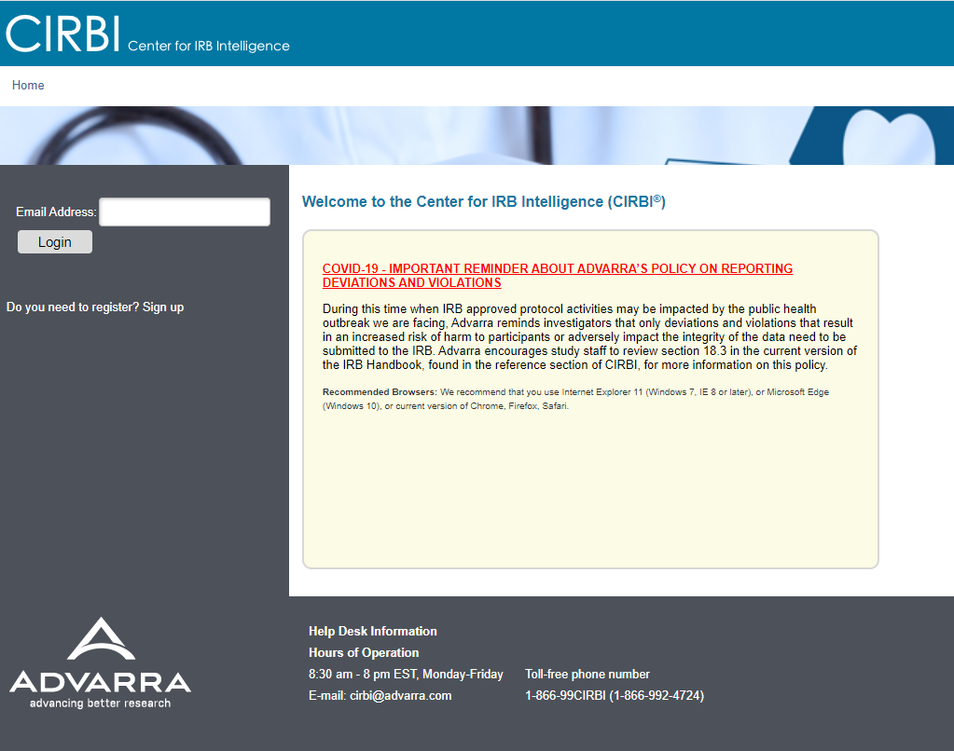
Create an Advarra Account
Visit link www.cirbi.net and click “Sign Up” or enter an email address to use an existing account.
New users must sign up and create an account

Slide 6
Initial Submission to Advarra
  On your Dashboard, select “Investigator Application.”

Slide 7
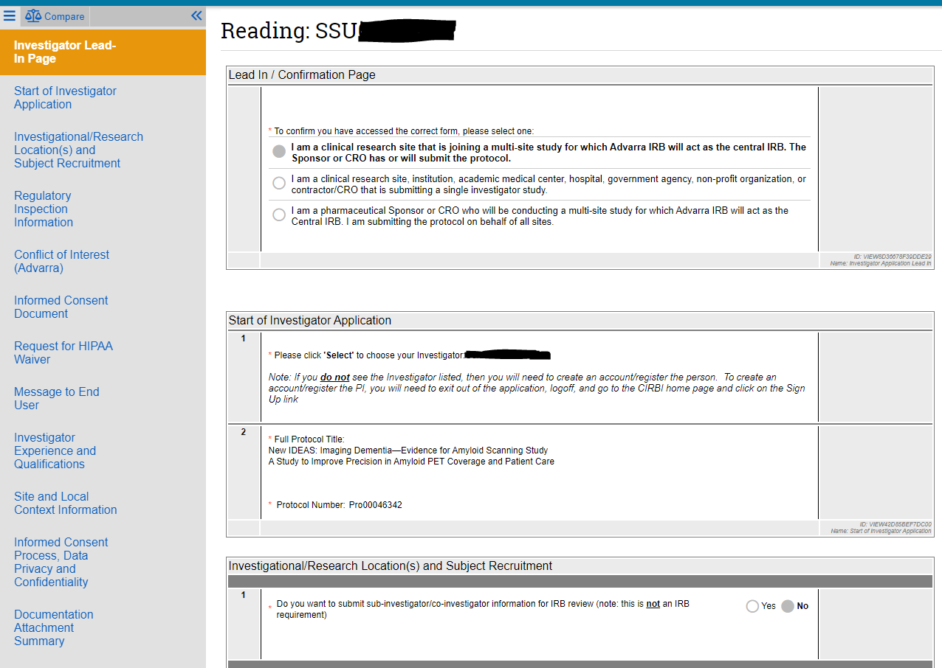
Initial Submission (cont.)
The application will open to an online form.
In the “Investigator Lead In Page” section:
  Select option #1: “I am a clinical research site that is joining a multi-site study for which Advarra IRB will act as the central IRB. The Sponsor or CRO has or will submit the Protocol.”
Select “Continue” on bottom right-hand corner to populate the correct form.

Slide 8
Initial Submission (cont.)
In the “Start of Investigator Application” section:
  Question #1: “Please Select to choose your investigator”
    A pop-up window will open, where the PI will need to be selected from a drop-down menu.
      The PI must have a CIRBI account to show up in the drop-down selection
        Please refer to slide 5 on how to create an account

Slide 9

Navigating the CIRBI Form
On the bottom right-hand corner of the form there will be options to:
Continue saves the form and moves you forward to the next slide.
  Note: if all the red asterisked (*) questions are not answered, you will not be able to move forward.
Save allows you to save the page in any stage and either exit application or navigate through the form.
Exit takes you out of the form without saving any changes

Slide 10
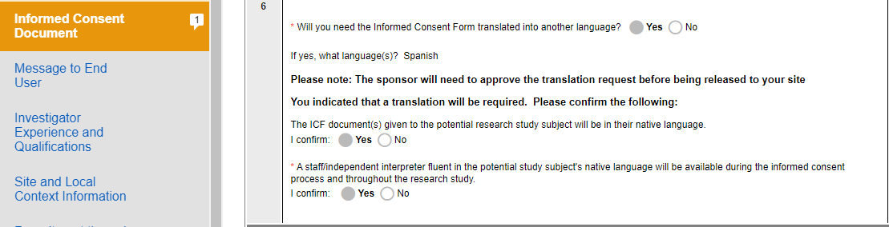
Important Application Information
Protocol Number for New IDEAS: Pro00046342
Translation Services:
  Select “Yes” to question #6 on Tab “Informed Consent Document.”
    Ensure that in section “Investigator/Research Location(s) and Subject Recruitment” that question #4 have “non-English Speakers” checked off.

Slide 11
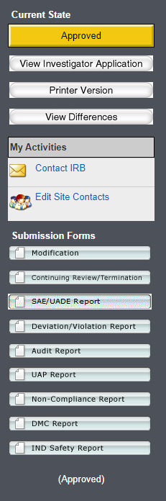
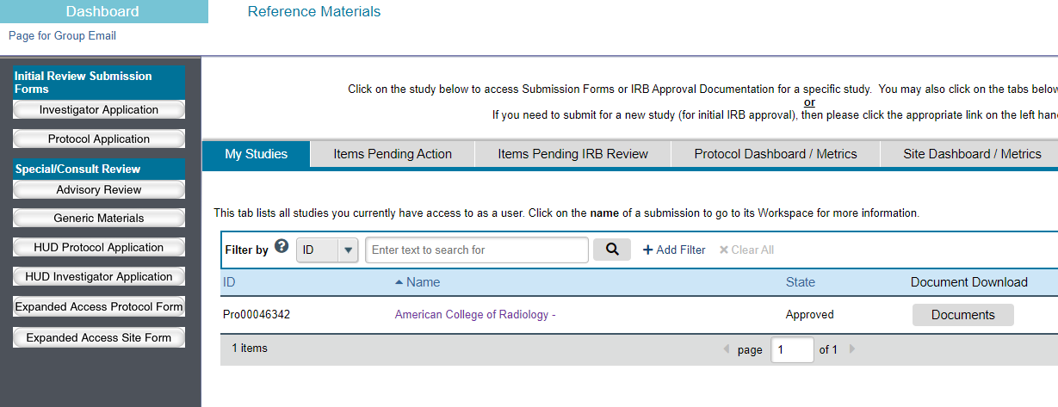
Translation Request
After receiving Initial Approval, you will need to submit a Modification Form on CIRBI for IRB Translation of the ICF.
Log into CIRBI (www.cirbi.net).
Select the New IDEAS Submission protocol on your Dashboard.
On the left side toolbar under Submission Forms, select “Modification.”

Slide 12
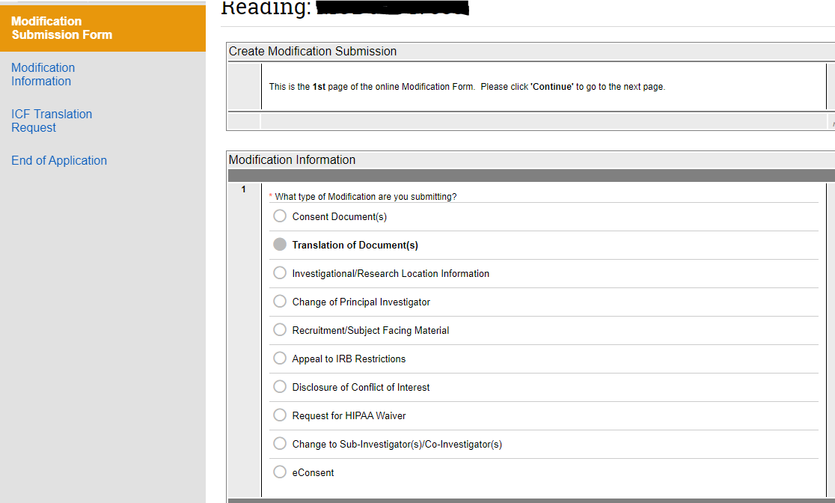
Translation Request (Cont.)
Select the Modification Submission Form:
  Question #1:
    Select “Translation of Document(s)”
  The language that the ICF needs to be translated into is Spanish.

Slide 13
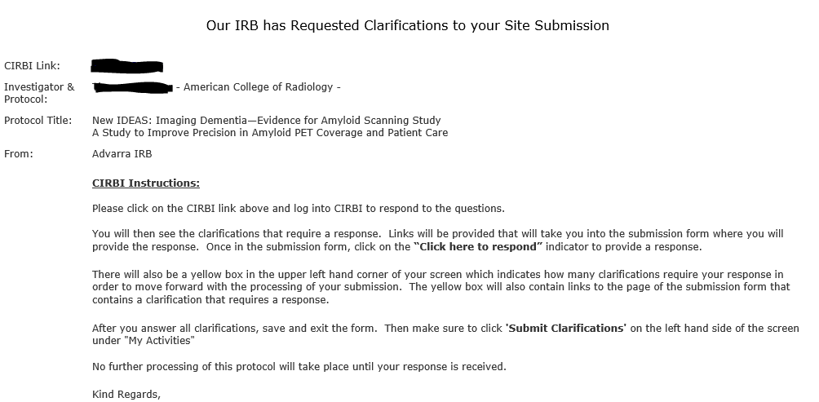
Responding to Questions
You will receive an automated email from Advarra requesting you respond to inquiries.
  Do not respond directly to the automated email
Click the link and log into CIRBI to respond to questions
Link to CIRBI

Slide 14
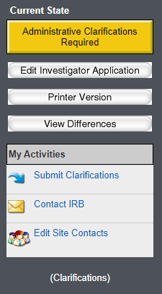
Responding to Questions (Cont.)
Once you are in CIRBI, respond to each inquiry.
After responding to each inquiry, you must submit the clarifications.
  To Submit:
    Select “submit clarification” on left hand toolbar and confirm that you wish to submit.

Slide 15
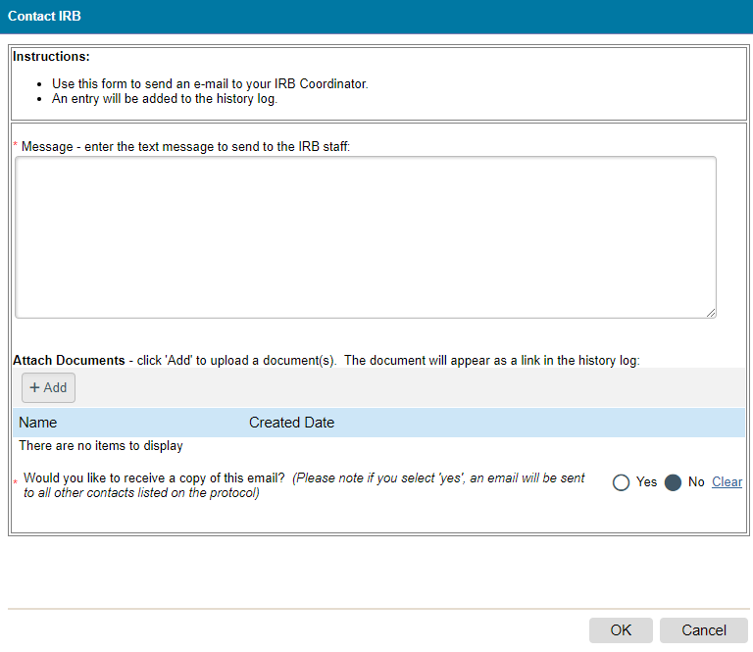
Communicating with Advarra IRB
All communication with Advarra must occur within the CIRBI system. Please follow the directions on how to communicate with Advarra below:
  Log onto www.cirbi.net
  Select the “New IDEAS” protocol from your dashboard
  On the left hand side you will see a toolbar
  Select “Contact IRB”
  This will populate a pop-up screen
    Type in your question to Advarra
    Select “submit” to sent communication

Slide 16
Modification Submission
When you are informed that an Amendment to the protocol or informed consent is needed:
  You will need to log into CIRBI (www.cirbi.net) and submit a Modification.
To submit a Modification:
  Select New IDEAS protocol on your Dashboard.
  Select “Modification” from the left-hand Toolbar.
Fill out the Submission Form as indicated by the sponsor or site instruction.

Slide 17
Continuing Review Submission
Login to CIRBI (www.cirbi.net)
Select “New IDEAS” from your Dashboard.
Select “Continuing Review/Termination” tab on left-hand toolbar.

Slide 18
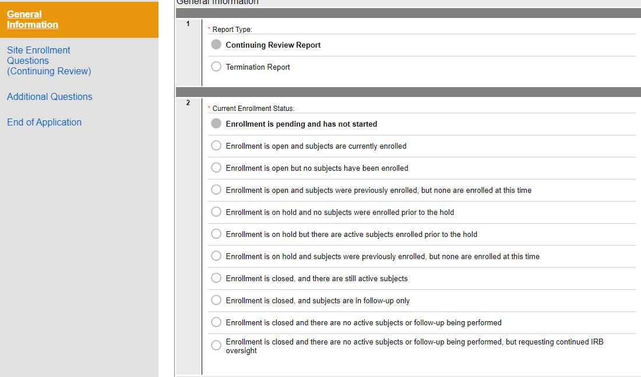
Continuing Review Submission (Cont.)
You will fill out the form per your site's enrollment status
Then submit to Advarra

Slide 19
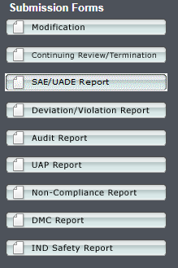
Submitting a Protocol Deviation
  Log onto www.cirbi.net
  Select the “New IDEAS” protocol from your dashboard
  Select the appropriate reportable event from the left-hand toolbar
  This will populate the appropriate form
  Complete the form and select “submit”
  Additional guidance regarding types of protocol deviations
    https://www.ideas-study.org/During-Study/Resources
Please note that you should never put patient PHI or PII to Advarra’s website.
This includes copies of patients unredacted ICF.

Slide 20
New IDEAS Regulatory
ACR Center for Research and Innovation
newideas-regulatory@acr.org
Phone: 215-574-3177

