Slide 1
Amyloid PET Image Submission
TRIAD™
Rebecca DiGati, CNMT
Senior Imaging Services Specialist
^{215.574.3175}
^{rdigati@acr.org}

Slide 2
Digital Image Submission via TRIAD™
All Amyloid PET and PET/CT scans are to be submitted via TRIAD™ to the ACR CRI within 7 business days from the time of acquisition
    No image data will be accepted on media for the New IDEAS study
TRIAD™ (Transfer of Images and Data) is the ACR CRI’s cloud-based image and data exchange platform that supports image and data archival as well as immediate transfer of data
All PET scans are required to be submitted using TRIAD™
TRIAD™ can be installed on one or several computers of choice within the institutional ‘firewall’ and/or on an institutional network
The application can be configured as a DICOM destination on either the scanner console or PACS system for direct network transfer

Slide 3
TRIAD™ Facts and System Requirements
TRIAD™ meets FDA regulatory requirements for use in Clinical Trials and is Title 21 CFR Part 11 compliant
  Sends images and data files securely
  Anonymizes the DICOM headers locally before submission based on flexible and profile-based algorithm
  A straight-forward software download is all that is needed to get started
  Images are submitted with the click of a button
TRIAD™ components are upgraded to newest .NET Framework version 4.8
TRIAD™ end user access/log in is authenticated by Okta Single Sign On (SSO) for added security
    Same login credentials as the New IDEAS database

Slide 4
Image Data to be Submitted
The Amyloid PET or PET/CT scans collected for the New IDEAS study must be in DICOM format and contain the following 3 primary image series:
        PET Attenuated Corrected (PET AC) series
        PET Non- Attenuated Corrected (PET NAC) series
        CT used for Attenuation Correction (CTAC) series
Secondary screen captures, MIPs, reconstructed axial, sagittal, coronal series as well as non-DICOM data is not required for submission and will not be utilized for trial purposes
All Patient Name and Patient ID DICOM tag fields are anonymized upon submission to TRIAD™
        TRIAD™ replaces Patient Name and Patient ID fields with trial-specific New IDEAS Case ID Number
        No 3rd party or additional anonymization programs are recommended to be used as these systems can often times wipe valuable DICOM tags related to patient gender, date/year of birth or specific image-related details such as radiotracer used during the Image Quality Assessment process

Slide 5
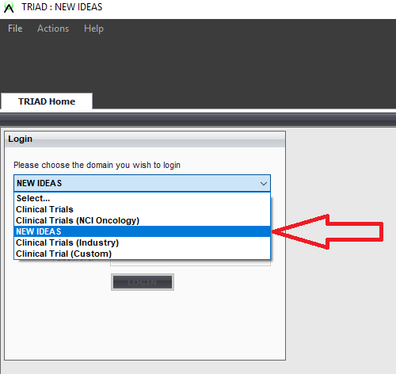
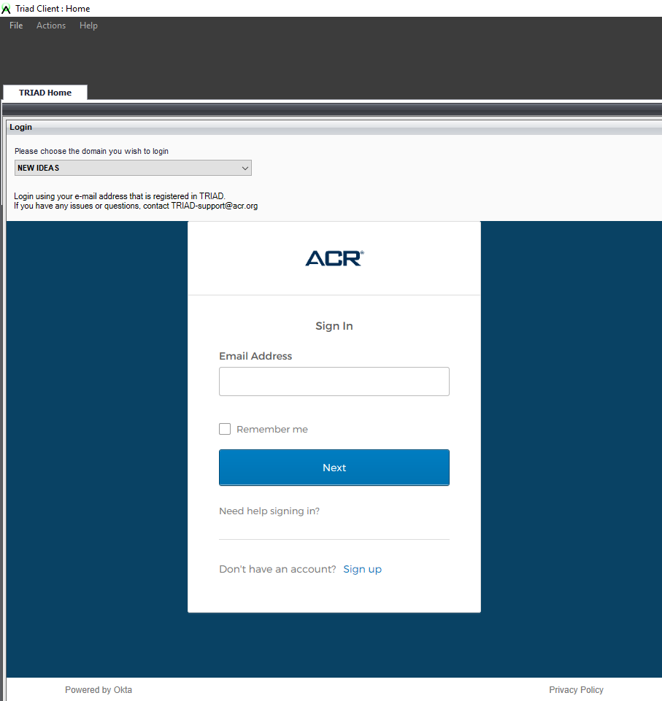
Accessing TRIAD™ for Image Submission
Select the ‘New IDEAS’ domain of TRIAD:
Enter the registered User email address :

Slide 6
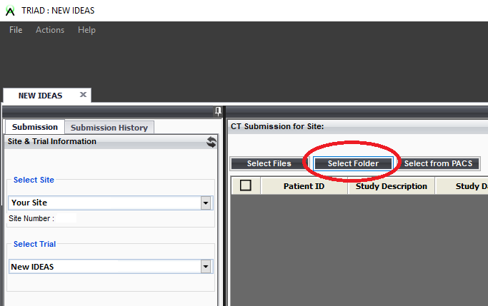
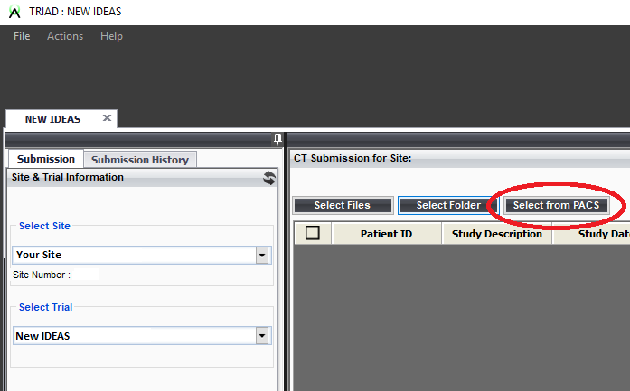
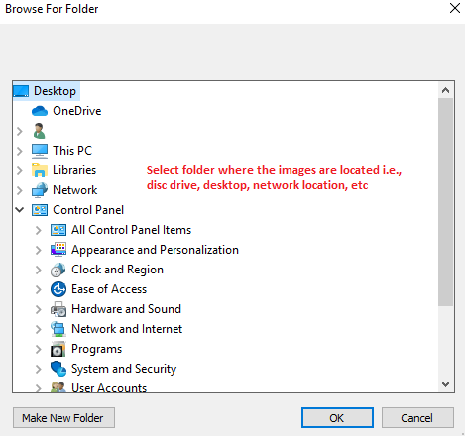

Selecting Image Data Files for Submission
If files are on CD or network location:
If data is on the configured scanner console or PACS destination:

Slide 7
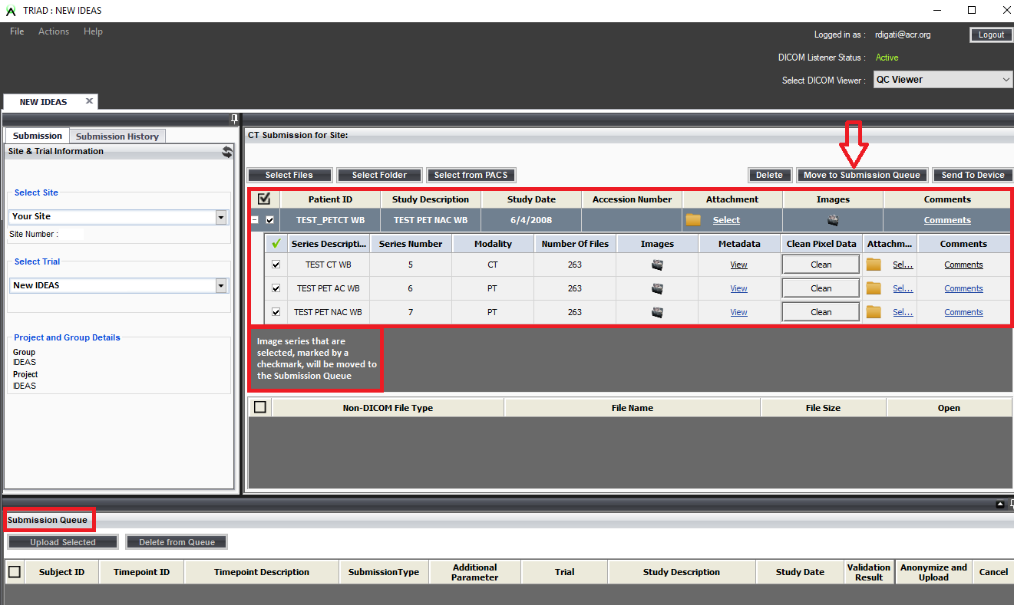
Moving Image Data to the Submission Queue
Images ready for submission will pre-populate and must be selected for the Image Submission queue:

Slide 8
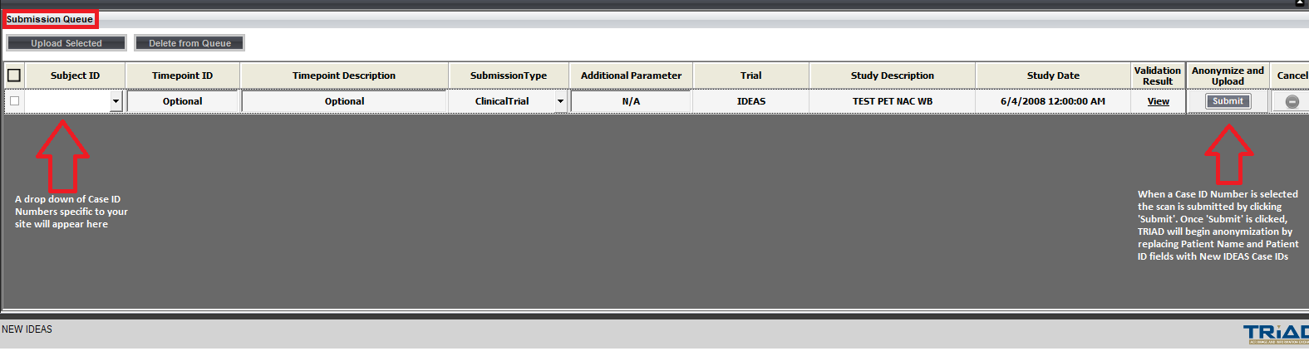
Moving Image Data to the Submission Queue
Once the desired image series are selected, click ‘Move to Submission Queue’:
The scan now appears at the bottom of the screen and is ready to be assigned the correct New IDEAS Case ID number and submitted:

Slide 9
TRIAD™ Support
Questions and inquiries related to the TRIAD™ Platform may be addressed to the TRIAD™ Support Team:
Triad-Support@acr.org
703.390.9858
Tech Support is available from Monday to Friday between 8am - 5pm EST
TRIAD™ User Guide is available:
https://triadinstall.acr.org/triadclient/

Slide 10
Upon Image Submission
Once the Amyloid PET or PET/CT scan has been submitted, the information related to the scan must be data entered in the New IDEAs database
The image-related details entered in the database are cross referenced with the data present on the submitted images
Upon the receipt of images and completion of data entry of the corresponding scan information on the image-related forms in the New IDEAS database, the Image Quality Assessment process at the ACR CRI can begin
Submitted images are reviewed by the ACR CRI for the following:
        Patient Identity (DOB/Year of Birth)
        Complete Submission (PET AC, PET NAC and CTAC series have been received)
        Radiotracer Details (which tracer was used, activity, uptake time, injection time, image start time)
        Image Quality (inspect for artifacts, motion, complete anatomy and other quality-degradation factors)

Slide 11
New IDEAS Amyloid PET Scan Support
Questions and inquiries related to the imaging requirements for the New IDEAS study may be addressed to the ACR CRI Imaging Technologist:
Rebecca DiGati, CNMT
rdigati@acr.org
215.574.3175

