Slide 1
PET Imaging Facility
Information and Training

Slide 2
Module Overview
Protocol Introduction: Slides 3-12
Including Medicare Reimbursement
Facility and Physician Registration: Slides 13-27
Case Specific Data Entry: Slides 28-46
Including Image Transmission via TRIAD
Additional Resources: Slide 47

Slide 3
Important New IDEAS Information
PET imaging facilities are not considered as participating in research, so Institutional Review Board (IRB) approval is not needed.
Medicare will reimburse for scans based on coverage plans (typically 80% coverage provided). This study is the only way Medicare covers beneficiaries for these scans.
As part of the New IDEAS Coinsurance Reimbursement Program, the study sponsor will pay for the unmet coinsurance associated with the amyloid PET scan for patients who receive a scan on or after January 1, 2022.
No escrow account is needed for patient scans.
PET image transfer will be conducted via the American College of Radiology® TRIAD platform.
Emphasis on balancing racial and ethnic make-up of study population.
At least 4,000 of the planned 7,000 New IDEAS participants will be Black or Hispanic which may allow better understanding of amyloid PET’s impact on change in management and health outcomes in diverse dementia cases.

Slide 4
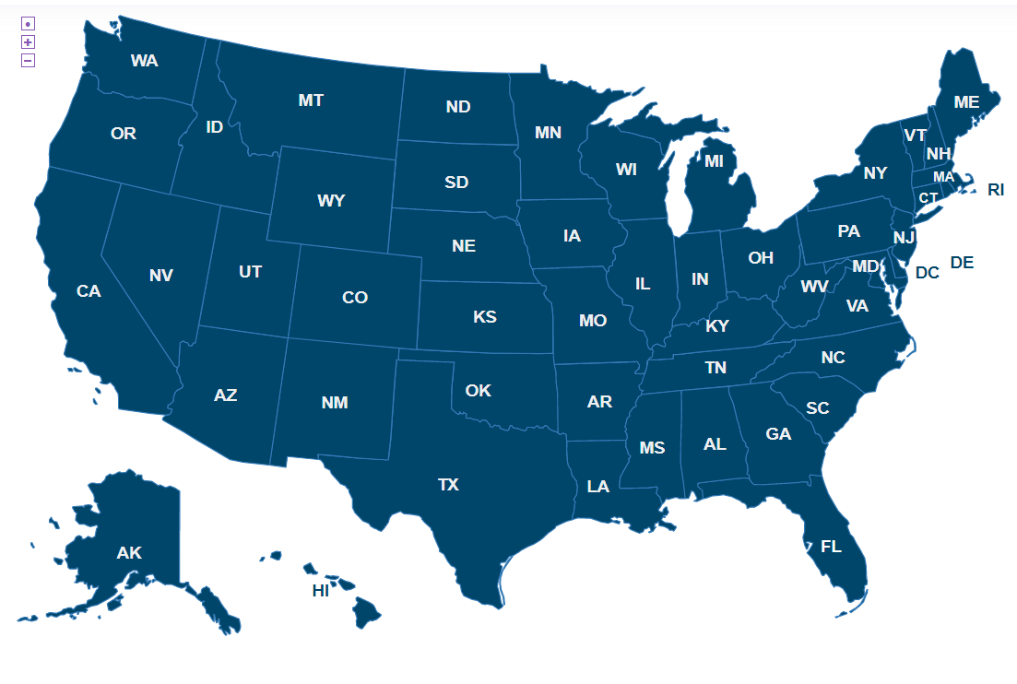
New IDEAS Site Selection Process
Reminder: Dementia Specialists and PET Imaging Facilities will be selected on a rolling basis.
PET Imaging facility must be within 3-4 hours of an amyloid tracer supplier.
Site Locator for Enrolled Dementia Specialists and PET Imaging Facilities: https://www.ideas-study.org/Find-a-Site
Interested sites start the application by completing the New IDEAS questionnaire: https://www.ideas-study.org/Getting-Started

Slide 5
PET Facility Requirements
Free standing PET facilities must be PET accredited by one of the following:
The ACR
The Intersocietal Accreditation Commission (IAC)
RadSite
Hospital based facilities must be accredited by the Joint Commission (or another Medicare-approved hospital-based accrediting organization).
Not required, but recommended: PET accreditation by ACR, IAC or RadSite.
The PET facility must document that it has experience performing brain PET, PET/CT or PET/MRI with one of the FDA-approved amyloid imaging agents or with F-18 fluorodeoxyglucose or with both in the last 12 months.
Complete and execute a Clinical Data and Image Access Agreement with ACR.

Slide 6
Scanner and Tracer Requirements
PET facilities may only participate if they have full-ring BGO, GSO, LSO or LYSO PET, PET/CT or PET/MRI scanners.
Partial-ring systems and dedicated NaI systems are not eligible for use in the New IDEAS Study.
Scans must be conducted using one of the following tracers:
Neuraceq™ (F-18 florbetaben)
Amyvid™ (F-18 florbetapir)
Vizamyl™ (F-18 flutemetamol)

Slide 7
Interpreting Radiologist Requirements
Board certified by one or more of the following:
American Board of Radiology (Diagnostic Radiology)
American Board of Radiology (Nuclear Radiology)
American Osteopathic Board of Radiology (Diagnostic Radiology)
American Board of Nuclear Medicine
American Osteopathic Board of Nuclear Medicine
Completed Vendor Specific Training for interpretation of amyloid images.
Trainings guidance available at: https://www.ideas-study.org/-/media/Ideas/Files/PET-Facilities/Amyloid-Radiotracer-Reader-Training-Guidance.pdf
Eligible to bill Medicare for PET services.

Slide 8
Medicare Reimbursement
Link to Medicare Reimbursement Information:
https://www.ideas-study.org/During-Study/Medicare-Reimbursement
PET imaging facility may not perform a New IDEAS Study PET scan until the referring physician has submitted a pre-PET clinical assessment form to the New IDEAS Study database.
Once the PET scan has been completed and the appropriate data uploaded to the New IDEAS Study database, a system-generated notification is sent from the email address NewIDEAS@acr.org to the PET imaging facility administrator indicating that the case data are complete.
These notifications should be maintained as documentation in the event that CMS opts to audit the PET imaging facility.
After receiving the notification, the PET facility (and the interpreting physician, if technical and professional component billing are performed separately) may submit the claim for the service to the local Medicare Administrative Contractor (MAC) or MA plan as appropriate.

Slide 9
Medicare Reimbursement (continued)
Hospital-based PET Facilities:
The National 2021 OPPS payment for CPT code 78811 or 78814 (limited body PET or PET/CT, respectively) is $1,305.94 - $1,480.34, respectively (rates are adjusted by local wage indexes, so the exact payment will vary slightly based on region).
Physician Offices and Independent Diagnostic Testing Facilities (IDTFs):
For physician offices and IDTFs, payment is determined by the Medicare Physician Fee Schedule (MPFS). The technical component payment for the procedure is carrier priced but is often capped at the OPPS technical component rate (For CPT 78811 at $1,305.94 and 78814 at $1,480.34).
In the MPFS setting, all rates are subject to co-payment, co-insurance and any deductibles that the patient’s Medicare plan requires. The co-payment policies for the diagnostic radiopharmaceutical differ in the MPFS setting versus the OPPS.
Payment for the diagnostic radiopharmaceutical is packaged into the OPPS payment amount. For hospital-based PET facilities, there is a co-payment or co-insurance associated with the procedure.
Payment for the diagnostic radiopharmaceutical is based on the invoice cost (approximately $3,000, depending on the product used).

Slide 10
Coinsurance Reimbursement Program
Review the Operational Training: New IDEAS Coinsurance Reimbursement Program Training Module for in depth training on the Coinsurance Reimbursement Program.
All PET imaging facilities and dementia practices that choose to participate in the New IDEAS study must adhere to the Coinsurance Reimbursement Program Policy.
Failure to comply with this policy or requirements specified by the New IDEAS Study will result in termination of the participating PET imaging facility or dementia practice as detailed in the study’s executed legal agreement.
Additional Resources:
Frequency Asked Questions

Slide 11
Participant Study Timeline

Slide 12
Training Materials
Updated New IDEAS training materials for PET Imaging Facilities can be found at https://www.ideas-study.org/During-Study/Resources.

Slide 13
Important Portal Information
Link to portal:
https://app.ideas-study.org/
Processed via a secure, role-based online application with a two-factor authentication system (Okta)
Each user is required to have his/her own username/password and current e-mail address for access and receipt of notifications/alerts.
Passwords must be changed every 90 days.
Physicians must complete their own data entry

Slide 14
Registration Overview
Registration should only be completed if your facility was invited to the New IDEAS study by ACR staff.
PET Facility registration is a one time event to be completed by the facility administrator (overall access).
Each user is required to have his/her own username/password and current e-mail address for access and receipt of notifications/alerts.

Slide 15
Facility User Roles in the New IDEAS Portal
To access your Facility's account in the New IDEAS Portal, your facility administrator needs to assign you a user role. (Note: a single user can have more than one role in the database).
Facility Administrator | Interpreting Radiologist | Facility User | Facility Finance User
Automatically assigned to the person who initially submits the facility pre-registration form (next slide) Has complete administrative functionality in the New IDEAS portal Responsible for administrative duties associated with facility registration and addition of staff profile accounts Has view access to all forms and edit/submission access to all forms except Amyloid PET Assessment Form Has edit/submission access to the Coinsurance Reimbursement Form, but NOT Banking/Tax information for Facility | Has view, edit and submission access to all case report forms Only user role that has edit and submission access to Amyloid PET Assessment Form | Has view access to all forms and edit/submission access to all forms except Amyloid PET Assessment Form | New role for Coinsurance Reimbursement Program Only user role that has access to facility finance portal Responsible for submitting facility banking and tax information Has edit/submission access to the Coinsurance Reimbursement Form Has view only access to Case Registration Form
Can't access your facility's account?
Email newideas@acr.org

Slide 16
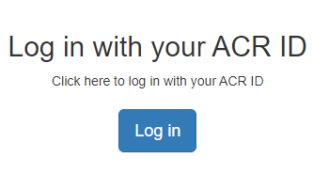
Facility Registration Tutorial
Link to portal:
https://app.ideas-study.org/
I do not have an
ACR ID specifically for New IDEAS
I already registered
for New IDEAS
Create your ACR ID profile.
You will receive an email link.
Follow slides for Administrator Login Instructions

Slide 17
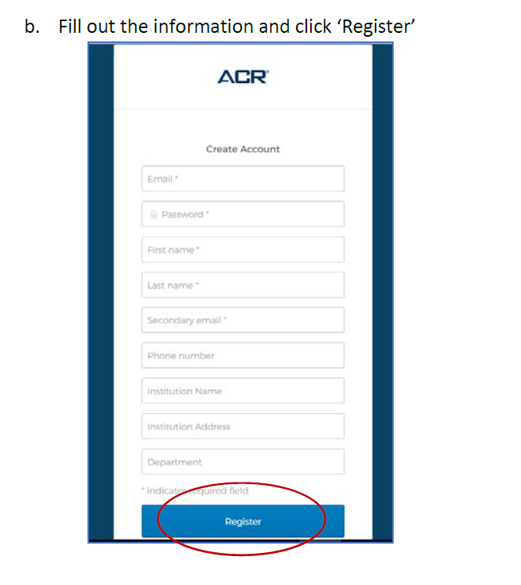
Facility Administrator Login Instructions
Create your account and click “Register.”
Locate the ‘Welcome to ACR ID’ email in the email inbox you used to register and follow the one-time link to activate your account. Simply clicking on this link will activate your account (Note: check spam folder).
Return to the application’s home page and click “Login with your ACR ID” (purple Login button).
Type in your username (email address used to create ACR ID).
Set up Okta (two-factor authentication).
Return to the login portal and login with username and two-factor authentication.
Note: You will have to utilize a ‘multifactor authentication’ mechanism to log in each time. This is for security purposes.

Slide 18
Facility Administrator Login Instructions (cont.)
Under PET Facilities,
Select “Register”

Slide 19
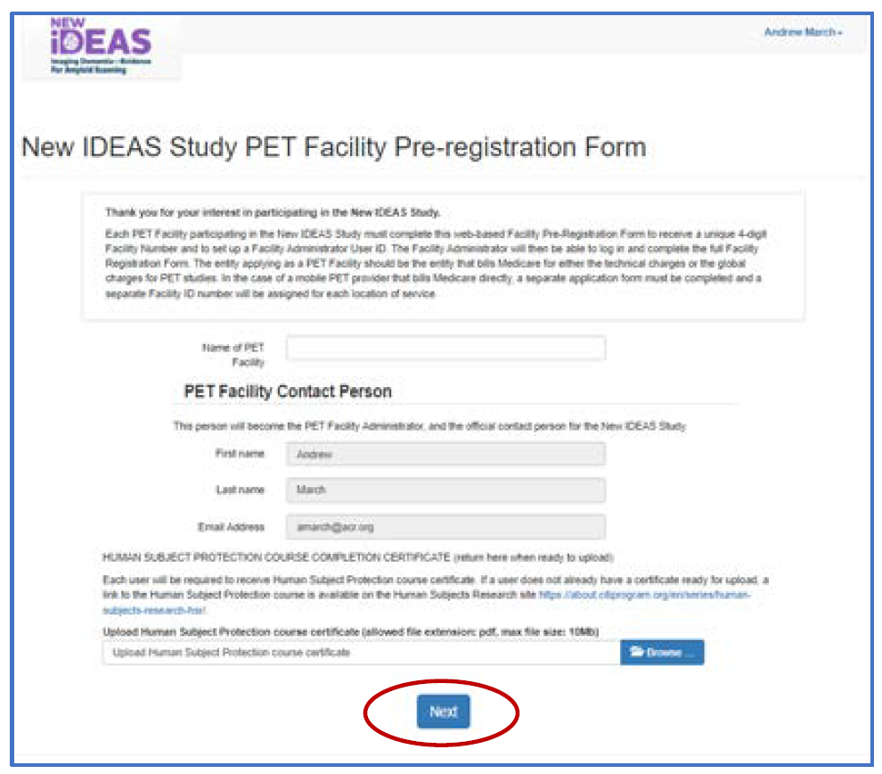
Pre-Registration Form
Fill out the Pre-Registration Form and click “Next”

Slide 20
Registration Form Overview
After a Pre-Registration Form is completed, a PET Facility Registration Form will be generated. Complete the PET Facility Registration Form.
Overview:
PET Facility Administrator Information
PET Facility Information
PET Facility Accreditation Information
Scanner Information
Staff Information
Interpreting Radiologists/Nuclear Medicine Physician Information

Slide 21
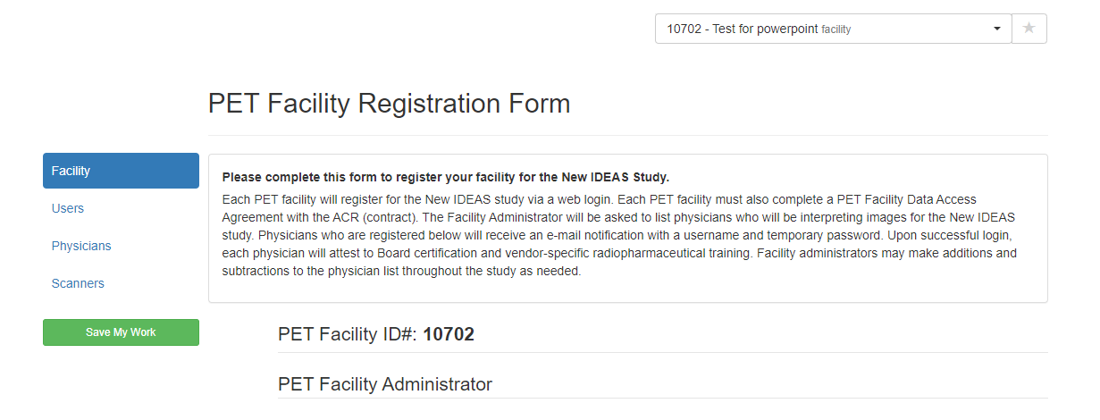
Registration Form Example
After a Pre-Registration Form is completed, a PET Registration Form will be generated. Complete the PET Facility Registration Form.
Identify your unique PET Facility ID #

Slide 22
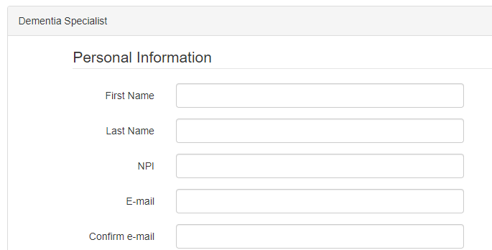
Add Physicians and Facility Staff
Select the type of user you want to add (e.g. Radiologist, Registrar, etc.)
Enter personal information for the new user.
An automated email will be sent to the email address entered for that user.
Instruct your team member to click on the link they receive in their email to activate their account (Note: Check SPAM folders).
Interpreting Radiologist
Unique email address for every user

Slide 23
Automated Email Example
Subject Line: New IDEAS-Study Interpreting Radiologist/Nuclear Medicine Physician Registration Confirmation
PET Facility Name: Name of PET facility entered on Pre-Registration Form
PET Facility ID#: 4-digit ID number
________________________________________
Your Facility Administrator has registered you as a Radiologist/Nuclear Medicine Physician for the New IDEAS Study.
The New IDEAS (Imaging Dementia—Evidence for Amyloid Scanning) Study is managed by the American College of Radiology and thus requires an ACR ID (username) to access the recently upgraded database.
Please read the following instructions before clicking on the study link below.
All users, including users with existing ACR IDs, need to sign up for a new ACR account to access the New IDEAS portal. Existing IDs do not work for the New IDEAS study. Click on “Sign up”, then fill out the necessary information. Upon submission, you will be sent another automatic email to ‘verify’ your ACR ID. Do so by clicking the link in that email and login to the New IDEAS portal. To access the study portal at any time, navigate to the study website and click “Login” in the top right-hand corner.
Once logged in you should see your name in the top right corner. Do Not re-register your facility. This has already been done. Instead, click on your name then click ‘physician profile’. You will be prompted to confirm your Board and Subspecialty certification(s) and verify completion of vendor specific training. Click submit and wait to be approved by the ACR.
To access your facility’s registration page, click ‘Facility Management’ along the top.
Note: the link below must be used in order to connect your account to the correct site. This link expires after 10 days. Once expired, your site administrator will have to re-issue the link from their account.
To log in to New IDEAS please access the following secure New IDEAS link and complete the steps outlined above: CLICK ON LINK TO LOGIN
We look forward to working with your facility on the New IDEAS Study!
Best Regards,
The New IDEAS-Study Team

Slide 24
Physician Profiles
Every Interpreting Radiologist added to the portal will need to:
Click on the login link in the automatically generated email from the New IDEAS portal.
Create a New ACR ID with a unique email address and set up two-factor authentication.
Login to the New IDEAS portal at https://app.ideas-study.org/
Use the site selection drop-down menu to the facility.
Click on his/her name in the top right-hand corner and select “Physician Profile”
Complete the following sections:
Personal information
Upload Human Subject Protection Course Completion Certificate *optional
Vendor-Specific Training for interpretation of amyloid images
Board and Subspecialty Certification(s)
Eligibility to bill Medicare for services
Review responses and Click “Submit.”
A member of the ACR New IDEAS Team will review and approve each Interpreting Radiologist.

Slide 25
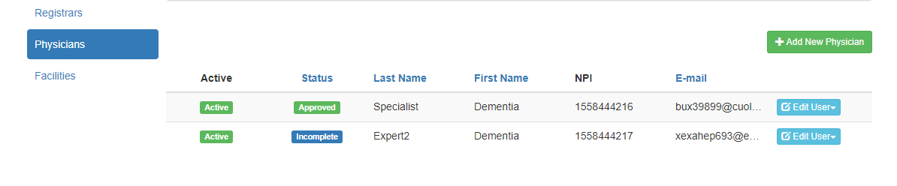
Physician Profile Status
Radiologist 1
Radiologist 2
Radiologist 1
Radiologist 2
May not have activated ACR ID.
Completed Physician Profile
Approved by study team.
Has not been approved.
Status is “Approved”
Status is “Incomplete”
May not have submitted physician profile

Slide 26
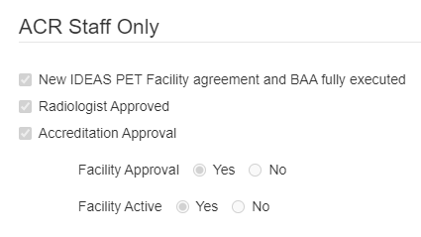
Facility Activation Requirements
The New IDEAS Operations Team at ACR will activate your facility when you complete the following tasks:
Complete the New IDEAS Referring Physician Site Agreement and BAA fully executed.
Interpreting Radiologists are approved by the New IDEAS Operations Team.
Accreditation status is added to the portal and approved by the New IDEAS Operations Team.

Slide 27
Protocol Reminder for Facility Activation
Your facility is only active for scanning patients for New IDEAS AFTER you receive approval from the New IDEAS Study Team.
Your facility administrator will receive an email notification when an ACR New IDEAS study staff member has activated your facility.

Slide 28
Study Forms Overview
Form/Assessment: | Must be completed by: | Requirements:
Amyloid PET Scan | PET Imaging Facility | Must be completed within 60 Days after Pre-PET electronic Case Report Form Completion.
Amyloid PET Completion Form | Facility Administrator, Registrar or Interpreting Radiologist | Must be completed by the PET Facility via Web-based data entry within 7 days after completing the Amyloid PET scan.
Amyloid PET Report | Facility Administrator, Registrar or Interpreting Radiologist | Must be completed by the PET facility via Web-based data entry within 7 days after completing the Amyloid PET scan.
Amyloid PET Assessment | Interpreting Radiologist ONLY | Must be completed via Web-based data entry within 7 days of the scan.
Coinsurance Reimbursement Form | Facility Administrator or Finance User | Must be completed via Web-based data entry for patients who have an outstanding balance for their amyloid PET scan. For step-by-step training, reference Operational Training: New IDEAS Coinsurance Reimbursement Program

Slide 29
Study Flow Overview:
The dementia specialist practice will consent the patient, schedule the scan and register the patient.
A patient case ID number will be generated to link all electronic case report forms.
Informed consent and case registration completed by Dementia Specialist
Pre-PET Visit
Completed by Dementia Specialist
Completed by PET Facility
(Scan NOT part of research)

Slide 30
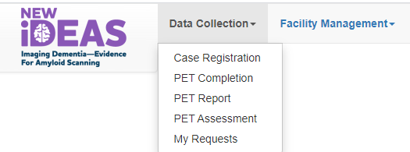
Case Status Overview
View list of registered cases under “Data Collection.” Select “Case Registration.”
Unique 5-digit study case identifier.
Click on this Case # to see patient form status.
A green box indicates the form has been completed.
A blue box indicates the form is available but has not been completed.
A white box indicates that the form is not available yet.

Slide 31
Amyloid PET Scan
The PET facility will receive an e-mail notification when the Pre-PET eCRF has been completed by the Referring Dementia Specialist.
The Amyloid PET Scan must be completed within 60 Days after Pre-PET electronic Case Report Form Completion.
Example Case: Patient 50011 has been registered, a Socio-Demographic form has been completed and the Pre-PET form has been completed. Patient is awaiting scan.

Slide 32
Study Timeline Overview
Amyloid PET Completion Form (within 7 days after scan is performed)
Amyloid PET Report (within 7 days after scan is performed)
Amyloid PET Assessment (within 7 days after scan is performed)
Image Upload to TRIAD (within 7 days after scan is performed)*
Completed by Dementia Specialist
Complc
Completed by Dementia Specialist
*Image Upload to TRIAD should only be completed for patients that consented to Image Archive. If patient OPTS OUT, TRIAD will block ability to upload.

Slide 33
Amyloid PET Completion Form
This form is completed by the PET Facility via Web-based data entry 7 days from the date the scan was performed.
Overview of Form:
PET Completion Visit Status
Identification Data
Scan Type
Radiopharmaceutical Tracer Information
Name of Person Submitting Form

Slide 34
Amyloid PET Completion Form Example
Click on the Case ID # of interest.
Select “PET Completion” Tab.
Complete the form and click “Submit”
Must be completed within 7 days from the day the scan was performed.

Slide 35
Amyloid PET Report
Must be completed by the PET facility via Web-based data entry within 7 days after completing the Amyloid PET scan.
This form is used to transmit the Amyloid PET Report.
Overview of Form:
Identification Data
Interpreting Physician Information
PET Report (entered as free text- copy and paste from Microsoft Word or Other text document)
Name of Person Submitting Form

Slide 36
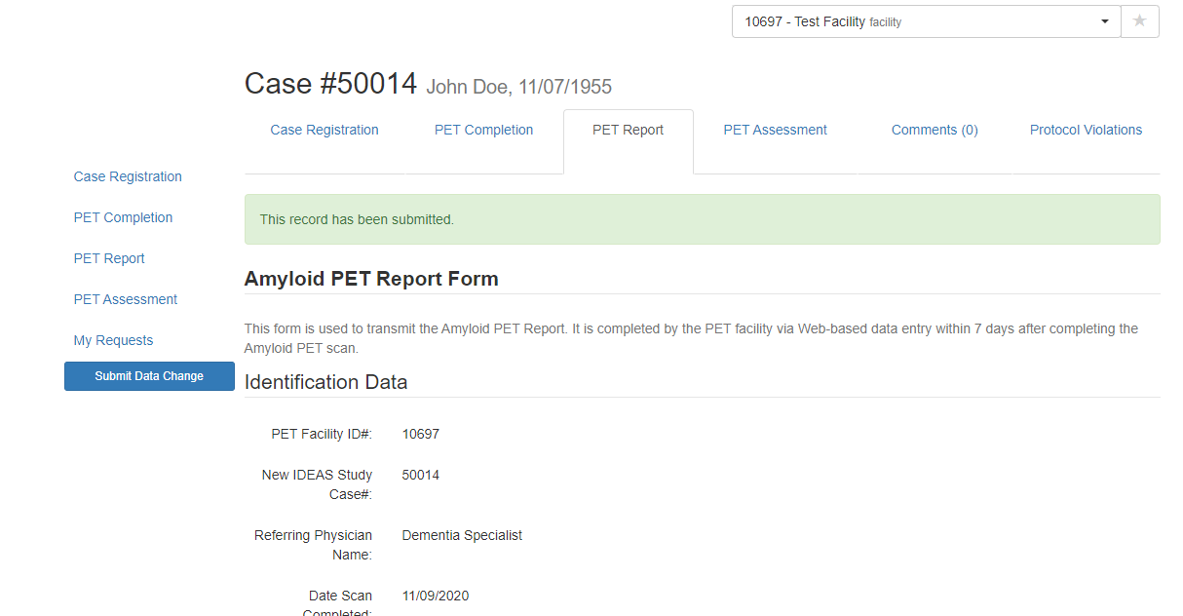
Amyloid PET Report Example
Click on the Case ID # of interest.
Select “PET Report” Tab.
Complete the form and click “Submit”
Must be completed within 7 days after completing the Amyloid PET scan.

Slide 37
Amyloid PET Assessment
The radiologist/nuclear medicine physician who interprets the amyloid PET will be required to complete the online Amyloid PET Assessment Form within 7 days of the scan.
Overview of Form:
Identification Data
Radiopharmaceutical
Scan Type
Image quantification question
Comparison of imaging question
Scan Quality Assessment
Global scan result
Name of Person submitting form

Slide 38
Amyloid PET Assessment Example
Click on the Case ID # of interest.
Select “PET Assessment” Tab.
Complete the form and click “Submit”
Must be completed by Interpreting Radiologist within 7 days of scan.

Slide 39
Coinsurance Reimbursement Form
Questions about this Form?
Email newideas@acr.org
For patient’s who owe a balance for the amyloid PET scan after all insurances have been billed, the Financer User or Facility Administrator will need to:
Verify patient's general information and confirm pre-populated fields:
PET facility provider type (Hospital-based/Not hospital-based)
Patient's Medicare type (Traditional/Medicare Advantage Plan)
Supplemental insurance (Yes/No)
Scan Date
Radiopharmaceutical administered
Upload required documentation for reimbursement
Upload patient's Explanation of Benefits (EOB) documents for all insurances
PDF document only; max file size 10Mb)
Multiple documents can be uploaded
Multiple documents must be uploaded before submission if technical and professional components are billed separately. Requests for partial payments will not be accepted.
Provide an attestation of coverage
Confirm that ALL insurances have been billed appropriately and all appeals have been pursued and resolved with Medicare and any supplemental insurer.
Indicate the total amounts requested for reimbursement
Entered amounts must match the coinsurance amounts shown on provided EOBs.

Slide 40
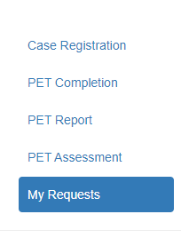
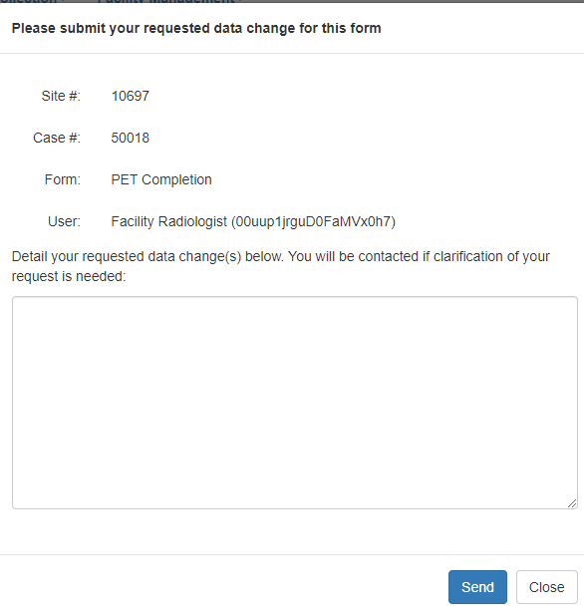
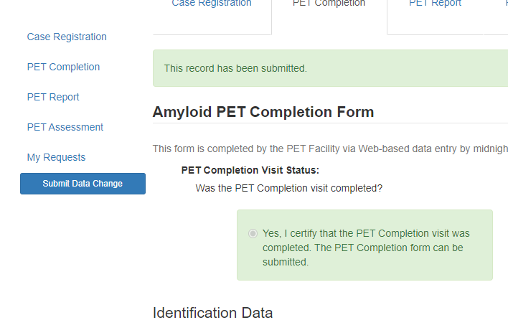
Data Change Re quest Form
Click on the Case # of interest.
Select the completed form you have a data change request for.
Detail your requested data changes in the comment box.
Click “Send.” An email will be sent to ACR New IDEAS staff for review.
View All requests by clicking “My Requests”

Slide 41
Protocol Violation Form
Protocol Violations can be viewed by clicking on the Case ID # of interest and clicking on the “Protocol Violations” tab.
Protocol Violations are initiated by the New IDEAS Study Team (ACR staff) and must be acknowledged by the Facility.

Slide 42
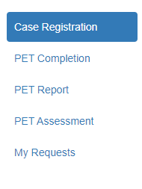
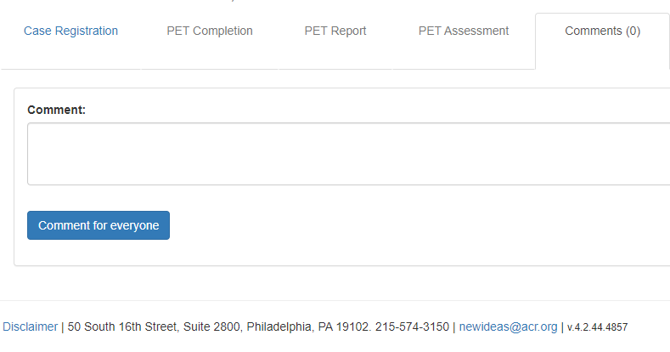
Case Comments Section
Communication about patient cases should only be communicated through the New IDEAS portal, never by email.
Select “Case Registration”
Click on the Case # of interest.
Select “Comments” tab.
Write patient comment and submit by selecting “Comment for everyone.”

Slide 43
Will Subjects Endure Any Costs?
Best Practice: Determine and discuss any potential out-of-pocket costs with the patient/family as part of the shared decision making prior to conducting the scan.
As a New IDEAS Study participant, the amyloid PET scan is a covered procedure by Medicare.
However, co-payments may apply for clinical services.
E.g. deductible or copay for the PET scan visit and/or the copay of the follow-up visit with the referring Dementia Specialist.
Patients with Medicare supplemental insurance (Medicaid):
Most co-payments will be covered
Patients with Medicare Advantage Plans:
Most will have no deductible or co-pay (some MA plans have co-share requirements).
Patients who do not have supplemental insurance:
Responsible for the usual patient co-share portion of the imaging (20% co-payment).
Amyloid PET scan estimate: $250-$700 (depending on the imaging facility setting and patient insurance plan).

Slide 44
TRIAD Overview
TRIADTM (Transfer of Images and Data)
Cloud based image and data exchange platform to support image and data sharing for Clinical Trials.
TRIAD meets FDA regulatory requirements for use in Clinical Trials; it is Title 21 CFR Part 11 compliant.
Sends images and data files securely.
Anonymizes the DICOM headers locally before submission based on flexible and profile-based algorithm.
A straight-forward software download to get started.
Images are submitted with a click of a button.
More info: http://triadhelp.acr.org/

Slide 45
Digital Image Submission
Except for subjects who have specifically opted out of image collection during the study consent process, all brain amyloid PET scans will be submitted to the American College of Radiology (ACR) archive within 7 days of scan acquisition using the TRIADTM application.
If patient OPTS OUT of Image Archive, TRIAD will automatically block access to transmit images.
Site staff (e.g., Nuclear Medicine Technologists) who submit images will need to be registered by the PET Facility Administrator as users, which will automatically enable them as TRIAD users.
Site staff who submit images through TRIAD will need to be registered in the New IDEAS Database and have a valid account.

Slide 46
Digital Image Submission (Continued)
Training on image transmission can be found at: https://www.ideas-study.org/Getting-Started/TRIAD
All PET scans are required to be submitted using TRIAD.
Can be installed on one or several computers of choice within the institutional ‘firewall’ and on institutional network.
TRIAD application can be used to submit images located on CDs/DVDs or network drives.
TRIAD application can also be configured as a DICOM destination on either scanner and/or PACS system for direct network transfer.

Slide 47
Additional Study Information
New IDEAS resources for PET Facilities:
https://www.ideas-study.org/PET-Facility
For protocol specific information visit:
https://www.ideas-study.org/Getting-Started/Protocol
Official study details and results reporting can be found at ClincalTrials.gov:
https://clinicaltrials.gov/ct2/show/NCT04426539

Slide 48
New IDEAS Operations Team
ACR Center for Research and Innovation
^{newideas@acr.org}
^{215-574-3150 ext. 4156}

