Slide 1
Practice and Staff Registration for Referring Dementia Practices

Slide 2
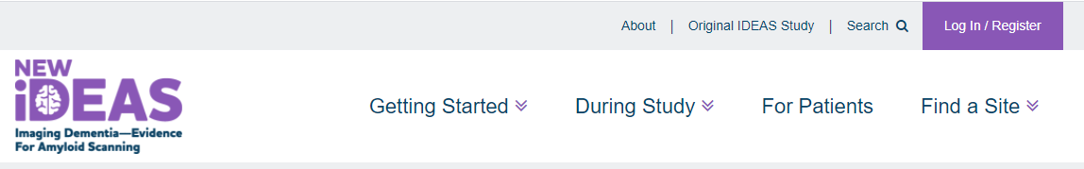
Important Portal Information
Link to portal:
https://app.ideas-study.org/
Processed via a secure, role-based online application with a two-factor authentication system (Okta)
  Each user is required to have his/her own username/password and current e-mail address for access and receipt of notifications/alerts.
  Passwords must be changed every 90 days.
  Physicians must complete their own data entry

Slide 3
Registration Overview
Registration should only be completed if your practice was invited to the New IDEAS study by ACR staff.
Practice registration is one time event to be completed by the practice administrator (overall access).
Each user is required to have his/her own username/password and current e-mail address for access and receipt of notifications/alerts.

Slide 4
User Role Information
  A user may have multiple roles in the study portal.
  *All practices must have an assigned Practice Administrator, Dementia Specialist and a Practice Finance User
Practice Administrator* | Dementia Specialist* | Practice Finance User* | Practice Registrar
- Automatically assigned to the person who initially submits the pre-registration form. - Has complete administrative functionality in the New IDEAS portal. - Responsible for administrative duties associated with practice registration and adding site staff profile accounts - Has view access to all case report forms and edit/submission access to all forms except pre- and post-PET form. | - Has view, edit and submission access to all case report forms. - Only user role that has edit and submission access to pre- and post-PET forms. | - Only user role that has access to the practice’s finance portal” - Responsible for submission of banking information - Does not have any access to patient case report forms | - Has view access to all case report forms and edit/submission access to all forms except pre- and post-PET form.

Slide 5
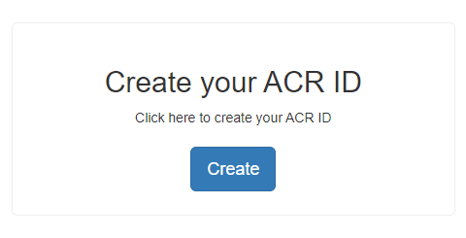
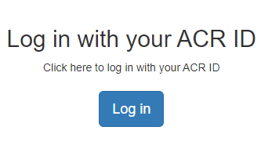
Practice Registration Tutorial
Link to portal:
https://app.ideas-study.org/
I do not have an
ACR ID
I already registered
for New IDEAS
Create your ACR ID profile.
You will receive an email link.
Follow slides Administrator Login Instructions

Slide 6
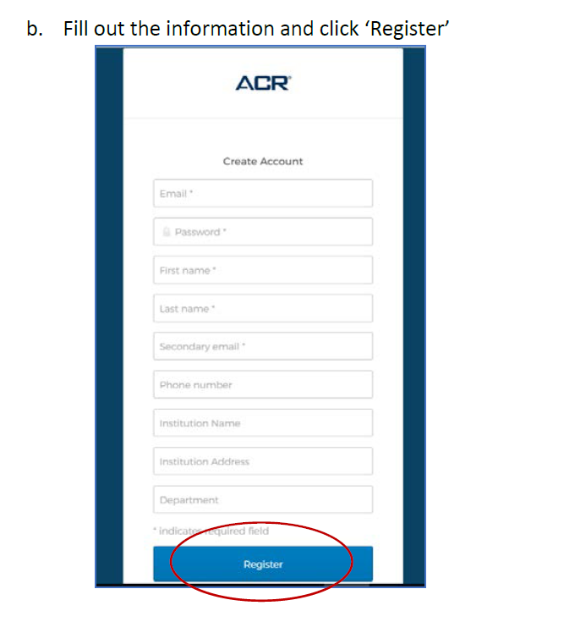
Administrator Login Instructions
Create your account and click “Register.”
Locate the ‘Welcome to ACR ID’ email in the email inbox you used to register and follow the one-time link to activate your account. Simply clicking on this link will activate your account (Note: check spam folder).
Return to the application’s home page, and click “Login with your ACR ID” (purple Login button).
Type in your username (email address used to create ACR ID).
Set up Okta (two-factor authentication).
Return to the login portal and login with username and two-factor authentication.
Note: You will have to utilize a ‘multifactor authentication’ mechanism to log in each time. This is for security purposes.

Slide 7
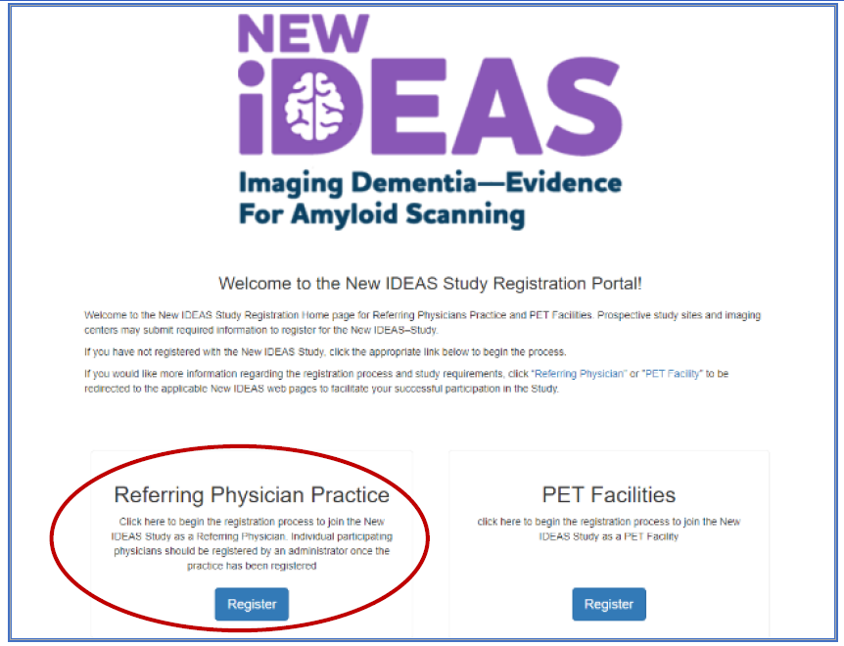
Administrator Login Instructions, continued
Select “Register”

Slide 8
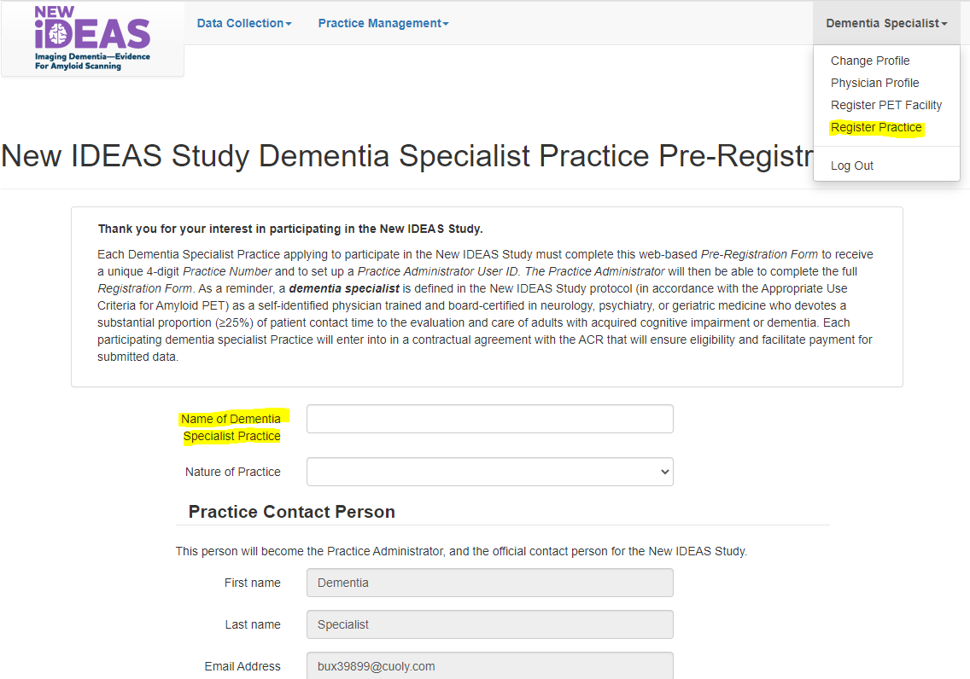
Pre-Registration Form
Fill out the Pre-Registration Form and click “Next.”
Enter the full name of your Dementia Practice.

Slide 9
Registration Form Overview
Your practice will need to provide the following information for each participating Dementia Specialist (referring physician):
  Name, National Provider Identifier (NPI) number, and Board and Subspecialty Certification. In addition, you will need the full mailing address and phone number for each PET facility to which you plan to refer study subjects.
Once registered, you will be able to return to the Registration Form and upload the following documents (pdf format only)
  Initial IRB approval letter
  Sample patient informed consent to be used at your practice.
  Human Subject Protection Certification for Dementia Specialists.

Slide 10
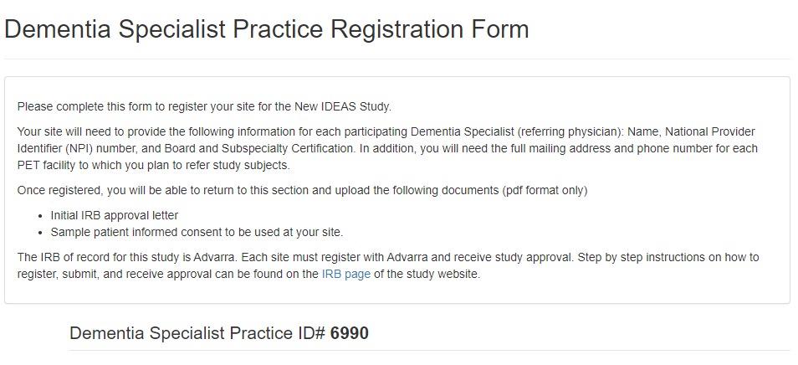
Registration Form Example
This is your 4-digit practice ID that is linked to your registration.

Slide 11
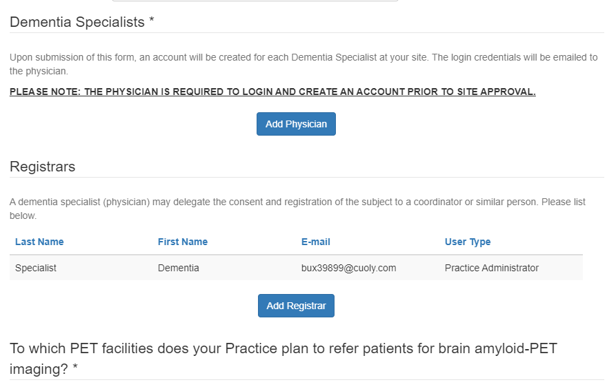
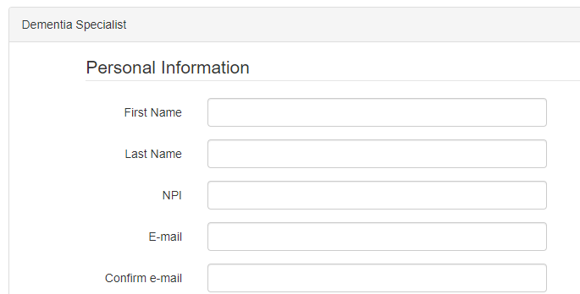
Add Physicians and Practice Staff
Step 1. Select the type of user you want to add (e.g. Dementia Specialist, Registrar)
Step 2. Enter personal information for the new user.
Step 3. An automated email will be sent to the email address entered for that user.
Step 4. Instruct your team member to click on the link they receive in their email to activate their account (Note: Check SPAM folders).
Unique email address for every user

Slide 12
Automated Email Example
Subject Line: New IDEAS-Study Dementia Specialist Registration Confirmation
Practice Name: <practice name>
Practice ID#: <practice ID>
________________________________________
Your Site Administrator has registered you as a Dementia Specialist for the New IDEAS Study
The New IDEAS (Imaging Dementia—Evidence for Amyloid Scanning) Study is managed by the American College of Radiology and thus requires an ACR ID (username) to access the recently upgraded database.
Please read the following instructions before clicking on the study link below.
All users, including users with existing ACR IDs, need to sign up for a new ACR account to access the New IDEAS portal. Existing IDs do not work for the New IDEAS study. Click on “Sign up”, then fill out the necessary information. Upon submission, you will be sent another automatic email to ‘verify’ your ACR ID. Do so by clicking the link in that email and login to the New IDEAS portal. To access the study portal at any time, navigate to the study website and click “Login” in the top right-hand corner.
Once logged in you should see your name in the top right corner. Do not re-register your practice. This has already been done. Instead, click on your name then click ‘physician profile’. You will also be prompted to confirm your Board and Subspecialty certification, answer a few questions about your practice and upload a Human Subject Protection Course Completion Certificate. Click submit and wait to be approved by the ACR.
To access your site’s registration page, click ‘Practice Management’ along the top.
Note: the link below must be used in order to connect your account to the correct site. This link expires after 10 days. Once expired, your site administrator will have to re-issue the link from their account.
To log in to New IDEAS please access the following secure New IDEAS link and complete the steps outlined above: <secure link>
We look forward to working with your site on the New IDEAS Study!
Best Regards,
The New IDEAS-Study Team

Slide 13
Complete the Physician Profile
Every Dementia Specialist added to the portal will need to:
  Click on the login link in the automatically generated email from the New IDEAS portal.
  Create a new ACR ID with a unique email address and set up two-factor authentication.
  Exit the ACR website and then login to the New IDEAS portal at https://app.ideas-study.org/
  Use the site selection drop-down menu to select your site.
  Click on their name in the top right-hand corner and select “Physician Profile”
  Complete the following sections:
      Personal information
      Upload Human Subject Protection Course Completion Certificate
      Principal Investigator designation
      Board and Subspecialty Certification(s)
      Patient Contact Time questions
  Review responses and Click “Submit.”
  A member of the New IDEAS Team will review and approve the Dementia Specialist.

Slide 14
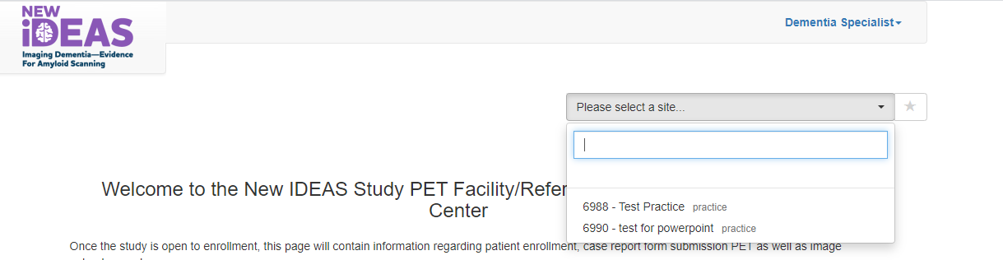
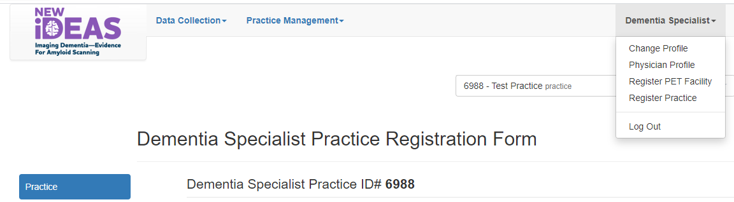
Complete Physician Profile Example
For Physician’s working with more than one practice:
Select the site (practice name) that you are affiliated with.
Use the drop down menu under “Dementia Specialist” (your name) to select “Physician Profile”

Slide 15
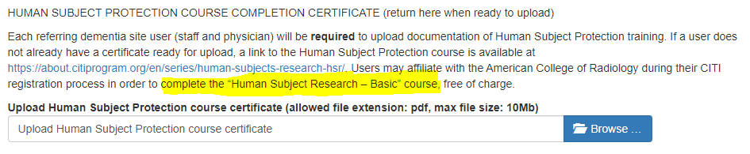
Upload Human Subject Protection Training
All Dementia Experts are required to complete the CITI Training “Human Subject Research- Basic”
  https://about.citiprogram.org/en/series/human-subjects-research-hsr/
  Upload Course Certificate to Physician Profile

Slide 16
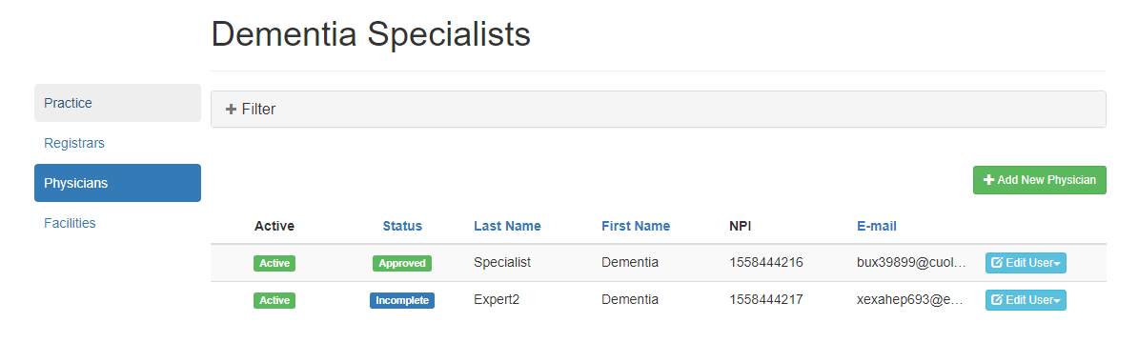
Check Physician Status
Specialist 1
Specialist 2
Specialist 1
Specialist 2
May not have activated ACR ID.
Uploaded human subject protection training.
Approved by study team.
May not have added human subject protection training
Has not been approved.
Status is “Approved”
Status is “Incomplete”
May not have submitted physician profile

Slide 17
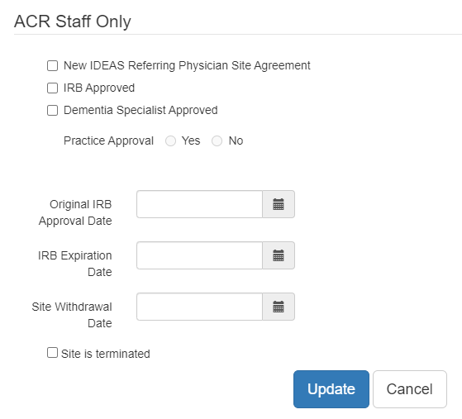
Practice Activation Requirements
The New IDEAS Operations Team at ACR will officially activate your site when you complete the following tasks:
Complete the New IDEAS Referring Physician Site Agreement
Upload appropriate documents that have received IRB approval
Referring physicians are approved by the New IDEAS Operations Team

Slide 18
Protocol Reminder for Practice Activation
Your practice is only active for recruitment and enrollment AFTER you receive approval from the New IDEAS Study Team.
Your practice administrator will receive an email notification when an ACR New IDEAS study staff member has activated your site practice.

Slide 19
Finance Portal: Add Financial Information
After logging in to the New IDEAS portal, Finance Users should select the “Financial Information” Tab, and select “Bank and Tax information”
Bank and Tax Information Overview:
  Bank Detail
  W9 Request for Taxpayer Identification Number and Certification
  Part 1 Taxpayer Identification Number
  Part 2 Certification
  Name of Institutional Official
  Name of Person Submitting Form

Slide 20
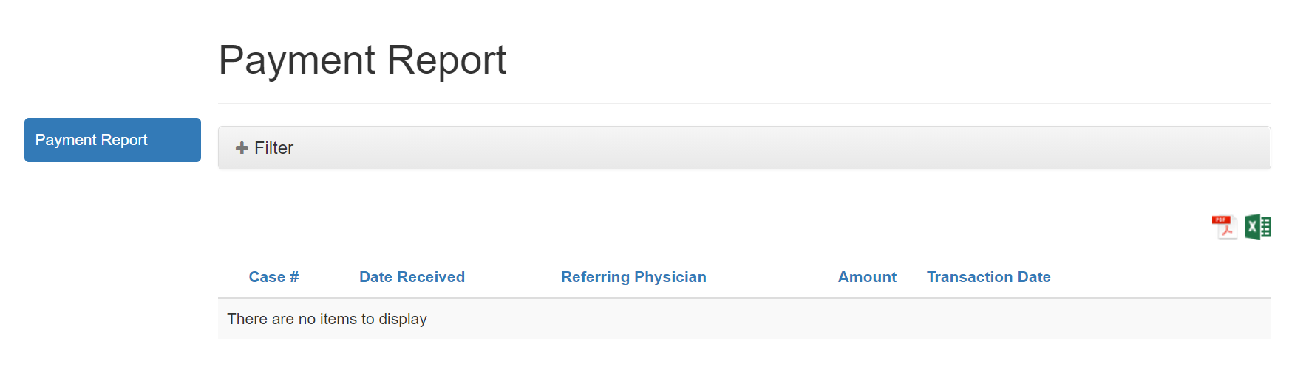
Finance Portal: View Practice Payments
Practice Finance Users can access practice payments at any time via the “Practice Payments” Tab.
Select “Payment Report” to view list of payments by case number or download a pdf or excel report of payments.
Click on the icon to download Payment Report (PDF or Excel)

Slide 21
New IDEAS Operations Team
ACR Center for Research and Innovation
^{newideas@acr.org}
^{215-574-3150 ext. 4156}

