Slide 1
Protocol Training for Referring Dementia Physicians and Practice Staff

Slide 2
New IDEAS Study History
Designed to address the requirements of the Coverage with Evidence Development provisions of the National Coverage Determination on beta-amyloid PET.
An observational, open-label, longitudinal cohort study building on the design of the initial Imaging Dementia—Evidence for Amyloid Scanning (IDEAS) study.
Will evaluate the association between amyloid PET and patient-centered outcomes in an expanded and more ethnoracially and clinically diverse group of Medicare participants presenting with cognitive impairment (N=7,000).
Including Black/African American patients (n=2,000), Latino/Hispanic patients (n=2,000), patients with early-onset (age < 65) cognitive impairment, and patients with typical or atypical presentation of MCI or dementia.

Slide 3
New IDEAS vs. the Original IDEAS Study
Original IDEAS | New IDEAS
N = ~11,400 included in analysis (>18,000 enrolled) | N = 7,000
Resulting Demographics MCI Dementia Black or African American 3.0% 5.0% White 90.0% 85.0% Other race 7.1% 10.0% Hispanic ethnicity 3.0% 5.4% | Recruitment Goals African American/Black n = 2,000 (28.6%) Latinx/Hispanic n = 2,000 (28.6%) Other racial categories n = 3,000 (42.8%)
Age ≥ 65y , Medicare recipient | Age can be <65y (Early-onset AD) if they are covered by Medicare
No genetic assays | ApoE genotyping via saliva collection
No blood collection | Optional blood collection to establish a biorepository

Slide 4
New IDEAS Study Aims
Aim 1
To compare 12-month claims-derived health outcomes in amyloid PET-positive versus amyloid PET-negative individuals presenting with MCI and dementia in the entire study cohort of diverse Medicare beneficiaries.
Aim 2
To describe the association of amyloid PET findings with changes in patient management and 12–month claims derived health outcomes among Blacks/African Americans, Latinx/Hispanics and Whites/Caucasians presenting with MCI and dementia.
Aim 3
To describe the association of amyloid PET findings with changes in management and 12-month claims-derived health outcomes in individuals presenting with typical (progressive amnestic) versus atypical clinical presentations of MCI and AD dementia.

Slide 5
Additional Study Objectives
Saliva Collection
Part of required protocol
Kits mailed directly to participants and completed at home. Specimens are mailed to ATRI and ApoE genotyping is performed.
Blood Collection
Participant must OPT-IN
Kits mailed directly to participants and completed at local Quest laboratory.
Sent to ATRI and plasma and DNA is stored for future research.
PET Image Archive
Participant may OPT-OUT
Images stored at ACR for future research.

Slide 6
New IDEAS: Clinical Care vs. Research
Clinical Care
Pre-PET and post-PET dementia expert visits
Amyloid PET scans and reads
Research
Consent (patients and physicians)
Clinical CPT codes should be applied
No standardized clinical metrics or assessments
Case report forms (CRF)
Image archiving
Following participants’ Medicare claims
Saliva and blood analysis

Slide 7
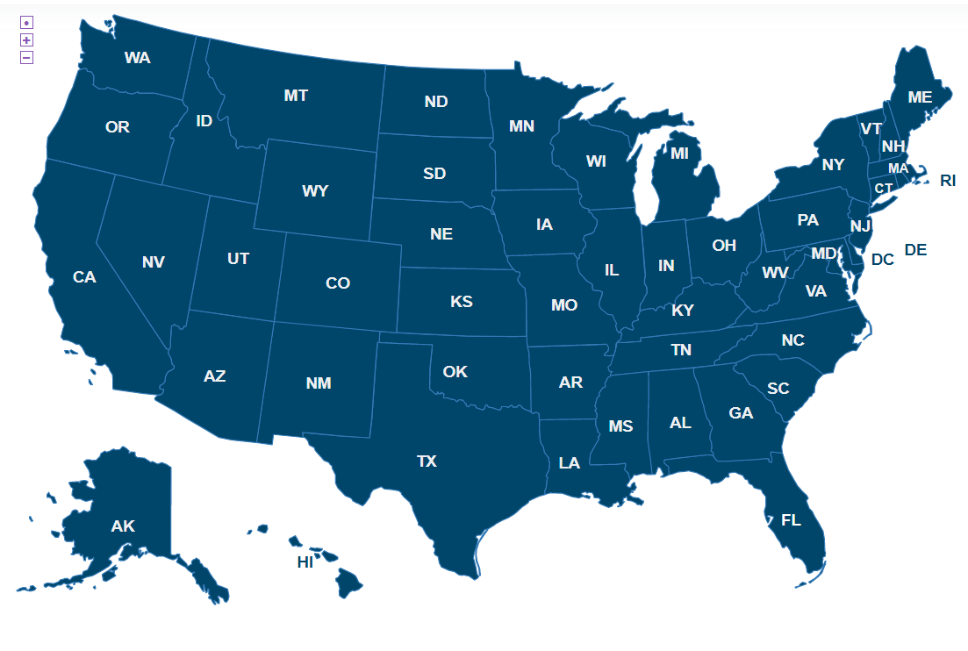
New IDEAS Site Selection Process
Dementia Specialists and PET Imaging Facilities will be selected on a rolling basis.
PET Imaging facility must be within 3-4 hours of an amyloid tracer supplier.
Site Locator by State: https://www.ideas-study.org/Find-a-Site
All interested sites must complete a New IDEAS questionnaire: https://www.ideas-study.org/Getting-Started

Slide 8
Referring Physician Qualifications
American Board of Psychiatry and Neurology
□ Neurology
□ Psychiatry
□ Geriatric Psychiatry
American Osteopathic Board of Neurology and Psychiatry
□ Neurology
□ Psychiatry
□ Geriatric Psychiatry
American Board of Internal Medicine
□ Geriatric Medicine
American Osteopathic Board of Internal Medicine
□ Geriatric Medicine
American Board of Family Medicine
□ Geriatric Medicine
American Osteopathic Board of Family Physicians
□ Geriatric Medicine Royal College of Physicians and Surgeons of Canada Certification □ Neurology □ Psychiatry □ Geriatric Medicine □ Geriatric Psychiatry
Must be board certified in at least one of the following
Devotes a substantial proportion (≥25%) of patient contact time to the evaluation and care of adults with acquired cognitive impairment or dementia.
Must provide CITI documentation to demonstrate certification in Human Subjects Protections training.

Slide 9
New IDEAS Study Timeline
Coinsurance Reimbursement Program Start Date:
January 1st, 2022
First Patient Registered
Dec 17th, 2020
Accrual/Enrollment Phase
Analysis Phase
Publication
For more information, visit Clinical Trials.gov:
https://clinicaltrials.gov/ct2/show/NCT04426539

Slide 10
Participant Study Timeline

Slide 11
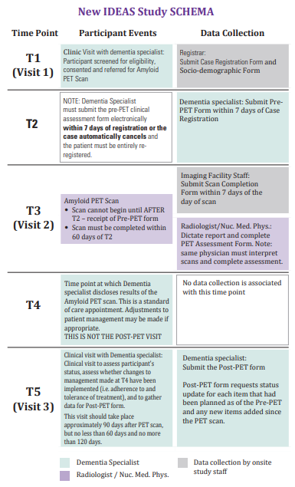
Study Resources
For Referring Dementia Practices:
Case Report Form Packet
New IDEAS Study Pocket Card
Tips for working with potential study participants
Inclusion/Exclusion Criteria
Study Schema
For Patients:
https://www.ideas-study.org/Patients
Pocket Card Example

Slide 12
Recruitment and Community Engagement Resources
New IDEAS Recruitment and Community Engagement Webinar (PDF Version |August 5th, 2021)
Faster Together, Enhancing the Recruitment of Minorities in Clinical Trials Free Course
Community Outreach Guide
Contact the New IDEAS Recruitment and Engagement Team:
newideas_recruitment@vumc.org

Slide 13
A Novel Community Engagement Approach for Minority Recruitment​
Engagement Across New IDEAS
Increase awareness of study
Increase referrals to dementia specialists
Increase knowledge of dementia symptoms
Input on recruitment plans
Assist with strategies to minimize workflow disruption
Community input on lay documents
Plan to return study findings at community level
Awareness
Retention
Dissemination
Practice readiness
Enrollment
Support training in cultural humility and communication
Identify practices with serving more minorities
Assess recruitment feasibility
Working with the research team to address barriers to retention of research participants

Slide 14
Community Engagement Strategies - Champions
New IDEAS will implement multifaceted strategies to increase study awareness and engagement in Black/African American and Latino/Hispanic populations
Phase 1: Identify 9 metro areas with Dementia Specialists with Capacity to Engage Black/African American and Latino/Hispanic populations.
Chicago, Dallas, Houston, Kansas City, Los Angeles, Miami, Philadelphia/New Jersey, San Diego, Washington DC/DMV
Phase 2: Launch Community Engagement in 9 metro areas
UNC will recruit volunteers (Champions) to partner with community organizations within their region
Champions receive training on New IDEAS, how to build strong community relationships, and cultural humility

Slide 15
The Champion Role
Champion duties include:
Conduct community outreach about importance of African American and Latino participation in research
Partner with local organizations and host community education events to support study awareness and New IDEAS Study enrollment
Deliver New IDEAS Study materials to potential participants and their caregivers
Champions share list of enrolled dementia specialists in their region with potential participants and their caregivers
Champions must:
Serve a 1-year commitment with opportunity to renew
NOT be working on the New IDEAS Study as employee of a participating provider
Please call
919-525-1020 or 984-664-1223
or email for more information NewIdeasStudy.CES@med.unc.edu

Slide 16
New IDEAS Study Policies
New IDEAS Enrollment Cap Policy
In concurrence with the clinical study agreement entered between the dementia practice and the American College of Radiology (ACR), the study reserves the right to cap enrollment for a physician, a dementia practice, or an entire study cohort (i.e. racial and ethnic sub-groups) with immediate effect.
Intended to ensure study generalizability through proportionate representation of dementia expert involvement and patient recruitment across socio-demographic and geographic populations.
New IDEAS Coinsurance Reimbursement Program Policy
Intended to outline the study’s Coinsurance Reimbursement Program and the obligations set forth for participating PET imaging facilities and dementia practices.
Retention of Records Policy for the New IDEAS Study
Participating Site Indirect Cost Rate Policy
New IDEAS Study Advertising Policy

Slide 17
Promote New IDEAS: Marketing Toolkit
Educate Patients:
https://www.ideas-study.org/Patients
Increase Physician Awareness:
Customizable physician-to-physician emails to increase awareness of New IDEAS within communities.
Prepare Press Release Materials:
Customizable press releases for local media outlet for both PET imaging facilities and referring physician practices.
Link to Marketing Toolkit:
https://www.ideas-study.org/During-Study/Marketing-Toolkit.
Additional study materials are being developed on a continual basis. Materials will be placed on the New IDEAS website once available.

Slide 18
Study Calendar Overview
Study Procedure | Visit 1: Eligibility/ Registration (T1) | Visit 1: Pre-PET Clinical Assessment (T2) | Visit 2: Amyloid PET (T3) | Disclosure of PET Results (T4) | Visit 3: Post-PET Office Visit (T5)
Screening/Eligibility Review
Informed Consent
Case Registration Online
Socio-demographic Form
Saliva Collection
Blood Collection
Refer for Amyloid PET
Pre-PET form Completion
Amyloid PET at PET Facility
Disclosure of PET Results to Patient
Post-PET Completion Form
x
x
x
x
x
x
x
x
x
x
x
X
Note: Eligibility determined at Visit 1; Collection to be completed after completion of Amyloid PET Scan.

Slide 19
Visit 1: Screening/Eligibility Review (T1)
The dementia specialist will be responsible for:
Identifying patients with MCI and dementia who meet inclusion criteria
Screening these candidates for exclusion criteria.
Review PowerPoint Slides “Inclusion Criteria” and “Exclusion Criteria”
Note: In order to ensure a diverse patient population in the study cohort, and in order to avoid potential bias related to disproportionate recruitment by a single dementia specialist, the maximum enrollment by any individual dementia specialist and their practice will be capped. Please refer to the enrollment cap policy found on the New IDEAS website https://www.ideas-study.org/During-Study/Resources

Slide 20
Inclusion Criteria
All inclusion and exclusion criteria must be confirmed by the referring dementia specialist and/or the participant’s medical records, prior to registration
Medicare beneficiary with Medicare as primary insurance;
Meets clinical criteria for Mild Cognitive Impairment (MCI) or Dementia as defined by the 2018 National Institute on Aging – Alzheimer’s Association Research Framework:61 (Refer to section 4.1.1 for guidance);
Brain MRI and/or CT within 24 months prior to enrollment;
Clinical laboratory assessment (complete blood count [CBC], comprehensive metabolic panel[CMP], thyroid stimulating hormone [TSH], vitamin B12) within the 12 months prior to enrollment;
Able to tolerate amyloid PET required by protocol, to be performed at a participating PET facility;
English or Spanish speaking (for the purposes of informed consent);
Willing and able to provide consent. Consent may be by proxy;
Neuropsychiatric syndrome can be classified into “clinically typical” or “clinically atypical” categories. (Refer to section 4.1.2 for guidance)
For additional clarification, visit https://www.ideas-study.org/Getting-Started/Protocol

Slide 21
Exclusion Criteria
For additional clarification, visit:
https://www.ideas-study.org/Getting-Started/Protocol
Normal cognition or subjective complaints that are not verified by cognitive testing or key informant.
Knowledge of amyloid status, in the opinion of the referring dementia expert, may cause significant psychological harm or otherwise negatively impact the patient or family.
Amyloid or tau status already known to patient or referring clinician based on prior imaging or cerebrospinal fluid analysis.
Previous amyloid PET scan obtained*.
Current or previous treatment with an anti-amyloid agent.
Current or previous enrollment in an anti-amyloid therapeutic trial.
Scan is being ordered solely based on a family history of dementia, presence of apolipoprotein E (ApoE) 4, or in lieu of genotyping for suspected autosomal mutation carriers.
Scan being ordered for nonmedical purposes (e.g., legal, insurance coverage, or employment screening).
Cancer requiring active therapy (excluding non-melanoma skin cancer).
Hip/pelvic fracture within the 12 months prior to enrollment.
Body weight exceeds PET scanner weight limit.
Currently pregnant or planning to become pregnant within 90 days of registration.
Life expectancy less than 24 months based on medical co-morbidities.
Residence in a skilled nursing facility (Note: assisted living facility is not an exclusion criterion).
*Note: Patients who received an amyloid PET scan in the original IDEAS study are automatically excluded from New IDEAS.

Slide 22
Informed Consent Process
Best Practice:
Face to face, in-person informed consent
When obtaining remote consent, researchers must document:
How the ICF was transmitted to the participant (e.g., email, fax, mail, etc.);
How the participant’s signature was obtained.
If an LAR is used, LAR signature and date are required on the ICF AND LAR initials must be documented on optional consent components.

Slide 23
Will Subjects Endure Any Costs?
Best Practice: Determine and discuss any potential out-of-pocket costs with the patient/family as part of the shared decision making prior to ordering the scan.
As a New IDEAS Study participant, the amyloid PET scan is a covered procedure by Medicare.
Patients are responsible for:
Unmet beneficiary deductibles.
Coinsurance or copayments associated with dementia expert visits.
As part of the New IDEAS Coinsurance Reimbursement Program, patients who received a scan on or after January 1st, 2022 are not responsible for:
Coinsurance amounts associated with the amyloid PET scan (including fixed copayments and technical, professional or global charges) not covered by patient’s supplemental insurance.

Slide 24
Obtaining Electronic Signatures
Advarra IRB Guidance on Remote Electronic Signatures
The site staff must have a discussion with the patient (and document this process) and not simply send the patient the form.
Electronic signatures must meet 21 CFR Part 11 Compliance.
The electronic signature system (including, but not limited to, DocuSign, Adobe, and Cosign) must have date/time stamp functionality and document:
The printed name of the signer
The date and time that the signature was applied.
The meaning of the signature. This is fulfilled by the signature line identifying who is signing (i.e. patient, LAR, witness, etc.)

Slide 25
Obtaining Signatures Remotely
Sites may fax/email the consent form to the patient and have them fax/email it back.
When a copy of the fully executed ICF will be returned to the study team, informed consent may be obtained by telephone/videocall. When obtaining consent by telephone/ videocall, researchers must:
Document how the ICF was transmitted to the participant (e.g., email, fax, mail, etc.).
Document how the participant’s signature was obtained. For example:
Electronic signature.
Scanned and emailed, faxed, or mailed back to the study team.
Photograph of signature/signature page sent back to the study team.
Additional resources can be found on the New IDEAS Study website:
New IDEAS Study Guidance for Remote Informed Consent

Slide 26
Informed Consent Process continued
Dementia Specialist determines patient’s capacity to consent (consent by proxy allowed).
BOTH Dementia Specialist/Authorized Designee AND patient/patient proxy sign.
Consenting site must ensure the fully executed ICF is uploaded to the case registration page in study database.
Provide IRB approved Informed Consent Form (ICF) to patient.
Dementia Specialist/Authorized Designee reviews ICF with patient/patient proxy.
Answer all outstanding questions with ample time to review and discuss the ICF.

Slide 27
Expectations of Study Participants
Consent to allow the study to obtain health and brain imaging for up to three years.
Provide name, address, social security number, Medicare identification number, and date of birth.
Provide a saliva sample to be tested for genetic status of Apolipoprotein E4 (ApoE4). Saliva collection kit will be sent to participant’s mailing address.
Schedule and have an amyloid PET scan from a participating imaging facility within approximately 60 days of joining the study.
Return to doctor for regular follow-up visit 90 days after having PET scan.
Allow amyloid PET scan to be collected and stored at the American College of Radiology for future research (Note: participants have the option to opt-out).
Main Study Consent Elements

Slide 28
Optional Informed Consent Form Components
Brain Imaging Records
Biorepository
Future Research Opportunities
Allow a copy of participant’s brain amyloid PET scan to be transferred to the New IDEAS Study image archive at the ACR for use in future research.
Images will be transferred unless the participant specifically opts out on the ICF.
Allow a blood collection kit to be mailed to the address on file.
Participants will take the kit to their local Quest Diagnostics Laboratory for staff to collect a blood sample (about 4 teaspoons) to be kept by the New IDEAS study for use in future research.
Participants must opt in on the ICF in order to participate.
Participants must opt in on the ICF in order to be contacted about other research opportunities.
Participants who opt in will be contacted by the Alzheimer’s Association TrialMatch™ staff after their New IDEAS PET scan has been completed.
TrialMatch™ staff will confirm participant’s interest in specific Add-On Studies for which they may qualify and explain who may be contacting them for each specific Add-On study.
Participation in any Add-On study is independent from participation in New IDEAS.

Slide 29
Additional Database Training
Practice and Staff Registration for Referring Dementia Practices
Instructions how to register your practice and staff.
Case Registration and Data Entry for Referring Dementia Practices
Instructions how to register patients and complete case report forms.

Slide 30
Visit 1: Clinical Assessment—Pre-PET Visit (T2)
Form/Assessment: | Must be completed by: | Requirements:
Case Registration Form | Administrator, Registrar OR Dementia Specialist | Must be completed after patient consent
Socio-demographic electronic Case Report Form | Administrator, Registrar OR Dementia Specialist | Must be completed within 7 days of case registration AND collected via patient self-reporting interview
Pre-PET electronic Case Report Form (Clinical Assessment) | Dementia Specialist ONLY | Must be completed within 7 days of case registration

Slide 31
Visit 2: Amyloid PET Scan (T3)
The PET facility will receive an e-mail notification when the Pre-PET eCRF has been completed.
The Amyloid PET Scan must be completed within 60 Days after Pre-PET electronic Case Report Form Completion.
Example Case: Patient 50011 has been registered, a Socio-Demographic form has been completed and the Pre-PET form has been completed. Patient is awaiting scan.

Slide 32
Disclosure of PET Results (T4)
Best Practice:
Results disclosed to patient as soon as results are available post-PET scan.
Every attempt should be made to avoid the patient receiving results directly from an electronic medical record portal.
Action Item: | Must be completed by: | When: | Where:
Disclosure of Amyloid PET to patient | Referring Dementia Specialist ONLY | As soon as results are available (best practice) | In-person (recommended) Remote (acceptable)
Recommendations for subsequent changes in management that are clinically appropriate that incorporate PET results and additional clinical information* | Referring Dementia Specialist ONLY | Prior to 90-day post-PET visit (T5) | In-person (recommended) Remote (acceptable)
*Potential management actions include further diagnostic testing/consultation, imaging, laboratory or genetic analysis, referrals and counseling for non-pharmaceutical care, and a detailed documentation of pharmaceutical treatments (started, continued, or stopped) by drug categories.

Slide 33
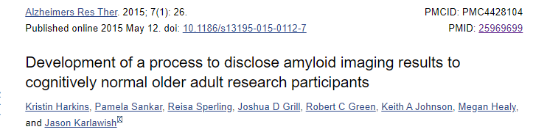
Disclosure of PET Results Resources
Additional training for best practice recommendations for amyloid PET counseling: “Development of a process to disclose amyloid imaging results to cognitively normal older adult research participants.”

Slide 34
Visit 3: Post-PET Office Visit (T5)
Must be completed 90 ± 30 Days after amyloid PET scan.
Document actual patient management as reflected by management changes that have been implemented into patient care.
Form/Action Item: | Completed by: | Requirements:
90-day (from day of PET scan) clinical office follow-up | Referring Dementia Specialist* | May occur within a window of 60-120 days post-PET scan date. In office visit (preferred)
Post-PET eCRF | Same Dementia Specialist who completed Pre-PET eCRF | Due within 30 days after 90-day visit.
*Under no circumstances is the dementia specialist permitted to delegate the post-PET contact (in person visit or telephone) to other staff or to another physician.

Slide 35
Post-PET Form Example
The referring Dementia Expert will document:
Diagnostic testing/consultation
Additional imaging
Laboratory or genetic analysis
Referrals and counseling for non-pharmaceutical care
Pharmaceutical treatments
Adverse effects attributed to learning amyloid status
Emergency room visits/hospitalizations during 90-day interval
Follow-up Visit Status
Differential Diagnosis
Management Plan
The blue box indicates that the Post-PET form is available but has not been completed.

Slide 36
Rare Events
When patient is not able to return for clinical follow-up within the allotted time (e.g., geographic distance from the dementia specialist):
The post-PET visit may occur by telephone between the dementia specialist and the patient and family.
Dementia specialist must document this on the post-PET eCRF.
IDEAS Study team will contact the physician if the reason for telephone follow-up is deemed unacceptable or the frequency of telephone visits appears excessive.
A documented reason for incomplete visit must be provided on the Post-PET eCRF for:
Patient has had subsequent events leading to prolonged care in a skilled nursing facility
Death

Slide 37
Protocol Violation Process
Any protocol violations must be reported to the IRB within 2 weeks (10 business days) from the time the deviation was identified.
Discovery of a protocol violation should result in an immediate email communication to NewIDEAS@acr.org and NewIDEAS-Regulatory@acr.org.
A protocol violation notification can come from internal source or from site directly.
Protocol violation documentation will require the following:
Case # and Study #
Description of the deviation
IRB acknowledgement, note that IRB will review at the next quarterly review period, or IRB feels this deviation does not warrant review.
Corrective action plan (CAPA)
Ensure that all information provided by Site is Redacted.
Protocol violations may include, but are not limited to:
Changing of protocol/consent without IRB approval
Use of non-current ICF to consent patients
Failure to consent patient who is enrolled.
Breach of confidentiality

Slide 38
Case Completion and Payment
All pre- and post-PET eCRF are completed
Data uploaded to New IDEAS portal within required timeframe
Payment via Bank of America to bank account registered by the referring physician practice

Slide 39
Case Reimbursement Breakdown
Case Report Form (CRF) Data Collection Timelines and Per Case Payment
Form | Completed By | Form Due Date | Accrued Compensation
Case Registration Form | Dementia Specialist or Registrar | After consent | $0
Socio-demographic Form | Dementia Specialist or Registrar | After consent, within 7 days of registration | $0
Pre-PET Form (Medical History and Clinical Assessment Form) | Dementia Specialist (must log into website and complete online) | Within 7 days of case registration and no more than 60 days before the amyloid PET scan | $250
Post-PET Form (Clinical Assessment Form) | Same Dementia Specialist who completed Pre-PET forms | No more than 30 days after completion of the post-PET 90 day visit | $250

Slide 40
Central IRB Overview
New IDEAS Regulatory Contact: Grace Dillon
newideas-regulatory@acr.org
1-215-574-4177
Referring physician sites must use Advarra IRB as the IRB of record.
Local IRBs are not permitted to serve as the IRB of record for the New IDEAS study.
IRB approval of each referring physician site is required prior to full activation by the ACR.
Advarra IRB protocol number for New IDEAS: Pro00046342
New IDEAS Study IRB Information:
https://www.ideas-study.org/Getting-Started/Institutional-Review-Board

Slide 41
Central IRB Requirements
New IDEAS Regulatory Contact: Grace Dillon
newideas-regulatory@acr.org
1-215-574-4177
Prior to Site Activation, each site must:
receive regulatory approval of the New IDEAS protocol AND informed consent form.
upload a copy of the initial approval letter from Advarra and approved consent form to the New IDEAS portal.
During the New IDEAS study, each site is responsible for:
notifying ACR AND the central IRB (Advarra) if any revisions are made to the consent during the study.

Slide 42
New IDEAS Operations Team
ACR Center for Research and Innovation
^{newideas@acr.org}
^{215-574-3150 ext. 4156}

