Slide 1
Guidelines for the Management of Myelofibrosis in Adults
An Educational Slide Set
American Society of Hematology 2026 Guidelines for the Management of Myelofibrosis in Adults
Slide set authors:
Rupali Bhave, Shireen Sirhan, Natasha Szuber, Douglas Tremblay

Slide 2
American Society of Hematology 2026 Guidelines for the Management of Myelofibrosis in Adults
Brady L Stein , Maya Abdallah, Gregory A. Abel, Ghaith Abu-Zeinah, Rupali Bhave, Francisca Ferrer Marin, Arpita Gandhi, Vikas Gupta, Juan Carlos Hernandez-Boluda, Anthony Hunter, Donal P. McLornan, Olatoyosi Odenike, Kristen Pettit, William Shomali, Shireen Sirhan, Andrew Srisuwananukorn, Natasha Szuber, Roni Tamari, Douglas Tremblay, Alessandro Maria Vannucchi, Kelley Clark, Lisa Jenkins, Bashar Hasan, and M. Hassan Murad.

Slide 3
How were these guidelines generated?
PANEL FORMATION
Guideline panel was formed following these key criteria:
Balance of expertise (including disciplines beyond hematology, & inclusive of patients)
Close attention to minimization & management of conflicts of interest
CLINICAL QUESTIONS
10 clinically-relevant questions generated in PICO format (population, intervention, comparison, outcome)
EVIDENCE SYNTHESIS
Evidence summary generated for each PICO question via systematic review of health effects plus:
Resource use
Feasibility
Acceptability
Equity
Patient values and preferences
MAKING RECOMMENDATIONS
Recommendations made by guideline panel members based on evidence for all factors.
Example: PICO question
“In individuals with higher-risk myelofibrosis receiving JAK inhibitor therapy, should we refer early on for allogeneic hematopoietic cell transplantation or delay post JAK inhibitor therapy failure?
ASH guidelines are reviewed annually by expert work groups convened by ASH. Resources, such as this slide set, derived from guidelines that require updating are removed from the ASH website.

Slide 4




How patients and clinicians should use these recommendations
 | STRONG Recommendation |  | CONDITIONAL Recommendation
 | “The panel recommends…” | “The panel recommends against…” | “The panel suggests…” | “The panel suggests against…”
For patients | Most individuals would want the intervention. |  | A majority would want the intervention, but many would not.
For clinicians | Most individuals should receive the intervention. |  | Different choices will be appropriate for different patients, depending on their values and preferences. Use shared decision making.

Slide 5
Objectives
By the end of this session, you should be able to
Recognize scenarios in which extended molecular testing and interferon-based approaches should be considered in myelofibrosis (MF).
Select initial treatment strategies for JAK inhibitor–naïve MF across different clinical phenotypes.
Individualize management of disease-related anemia, JAK inhibitor–associated anemia, iron overload, and thrombosis prevention.
Apply transplant referral and pre-transplant treatment recommendations in higher-risk MF.

Slide 6
Case 1: Extended molecular mutation testing in myelofibrosis (PICO 1)
66-year-old man, no significant PMH
Denies fevers, night sweats
Early satiety, no significant weight loss
Active, ECOG PS 0
Physical exam: palpable splenomegaly, 5 cm below left costal margin
12
Peripheral blood tested for CALR, MPL and JAK2 mutations: JAK2 V617F mutation present
Bone marrow biopsy: megakaryocytic clustering and reticulin fibrosis (MF-2) present consistent with primary myelofibrosis
Karyotype: 46, XY
17
Peripheral blasts 2%
Nucleated RBC and dacrocytes noted
150
36

Slide 7
Case 1: Extended molecular mutation testing in myelofibrosis (PICO 1)
Patient requests comprehensive education on primary myelofibrosis, including prognosis and a review of all available interventions, including aggressive options
Patient has Intermediate-1 risk disease by IPSS, DIPSS, and DIPSS PLUS
Estimated overall survival based on these risk models was discussed with the patient
Question 1
Should extended molecular mutation testing be performed on this patient, and why?
Yes, because it reliably predicts response to JAK inhibitors.
Yes, because extended molecular testing refines prognostic risk stratification and may inform management decisions such as transplant referral.
No, because a patient’s prognosis will not change from one scoring system to the next, even if the scoring system incorporates extended molecular mutation data.

Slide 8
Prognostic models in myelofibrosis that do not incorporate molecular mutations
Prognostic model | Variables (Scoring) | Risk groups (Median OS)
IPSS | Age >65 (1) Hb <10 g/dL (1) Circulating blasts >1% (1) Constitutional symptoms (1) | 0 = Low (11.3 years) 1 = Intermediate-1 (7.9 years) 2 = Intermediate-2 (4.0 years) ≥3 = High (2.3 years)
DIPSS (applicable anytime during disease course) | Age >65 (1) Hb <10 g/dL (2) WBC >25×10⁹/L (1) Circulating blasts >1% (1) Constitutional symptoms (1) | 0 = Low (not reached) 1-2 = Intermediate-1 (14.2 years) 3-4 = Intermediate-2 (4.0 years) 5-6 = High (1.5 years)
DIPSS PLUS (applicable anytime during disease course) | DIPSS Low (0) DIPSS Int-1 (1) DIPSS Int-2 (2) DIPSS High (3) Unfavorable karyotype (1) Red cell transfusion dependency (1) Platelets <100×10⁹/L (1) | 0 = Low (15.4 years) 1 = Intermediate-1 (6.5 years) 2-3 = Intermediate-2 (2.9 years) 4-6 = High (1.3 years)
Cervantes F et al. Blood. 2009.
Passamonti F et al. Blood. 2010.
Gangat N et al. JCO. 2011.
How J et al. JNCCN. 2020.

Slide 9
High molecular risk (HMR) non-driver mutations in myelofibrosis
ASXL1, EZH2, SRSF2, U2AF1 Q157, IDH1/2, multi-hit TP53, N/K RAS
Associated with shorter overall survival and shorter leukemia-free survival
Number of HMR mutations affects prognosis
Incorporating molecular data can result in an upgrade in risk assignment
Santos et al. Leukemia. 2020.
Coltro G et al. Blood Adv. 2020.
Loscocco GG et al. Am J Hematol. 2023.
Rolles B et al. Leukemia. 2026.
Guglielmelli P et al. JCO. 2018.

Slide 10
Prognostic models in myelofibrosis that do incorporate molecular mutations
Prognostic model | Variables (Scoring) | Risk group (Median OS)
MIPSS70 | Hb <10 g/dL (1) WBC >25×10⁹/L (1) Circulating blasts >2% (1) Constitutional symptoms (1) Platelets <100×10⁹/L (1) Bone marrow fibrosis grade >2 (1) 1 HMR mutation (1) >2 HMR mutations (2) Type 1/like CALR absent (1) | 0-1 = Low (27.7 years) 2-4 = Intermediate (7.1 years) >5 = High (2.3 years)
MIPSS70 Plus | Hb <10 g/dL (1) Circulating blasts >2% (1) Constitutional symptoms (1) 1 HMR mutation (1) >2 HMR mutations (2) Type 1/like CALR absent (1) Unfavorable karyotype (3) | 0-2 = Low (20 years) 3 = Intermediate (6.3 years) 4-6 = High (3.9 years) >7 = Very high (1.7 years)
GIPSS | Very high-risk karyotype (2) Unfavorable karyotype (1) Type 1/like CALR absent (2) ASXL1 (1) SRSF2 (1) U2AF1 Q157 (1) | 0 = Low (26.4 years) 1 = Intermediate-1 (8.0 years) 2 = Intermediate-2 (4.2 years) >3 = High (2.0 years)
Guglielmelli P et al. JCO. 2018.
Teferri A et al. Leukemia. 2018.
How J et al. JNCCN. 2020.

Slide 11
Prognostic models in myelofibrosis that do incorporate molecular mutations (cont.)
Prognostic model | Variables (Scoring) | Risk group (Median OS)
MIPSS70 Plus v2.0 | Very high-risk karyotype (4) Unfavorable karyotype (3) 1 HMR mutation (2) >2 HMR mutations (3) Type 1/like CALR absent (2) Severe anemia (2) --Hb <8 g/dL in women, <9 g/dL in men Moderate anemia (1) --Hb 8-9.9 g/dL in women, 9-10.9 g/dL in men Circulating blasts >2% (1) Constitutional symptoms (2) | 0 = Very low (not reached) 1-2 = Low (16.4 years) 3-4 = Intermediate (7.7 years) 5-8 = High (4.1 years) >9 = Very high (1.8 years)
MYSEC-PM | Age (0.15 per yr of age) Hb <11 g/dL (2) Platelets <150×10⁹/L (1) Circulating blasts >3% (2) CALR absent (2) Constitutional symptoms (1) | <11 = Low (Not reached) 11-13 = Intermediate-1 (9.3 years) 14-16 = Intermediate-2 (4.4 years) >16 = High (2.0 years)
Tefferi A et al. JCO. 2018.
Passamonti F et al. Leukemia. 2017.
How J et al. JNCCN. 2020.

Slide 12
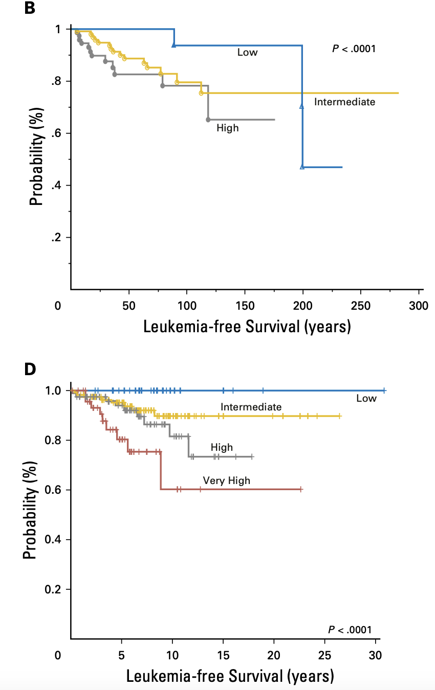
Molecularly enhanced prognostic scoring systems can also predict
Leukemia-free survival
MIPSS
MIPSS PLUS
Guglielmelli P et al. JCO. 2018.

Slide 13
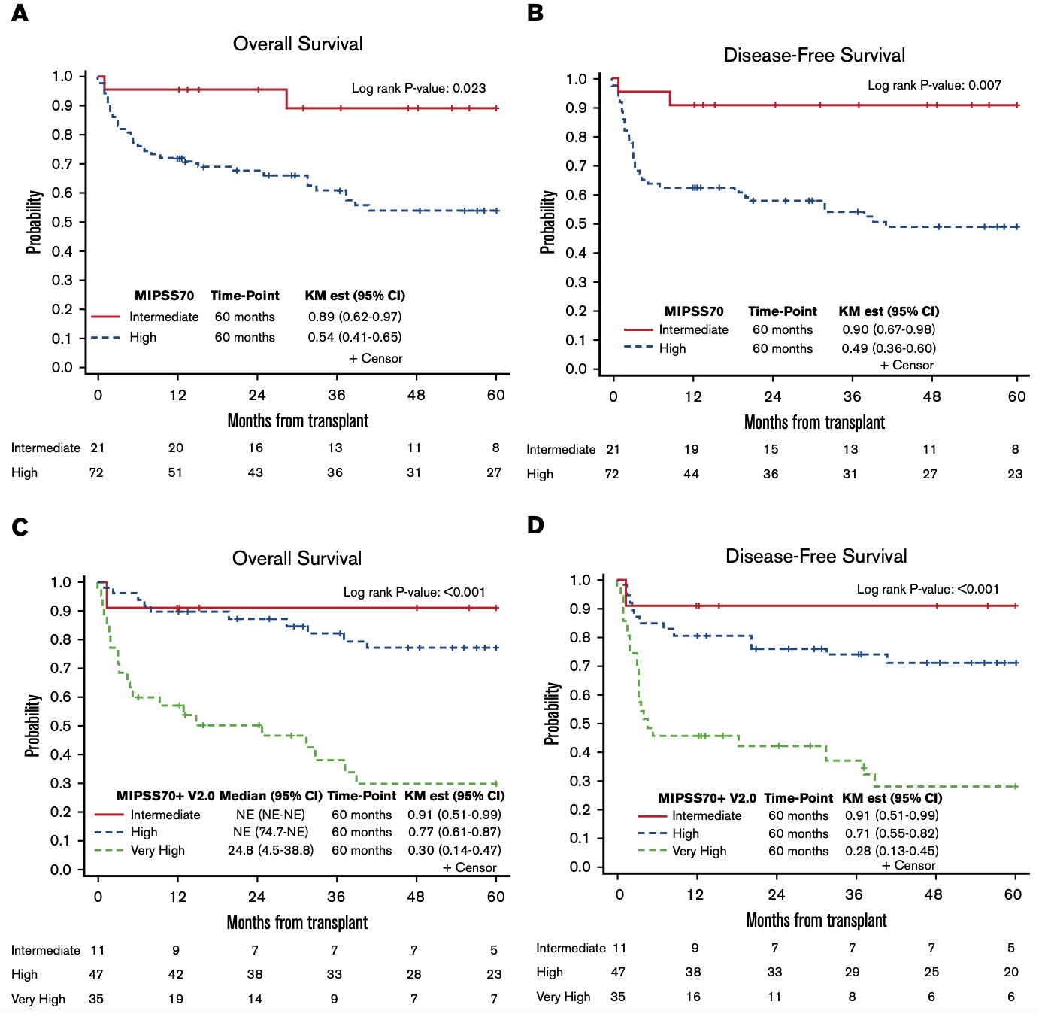
Driver mutation and HMR mutation status have been shown to play a role in outcomes after alloSCT
Ali H et al. Bl Adv. 2019.

Slide 14
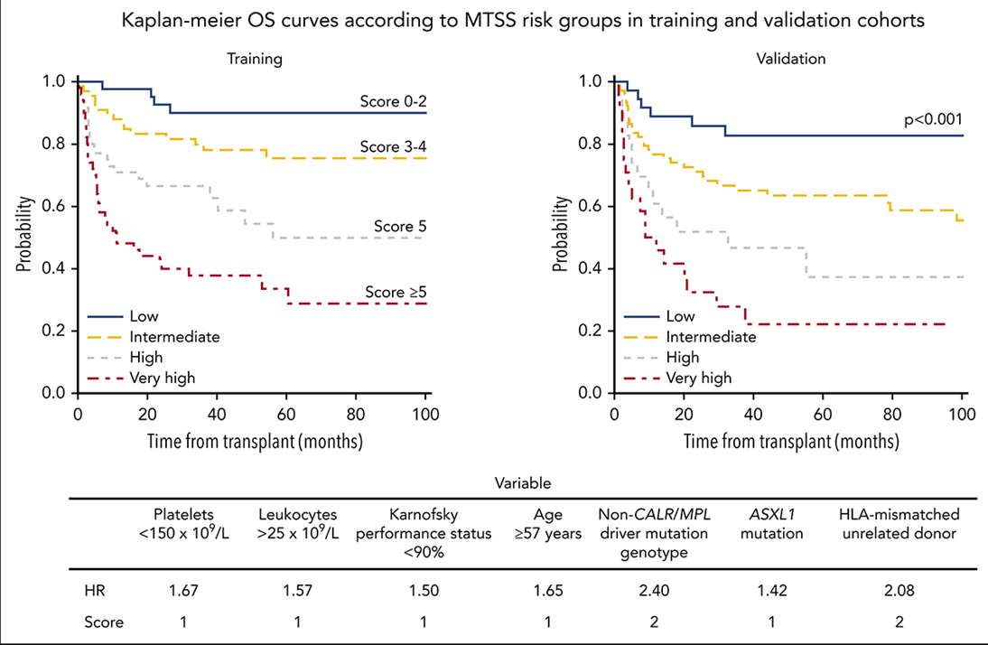
MTSS: Myelofibrosis Transplant Scoring System
Uses molecular, clinical, and transplant-specific factors to predict post-transplant outcomes
Gagelmann et al. Blood. 2019.

Slide 15
Case 1: Back to our patient…
Extended molecular mutation panel obtained from peripheral blood
ASXL1 and EZH2 mutations detected, both HMR mutations
High-risk disease by MIPSS70, MIPSS70-Plus, and MIPSS70-Plus v2.0
Transplant referral made to initiate discussion

Slide 16
Recommendation 1
Recommendation | Strength | Certainty of evidence
In all patients with myelofibrosis, we suggest extended molecular genetic testing compared to limited testing from MPN driver mutations. | Conditional | Moderate
Remarks:
Extended molecular genetic testing should be performed at diagnosis. It may be repeated at key clinical decision points, such as disease progression, pre-transplant evaluation, or when making new treatment decisions, to identify acquisition of new mutations.
Extended testing is less compelling for patients that are transplant-ineligible with poor extended longevity, or among patients that do not want to know prognosis if there is no impact on their treatment.

Slide 17
Case 2a: Use of interferon in myelofibrosis (PICO 2)
A 56-year-old, non-smoking man with no significant past medical history (including no prior thrombotic events) was incidentally found to have an elevated platelet count by his primary care physician. He feels well, is active, and reports no complaints, including no microvascular symptoms. Physical examination shows no hepatosplenomegaly.
Question 2a
In this newly diagnosed prefibrotic MF patient, what is the most appropriate management?
Observation alone.
Ruxolitinib.
14.8
Pegylated interferon.
6.2
956
No leukoerythroblastosis noted
LDH normal
43.6
Peripheral blood tested for CALR, MPL and JAK2 mutations: type 1 CALR mutation present
Bone marrow biopsy: slightly hypercellular, slight myeloid predominance, megakaryocytic hyperplasia with atypia, megs arranged in clusters, grade 0-1 fibrosis noted, most consistent with prefibrotic MF
Karyotype: 46, XY

Slide 18
Prefibrotic MF
 | Prefibrotic MF (2022 ICC)
MAJOR | Bone marrow biopsy --Increased age-adjusted bone marrow cellularity --Megakaryocytic proliferation and atypia --Granulocytic proliferation and (often) decreased erythropoiesis --Bone marrow fibrosis grade 0-1 Diagnostic criteria for BCR::ABL1-positive CML, PV, PMF, or other myeloid neoplasms are not met Presence of JAK2, CALR, or MPL mutation or presence of another clonal marker or absence of reactive bone marrow reticulin fibrosis
MINOR | Anemia not attributed to a comorbid condition Leukocytosis >11×10⁹/L Palpable splenomegaly LDH above reference range Leukoerythroblastosis
ALL 3 MAJOR AND 1 MINOR
Recognized as a distinct clinicopathologic entity in 2016 WHO classification
Continues to be recognized in 2022 International Consensus Classification (ICC)
Khoury J et al. Leukemia. 2022.
Arber D et al. Blood. 2022.

Slide 19
Prefibrotic MF and Goals of treatment
Currently, no standard-of-care treatment algorithm for prefibrotic MF
Variable clinical presentation that may not benefit from treatment with JAK inhibitors
Goals of treatment
  Control symptoms if present
  Prevent thrombotic or hemorrhagic complications
    10 yr cumulative incidence of thrombosis in preMF 17.9%
    10 yr cumulative incidence of bleeding in preMF 14.9%
  Prevent progression to overt MF, prevent transformation to AML, and prolong overall survival
    10 yr risk of progression to overt MF 12.3%
    5-year risk of leukemic transformation 5%; 10 yr risk of leukemic transformation 12%
    Median overall survival 14.7 years
Guglielmelli et al. Blood. 2017.
Finazzi et al. Leukemia. 2012.
Rumi et al. Oncotarget. 2017.

Slide 20
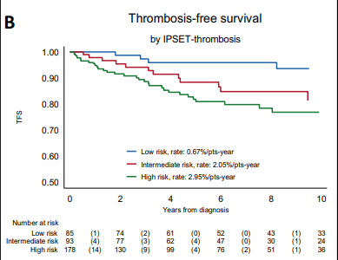
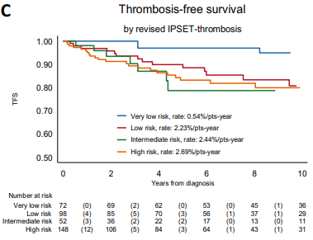
Thrombosis-free survival: (Revised) IPSET-Thrombosis validated in Prefibrotic MF
Guglielmelli et al. Blood Cancer J. 2020.

Slide 21
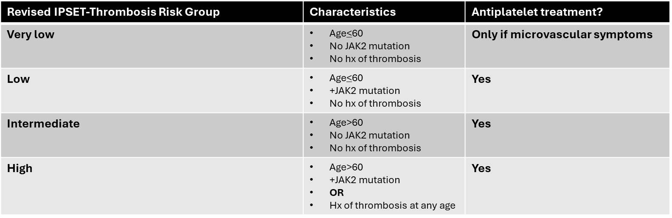
Prefibrotic MF: Antiplatelet treatment
It is reasonable to consider initiating an antiplatelet agent in preMF patients, using the same criteria as in ET patients.

Slide 22
Prefibrotic MF: Cytoreductive treatment
It is reasonable to consider initiating a cytoreductive agent in preMF patients using the same criteria as in ET patients.
Revised IPSET-Thrombosis Risk Group | Characteristics | Cytoreductive treatment?
Very low | Age <60 No JAK2 mutation No Hx of thrombosis | Only if refractory symptoms
Low | Age <60 +JAK2 mutation No Hx of thrombosis | Only if refractory symptoms
Intermediate | Age >60 No JAK2 mutation No Hx of thrombosis | If no cardiovascular risk factors present: only if refractory symptoms If cardiovascular risk factors present: consider use
High | Age >60 +JAK2 mutation OR Hx of thrombosis | Yes

Slide 23
Case 2a: Back to our patient…
56-year-old with type 1 CALR+ prefibrotic MF, no prior thrombotic event, asymptomatic
Very low risk by Revised IPSET-Thrombosis score, validated in prefibrotic MF
No indication for aspirin or cytoreductive agent
No signs or symptoms warranting JAK inhibitor initiation
Observation is most appropriate

Slide 24
Case 2b: Use of interferon in myelofibrosis (PICO 2)
A 45-year-old man with no significant past medical history presents with right arm weakness and is found to have a cerebrovascular accident (CVA). He has no other symptoms, and physical examination shows no hepatosplenomegaly.
Question 2b
What is an appropriate initial treatment for this newly diagnosed prefibrotic MF patient?
Observation alone.
Ruxolitinib.
14.8
6.2
654
No leukoerythroblastosis noted
LDH elevated
Pegylated interferon.
43.6
Peripheral blood tested for CALR, MPL and JAK2 mutations: JAK2 V617F mutation present
Bone marrow biopsy: slightly hypercellular, slight myeloid predominance, megakaryocytic hyperplasia with atypia, megs arranged in clusters, grade 0-1 fibrosis noted, most consistent with prefibrotic MF
Karyotype: 46, XY

Slide 25
Interferon in MPNs
Interferons thought to act at the level of the mutant MPN stem cell
Interferons have a long history of efficacy and safety in MPNs
  PV
  ET
  Myelofibrosis

Slide 26
Interferon in prefibrotic myelofibrosis
Clinical trial | Phase | Patients | Agent(s) | Clinical response |  |  | Molecular response | Toxicity
Silver et al | Retrospective | N=30 MF -low-INT-1 DIPSS | IFN-2b or PEG-IFNa-2a | CR 7% PR 30% CI 13% SD 23% 5-year PFS 88% 5-year OS 91.5% |  |  | 28% VAF reduction of 23% and reduction in marrow cellularity | Mostly grade 1/2 toxicity
Ianotto et al | Retrospective | N=62 MF -42.6% low-INT-1 IPSS -53.2% low-INT-1 DIPSS | PEG-IFNa-2a | Median OS 7.4 years Median LFS NR |  |  | >10% VAF reduction 63% >20% VAF reduction 55.6% >50% VAF reduction 37% | AE-related tx discontinuation 44.4%
Gill et al | 2 Prospective | N=51 preMF N=6 PMF (low-INT-1 DIPSS) N=5 SMF (low-INT-1 DIPSS) | RoPEG-IFNa-2b | preMF: W104 CHCR 78.4% | PMF: W104 CHCR 33.3% | SMF: W104 CHCR 50% | W104 JAK2 VAF reduction 67.6% W104 CALR VAF reduction 40% | AE-related tx discontinuation 4.2%
 |  |  |  | Entire cohort: W104 TSS50 40% W104 SVR 50%
Silver RT et al. Cancer. 2017.
Ianotto J-C et al. Haematologica. 2018.
Gill H et al. Blood Adv. 2026.

Slide 27
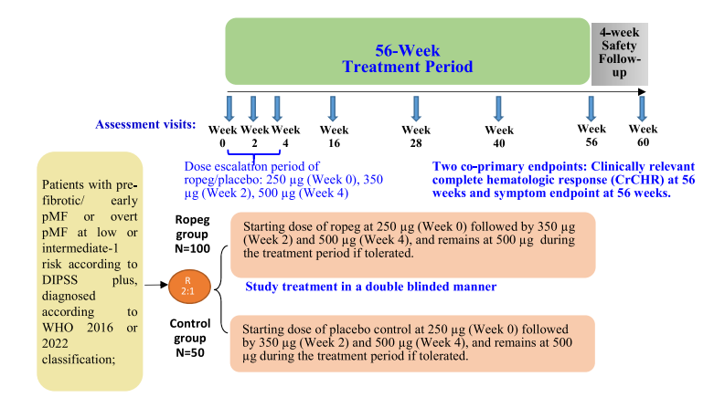
Interim ropeginterferon alfa-2b data in preMF and low/intermediate-1 risk overt MF
Interim analysis: N=66; median follow-up 69 weeks
PreMF cohort: no progression to overt MF or leukemia after 48 weeks of therapy
No deaths reported in preMF cohort at median follow-up of 69 weeks
Five-year OS estimates apply to separate overt MF interferon cohorts, not the interim preMF analysis.
Phase 3 trial design (randomized, double-blind, placebo-controlled)
Gill H et al. Blood. 2023.
Abu-Zeinah G et al. Ann Hematol. 2024.

Slide 28
Recommendation 2
Recommendation | Strength | Certainty of evidence
In patients with prefibrotic myelofibrosis (preMF) and no indication for cytoreduction, the panel suggests against routine use of pegylated interferons. | Conditional | Very low
Remarks:
There is a paucity of evidence to suggest routine use of pegylated interferons in preMF, but this body of literature is growing.
Conversely, for patients with an indication for cytoreduction, which may include high risk disease by the International Prognostic Score of Thrombosis in Essential Thrombocythemia (IPSET-Thrombosis) score, profound leukocytosis or thrombocytosis, or symptomatic splenomegaly, the use of pegylated interferons could be considered.

Slide 29
Case 3: Asymptomatic Higher-Risk MF (PICO 3)
A 67-year-old dentist presents for evaluation of anemia, incidentally identified by his primary care physician. He denies fevers, night sweats, weight loss, and pruritus, and reports an excellent appetite without early satiety. Physical examination shows no palpable splenomegaly.
Question 3
What is the appropriate initial treatment for a newly diagnosed, asymptomatic patient with DIPSS Intermediate-2 risk MF?
Initiate JAK inhibitor therapy.
Closely monitor for the development of spleen or constitutional symptoms.
9.8
Peripheral blasts: 2%
Nucleated RBC and dacrocytes noted
26.1
167
  Bone marrow biopsy: megakaryocytic clustering and bone marrow fibrosis (MF-2) consistent with myelofibrosis
  Karyotype: 46, XY
  NGS: JAK2 V617F (32%) and SF3B1 (18%)
Hypomethylating agent therapy.
29.6

Slide 30
Recommendation 3
Recommendation | Strength | Evidence Certainty
In JAK inhibitor–naïve patients with higher-risk overt myelofibrosis without symptomatic splenomegaly and/or disease-related symptoms, the ASH guideline panel suggests against the initiation of JAK inhibitors. | Conditional | Very low
Good practice statement. Use dynamic, structured symptom assessment during observation, as higher-risk patients under observation are increasingly likely to need treatment during their disease course.

Slide 31
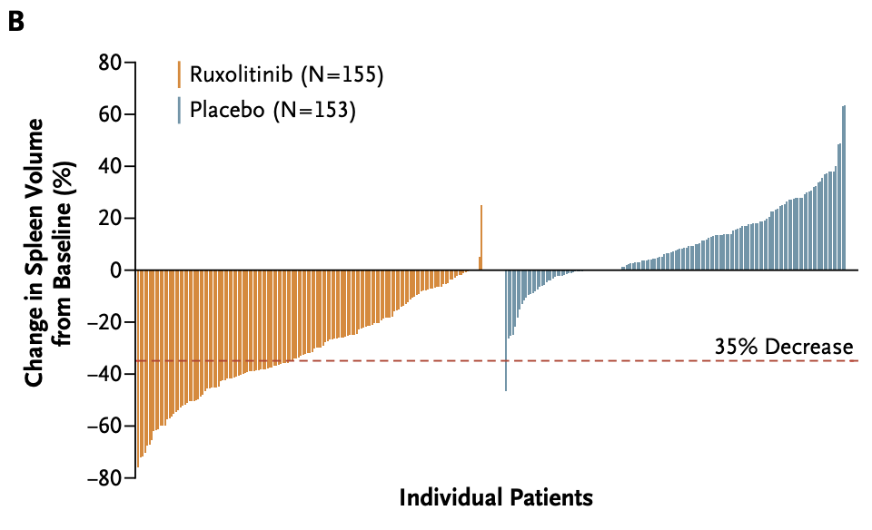
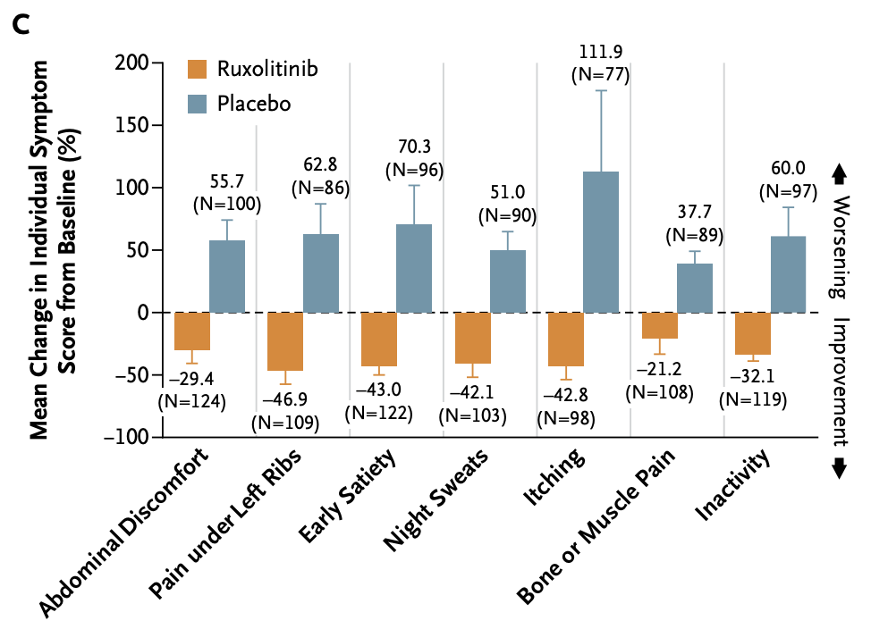
Case 3: Asymptomatic Higher-Risk MF
Why observation is important
JAK inhibitors reduce spleen size and improve symptoms.
Evidence in asymptomatic patients without splenomegaly is limited.
https://pubmed.ncbi.nlm.nih.gov/22375971/
Verstovsek et al NEJM 2012

Slide 32
Case 3: Asymptomatic Higher-Risk MF
JAK inhibitor | Upfront Study | Inclusion criteria
 |  | Risk score | Spleen size | Symptom burden
Ruxolitinib | COMFORT-I | IPSS intermediate-2 or high | Spleen >5 cm below LCM | Active symptoms of MF
 | COMFORT-II |  |  | -
Fedratinib | JAKARTA | IPSS intermediate-2 or high | Spleen >5 cm below LCM | -
Pacritinib | PERSIST-I | DIPSS intermediate-1, intermediate-2 or high | Spleen >5 cm below LCM | MPN-SAF TSS ≥13
 | PERSIST-II | DIPSS intermediate-1, intermediate-2 or high | Spleen >5 cm below LCM | MPN-SAF TSS ≥13
Momelotinib | SIMPLIFY-1 | IPSS intermediate-2 or high | Spleen >5 cm below LCM | -
In asymptomatic higher-risk MF without splenomegaly, benefit is uncertain and treatment-related toxicity remains relevant.
Monitor symptoms and spleen size over time.
LCM, left costal margin.
Verstovsek et al NEJM 2012; Harrison et al NEJM 2012; Pardanani et al JAMA Onc 2015; Mesa et al Lancet Haem 2017; Mascarenhas et al JAMA Onc 2018; Mesa et al JCO 2017

Slide 33
Case 4: Disease-Related Anemia (PICO 5)
After 2 years, the patient develops worsening fatigue that limits his activity and ability to practice dentistry. Physical examination reveals the spleen palpable 5 cm below the left costal margin (LCM). Labs and bone marrow biopsy are repeated.
Question 4
What is the appropriate initial treatment for a JAK inhibitor–naïve MF patient whose primary symptom burden is disease-related anemia?
Transfusion support alone.
7.9
Peripheral blasts: 2%
Nucleated RBC and dacrocytes noted
Erythropoiesis-stimulating agent (ESA) or danazol.
32.2
89
  Bone marrow biopsy: megakaryocytic clustering and bone marrow fibrosis (MF-3)
  Karyotype: 46, XY
  NGS: JAK2 V617F (37%) and SF3B1 (43%)
Momelotinib or pacritinib.
24.4

Slide 34
Recommendation 5
Recommendation | Strength | Evidence Certainty
In JAK inhibitor–naïve patients with myelofibrosis whose primary indication for treatment is disease-related anemia, the ASH guideline panel suggests either JAK inhibitor therapy (momelotinib or pacritinib) or non-JAK inhibitor anemia-directed therapies. | Conditional | Low
Remarks
Severity of anemia influences decision-making. Some transfusion-dependent patients can become transfusion-independent when treated with momelotinib or pacritinib; in this context, these JAK inhibitors would be the preferred strategy compared to non-JAK inhibitor anemia-directed therapies. Pacritinib can be considered in patients with concurrent anemia and thrombocytopenia.
Alternatively, non-transfusion dependent patients may start with a non-JAK inhibitor directed therapy (e.g erythropoiesis-stimulating agent (if eligible), luspatercept, or danazol).

Slide 35
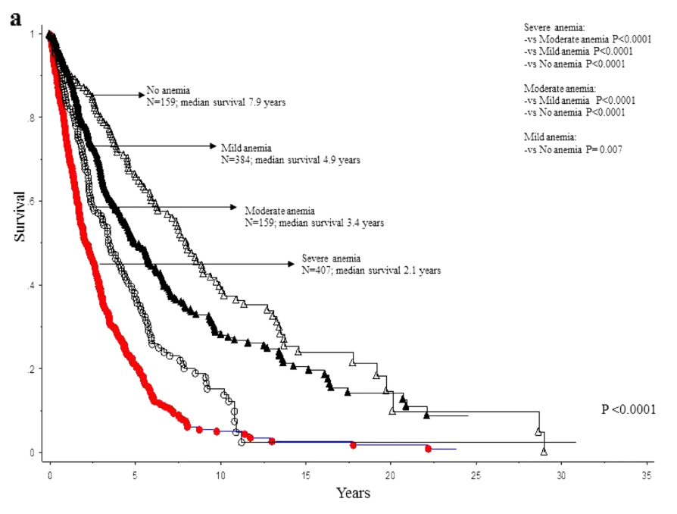
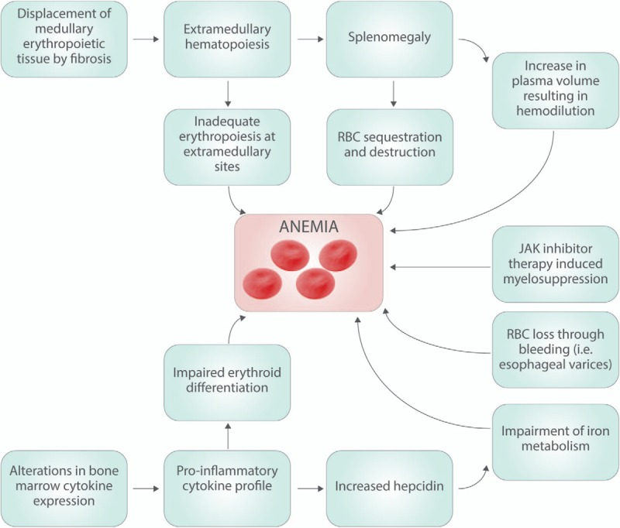
Anemia is a poor prognostic marker in MF and has multifactorial causes
Anemia affects symptoms, quality of life, and transfusion burden.
Nicolosi M et al Leukemia 2018. Naymagon et al Hemasphere 2017

Slide 36
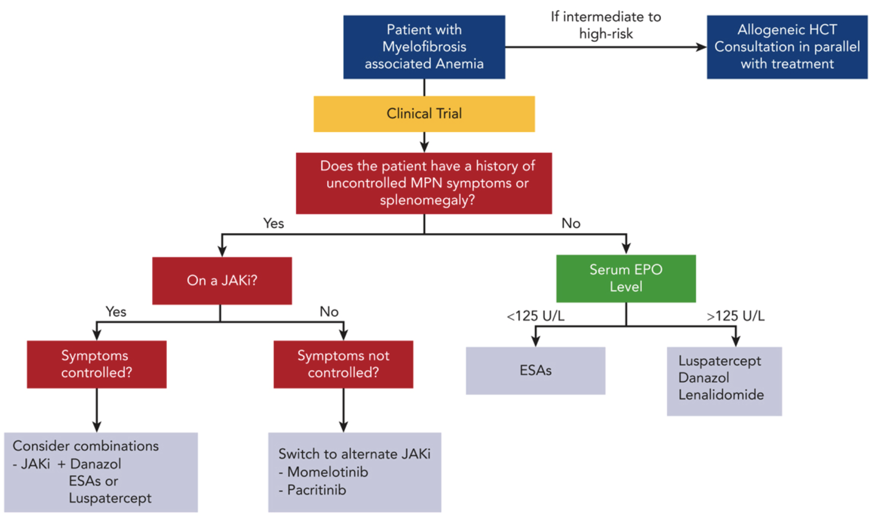
Non-JAK inhibitor anemia directed therapies may also improve hemoglobin levels
Momelotinib and pacritinib may improve anemia/transfusion dependence.
ESA, danazol, and other non-JAK anemia-directed options may be appropriate.
Access and resource considerations may influence treatment choice.
Jain and Gerds Blood 2025

Slide 37
Case 5: Symptomatic Lower-Risk MF (PICO 4)
A 54-year-old marketing executive with no significant past medical history is seen by her primary care physician for unintentional weight loss (7% of baseline body weight) driven by early satiety. She has pruritus but no unexplained fevers or night sweats. Physical examination reveals the spleen palpable 12 cm below the left costal margin (LCM). Labs and bone marrow biopsy are repeated.
Question 5
In a newly diagnosed, low-risk, JAK inhibitor–naïve, overt MF patient with spleen-related complaints and constitutional symptoms, what is the most appropriate management?
Active monitoring.
Peripheral blasts: 0%
Nucleated RBC and dacrocytes noted
Allogeneic stem cell transplantation referral.
13.1
17.1
124
  Bone marrow biopsy: megakaryocytic atypia with clustering and bone marrow fibrosis (MF-2)
  Karyotype: 46, XY
  NGS: JAK2 V617F (61%) and ASXL1 (11%)
Initiate JAK inhibitor therapy.
42.0

Slide 38
Recommendation 4
Recommendation | Strength | Evidence Certainty
In JAK inhibitor–naïve patients with lower-risk overt myelofibrosis with symptomatic splenomegaly and/or disease-related symptoms, the ASH guideline panel suggests the use of JAK inhibitors. | Conditional | Very low

Slide 39
Takeaways
Treat the Patient, Not the Score: Symptomatic presentation should override prognostic scoring when deciding whether to initiate JAK inhibitor therapy.
Specifically, we suggest JAK inhibitor therapy for low-risk patients with disease-related symptoms and/or splenomegaly. Conversely, we suggest against JAK inhibitor therapy in asymptomatic high-risk patients without splenomegaly.
Anemia in MF is a poor prognostic marker. Momelotinib, pacritinib, and non–JAK inhibitor therapies can be utilized.

Slide 40
Case 6: Anemia With Ongoing Disease Control (PICO 6)
A 68-year-old man has primary overt MF. Symptoms include fatigue, early satiety, and night sweats. Exam reveals the spleen palpable 10 cm below the LCM. CBC shows Hb 10.4 g/dL, WBC 18×10⁹/L, platelets 145×10⁹/L, and 1% peripheral blasts. Bone marrow shows MF-2 fibrosis; karyotype is 46,XY. NGS shows JAK2 V617F and ASXL1 mutations. Ruxolitinib was started for symptomatic splenomegaly and constitutional symptoms.
At 12-week follow-up, symptoms had improved significantly and the spleen was now 4 cm below the LCM. However, hemoglobin declined to 7.8 g/dL, and intermittent RBC transfusions are now needed.
Question 6
How should JAK inhibitor–associated anemia be managed?
Switch to an alternative JAK inhibitor.
Maintain current therapy and implement an anemia-optimization strategy.
Discontinue JAK inhibitor.
Observation.

Slide 41
Recommendation 6B
Recommendation | Strength | Evidence Certainty
In MF patients who experience JAK inhibitor–associated anemia but maintain adequate symptoms and spleen control on the current dose of first-line JAK inhibitor, the ASH guideline panel suggests implementing anemia optimization strategies. | Conditional | Low
Remarks:
Options include RBC transfusion, ESA, luspatercept, and androgens.
Pacritinib may be considered in patients with concurrent anemia and thrombocytopenia.
Early-onset anemia may be drug-related.
Late-onset or progressive anemia may indicate disease progression.
Good practice statement. In patients with myelofibrosis receiving first-line JAK inhibitor, anemia management should be guided by its timing and impact on disease control, using optimization strategies when benefit is maintained and switching therapy when anemia limits effective dosing.

Slide 42
Case 7: Anemia Limiting Effective JAK Inhibitor Dosing (PICO 6)
In the same clinic, you evaluate a similar case: a 68-year-old man with primary overt, JAK2-mutated MF. Bone marrow shows MF-2 fibrosis, karyotype is normal, and NGS is negative for additional mutations.
He started ruxolitinib 4 months ago for constitutional symptoms and symptomatic splenomegaly (12 cm below LCM). Shortly after initiation, he developed anemia (Hb 6.9 g/dL) requiring weekly transfusions, which he finds difficult to sustain. Ruxolitinib could not be titrated above 10 mg twice daily, and symptom and splenomegaly control remain suboptimal.
Question 7
How should JAK inhibitor–associated anemia be managed?
Switch to an alternative JAK inhibitor.
Maintain current therapy and implement an anemia-optimization strategy.
Discontinue JAK inhibitor.
Observation.

Slide 43
Recommendation 6A
Recommendation | Strength | Evidence Certainty
In patients with myelofibrosis who experience JAK inhibitor–associated anemia that prevents the use of an optimal dose of first-line JAK inhibitor for symptoms and spleen control, the ASH guideline panel suggests switching to momelotinib or pacritinib. | Conditional | Low

Slide 44
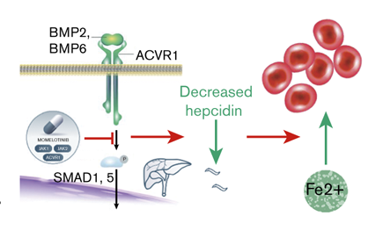
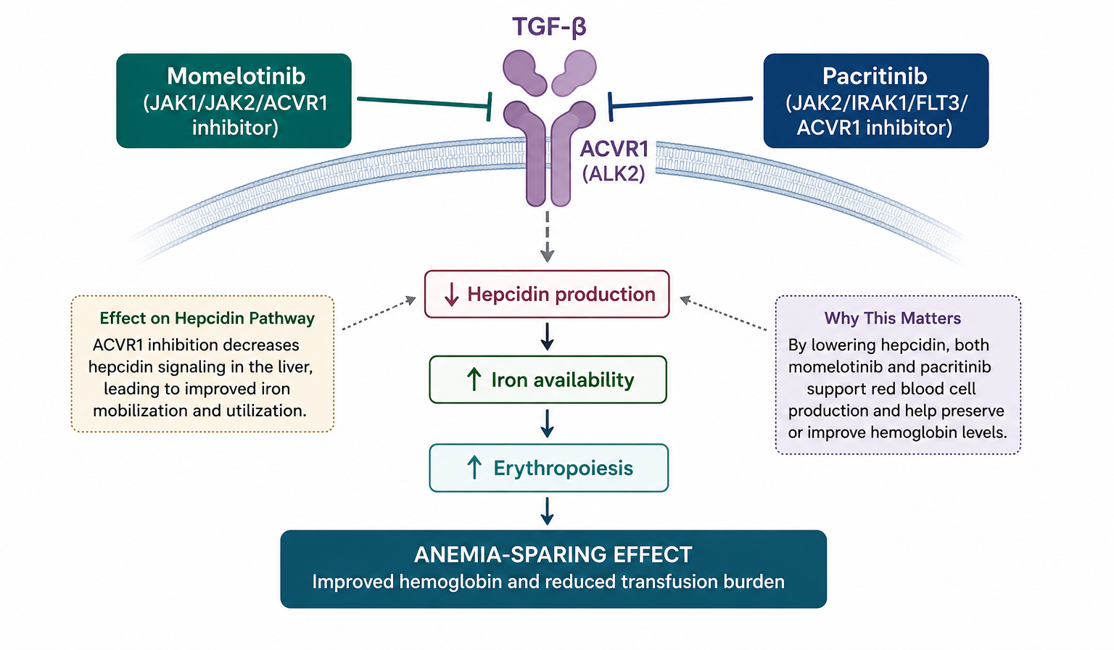
Case 7: Anemia Limiting Effective JAK Inhibitor Dosing
Newer JAK inhibitors may reduce anemia and improve anemia and achieve transfusion independence in some patients while controlling splenomegaly and disease-related symptoms
Momelotinib and pacritinib inhibit ACVR1 and may improve anemia. Pacritinib is particularly relevant when anemia coexists with thrombocytopenia.
Oh ST, et al. Blood Adv. 2020 Sep 22;4(18):4282-4291

Slide 45
Case 8: Transfusional Iron Overload (PICO 10)
The patient from Case 7 remains transfusion-dependent. After sustained transfusions, ferritin has risen to 1,500 ng/mL. He is not a transplant candidate.
Question 8
Should iron chelation be started?
Yes, routinely.
Yes, if ferritin >1,000 ng/mL.
No, individualized decision.
Never.

Slide 46
Recommendation 10
Recommendation | Strength | Evidence Certainty
In patients with overt myelofibrosis and transfusional iron overload, the ASH guideline panel suggests against routine iron chelation therapy. | Conditional | Very low
Remark: Special considerations might apply for patients planned for hematopoietic stem cell transplant.

Slide 47

Case 8: Transfusional Iron Overload
Balance of benefits and harms
Potential benefits
Overall survival*
Leukemic transformation/ leukemia-related mortality*
Hematologic benefits
*very low certainty
Adverse events
Present in up to 50% of patients
Primarily:
Renal
Gastrointestinal
Cardiac
Overall insufficient data to routinely suggest
Elli, EM et al, British Journal of Haematology, April, 2022; Leitch, HA et al, Hematological Oncology, March, 2010; Di Veroli, A et al. Leuk Res; January, 2019; Latagliata, R et al. Eur J Haematol, June, 2016.

Slide 48
Case 9a: Aspirin Use in Secondary Myelofibrosis (PICO 9)
A 66-year-old man with JAK2 V617F-mutated essential thrombocythemia (ET), diagnosed in 2000, has no history of thrombosis. He is Revised IPSET-Thrombosis high risk and has been managed with aspirin 80 mg daily and cytoreduction with hydroxyurea. In 2024, he developed elevated lactate dehydrogenase, splenomegaly, and leukocytosis (30×10⁹/L); bone marrow biopsy confirmed myelofibrotic transformation. He has no bleeding history or major bleeding risk factors.
Question 9a
How would you manage aspirin?
Maintain aspirin, since the patient is JAK2 V617F-mutated, at high thrombotic risk, and tolerating it well.
Discontinue aspirin, as it is no longer required now that the disease has transformed to MF (lower thrombosis risk) and unduly increases bleeding risk.

Slide 49
Case 9b: Aspirin Use in Primary Myelofibrosis (PICO 9)
A 66-year-old man has newly diagnosed primary myelofibrosis (PMF) with CALR type 2 mutation. He has no comorbidities, no history of thrombosis, and is asymptomatic. WBC is 15-20×10⁹/L, with no significant anemia and a normal platelet count. MIPSS70+ version 2.0 score is low risk.
Question 9b
How would you manage aspirin?
Recommend aspirin, given the higher thrombotic risk in PMF compared with the general population.
No aspirin; favor observation through shared decision-making, given CALR mutation, no cardiovascular risk factors or thrombosis history, normal platelet count, and no bleeding risk factors.

Slide 50
Balance of effects: thrombosis
Prefibrotic MF: higher risk of thrombosis than general population and
≥ vascular risk than those with ET and overt MF
Overt MF: thrombosis incidence ~7%–12%*
  Subgroup consideration: highest risk in JAK2 V617F-mutated, age >60 years, cardiovascular risk factors, and lower-risk IPSS*
Post-PV/ET MF: thrombosis incidence MYSEC cohort ~11%**
  Post-PV MF consistently demonstrated as being at higher risk (nearly universally JAK2 V617F-mutated)
*Barbui T et al. Blood Cancer J, 2022/Blood, 2010; Finazzi G et al. Leukemia, 2015; Hernandez-Boluda J-C et al. BJH, 2022; Lussana F et al. Thromb Res, 2009 **Mora B et al. Leukemia, 2022

Slide 51
Balance of effects: bleeding
Baseline risk:
  Prefibrotic MF: higher than or comparable to ET*
  Overt and post-PV/ET MF: potentially increased vs other MPNs**
Impact of ASA:
  Extrapolating from PV and ET (indirect evidence):
    Increased incidence of bleeding in CALR-mutated ET patients (vs no effect in JAK2 V617F-mutated)
    No increased major bleeding in PV
  In MF: potentially increased risk with ASA, but conflicting data***
*Finazzi G et al. Leukemia, 2012; Rumi E et al. Oncotarget, 2017; **Larsson AE et al. Blood, 2024; ***Finazzi G et al. Leukemia, 2012; Larsson AE et al. Blood, 2024; Kander EM et al. Int J Hematol, 2015; Kaifie A et al. J Hematol Oncol, 2016

Slide 52
Recommendation 9
Recommendation | Strength | Evidence Certainty
In patients with JAK2 V617F-positive myelofibrosis, the ASH guideline panel suggests primary prevention with low-dose aspirin over no aspirin*. *in the absence of contraindications *panel members emphasized the very low certainty in the evidence | Conditional | Very Low
In all other MF patients, we suggest a shared decision-making process that incorporates: MF subtype Thrombotic risk factors (age >60, cardiovascular risk factors) Bleeding risk factors (extreme thrombocytosis, acquired von Willebrand disease, thrombocytopenia [platelets <50×10⁹/L], prior bleeding history) | Conditional | Very Low

Slide 53
Summary of Decision-Making Regarding Aspirin use in MF
66 year-old man
JAK2-mutated post-ET MF
No previous thrombosis
Revised IPSET-thrombosis: high risk
Previously on ASA 80 die and hydroxyurea
No risk factors for bleeding
66 year-old man
PMF
CALR-mutated
No CV risk factors, no history of thrombosis
WBC 15-20×10⁹/L, Hb/PLT normal
MIPSS70+v2.0 = low risk
PURSUE ASA
Watch-and-wait > ASA
(shared decision-making)

Slide 54
Case 10: Higher-Risk MF and Transplant Timing (PICO 7)
A 62-year-old man has post-ET myelofibrosis with symptomatic splenomegaly (21.5 cm at baseline). WBC is 5.3×10⁹/L, hemoglobin 7.7 g/dL, and platelet count 87×10⁹/L, with no blasts. Karyotype is normal. NGS shows JAK2 29%, TET2 12%, U2AF1 Q157 23%, IDH2 17%, and SH2B3 48% (variant of uncertain significance, VUS). Risk stratification: DIPSS-Plus Intermediate-2; MIPSS70+ version 2.0, very high risk. He started ruxolitinib and has had a good spleen and symptom response.
Question 10
When should this patient be referred for transplant consultation?
Refer now, while response to JAK inhibitor therapy is maintained.
Wait until JAK inhibitor failure or suboptimal response.
Refer only after disease progression.
Do not refer, because the patient is currently responding.

Slide 55
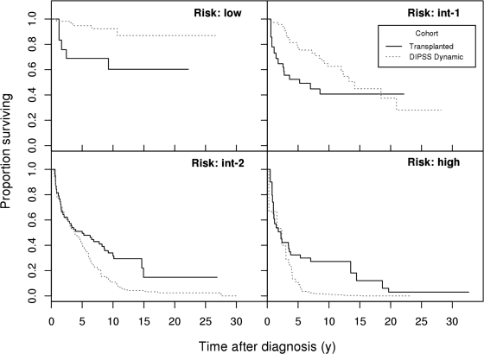
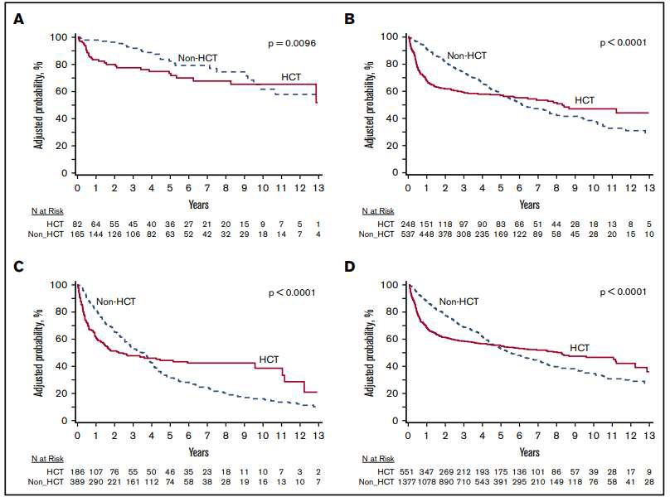
Evidence: Timing of transplant and outcomes
DIPSS low
DIPSS int-1
DIPSS int-2/high
Overall (all DIPSS)
HCT is associated with higher early mortality but may improve longer-term survival in higher-risk MF.
Kröger et al. Blood, 2015
Gowin et al. Blood Advances, 2020

Slide 56
Recommendation 7
Recommendation | Strength | Evidence Certainty
In patients with higher-risk myelofibrosis receiving JAK inhibitor therapy, and responding to therapy, the ASH guideline panel suggests early referral for allogeneic hematopoietic cell transplantation consultation compared to delayed referral after failure of response to JAK inhibitor therapy. | Conditional | Low

Slide 57
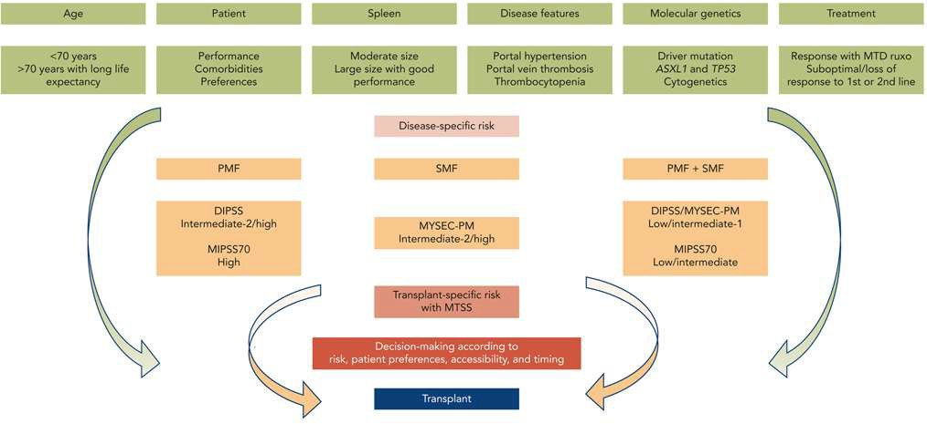
Recommendation 7: Good Practice Statements
Early referral does not mean immediate transplant and does not mean transplant will necessarily occur.
Prioritize early transplant consultation for high-risk molecular or cytogenetic features, even with optimal JAK inhibitor response.
The final decision regarding transplant should be individualized based on risks, benefits, patient preferences, and values.
Kroger N et al. Blood, 2023

Slide 58
Case 11: Asymptomatic Higher-Risk MF (PICO 8)
Question 11
In a JAK inhibitor–naïve patient scheduled for transplantation, should JAK inhibitor therapy be routinely initiated before transplantation?
Yes, in all transplant candidates.
Yes, but only with marked splenomegaly or disease-related symptoms.
No, routine pre-transplant JAK inhibitor therapy is not recommended.
Never use JAK inhibitors before transplant.

Slide 59
Recommendation 8
Recommendation | Strength | Evidence Certainty
In JAK inhibitor–naïve patients planned for transplantation, the ASH guideline panel suggests against the routine use of pre-transplant JAK inhibitors, except for patients with marked splenomegaly or disease-related symptoms. | Conditional | Very Low
Practical takeaways
Do not require pre-transplant JAK inhibitor therapy for every patient.
Consider a JAK inhibitor when marked splenomegaly or disease-related symptoms require treatment.
Do not delay transplant solely to give routine JAK inhibitor therapy.
Evidence is very low certainty, and practice should be individualized.

Slide 60
Future Priorities for Research
Better evidence for extended molecular testing at serial clinical decision points.
Prospective trials in prefibrotic MF and asymptomatic higher-risk MF.
Direct comparisons of JAK inhibitor versus non-JAK anemia-directed therapy.
Better evidence on optimal transplant timing and peri-transplant JAK inhibitor use.
Prospective studies of aspirin and iron chelation in MF.

Slide 61
In Summary: Back to our Objectives
Recognize scenarios in which extended molecular testing and interferon-based approaches should be considered in myelofibrosis (MF).
Select initial treatment strategies for JAK inhibitor–naïve MF across different clinical phenotypes.
Individualize management of disease-related anemia, JAK inhibitor–associated anemia, iron overload, and thrombosis prevention.
Apply transplant referral and pre-transplant treatment recommendations in higher-risk MF.

Slide 62
Acknowledgements
ASH Guideline Panel team members
Knowledge Synthesis team members
Authors of the Myelofibrosis Guidelines Teaching Slide Set
ASH 2025 Annual Meeting Presenters for slide drafting support
Learn more about the ASH myelofibrosis guidelines at hematology.org/myelofibrosis-guidelines

