Slide 1
MEDUSA: Maintaining Entire DNA Duplexes for Utmost Sequencing Accuracy
Speaker: Azeet Narayan, PhD
Broad Institute of MIT and Harvard
Moderator: Linnea M. Baudhuin, PhD, DABMGG, FACMG
Mayo Clinic

Slide 2
Disclosures
A. Narayan
  Stocks/ and or bonds: Transmedics group, TG Therapeutics, Viking Therapeutics, Axsome Therapeutic, Uniqure, CLPT, Ardelyx, Corvus Pharma, Prime Medicine, ARVN, and Tempuss.
L. Baudhuin
  Nothing to disclose
Disclosure of AI use
Generative AI (Anthropic, Claude Sonnet 5) was used in portions of the presentation for image creation and to improve presentation text.

Slide 3
MEDUSA: Maintaining Entire DNA Duplexes for Utmost Sequencing Accuracy
Kan Xiong, Rachel Li, Ning Li, Ruolin Liu, Azeet Narayan, Justin Rhoades, Catherine Song, R. Coleman Lindsley, Heather A. Parsons, G. Mike Makrigiorgos, and Viktor A. Adalsteinsson
July 2026
https://doi.org/10.1093/clinchem/hvag046
© 2026 Association for Diagnostics & Laboratory Medicine

Slide 4
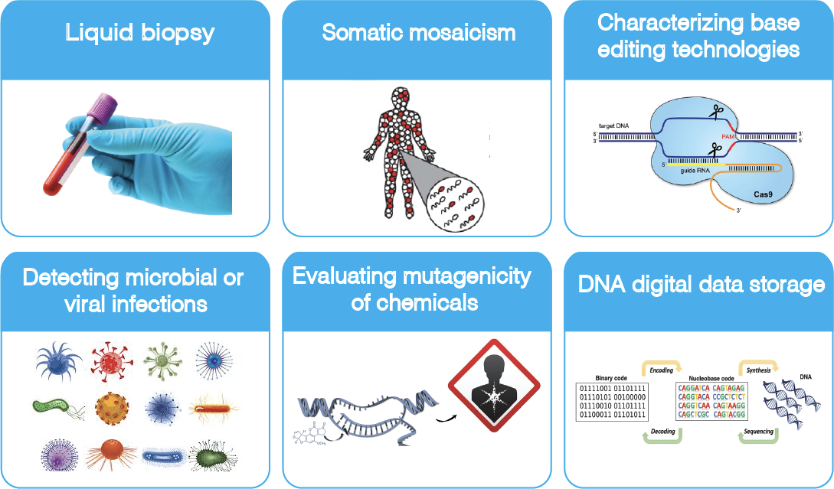
Resolving low-abundance mutations is crucial

Slide 5
The NGS Accuracy Gap
Next-generation sequencing (NGS) costs have declined dramatically over 2 decades.
However, NGS error rates remain high (~1 in 1,000 bases).
At 0.1% background error, detecting low abundance variants is challenging.
0.1%
STANDARD NGS ERROR RATE

Slide 6
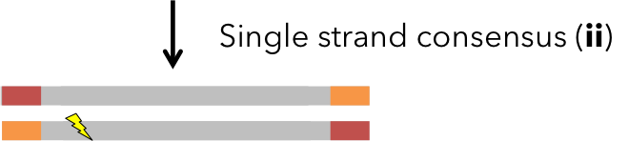

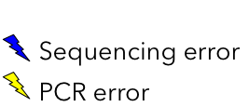
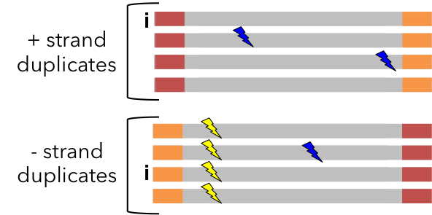
Duplex sequencing is the gold standard for accuracy
original + strand
original - strand
PCR
Random errors
Recurrent errors
UMIs
Adapted from Loeb lab (see Schmitt et al, PNAS, 2012)

Slide 7
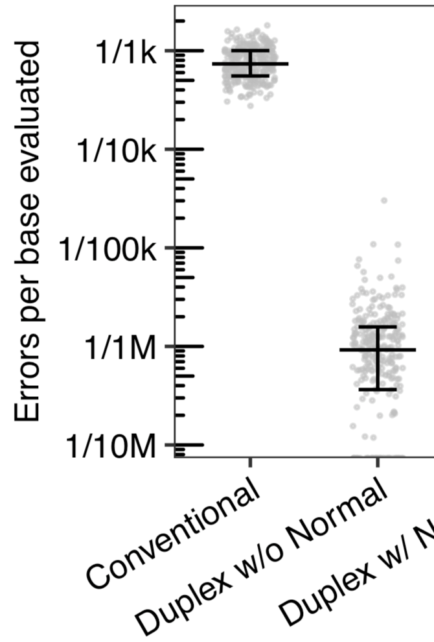
Duplex sequencing can achieve up to 10,000x higher accuracy than conventional NGS
However, error rates in duplex sequencing vary up to 100x based on sample quality
Duplex
Adapted with permission from Parson et al, Clin Cancer Res, 2020.

Slide 8
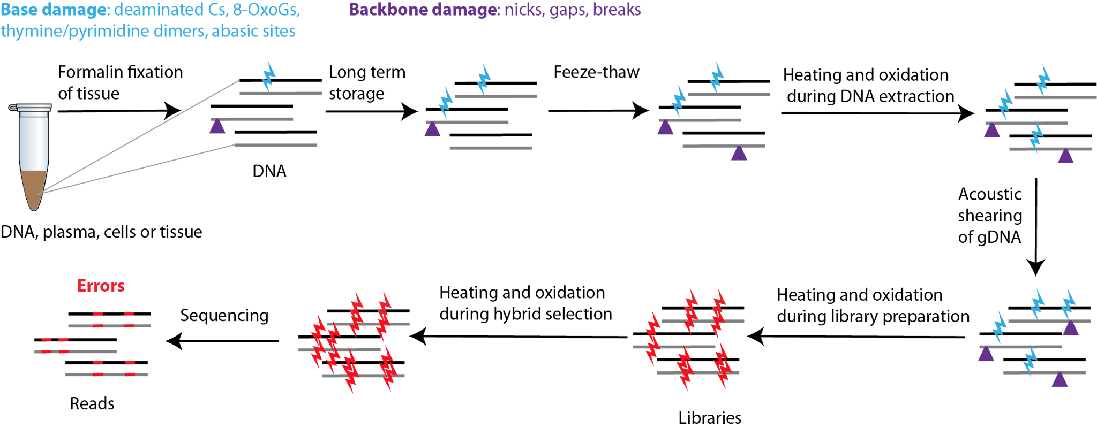
DNA quality deteriorates due to constant damage during sample collection, storage and preparation
Notes:
DNA damage contributes to an error rate of 0.1-1% in conventional NGS.
Though the most recurrent artifacts can be modeled, low abundance noise cannot be modeled or suppressed analytically. Recurrent artifacts (such as orientation bias filter, DNA sequence context dependent errors, errors accumulated near the end of fragment, hypermutable sites)

Slide 9
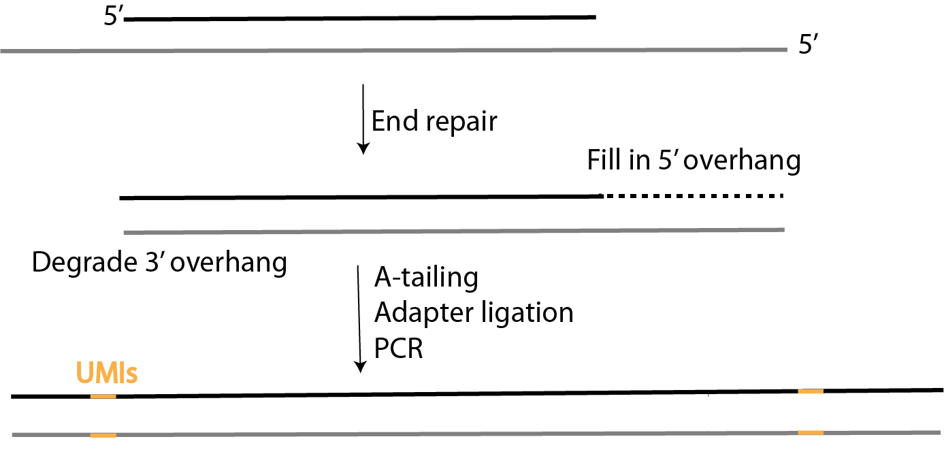
Library construction workflow for duplex sequencing
Notes:
Introduce end repair

Slide 10
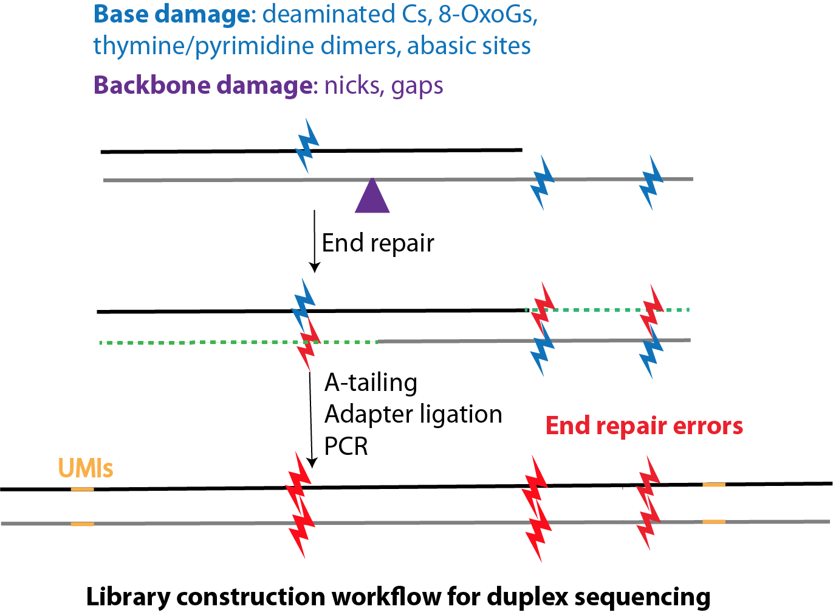
Duplex sequencing is susceptible to errors introduced during end repair and dA-tailing (ER/AT)
5'
5'
5’ overhang fill-in by DNA polymerase I, large (Klenow) fragment and T4 DNA polymerase
nick translation by Taq DNA polymerase and strand displacement by Klenow fragment (3'→5' exo-)
Notes:
Introduce end repair

Slide 11
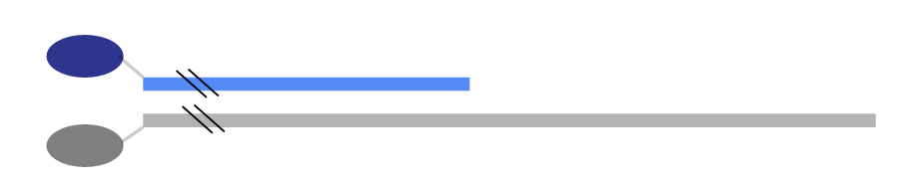
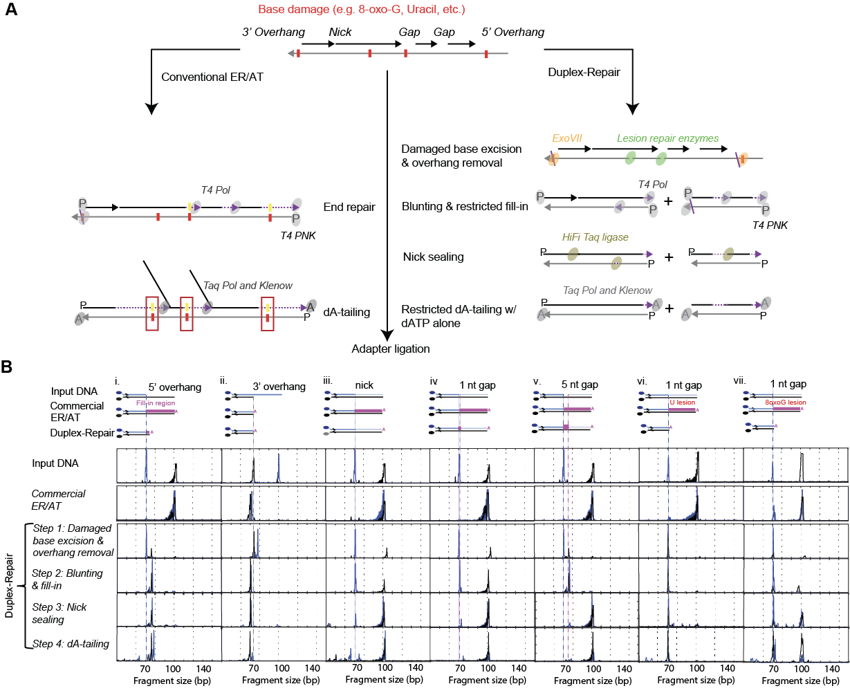
Capillary electrophoresis shows that conventional ER/AT kits can resynthesize large portions of each duplexes
Fluorescently labelled oligonucleotides
70 base pairs
6-FAM
5’
3’
ATTO 550
3’
5’
100 base pairs
Conventional
Conventional
Xiong K, et al. Nucleic Acids Res 2022.

Slide 12
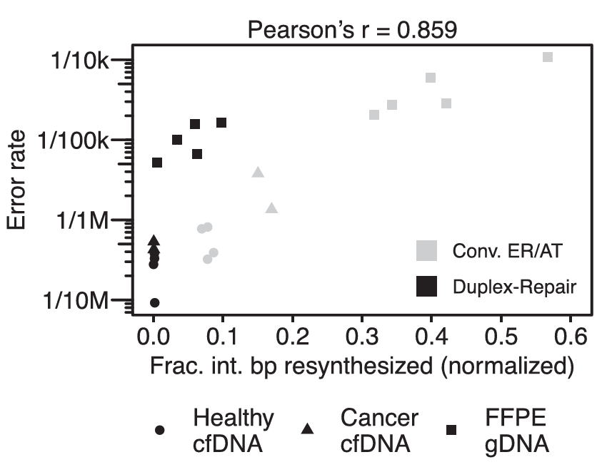
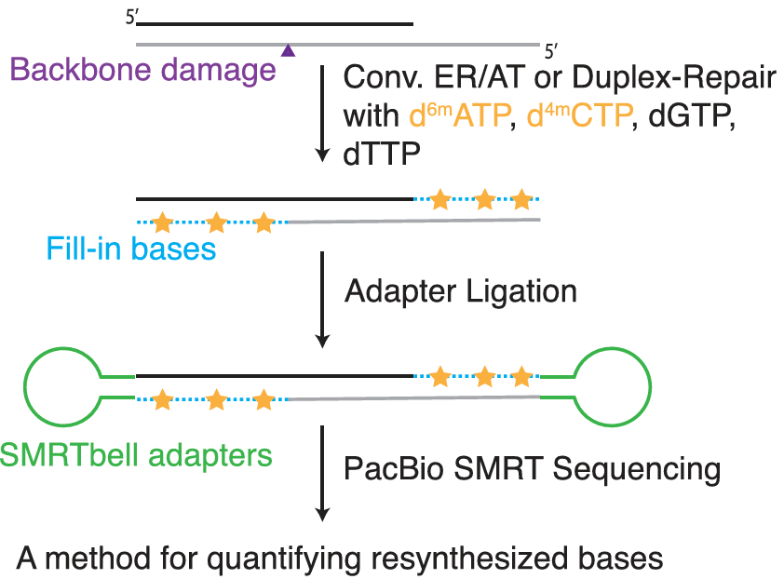
The extent of strand resynthesis is associated with duplex error rate
Reproduced from Xiong K, et al. Nucleic Acids Res 2022. Open Access (CC-BY)

Slide 13
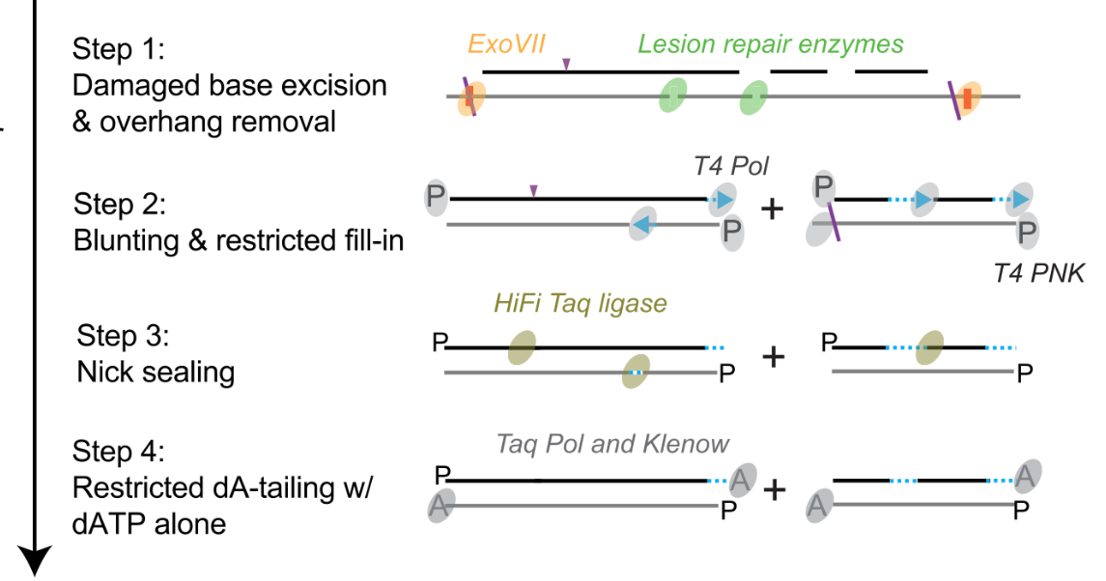
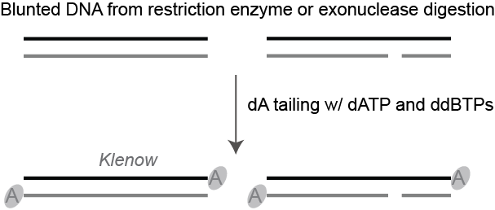
Limitations of current methods that minimize DNA resynthesis
NanoSeq
Duplex-Repair
Uses ddBTP-blocked ER/AT. Achieves extremely high accuracy but only covers ~60% of the genome and performs poorly on fragmented DNA.
Limits resynthesis but doesn't eliminate it. Complex workflow with low duplex recovery due to multiple cleanups.
Reproduced from Xiong K, et al. Nucleic Acids Res 2022. Open Access (CC-BY)

Slide 14
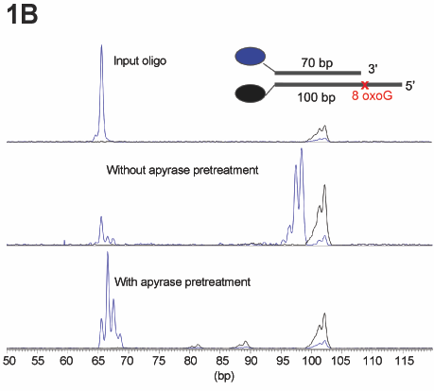
Key Discovery: Trace amount of dBTP carryover could drive DNA resynthesis during dA-tailing
Duplex-Repair
1: Base excision repair
2: Restricted fill in
3: Nick sealing
3X AMPure
After restricted dA-tailing
4: Restricted dA-tailing
1.8X AMPure
Ligation

Slide 15
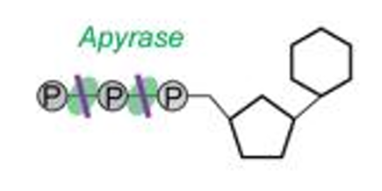
MEDUSA v0 uses Apyrase to degrade dBTP carryover and further suppress DNA resynthesis
MEDUSA v0
1: Base excision repair
2: Restricted fill in
3: Nick sealing
3X AMPure
4: Apyrase tx
5: Restricted dA-tailing
1.8X AMPure
Ligation
Notes:
We made sure that apyrase does NOT affect downstream dA-tailing efficiency (confirmed by fragment analysis) or impair adapter ligation

Slide 16
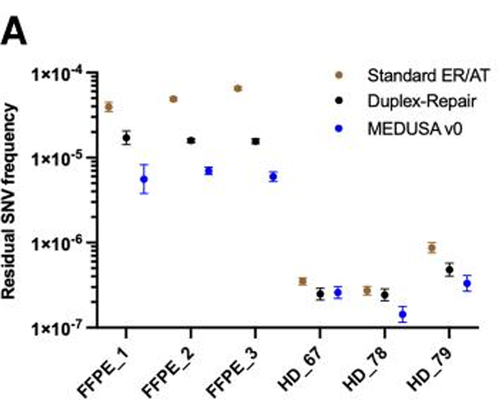
MEDUSA v.0 on FFPE DNA and cfDNA: Hybrid Capture Duplex Sequencing
FFPE Tumor DNA (n=3 samples)
2.61×
7.07×
C>T
Lower SNV freq
vs Duplex-Repair
Lower SNV freq
vs Standard ER/AT
Largest reduction
in this context
cfDNA from Healthy Donors (n=3 samples)
Limited Additional Benefit Over Duplex-Repair
Key Interpretation
Impact of limiting resynthesis scales with degree of DNA damage in the sample
FFPE DNA — heavily damaged by formalin fixation — benefits most from MEDUSA v0
Fresh cfDNA from healthy donors has relatively low baseline damage
Archival/degraded cfDNA would be expected to show greater MEDUSA benefit
Notes:
The FFPE results are striking: MEDUSA v.0 achieved more than 7-fold lower residual SNV frequency compared to standard ER/AT. This makes biological sense — FFPE tissue undergoes extensive chemical modification during fixation, causing C→T deamination artifacts that MEDUSA's BER step addresses.

Slide 17
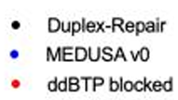
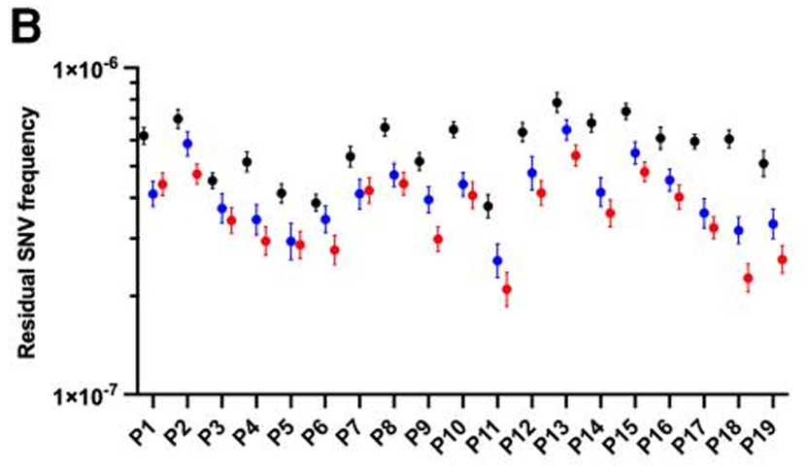
MEDUSA v.0 on Blood Cell-Derived gDNA: Whole Genome Duplex Sequencing
Blood cell–derived gDNA samples (n=19 samples)
1.40×
Lower vs Duplex-Repair
(MEDUSA v.0)
1.53×
Lower vs Duplex-Repair
(ddBTP-blocked)
1.15×
MEDUSA v.0 vs ddBTP
(slightly higher)
CODEC reference: Bae et al, Nat Gen, 2023.
Notes:
With CODEC whole-genome duplex sequencing on 19 samples, MEDUSA v.0 achieved residual SNV frequencies nearly equivalent to ddBTP-blocked ER/AT — while covering the full genome. The key trade-off for ddBTP: limited to ~63.5% of the mappable genome due to restriction enzyme cutting bias.

Slide 18
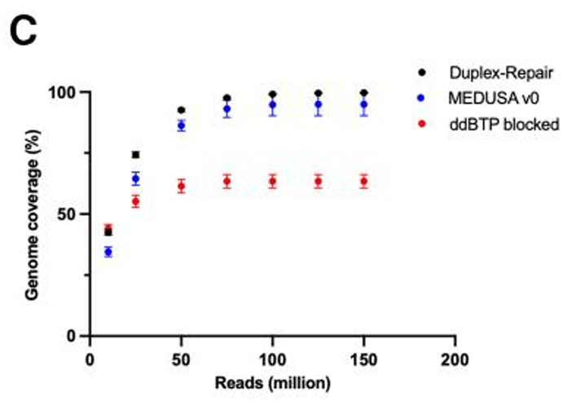
Full Genome Coverage: A Critical Advantage of MEDUSA v0
Coverage Ceiling
~100%
MEDUSA / Duplex-Repair
Full mappable genome
~63.5%
ddBTP-blocked ER/AT
Limited by RE choice
Restriction enzyme-based fragmentation kits for full coverage exist but ddBTP-blocked ER/AT only works with blunt-ended DNA from specific RE combinations
Notes:
This figure from the paper (Fig. 2C) illustrates the genome coverage trade-off. MEDUSA and Duplex-Repair reach ~100% of the mappable genome with sufficient reads, while ddBTP-blocked ER/AT plateaus at 63.5% — a major limitation for studies requiring whole-genome or comprehensive cancer genome profiling.

Slide 19
The workflow of MEDUSA
Step 1
BER + Restricted Fill-in + Nick Sealing
BER enzymes (optional): EndoIV, Fpg, UDG, T4 PDG, EndoVIII excise damaged bases · ExoVII shortens 5’ overhangs · T4 DNA polymerase: blunts 3′ overhangs, fills short 5’ overhangs and small gaps (no strand displacement)
45 min
Step 2
Degrade dNTP Carryover with Apyrase
Apyrase added directly to Step 1 reaction mix · Heat inactivation at 65°C for 20 min — apyrase deactivated
30 min
Step 3
Restricted dA-Tailing
Klenow fragment (3′→5′ exo-) + Taq DNA polymerase + dATP only · Cannot resynthesize (no dNTPs available, only dATP)
30 min
Total hands-on time: ~20 min | Total protocol time: ~2 hours | No intermediate bead cleanup required
Notes:
MEDUSA simplifies the workflow while achieving better accuracy than its predecessor, MEDUSA v.0. The critical change: no bead cleanup between ER and AT steps — instead, apyrase directly degrades dNTPs in solution. This both saves time and improves recovery.

Slide 20
MEDUSA Step 1: Enzyme Functions in the Integrated Buffer
Endonuclease IV
Optional (BER)
Fpg
Optional (BER)
Nicks abasic sites; AP endonuclease activity
Removes 8-oxoguanine and formamidopyrimidines
Target: Depurinated/depyrimidinated sites
Target: Oxidized purines — key for FFPE/cfDNA
UDG
Optional (BER)
T4 PDG / Endo VIII
Optional (BER)
Removes uracil from DNA
Removes oxidized pyrimidines, cyclobutane dimers
Target: Deaminated cytosines (major FFPE artifact)
Target: UV-induced pyrimidine damage
ExoVII
Core step
T4 DNA Polymerase
Core step
Degrades long 5′ single-strand overhangs
Blunts 3′ overhangs; fills short 5′ overhangs & 1-nt gaps
Target: long 5’ overhang
Target: No strand displacement — cannot resynthesize from nicks
T4 PNK
Core step
HiFi Taq Ligase
Core step
Phosphorylates/dephosphorylates 5′ and 3′ ends
Seals nicks in the dsDNA backbone
Target: Prepares termini for ligation
Target: Nicks remaining after fill-in
Notes:
BER enzymes are optional — recommended for damaged samples like FFPE DNA and archival cfDNA, but can be omitted for high-quality fresh DNA. A critical detail: T4 DNA polymerase lacks strand displacement activity, so it cannot resynthesize new strands from nicks — only from genuine gaps or overhangs.

Slide 21
MEDUSA vs MEDUSA v.0: Streamlining Without Compromising Accuracy
Feature
MEDUSA v.0
MEDUSA (Final)
Change
ER Steps
3 separate steps
1 integrated step
Reduced by 2
Bead Cleanup Between ER & AT
3× AMPure XP required
None — apyrase replaces it
Eliminated
Apyrase Treatment
20 min at 30°C
10 min at 30°C
Halved
dA-Tailing Incubation
2×30 min (RT + 65°C)
15+15 min (RT + 65°C)
Halved
Total Protocol Time
>4 hours
~2 hours
2× faster
DNA Recovery (vs v.0)
Reference
Higher
Improved
Residual SNV Frequency vs v.0
Reference
Similar (median 1.05×, P=0.18)
Maintained
Notes:
MEDUSA v.0 was the development version that combined Duplex-Repair's ER steps with the new apyrase treatment. MEDUSA is the streamlined, production-ready version that integrates all steps, eliminates bead cleanups, and cuts total time in half — with no compromise in accuracy or recovery.

Slide 22
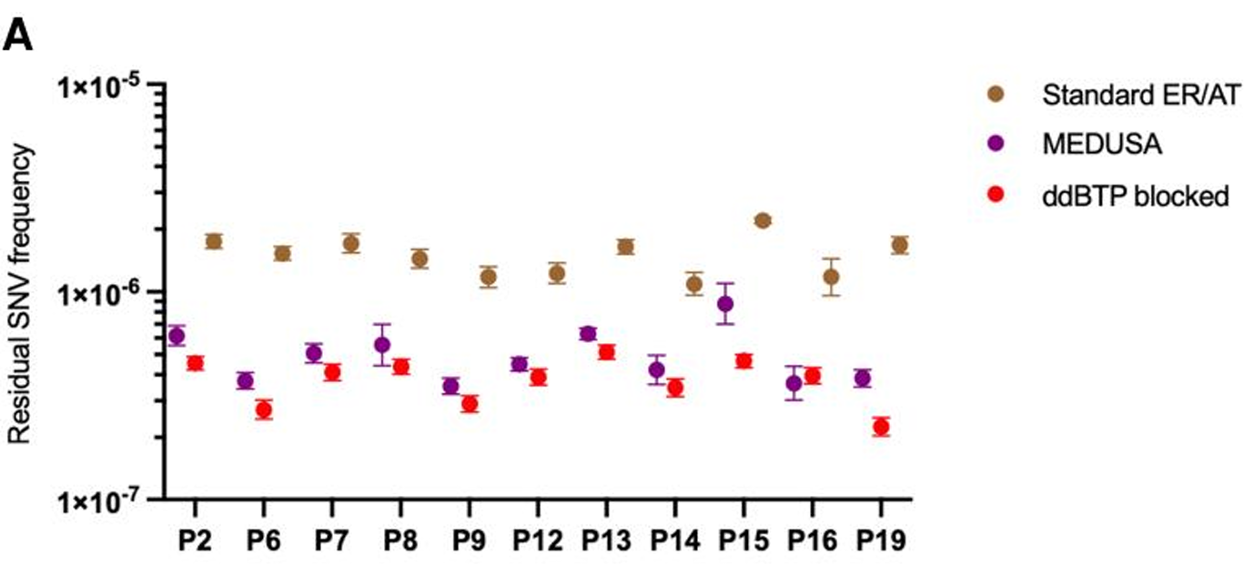
Final MEDUSA Performance: Blood Cell–Derived gDNA (n=11)
MEDUSA Highlights
2.84×
Lower SNV freq
vs Standard ER/AT
1.23×
Higher SNV freq
vs ddBTP (near equivalent)
0.92–1.88
Range across
11 samples
P < 0.001
Statistical significance
(weighted paired t-test)
Context-specific: C>A and C>G showed greatest reduction. MEDUSA had higher background in C>G context (median 3.07× vs ddBTP), likely from 8-oxoG introduced by Covaris shearing + trace resynthesis.
Notes:
These are the primary efficacy results for the streamlined MEDUSA method. A 2.84-fold improvement over standard ER/AT is clinically meaningful — it dramatically reduces false mutation calls. The slight residual difference from ddBTP-blocked ER/AT is an acceptable trade-off for full genome coverage.

Slide 23
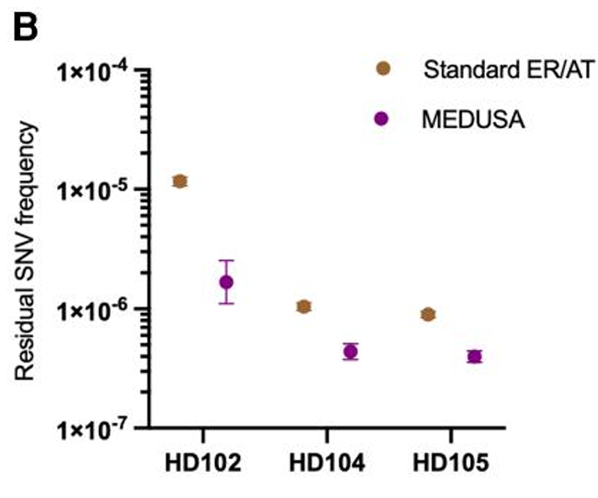
MEDUSA on cfDNA: Hybrid Capture Duplex Sequencing (n=3 HD)
Performance vs Standard ER/AT
2.34×
Median lower residual SNV frequency
Range: 2.24–6.94×
P = 0.003
Statistical significance
3 HD cfDNA samples, 3 replicates each
1.02×
Duplex depth recovered vs Standard ER/AT
P=0.258 Wilcoxon — no significant difference
Notes:
For cfDNA — the primary substrate for liquid biopsy — MEDUSA achieves meaningful error reduction without compromising molecular recovery. This is critical for clinical applications where input material is limiting, such as early cancer screening or monitoring minimal residual disease.

Slide 24
MEDUSA: Enabling a Broad Range of Clinical Applications
🩸
cfDNA ✓
💊
cfDNA ✓
Early Cancer Detection
Minimal Residual Disease
Detect ctDNA at ultra-low allele fractions in asymptomatic individuals; cfDNA compatible; BER reduces background noise from damaged cell-free DNA
Monitor treatment response and emerging resistance at single-molecule resolution; deep targeted sequencing with high sensitivity
🧬
gDNA ✓
🤰
cfDNA ✓
Clonal Hematopoiesis
Prenatal Testing / NIPT
Study CHIP mutations in blood cells; somatic mosaicism in tissue; accurate at very low VAF without age-related damage artifacts
Non-invasive prenatal testing from maternal plasma cfDNA; high accuracy needed for rare fetal variants against large maternal background
🔬
FFPE ✓
🌱
All ✓
FFPE Tumor Profiling
Drug Resistance / Mutagenicity
Retrospective studies on archival tumor tissue; dramatically reduces C>T deamination artifacts; 7× improvement over standard ER/AT
Track emergence of resistance mutations; evaluate mutagenicity of drugs or agents in vivo; characterize CRISPR off-target effects
Generative AI (Anthropic, Claude Sonnet 5) was used for icon image creation, summary text suggestion, and slide design.
Notes:
MEDUSA's compatibility with multiple sample types — cfDNA, FFPE, fresh gDNA — and its integration with CODEC and Methyl-CODEC makes it a versatile platform for clinical genomics. The key advantage for each application is the reduction in false positive variants that could lead to incorrect clinical decisions.

Slide 25
MEDUSA Integration: Compatible Platforms & Methods
CODEC
Validated ✓
Methyl-CODEC
Possible
Concatenating Original Duplex for Error Correction — WGS duplex sequencing with 100× fewer reads. Used in this study for whole-genome benchmarking.
Simultaneous methylation profiling and duplex sequencing. MEDUSA is described as directly integrable for methylome + mutation co-analysis.
Hybrid Capture
Duplex Sequencing
Validated ✓
Covaris
Acoustic Shearing
Validated ✓
Standard targeted panel approach with custom UMI duplex adapters. Validated on breast cancer and healthy donor cfDNA panels.
Mechanical shearing of gDNA. Used in this study; introduces 8-oxoG damage that MEDUSA's BER step addresses.
Restriction Enzyme
Fragmentation
Possible
Illumina NGS
(NovaSeq 6000 / X)
Validated ✓
Alternative to shearing; avoids Covaris-related oxidative damage. Compatible; some RE kits also work with Duplex-Repair.
Primary sequencing platform used in this study. MEDUSA libraries are standard indexed libraries compatible with any Illumina instrument.
Third-Generation
Sequencing (PacBio/ONT)
Possible
Enzymatic
Fragmentation
Possible
In principle compatible with any technology requiring dsDNA adapter ligation. Not experimentally validated in this study.
Alternative to Covaris; reduces oxidative damage at fragmentation step. Compatible with MEDUSA ER/AT.
Generative AI (Anthropic, Claude Sonnet 5) was used for summary text suggestion, and slide design.
Notes:
MEDUSA is designed as a modular front-end library preparation step. It produces standard dsDNA libraries with UMI-tagged adapters that can feed into any downstream workflow — targeted panels, whole-genome, or methylation sequencing.

Slide 26
Limitations, Caveats & Future Directions
Current Limitations
Future Directions
Slightly higher C>G background vs ddBTP-blocked ER/AT — attributed to 8-oxoG from Covaris shearing + trace resynthesis
Requires two tube openings to add reagents (vs one for commercial kits)
Higher recovery variability for cfDNA than standard ER/AT (Supplemental Fig. S18)
Gaps not fully repaired after Step 1 cannot be resealed — may become PCR artifacts (though expected only on one parental strand)
BER enzymes validated in integrated buffer but some minor differences noted (ExoVII leaves slightly longer 5′ overhangs)
Third-generation sequencing compatibility not yet experimentally confirmed
One-pot reaction to eliminate all tube-opening steps and reduce pipetting variability
Premade enzyme and buffer mixtures for more consistent performance
Enzymatic fragmentation to reduce oxidative damage before ER/AT
Further streamlining of incubation times and reagent volumes
Prospective clinical validation in cancer screening and MRD settings
Integration with third-generation long-read sequencing platforms
Multi-site validation across clinical laboratories
Generative AI (Anthropic, Claude Sonnet 5) was used for summary text suggestion and slide design.
Notes:
Transparency about limitations is important. The C>G context residual difference versus ddBTP-blocked ER/AT is the most notable remaining gap. The authors hypothesize this comes from 8-oxoG introduced by Covaris shearing that is then propagated by trace resynthesis. Switching to enzymatic fragmentation may close this gap.

Slide 27
Key Takeaways: What MEDUSA Delivers
01
dBTP carryover through even 3× AMPure bead cleanups is sufficient to drive significant strand resynthesis during dA-tailing — a previously underappreciated source of duplex errors.
Identified a Hidden Problem:
02
Adding apyrase before dA-tailing degrades residual dNTPs and limits resynthesis to ≤2 bp — a simple enzymatic intervention with large impact.
Elegant, Targeted Solution:
03
MEDUSA achieves median 1.23× higher residual SNV frequency vs ddBTP-blocked ER/AT while covering ~100% of the mappable genome (vs 63.5%).
Near-ddBTP Accuracy + Full Genome:
04
Streamlined & Compatible:
~2 hour protocol, no bead cleanup between ER and AT, compatible with cfDNA / FFPE / gDNA / shearing / restriction digest — broadly applicable.
05
High Molecular Recovery:
Duplex yield within median 1.02× of standard ER/AT (P=0.258) — suitable for limited specimens like liquid biopsies and fine needle aspirates.
Generative AI (Anthropic, Claude Sonnet 5) was used for summary text suggestion and slide design.
Notes:
These five takeaways summarize MEDUSA's contribution. The method doesn't require new sequencing instrumentation — it's a better library preparation protocol that plugs into existing workflows and dramatically reduces the false mutation rate.

