Slide 1
Age-Dependent z Scores and eGFR-Adjusted Reference Ranges for Neurofilament Light: A Practical Approach for Clinical Laboratories
O. Evliyaoglu, P. Findeisen, H.-W. Rausch, L. Schirmer,
A. Fischer, M. Neumaier, C. Gerhards
September 2026
https://doi.org/10.1093/clinchem/hvag053
© 2026 Association for Diagnostics & Laboratory Medicine

Slide 2
Introduction
Neurofilament light (NfL), neuronal protein released into blood after neuroaxonal injury
  Marker in MS, Alzheimer disease, ALS; prognosis after cardiac arrest, stroke, TBI
Confounders limit clinical use
  Age: strongest contributor
  eGFR: renal clearance; dominates below 30 mL/min/1.73 m²
  BMI: inconsistent
Fixed cutoffs misclassify elderly patients, so individualized ranges are needed
No reference intervals for Siemens Atellica
Goal: Age-dependent z scores and eGFR impact for plasma NfL on Siemens Atellica

Slide 3
Introduction
Question 1: The reference cohort consists of healthy individuals from occupational health screenings, and older participants with an eGFR below 60 mL/min/1.73 m² were deliberately retained as representing normal ageing.
Is a physiologically reduced eGFR part of a healthy reference population, or already a state that should be excluded?

Slide 4
Materials and Methods
Study population:
  153 healthy subjects (occupational health screening), age 20 to 89 years
  133 EDTA plasma (Mannheim); 20 serum (Limbach) for independent validation only
Biomarker measurements:
  NfL: Siemens Atellica (plasma), Lumipulse G (serum)
  eGFR: CKD-EPI (BIS1 as sensitivity analysis, age 70 and older)

Slide 5
Materials and Methods
Statistics:
  z scores per 10-year age stratum; multivariate linear regression
Derivation of the index:
  AI tools (ChatGPT, Claude, DeepSeek-V2) proposed 125 candidate formulae for hypothesis generation only; all re-tested by regression
  Selected: Age- and eGFR-Adjusted NfL Index (AGI) = Age² / eGFR^{0.5} (the Mannheim Index).

Slide 6
Materials and Methods
Question 2: The AGI was picked as the best of 125 AI-generated candidate formulae in a cohort of 133 individuals, and the five best candidates performed almost identically (r = 0.86 to 0.88).
  Overfitting Risk: Does testing 125 AI formulas on a small group of 133 people risk selecting a "lucky" model that will fail on new patients?
  Standard vs. AI Models: Given that age and eGFR are already correlated, should the AI formula have been compared against a traditional statistical model?

Slide 7
Age-stratified NfL concentrations
Age category, years | n | Mean pg/mL | Median pg/mL | SD | 95th pct pg/mL | 97.5th pct pg/mL
20–29 | 21 | 7.19 | 7.3 | 1.06 | 8.70 | 8.75
30–39 | 23 | 8.36 | 8.5 | 1.62 | 10.39 | 10.99
40–49 | 25 | 9.85 | 10.3 | 2.59 | 13.38 | 13.78
50–59 | 24 | 10.69 | 10.6 | 2.38 | 14.98 | 15.27
60–69 | 20 | 14.39 | 14.1 | 4.59 | 22.35 | 22.77
70–100 | 20 | 24.97 | 24.15 | 6.28 | 33.80 | 35.65
Table 1. Descriptive statistics of the study groups for NfL values, measured in EDTA plasma on the Siemens Atellica platform (n = 133). All concentrations in pg/mL. Percentiles are given for the 95th and 97.5th centile of each 10-year age stratum.

Slide 8
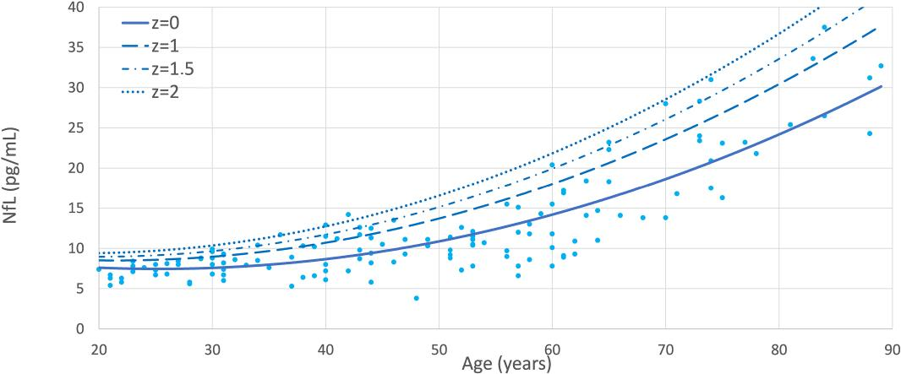
Age-dependent z scores
Figure 1. Age-dependent z scores for plasma NfL concentrations in healthy individuals (n = 133), showing a significant polynomial increase with age that becomes pronounced after age 50 years. Limits are shown for each age stratum at z = 0 (age-adjusted mean), z = 1.0, z = 1.5, and z = 2.0 (upper limit of normal, 97.5th percentile).

Slide 9
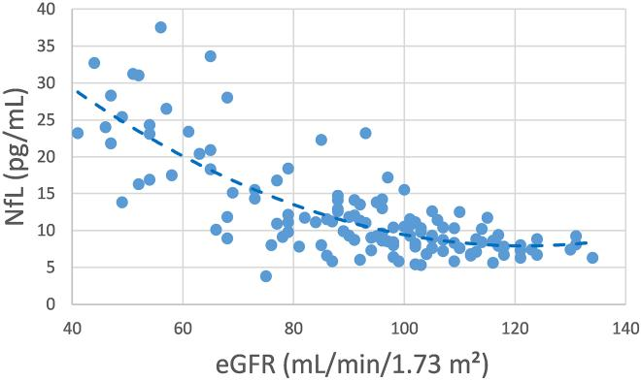
Renal function as a key confounder
Figure 2. Relationship between plasma NfL concentrations and eGFR, a negative exponential correlation (r = -0.78, P < 0.001) that remained consistent across all age groups and significant after adjustment for age. Abbreviations: eGFR, estimated glomerular filtration rate.

Slide 10
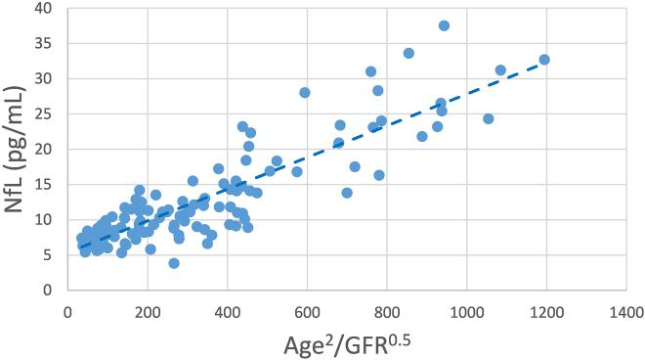
The AGI linearizes the relationship
Figure 3. Linear correlation between the novel AGI and plasma NfL concentrations (r = 0.87, P < 0.001). The line represents the laboratory-specific regression NfL (pg/mL) = 0.02 x AGI + 5.4. Abbreviations: AGI, Age- and eGFR-Adjusted NfL Index.

Slide 11
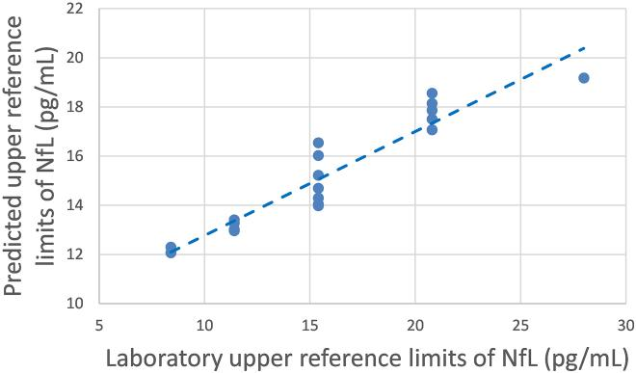
External validation on a second platform
Figure 4. Concordance between the upper reference limits derived from the AGI regression model and the laboratory-specific reference ranges obtained with the Lumipulse G assay in an independent serum cohort (n = 20, r = 0.96).

Slide 12
Practical implementation of the AGI
Three steps at the bench:
Measure NfL and creatinine-based eGFR
Calculate AGI = Age² / eGFR^{0.5}
Calculate the AGI-predicted personalized upper limit
  Formula derived from 20 healthy individuals by linear regression.
  Plasma (Atellica): NfL = 0.02 x AGI + 5.4,
    SE of the estimate 3.3 pg/mL; upper limit = predicted NfL + 1.96 x SE
  Serum (Lumipulse): NfL = 0.018 x AGI + 5.6,
    SE of the estimate 2.9 pg/mL ; upper limit = predicted NfL + 1.96 x SE
Compare the measured NfL with the personalized upper limit.

Slide 13
Worked example of the AGI
Patient Profile
  Age: 65 years, serum NfL: 11 pg/ml, plasma NfL: 9 pg/ml, eGFR: 65 mL/min/1.73 m²
Calculate the Mannheim Index (AGI)
  65² / 65^{0.5} =524
AGI-predicted personalized upper limit
  Plasma (Atellica): NfL = 0.02 x 524+ 5.4 = 22.4 pg/ml
  Serum (Lumipulse): NfL = 0.018 x 524+ 5.6 = 20.7 pg/ml
Comparing the results.
  Measured NfL levels are below the AGI-predicted upper limits and within the expected range.

Slide 14
Main results and discussion
Age: NfL rise about 2.6% per year (r = 0.83), steeper after 50.
eGFR: NfL rise as eGFR fall (r = -0.78), independent of age.
AGI is linear with NfL (r = 0.87); matched age-stratified z scores (r = 0.96).
Platform Consistency: Same model hold (r = 0.96); only slope and intercept need recalibration.
Method Agreement: Plasma and serum show strong agreement, and switching kidney equations has minimal impact.
Manufacturer cutoff: 12.6 vs 13.9 pg/mL, no significant difference

Slide 15
Limitations
Stated by the authors:
  Small sample (133 plasma, 20 serum).
  Single geographic region: limited diversity.
  Cross-sectional: no intraindividual change over time
Further considerations for discussion:
  Only 2 participants in G3b, none below eGFR 30 mL/min/1.73 m²
  Parametric limits, not the non-parametric CLSI EP28-A3c approach
  No neurological patients: diagnostic accuracy not assessed

Slide 16
Main results and discussion
Question 3: The AGI yields a personalized upper reference limit, but agreement with simple age-stratified z scores was already excellent (r = 0.96) and no diseased patients were studied.
What clinical endpoint would you want to see before replacing a fixed cutoff with an individualized limit in routine reporting?
Would you apply the formula in patients with an eGFR below 30 mL/min/1.73 m², a range this cohort does not cover?

