Slide 1
Cannabinoid Concentrations Detected in Fatal Road Traffic Collision Victims Compared with a Population of Other Post Mortem Cases
R. Andrews, K.G. Murphy, L. Nahar, and
S. Paterson
October 2015
www.clinchem.org/content/61/10/1256.full
© Copyright 2015 by the American Association for Clinical Chemistry

Slide 2
Introduction
Cannabis use
  Most prevalent drug used worldwide
  Increase in use since legalization in 4 US states and approval of medical cannabis in 23 US states
Cannabis and driving
  Impairs driving skills, reduces reaction times, road-tracking performance, performance in divided attention tasks and hand-eye co-ordination
  Acute cannabis consumption doubles risk of motor vehicle collision resulting in injury or death
  Most prevalent drug detected in fatal road traffic accidents after alcohol

Slide 3
Introduction
Cannabinoids in post mortem blood
  Lack of data on prevalence of cannabis in fatal road traffic collisions
  Lack of data on concentrations of
    Psychoactive component ∆⁹-tetrahydrocannabinol (THC)
    Metabolites 11-hydroxy-THC (11-OH-THC) and 11-nor-THC-9-carboxylic acid (THC-COOH)
    Other cannabinoids - cannabidiol (CBD) and cannabinol (CBN)
  Lack of good control data
Difficulty with interpretation
  Frequent users may have detectable concentrations for several days after consumption
  Post mortem redistribution must be considered
    Highly lipophillic compounds such as THC may be sequestered in body fats and then released into the blood after death

Slide 4
Introduction
Objectives
  Compare between fatal road traffic collision (RTC) victims and other routine non-RTC coroners’ cases (in post mortem blood)
    Prevalence of cannabinoid detection
    Concentrations of cannabinoids
  Compare within the fatal RTC victims
    Prevalence of cannabinoid detection with that of other drugs and alcohol

Slide 5
Question
  Why is interpretation of cannabinoid concentrations difficult in post mortem blood and what data could help to aid this?

Slide 6
Materials and Methods
Study design
  Analysis for alcohol in blood/urine/vitreous humor
  General screen for licit/illicit/unknown drugs in blood
  Specific screen for morphine in blood
  Screen/quantification for THC, 11-OH-THC, THC-COOH, CBD and CBN in blood
    Limit of detection 0.5 µg/L
    Limit of quantification 0.5 µg/L for THC, 11-OH-THC and CBN and 1 µg/L for CBD and THC-COOH
  Quantification of drugs as required in blood
  Specific screen for illicit drugs in urine

Slide 7
Materials and Methods
Study population
  Coroners’ cases submitted for routine toxicology
  Jurisdictions in London and South East of England
  Between February 2011 and March 2013
  100 consecutive fatal RTC cases
  114 consecutive non-RTC cases
Data analysis
  Demographics and classification of cases
  Incidence of cannabinoids assessed – Chi squared test
  Distribution of the cannabinoid concentrations assessed – Mann Whitney U test
  Positive cases divided into categories of THC concentration ranges

Slide 8
Materials and Methods
Categorization of THC concentrations for interpretation
  Based on evidence in literature regarding concentrations associated with crash risk and driver culpability and impairment
    Category 1 – THC not detected
    Category 2 – THC < 3.5 µg/L
    Category 3 – THC 3.5 – 5 µg/L
    Category 4 – THC > 5 µg/L

Slide 9
Question
What limits the range of samples that can be analyzed and the type of analysis that can be conducted in routine coroners work?

Slide 10
Results
Non-RTC cases (n = 114)
  29 were positive for any cannabinoid (25%)
  Median age - 39 yrs (range 18 – 60)
  26% of males tested were positive
  28% of females tested were positive
  Included found dead - drug/alcohol related deaths (15) followed by hanging (6) and found dead - unknown cause (3) as next most common
RTC cases (n = 100)
  21 were positive for any cannabinoid (21%)
  Median age – 24 yrs (range 16 – 57)
  22% of males tested were positive
  17% of females tested were positive
  Included motorcyclists (9), pedestrians (4), car drivers(4), car passengers (3) and pedal cyclist (1)

Slide 11
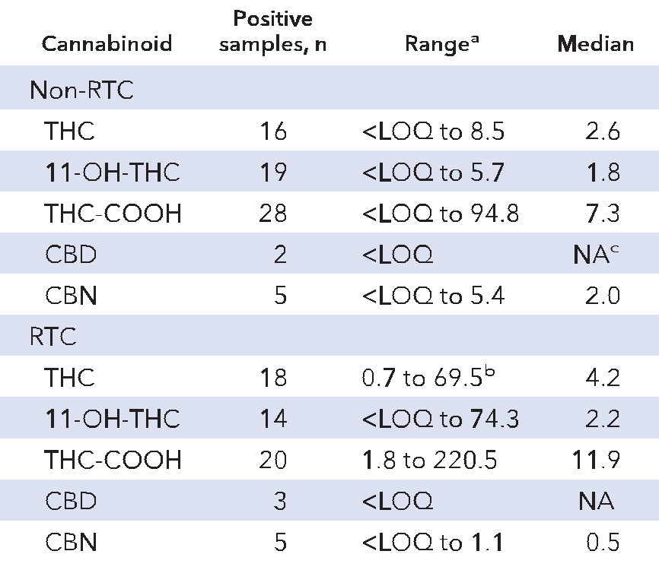
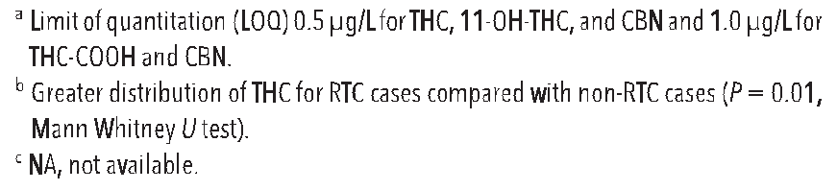
Results
The incidence of cannabinoids detected
in non-RTC and RTC cases was similar
(25% vs 21%)
THC was detected more frequently in
cannabinoid positive RTC cases than
cannabinoid positive non-RTC cases
(90% vs 59%, P = 0.01)
There was no significant difference in the
incidence of 11-OH-THC and THC-COOH
between non-RTC and RTC cases
CBD and CBN were only detected in a
small number of cases
Table 1. Cannabinoid concentrations (µg/L) detected in post mortem blood from non-RTC cases and RTC cases

Slide 12
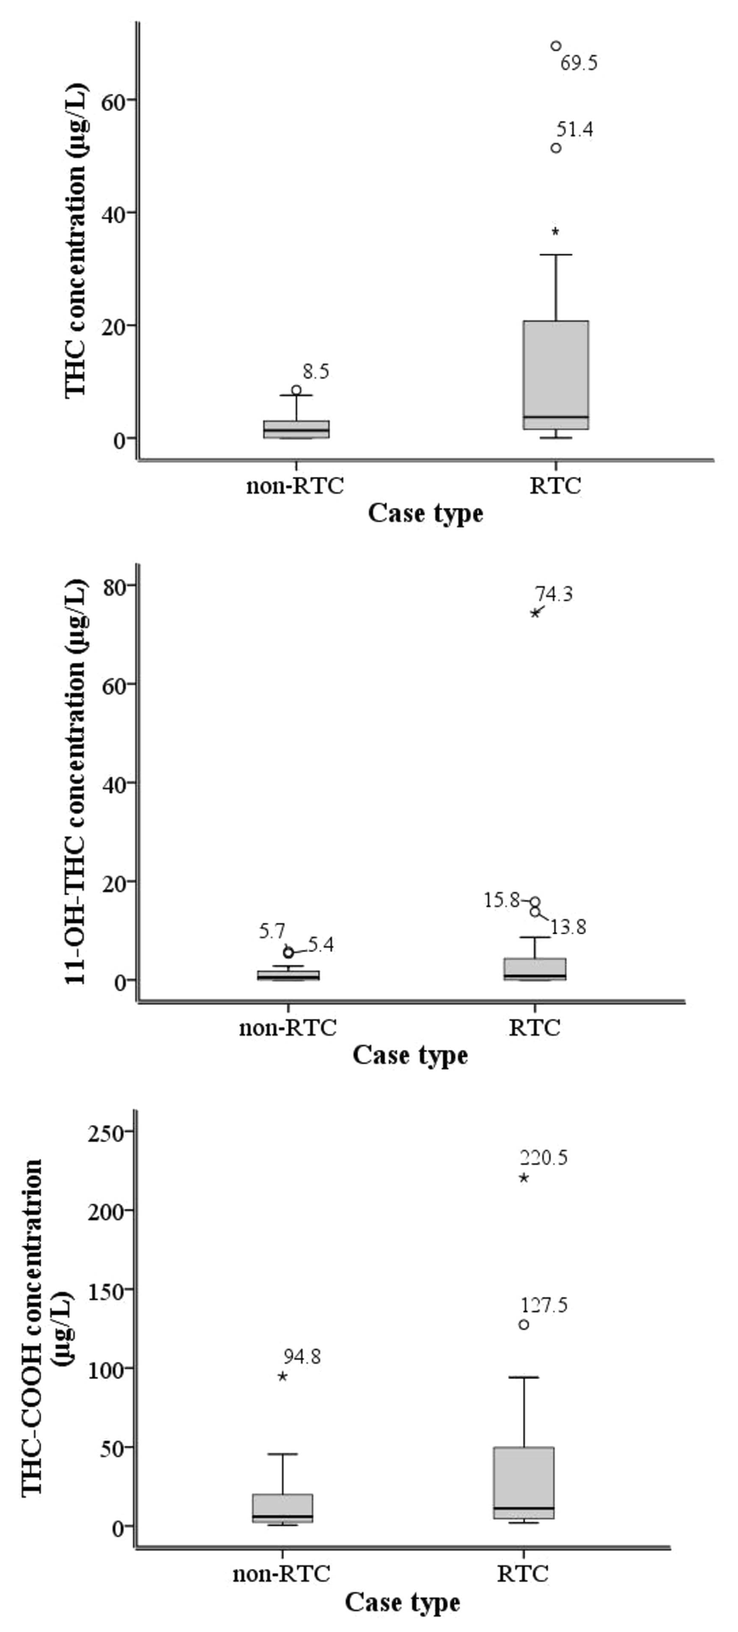
Results
Concentrations of THC in cannabinoid positive
RTC cases significanlty higher than in
cannabinoid positive non-RTC cases (P = 0.01)
When only RTC drivers (excluding passengers
pedestrians) compared to non-RTC cases, no
longer statistically significant but similar trend
observed
No significant difference in the distribution of
concentrations of 11-OH-THC and THC-COOH
between the positive RTC cases and the positive
non-RTC cases (P = 0.34 and 0.12)
CBD and CBN were not compared due to a low
incidence of cases positive for these compounds
Figure 1. Boxplot diagrams displaying the median and interquartile range of THC, 11-OH-THC, and THC-COOH concentrations detected in the cannabinoid-positive victims of fatal RTCs and non-RTC cases.

Slide 13
Results
Categorization of THC concentrations
  Significant difference in distribution across 4 categories for non-RTC and RTC cases
  Non-RTC cases grouped mostly in categories 1 and 2 (< 3.5 µg/L)
  RTC cases grouped mostly in categories 2 and 4 (0 - 3.5 µg/L and > 3.5 µg/L)
Other drugs and alcohol in the RTC group
  Cannabis most common drug detected (21 cases)
  Next most common were drugs associated with emergency treatment (7 cases) then cocaine (5 cases)
  No other drugs detected in conjunction with cannabis
  More cases positive for cannabis than alcohol > 80 mg/dL (17 cases)

Slide 14
Question
Why might the low number of cases with CBD and CBN detected in them be important and how might this impact on any future studies undertaken?

Slide 15
Conclusions
This study informs the debate on cannabis-impaired driving by
  Providing data on THC, 11-OH-THC, THC-COOH, CBD and CBN concentrations in post mortem blood
  Detecting higher THC concentrations in fatal RTC victims compared to routine post mortem cases even though there was a similar incidence of cannabinoids in both groups
  Only detecting CBD and CBN in a small number of cases – previously suggested as potential markers for recent ingestion
  Detecting more RTC cases positive for cannabinoids than alcohol > 80 mg/dL

