Slide 1
Recalibration of Blood Analytes over 25 Years in the Atherosclerosis Risk in Communities Study: Impact of Recalibration on Chronic Kidney Disease Prevalence and Incidence
C.M. Parrinello, M.E. Grams, D. Couper,
C.M. Ballantyne, R.C. Hoogeveen, J.H. Eckfeldt,
E. Selvin, and J. Coresh
July 2015
www.clinchem.org/content/61/7/938.full
© Copyright 2015 by the American Association for Clinical Chemistry

Slide 2
Introduction
Background
  Equivalence of laboratory measurements over time is important for studies of trends
  Small systematic differences may shift the entire distribution of a biomarker at the population level
Objectives
  Assess the equivalence of different biomarker measurements across 5 Atherosclerosis Risk in Communities (ARIC) visits
  Determine recalibration corrections for those analytes lacking equivalence
  Assess trends in each analyte before and after recalibration

Slide 3
Question
What are some potential implications of not conducting assay recalibration in a prospective cohort study with multiple measurements over time?

Slide 4
Materials & Methods
Study population
  Subsample of 200 ARIC participants who had plasma available at all 5 visits (full cohort N=15,792) for 8 analytes that were also reassayed (Figure 1)
  Stratified random sampling selection based on age, sex, and race
Statistical analysis - Recalibration
  Removed outliers extraneous to the recalibration process
  Deming regression of original vs reassayed measurement
  Recalibration equations derived for analytes with differences >10%
Statistical analysis – Impact of recalibration
  Regressed mean analyte value pre- and post-recalibration on age at each visit
  Compared prevalence and incidence of chronic kidney disease (CKD) (using creatinine-based estimated glomerular filtration rate [eGFR]) pre- and post-recalibration (and to previous statistical calibration)

Slide 5
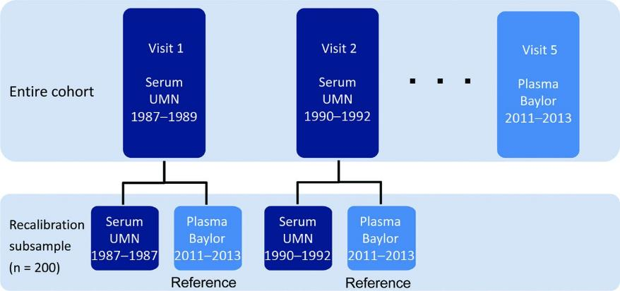
Figure 1. Study design for original measurements in the entire ARIC cohort and reassay of analytes in the recalibration subsample.

Slide 6
Question
What is the purpose of removing outliers prior to recalibration?

Slide 7
Results
Most analytes were well-calibrated
  Reassayed measurement values were highly correlated with original values
  Bias <10% for all analytes except creatinine and uric acid (Table 2)
Developed recalibration equations for creatinine and uric acid and compared pre- and post-calibration results
  Trends in eGFR and uric acid were better aligned after applying equations to the entire cohort (Figure 2)
  Post-recalibration prevalence and incidence estimates of CKD determined by eGFR were more accurate (Figure 3)

Slide 8
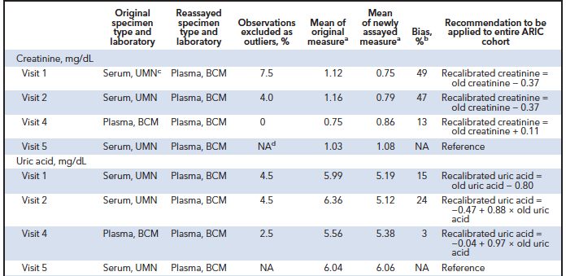
Table 2 (Partial). Recalibration recommendations to maximize reproducibility across visits 1-5.

Slide 9
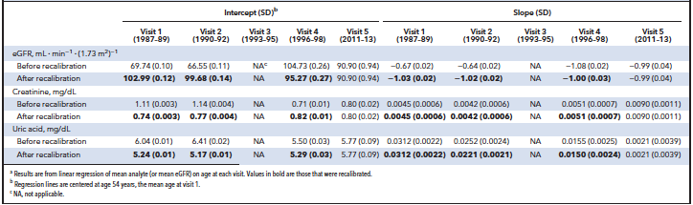
Table 3. Comparisons of intercepts and slopes of regression lines of mean analytes vs ageª

Slide 10
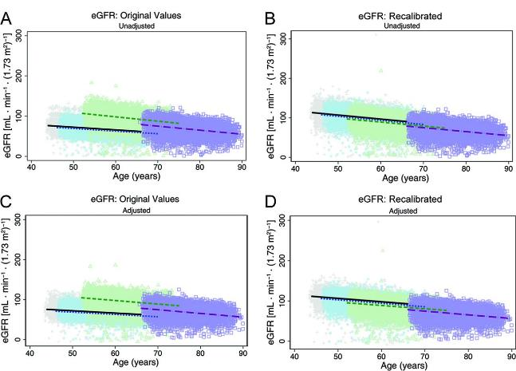
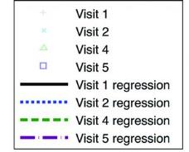
Figure 2 (Panels A-D). Regression of eGFR versus age across 5 ARIC visits before and after applying the laboratory recalibration

Slide 11
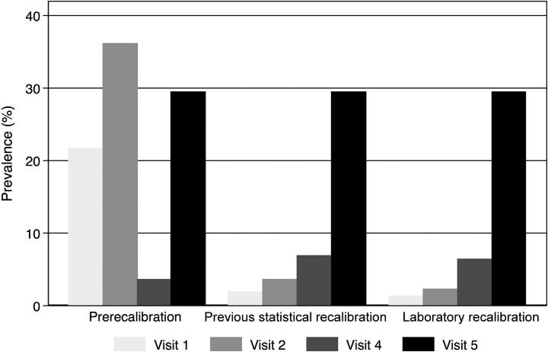
Figure 3. Comparison of prevalence estimates of CKD before and after recalibration of creatinine.

Slide 12
Question
What other approaches could be used to assess the impact of applying a recalibration equation to full cohort data?

