Slide 1
Influence of Glycosylation on Diagnostic and Prognostic Accuracy of N-Terminal Pro–B-type Natriuretic Peptide in Acute Dyspnea: Data from the Akershus Cardiac Examination 2 Study
H. Røsjø, M.B. Dahl, M. Jørgensen, R. Røysland,
J. Brynildsen, A. Cataliotti, G. Christensen,
A.D. Høiseth, T.-A. Hagve, and T. Omland
August 2015
www.clinchem.org/content/61/8/1087.full
© Copyright 2015 by the American Association for Clinical Chemistry

Slide 2
Introduction
N-terminal pro-B-type natriuretic peptide (NT-proBNP) measurement is currently used in clinical practice
  To diagnose or rule out heart failure
  To provide prognostic information in cardiovascular disease
  To monitor the effect of therapy (on-going studies)
NT-proBNP is glycosylated
  The sugar moieties attached to NT-proBNP cover cleavage sites, which limit the binding of proteases to the molecule and thus the processing of proBNP₁₋₁₀₈
  The sugar moieties in the N-terminal fragment of proBNP₁₋₁₀₈ influence antibody binding of the commercially available assay for detection of circulating NT-proBNP (Elecsys proBNP II assay, Roche Diagnostics, Basel, Switzerland)

Slide 3
Introduction – Key Question
Could NT-proBNP glycosylation impact on NT-proBNP measurements?
To diagnose acute heart failure (HF) in patients presenting with acute dyspnea?
To risk stratify patients presenting with dyspnea?

Slide 4

Materials and Methods
NT-proBNP concentrations (Elecsys proBNP II assay) measured in 309 patients with acute dyspnea (ACE 2 Study)
Standard EDTA plasma tubes
EDTA tubes pre-treated for 24 h with deglycosylation enzymes
Each patient, two tubes of blood
EDTA tubes spiked
with deglycosylation
enzymes for 24 h
Standard EDTA tubes
(+ control tubes spiked with phosphate buffer alone for 24 h)
Total NT-proBNP
Non-glycosylated NT-proBNP

Slide 5
Materials and Methods
The diagnosis for the index hospitalization was adjudicated by two independent physicians:
Heart failure OR
non-heart failure
Collected information on all-cause mortality during follow-up (median 816 days)

Slide 6
Materials and Methods - Key Question
Is 24 h incubation with deglycosylation enzymes sufficient to remove the sugar moieties from NT-proBNP?¹
  ¹See accompanying editorial on this article:
  A.S. Jaffe, F.S. Apple, A. Mebazaa, and N. Vodovar. Unraveling N-Terminal Pro–B-Type Natriuretic Peptide: Another Piece to a Very Complex Puzzle in Heart Failure Patients. Clinical Chemistry 2015; v. 61, p.1016-1018. http://www.clinchem.org/content/61/8/1016.full

Slide 7
Results- diagnosis
NT-proBNP concentrations were markedly increased after pre-treatment with deglycosylation enzymes, but correlated with NT-proBNP concentrations measured in standard EDTA tubes
The AUC to separate HF patients vs. patients with non-HF related dyspnea was 0.871 (95% CI 0.829-0.907) for deglycosylated NT-proBNP vs. AUC=0.852 (0.807-0.890) for NT-proBNP measurements in standard EDTA plasma

Slide 8
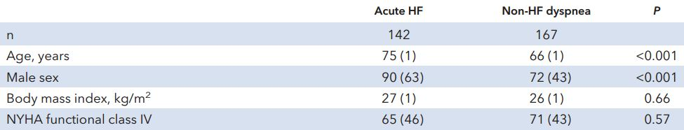
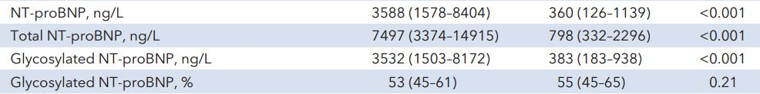
Patients characteristics
Table 1. Descriptive statistics on admission for patients hospitalized with dyspnea (selected key variables)

Slide 9
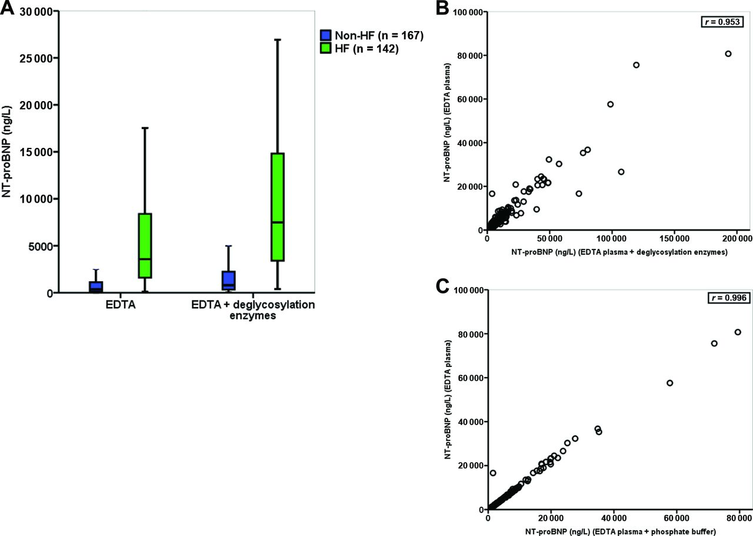
NT-proBNP concentrations in EDTA plasma samples with and without deglycosylation enzymes
Figure 2. (A) NT-proBNP concentrations in EDTA plasma samples with and without deglycosylation enzymes. The horizontal line within the box represents the median concentration, the boundaries of the box quartiles 1-3, and the whiskers range (maximum value restricted to 1.5 x interquartile range from the median). (B) Scatter plot of NT-proBNP concentrations in EDTA plasma samples with and without deglycosylation enzymes. (C) Scatter plot of NT-proBNP concentrations in normal EDTA plasma samples and EDTA plasma samples spiked with phosphate buffer.

Slide 10
Results - prognosis
NT-proBNP concentrations measured in standard EDTA tubes and EDTA tubes pre-treated with deglycosylation enzymes were both associated with all-cause mortality
NT-proBNP concentrations measured in EDTA tubes pre-treated with deglycosylation enzymes, but not NT-proBNP measurements in standard EDTA tubes, provided added value to the basic risk model of our dataset as assessed by the net reclassification index: 0.24 (95% CI 0.003-0.384)

Slide 11
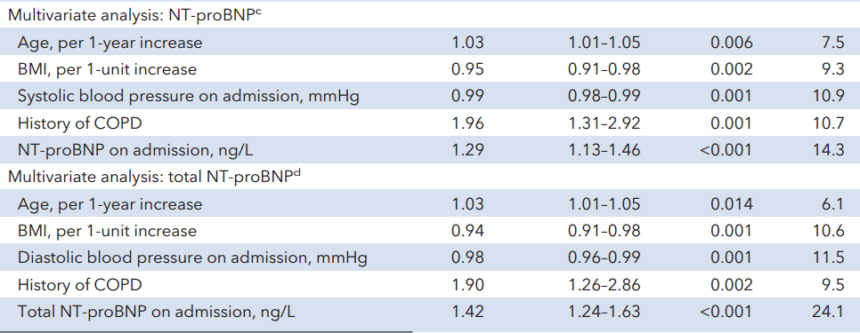
NT-proBNP concentrations and prognosis
NT-proBNP and total-NT-proBNP were transformed by the natural logarithm prior to regression analysis
Table 3. Predictors for mortality during follow-up in patients with acute dyspnea (n=309) by multivariate Cox proportional hazard regression analysis. ^{c}Variables retained in the final model with ln(NT-proBNP )(−2 log likelihood = 1120). ^{d}Variables retained in the final model with ln(total NT-proBNP) (−2 log likelihood = 1114).

Slide 12
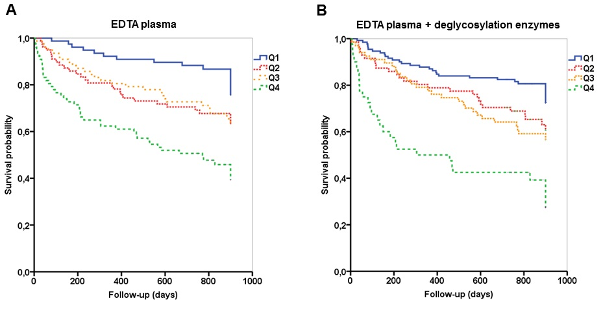
NT-proBNP concentrations in EDTA plasma samples with and without deglycosylation enzymes and prognosis
Figure 3. Patients stratified according to quartiles of (A) NT-proBNP and (B) _{Total}NT-proBNP concentrations measured on admission for acute dyspnea (P<0.001 for both by the log-rank test).

Slide 13
Results- Key questions
Will the results be similar in heart failure patients with preserved and reduced ejection fraction?¹
There seems to be differences in NT-proBNP glycosylation between patients with acute and chronic disease; how would this influence the results?¹
[Ref also the Editorial: the effect by BMI was adjusted for in the multivariate models]¹
  ¹See accompanying editorial on this article:
  A.S. Jaffe, F.S. Apple, A. Mebazaa, and N. Vodovar. Unraveling N-Terminal Pro–B-Type Natriuretic Peptide: Another Piece to a Very Complex Puzzle in Heart Failure Patients. Clinical Chemistry 2015; v. 61, p.1016-1018. http://www.clinchem.org/content/61/8/1016.full

Slide 14
Conclusions
NT-proBNP concentrations were markedly increased after pre-treatment with deglycosylation enzymes
The AUC was higher to diagnose heart failure for NT-proBNP concentrations measured in EDTA tubes pre-treated with deglycosylation enzymes vs. NT-proBNP measurements in standard EDTA tubes
NT-proBNP concentrations measured in EDTA tubes pre-treated with deglycosylation enzymes, but not NT-proBNP measurements in standard EDTA tubes, provided added value to the basic risk model of our dataset

