Slide 1
Mass Spectrometry–Based Escherichia coli H Antigen/Flagella Typing: Validation and Comparison with Traditional Serotyping
K. Cheng, Y.-M. She, H. Chui, L. Domish, A. Sloan, D. Hernandez, S. McCorrister, J. Ma, B. Xu, A. Reimer, J.D. Knox, and G. Wang
June 2016
www.clinchem.org/content/62/6/839.full
© Copyright 2016 by the American Association for Clinical Chemistry

Slide 2
Introduction
Escherichia coli (E. coli)
  Common bacteria
  Most are non-pathogenic
  Pathogenic strains can be deadly to humans
How are pathogenic E. coli typically detected?
  E. coli is isolated from food/liquid or biological matrices (e.g. stool)
  Cultures are identified (i.e. “typed”) by characterizing biomarkers such as O antigens (lipopolysaccharides) and H antigens (flagella)
  Pathogenicity can be determined by detecting E. coli toxins through PCR or ELISA
  Serotyping is the current gold standard for categorizing E. coli

Slide 3
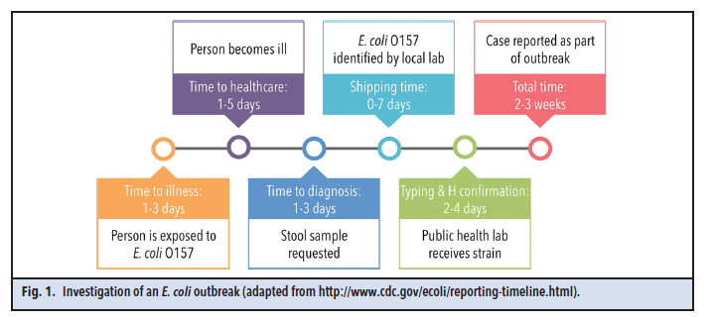
Workflow of traditional E. coli identification and typing
Figure 1 (Editorial). Investigation of an E. coli outbreak (adapted from http://www.cdc.gov/ecoli/reporting-timeline.html).
Lowe C and DeMarco ML. Ready, Set, Type! Proteomics vs Agglutination for Escherichia coli H Antigen Confirmation. Clinical Chemistry 2016; 62: 793.

Slide 4
Question
What are the common problems in serotyping of E. coli?

Slide 5
Common problems of E. coli serotyping
Too many serotypes
  182 O types (O1 to O188; O31, O47, O67, O72, O94, and O122 have been withdrawn)
  53 H types (H1 to H56; H13, H22, and H50 have been withdrawn)
  Some serotypes are very similar (e.g. H11 and H21)
  It is challenging to produce specific antisera against so many serotypes
Too laborious and time-consuming
  Serotyping procedures are mainly performed by hands
  Many agglutination cycles must be performed to gradually narrow down the serotype: from multivalent antisera pools to monovalent antisera
  Motility induction must be performed to induce flagella growth and optimize H antigen/antisera reactions

Slide 6
Question
Which problem should be targeted first in E. coli typing?

Slide 7
Why focus on H antigen for MS in the paper?
H typing: most time-consuming and difficult part of E. coli serotyping
  Motility induction can be time-consuming as some isolates are non-motile
  H typing is more difficult to achieve than O typing due to the nature of the antigens, and because “H type undetermined” isolates often appear
  Rough strains cannot be H typed even though flagella exist due to auto-agglutination
The unique structure of flagella and composition make it an ideal candidate for isolation and characterization
  Flagella are thin and long protein polymers
  Flagella can be easily sheared from cell bodies by repeated vortexing
  Flagella can be easily collected from the supernatant through centrifugation
  Flagella can be easily depolymerized and trypsinized

Slide 8
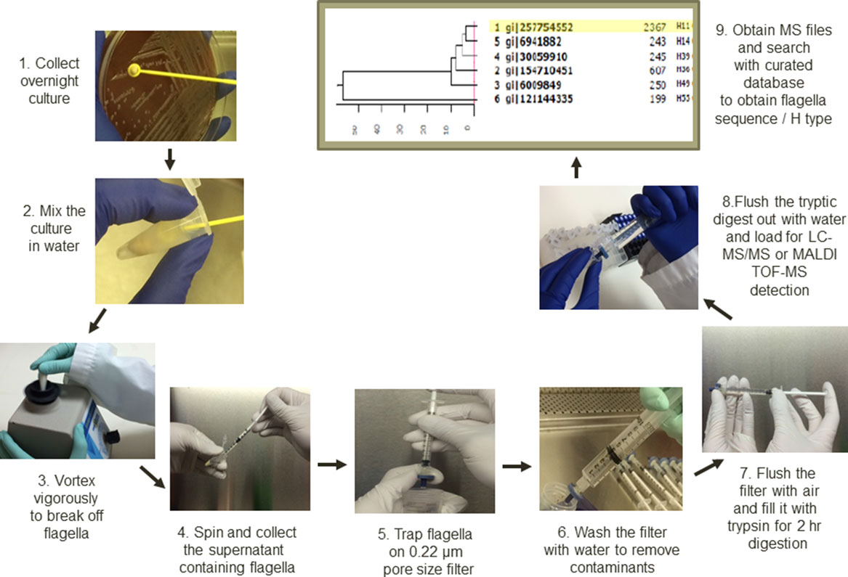
Methods: MS-H typing workflow
Figrue reproduced with permission from: Cheng K et al. Recent development of mass spectrometry and proteomics applications in identification and typing of bacteria. Proteomics Clin. Appl. 2016, 10, 346–357, Copyright Wiley-VCH Verlag GmbH & Co. KGaA.

Slide 9
Method: Validation of MS-H typing and comparison with other platforms
The matrix effect, analytical sensitivity and specificity, repeatability, carryover, and correlation between biomass and H typing data output [sequence coverage (%) and Exponentially Modified Protein Abundance Index (emPAI)] of reference strains were examined
Followed CLSI guideline C62-A
Serotyping used as a reference method
Whole genome sequencing (WGS) used to resolve discordant results between serotyping and MS-H typing
MALDI-TOF peptide mass fingerprinting compared with LC-MS/MS on 85 isolates
The same result from two of the three platforms (serotyping, MS-H and WGS) was considered accurate

Slide 10
Question
What’s the major challenge in LC-MS/MS runs in comparison with MALDI-TOF tests?

Slide 11
Methods: MS-H typing rules
emPAI data was used:
  A sample run was followed by a jigsaw column wash to clean the nano-LC column and then a normal gradient blank wash to equilibrate the column for the next sample
  A minimum emPAI value of 1 was necessary for the sample to be designated an H type
  The top Mascot search hit should have an emPAI value at least twice that of the previous adjacent blank run when the emPAI value of the previous blank run >1 due to carryover
  Repeated jigsaw cleanups and LC-MS/MS analyses of samples were performed after blank runs showing emPAI values >1
  If the adjacent previous blank run had no significant flagella identified (less than two specific peptides) and the emPAI value of the subsequent sample run was 0.10-0.99 due to low flagella production from “sluggish” isolates, repeat testing should be performed with a higher sample amount to obtain an emPAI value ≥1.

Slide 12
Results
 | Serotyping | LC-MS/MS-based MS-H
Number of isolates | 302 | 302
Motility induction | Routine | No
Accurately identified | 253 | 289
Inaccurately identified | 49 | 13
Accuracy, (%) | 253/302 (83.8%) | 289/302 (95.7%)
Table 5. Comparison of serotyping and MS-H on 302 clinical isolates.

Slide 13
Results
Parameter | H Antigen Serotyping | MS-H Typing | WGS-based H Typing
Diagnostic sensitivity | 83.8% | 95.7% | 82.0%
Diagnostic specificity | 100.0% | 100.0% | N/A
Analytical sensitivity | Loop culture (high milligram range, ~100 mg) | Sub-single colony (microgram range, ~16.97 µg) | Multiple colonies (low milligram range, ~1 mg)
Analytical specificity | Antibody specific | Amino acid sequence specific | Nucleic acid sequence specific
Phenotypic identification | 83.8% identifiable | 95.7% identifiable | Not applicable with this platform
Read-out | Subjective agglutination titer observation; from “-” to “++++” | emPAI values (0 to 126.6) or sequence coverage (%, 0.0 to 91.0%); one step | 100.0% coverage and zero divergence; one step
Motility induction | Routinely required, 2 to 14 days | Not required; 0 days | Not required; 0 days
Rapidity to get result | 7 days | 4 hr for a single sample | 7 days
Rough strains | Impossible; 0.0% identification | Possible; 100.0% identification | Not phenotypic: not applicable
Repeatability | 100.0% | 100.0% | Not repeated in this study
Reproducibility | Not performed in this study | 95.7% | Not formally tested in this study due to high cost
Throughput | Manually, 20 isolates per day with multiple reactions per isolate | Mainly automatic, 42 isolates per week with single detection per isolate | Mainly automatic, 24 isolates per week with single detection per isolate
Sample Preparation | Multiple steps | Single step | Multiple steps
Consumables and labor used | $12 per strain; multiple days of labor | $9 per strain; half hour of labor | $50 per strain; half day of labor
System suitability | Reference labs with antisera or antibody production | Institutions or service labs with MS capability | Institutions or service labs with WGS capability
Table 6. Performance Comparison.

Slide 14
Conclusions
MS-H typing is faster and more accurate than traditional H antigen serotyping
MS-H typing should be very useful during E. coli outbreaks
MS-H typing can be extended to other bacteria
“…it is apparent that clinical microbiology laboratories may soon experience a second wave of MS technology (LC-MS/MS), after the revolutionary first wave of MALDI-TOF-MS” (quoted from C. Lowe and M. L. DeMarco. Editorial: Ready, Set, Type! Proteomics vs Agglutination for Escherichia coli H Antigen Conﬁrmation. Clinical Chemistry 2016; 62: 793)

