Slide 1

Is It Time to Remove Total Calcium from the Basic and Comprehensive Metabolic Panels? Assessing the Effects of American Medical Association–Approved Chemical Test Panels on Laboratory Utilization
B.M. Katzman, S.C. Bryant, B.S. Karon
November 2020
https://doi.org/10.1093/clinchem/hvaa203
© Copyright 2020 by the American Association for Clinical Chemistry

Slide 2
Introduction
Utilization of clinical laboratory testing services has rapidly increased in recent years
  Generated more than $87 billion in revenue in 2017
  Accounted for ~3% of annual healthcare spending in the United States
Organ- or disease-oriented test panels approved by the American Medical Association (AMA) were published in 1998
  Aimed to control costs and facilitate review of utilization and the medical necessity of laboratory testing
Basic metabolic panel (BMP) and comprehensive metabolic panel (CMP) are two of the most commonly ordered AMA panels
  Necessity of individual tests within these panels has not been well-established.

Slide 3
Unique Opportunity to Evaluate Test Utility
In 2018, Mayo Clinic implemented an enterprise-wide electronic health record (EHR)
  Decision to offer 10 most commonly ordered AMA panels with EHR/ordering system at all Mayo Clinic sites
Prior to EHR convergence, no AMA chemistry panels were offered
  Providers were asked to order specific tests individually needed to assess electrolytes, glucose, renal function, and hepatic function based on patient disease, symptoms, etc.
For hospital inpatients, the most common grouping of orders included all components of the BMP, with the exception of total calcium
  Opportunity to evaluate test-ordering patterns before and after implementation of the new EHR

Slide 4
Discussion Question:
What are the drivers of utilization management efforts?

Slide 5
Materials and Methods
Retrospective review of total calcium-containing test orders for Mayo Clinic Rochester patients (for adults ≥18 years) obtained from the Laboratory Information System for the months of April 2018 and June 2018, pre- and post-implementation of AMA panels
Test volumes were categorized:
  According to the panel in which calcium was included
  By patient location (inpatient, outpatient, or emergency department [ED]) at the time of order
Percentages of abnormal results (high or low) before and after the implementation of AMA panels were compared

Slide 6
Materials and Methods (cont.)
Institutional databases were queried for:
  Unique patients during the 5 months before EHR implementation (December 2017–April 2018) and 5 months after EHR implementation (June 2018–October 2018)
  Corresponding International Classification of Diseases, Ninth and Tenth Revision (ICD-9/10) codes
    Patients were classified as having any diagnoses related to hyper- or hypocalcemia or parathyroid disorders
Differences in percentage of unique patients with calcium-related diagnoses during the 2 time periods (a prevalence estimate) were assessed using a Poisson model

Slide 7
Discussion Question:
What are some of the limitations associated with this study design?

Slide 8
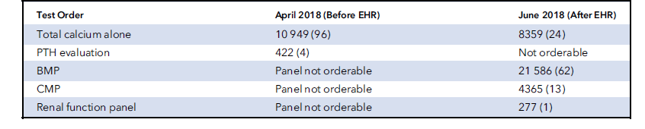
Volume of Total Calcium Orders By Order Type
Total Number of Calcium Tests 11 371 34 587
Table 1. Volume (percentage) of total calcium tests by order type before (April 2018) and after (June 2018) EHR implementation

Slide 9
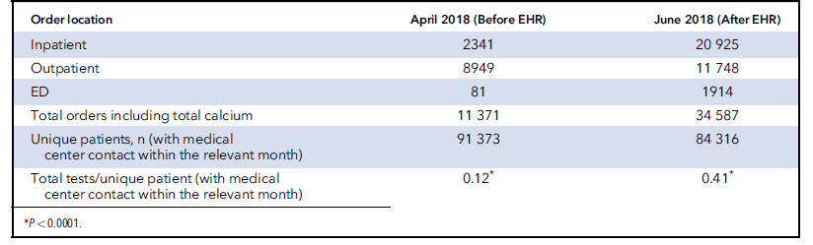
Volume of Total Calcium Orders By Ordering Location
Table 2. Volume of total calcium tests by ordering location before (April 2018) and after (June 2018) EHR implementation

Slide 10
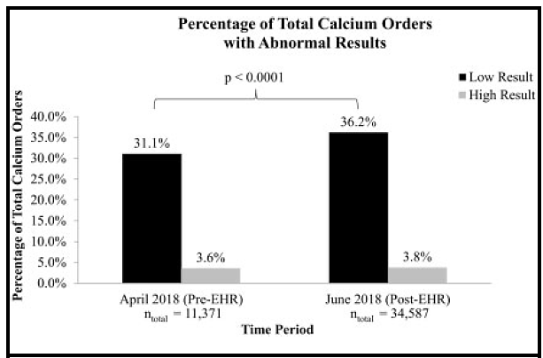
Percentage of Total Calcium Orders with Abnormal Results
Figure 1. Percentage of total calcium orders with abnormal
results before and after implementation of BMP and CMP
panels in the EHR

Slide 11
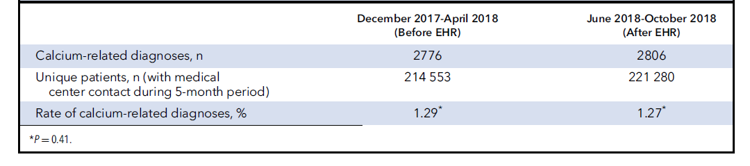
Calcium-Related Diagnoses
Table 3. Rate of calcium-related diagnoses before and after EHR implementation

Slide 12
Discussion Question:
What strategies can be employed by institutions to address misutilization, overutlization, and underutilization of laboratory tests?

Slide 13
Discussion
Volume of total calcium orders increased by 3-fold post-implementation of panel testing
Rate of low calcium values increased post-implementation because of the shift toward more inpatient testing; however, percentage of abnormal results within each patient population (inpatient, outpatient, ED) decreased
Prevalence of hypo- and hypercalcemia-related diagnoses among patients in the 5 months after implementation did not change significantly (1.29% before implementation vs. 1.27% after implementation)
Direct variable cost to the laboratory to perform the incremental calcium testing was estimated at ~$480,000 per year
Other disease-oriented group tests warrant critical evaluation to determine whether they, too, include tests that may have limited diagnostic utility

