Slide 1
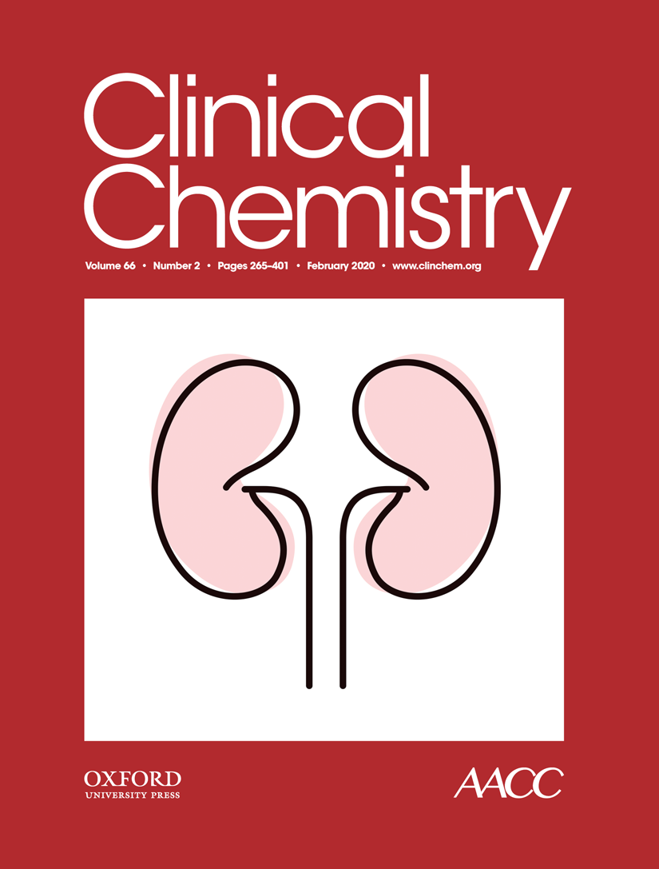
The Silence Speaks, but We Do Not Listen: Synonymous c.1824C>T Gene Variant in the Last Exon of the Prothrombin Gene as a New Prothrombotic Risk Factor
I. Pruner, M. Farm, B. Tomic, M. Gvozdenov, M. Kovac, P. Miljic, N. Mahmoud Hourani Soutari, A. Antovic, D. Radojkovic, J. Antovic, and V. Djordjevic
February 2020
https://doi.org/10.1093/clinchem/hvz015
© Copyright 2020 by the American Association for Clinical Chemistry

Slide 2
Background and goals
Introduction
  Thrombophilia is a multifactorial disease with complex clinical phenotype commonly presented as venous thromboembolism (VTE).
  Strong genetic background assumed (50-60%), but the majority of cases remains without obvious genetic cause.
  GWAS studies in VTE patients did not reveal many new risk factors.
  Prothrombin gene possesses unique non canonical structure of the 3’end that makes it susceptible to formation of new single nucleotide polymorphisms (SNPs).
  Previous study revealed silent (synonymous) SNP in the last exon of the prothrombin gene (FII c.1824C>T) as a potential risk factor for recurrent pregnancy loss.
Goals
  Determine the frequency of FII c.1824C>T sSNP in patients with VTE and cerebrovascular insult (CVI).
  Perform functional analyses in vitro, in silico and ex vivo.

Slide 3
Question 1.
  What is the current status of synonymous single nucleotide polymorphisms in regards to genome-wide association studies?

Slide 4
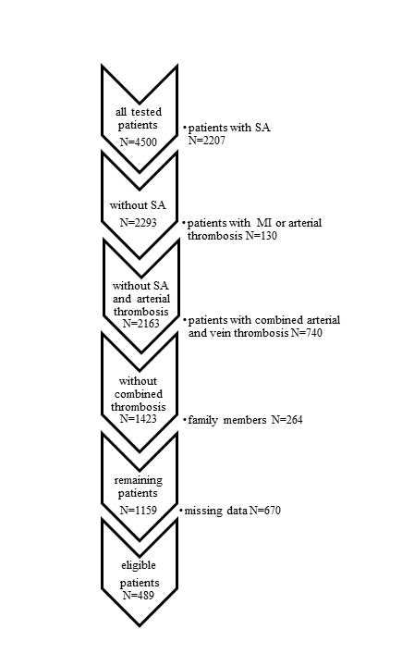
Methods I
Frequency determination
  VTE, CVI and control group
  Patient selection
  FV Leiden, FII G20210A and FII c.1824C>T genotyping
Supplemental Figure 1. Patient selection algorithm. SA-spontaneous abortion, MI-myocardial infarction. Missing data: no information regarding diagnosis process of DVT, PE and CVI.

Slide 5
Methods II
In vitro study
  Determination of prothrombin mRNA levels
    Stable transfection of Cos-7 cells
    Total RNA isolation
    qPCR
In silico study
  Prediction of RNA secondary structure
    RNAfold
    Mfold

Slide 6
Methods III
Functional ex vivo study
  Second cohort
    11 control subjects
    6 FII G20210A carriers
    6 FII 1824C>T carriers
  Routine coagulation tests
    Prothrombin time
    Activated partial thromboplastin time
    FII activity
    D-dimer
  Prothrombin level in plasma
    ELISA
    Western blot
  Global hemostatic assays
    Endogenous thrombin potential (ETP)
    Overall hemostasis potential (OHP)
  Clot turbidity assay
  Scanning electron microscopy of fibrin clots

Slide 7
Question 2.
What additional experiments or alternative approaches could be proposed for the analysis of potential new sSNP as a risk factor for thrombophilia from the aspects of
-Epidemiology
-Special coagulation testing
-In vitro studies

Slide 8
Results-Summary
  Higher frequency of FII c.1824C>T was detected in the groups of patients with VTE and CVI compared to control group
  Increased expression of prothrombin mRNA in cells transfected with FII c.1824T cDNA
  The RNA stability is increased by the presence of thymine at the position 1824
  Carriers of FII c.1824C>T sSNP have
    Hyperprothrombinemia
    Decreased fibrinolysis potential
    Prolonged clot lysis time
    Highly stabilized fibrin clots with prothrombotic phenotype

Slide 9
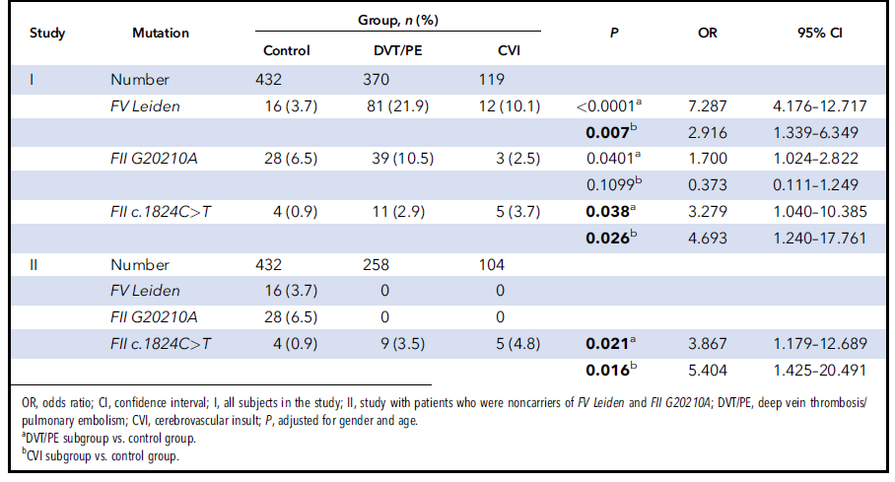
Results:Genotype frequencies
Table 1. Genotype frequencies of the mutations in control patients and patient subgroups DVT/PE and CVI.

Slide 10
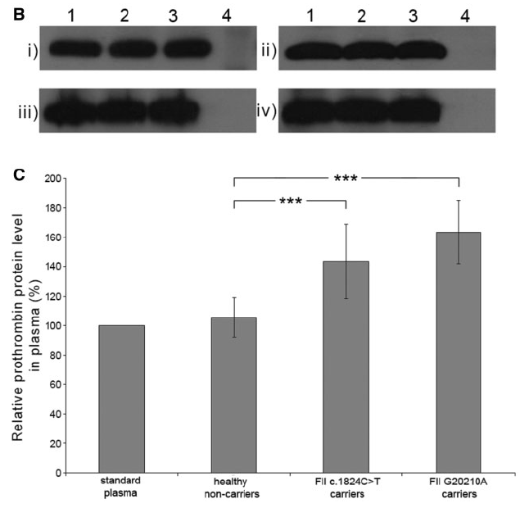
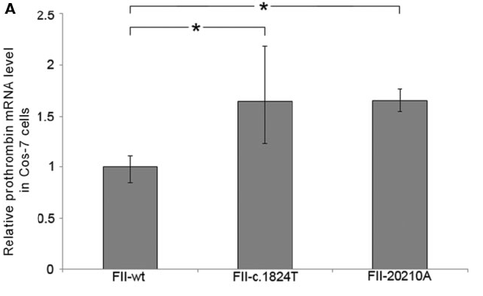
Results: Prothrombin expression
Figure 1. (A) Relative quantification of prothrombin mRNA expression. FII-wt: prothrombin mRNA expression in cells transfected with the FII wild-type vector; FII-c.1824T: prothrombin mRNA expression in cells transfected with the FII-c.1824T vector; FII-20210A: prothrombin mRNA expression in cells transfected with the FII-20210A vector. *P<0.05 compared to FII-wt. (B) Western blot analysis of prothrombin level in plasma. (a) Representative images of Western blots. (i) standard human plasma;(ii) healthy noncarriers; (iii) FII G20210A carriers, and (iv) FII c.1824C>T carriers. Lanes 1, 2, 3: sample; 4: negative control. (C) Quantification of plasma prothrombin level by densitometry.***P<0.0001 compared to healthy noncarriers.

Slide 11
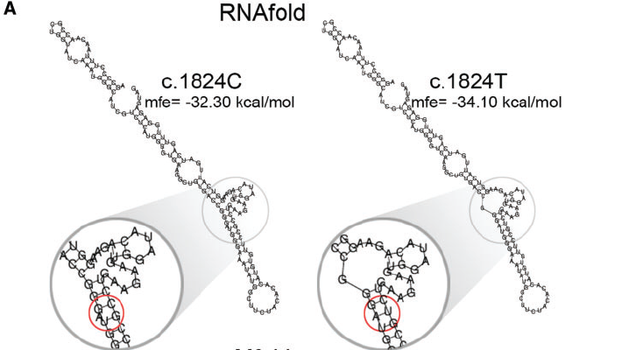
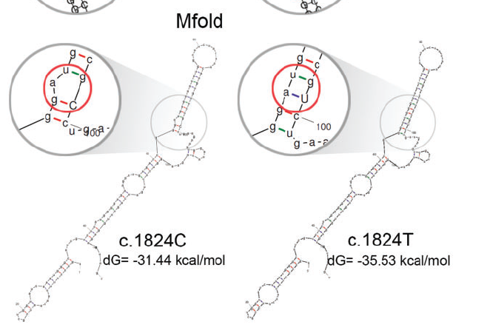
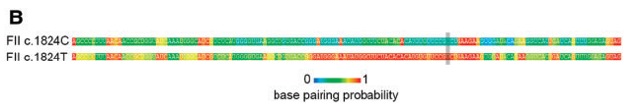
Results: Prediction of RNA secondary structure
Figure 2. (A) Prediction of the RNA secondary structure of the last exon of the prothrombin gene; mfe, minimum free energy; dG, Gibbs free energy; red circle points the exact location of the FII c.1824C>T change. (B) Base pairing probability of FII c.1824C and FII c.1824T sequences. The linear sequence of 144 bp long last exon of the prothrombin gene is shown. FII c.1824C>T positionis marked within gray.

Slide 12
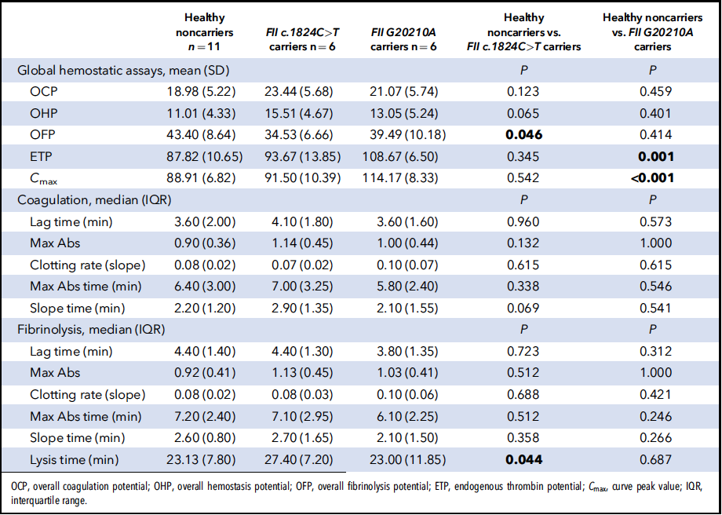
Results: Global hemostatic assays and clot turbidity assay
Table 2. Tested parameters in global hemostatic assays and turbidity parameters of clot formation and fibrinolysis in plasma.

Slide 13
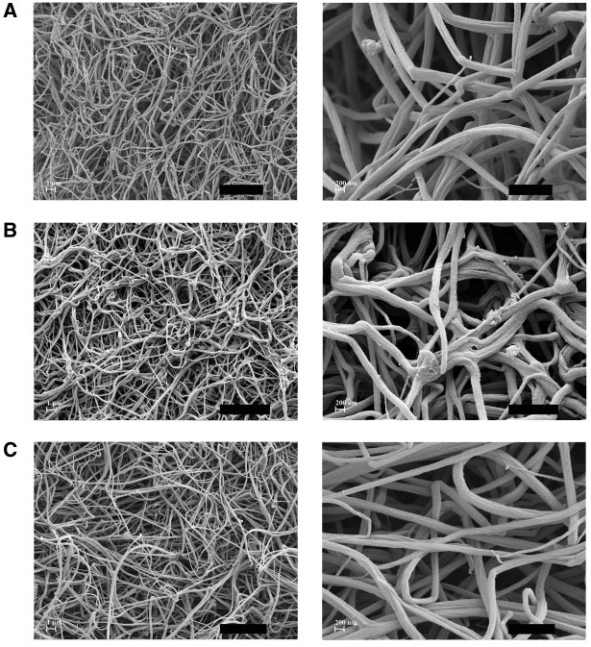
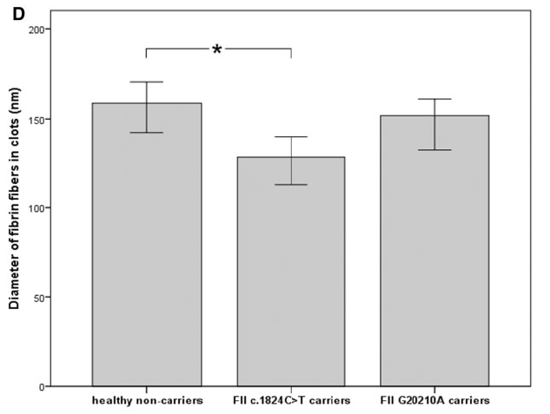
Results: Scanning electron microscopy
Figure 3. Representative scanning electron micrographs of fibrin clots. (A) Fibrin clot derived from plasma sample of healthy noncarrier. (B) Fibrin clot derived from plasma sample of FII c.1824C>T carrier. (C) Fibrin clot derived from plasma sample of the FIIG20210A carrier. (D) Average diameter of fibers in fibrin clots. *P<0.05 compared to healthy noncarriers.

Slide 14
Question 3.
What would be the minimal criteria to proclaim sSNP for new risk factor and how would you further validate it?

