Slide 1

Targeted Sequencing Workflows for Comprehensive Drug Resistance Profiling of Mycobacterium tuberculosis Cultures Using Two Commercial Sequencing Platforms: Comparison of Analytical and Diagnostic Performance, Turnaround Time and Cost
K. Tafess, T.T.L. Ng, H.Y. Lao, K.S.S. Leung, K.K.G. Tam, R. Rajwani, S.T.Y. Tam, L.P.K. Ho, C.M.K. Chu, D. Gonzalez, C. Sayada, O.C.K. Ma, B.H. Nega, G. Ameni, W.C. Yam, G.K.H. Siu
June 2020
https://doi.org/10.1093/clinchem/hvaa092
© Copyright 2020 by the American Association for Clinical Chemistry

Slide 2
Introduction - disadvantages for current drug resistance detection methods
Multidrug-resistant tuberculosis (MDR-TB), extensively drug resistant TB (XDR-TB), and totally drug-resistant TB are major challenges for curing TB and controlling the transmission.
Culture-based phenotypic drug susceptibility tests (pDSTs) are time-consuming.
Molecular assays, such as GenoType MTBDRplus and Xpert MTB/RIF, are limited to hotspot mutations and provide only partial data on drug susceptibility.
The limited sequencing capacity of Sanger sequencing cannot meet the high throughput requirement in public clinical laboratories.

Slide 3
Introduction – what is the problem with whole genome sequencing strategy?
Whole-genome sequencing (WGS) with next generation sequencing (NGS) technology generate genomic data for transmission tracing and epidemiological investigations, in addition to the determination of drug resistance.
This strategy may not favor the middle-low income countries.

Slide 4
Our objective
Development of a sequencing-based test compatible with Illumina MiSeq and Oxford Nanopore MinION that could be applied in diagnostic centers with different levels of throughput and financial support, which would be beneficial to global control of drug-resistant TB.

Slide 5
Question
What are the possible reasons for hindering middle-low countries from adopting the sequencing technologies to clinical diagnosis?

Slide 6
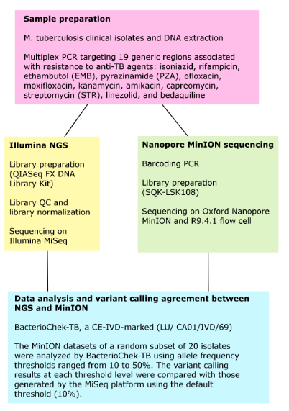
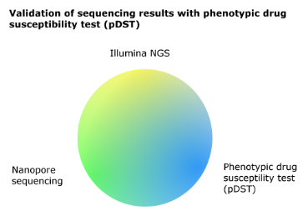
Materials and methods
Turnaround time and cost assessment
The times required to generate a BacterioChek-TB report
from a positive MGIT culture using MiSeq and MinION
platform were assessed and compared with those of pDST.
The cost were calculated based on a batch of 24 samples
and 12 samples per run for MiSeq and MinION workflows,
respectively.

Slide 7
Question
The validation of sequencing results with pDST is one common strategy for evaluating the detection performance. Is there any alternative?

Slide 8
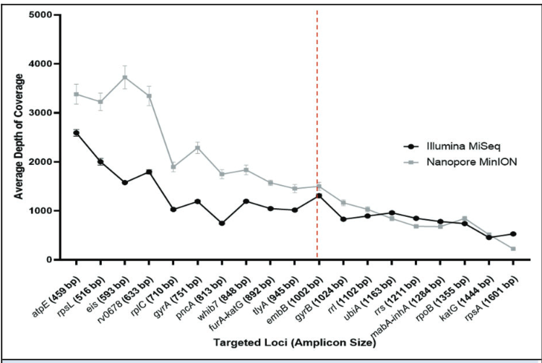
The read depth of 19 targeted loci in MinION and MiSeq sequences
Figure 1.
Line graph illustrating the read depth at each locus in MinION and MiSeq sequences (n=163). Error bars are standard error of mean (SEM); The reference line (broken line) indicates the cut-off point (1000 bp) to categorize the amplicon size as long and short.

Slide 9
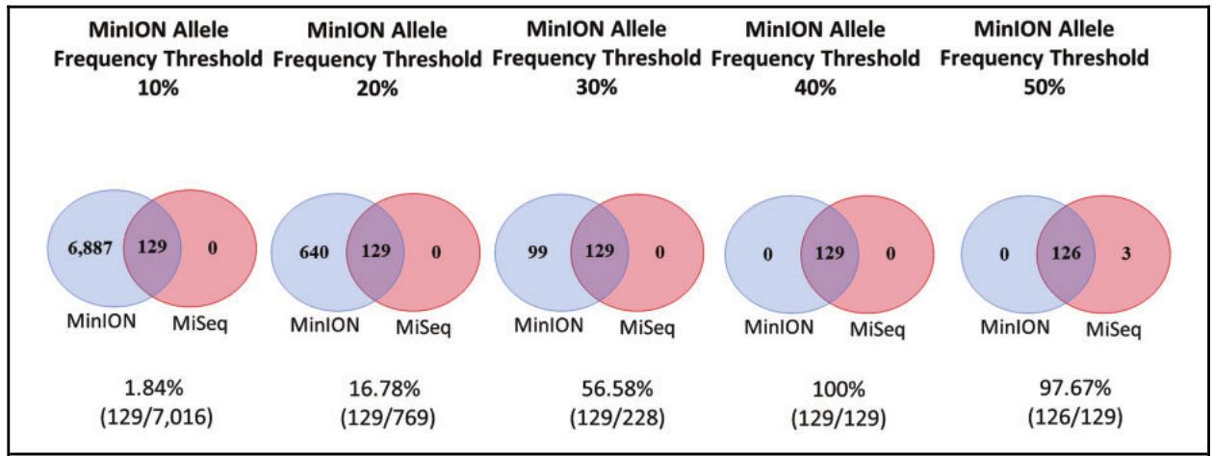
The agreement of variant calling between two sequencing platforms
Figure 2.
Venn diagrams showing the agreement of variant calling between two sequencing platforms when the allele frequency threshold was adjusted to 10% (a default setting) for Illumina MiSeq and 10–50% for Nanopore MinION. The sum of the number in a circle indicates the total number of variants, regardless of their relatedness to drug resistance, reported by the respective sequencing platform for a subset of 20 M. tuberculosis cultures.

Slide 10
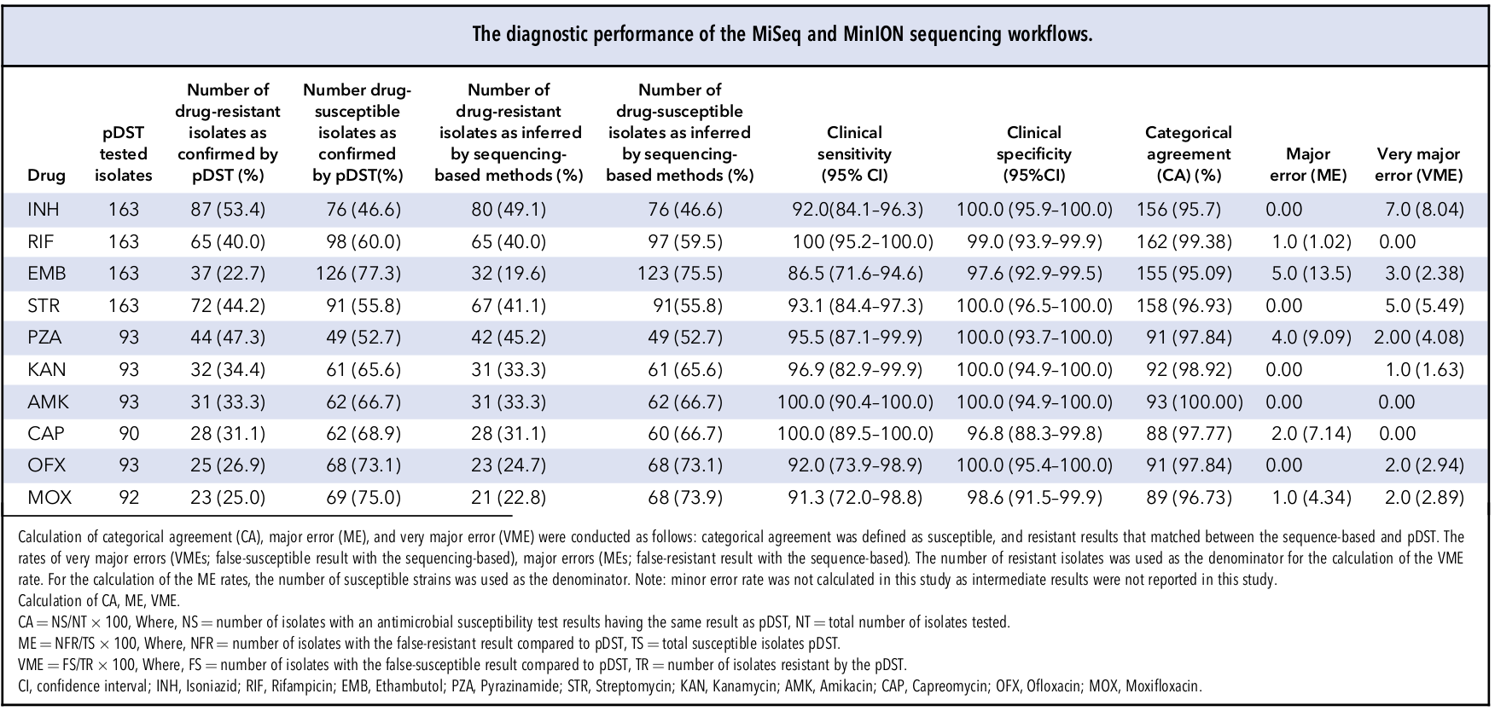
The diagnostic performance of the MiSeq and MinION sequencing workflows
Table 1.

Slide 11
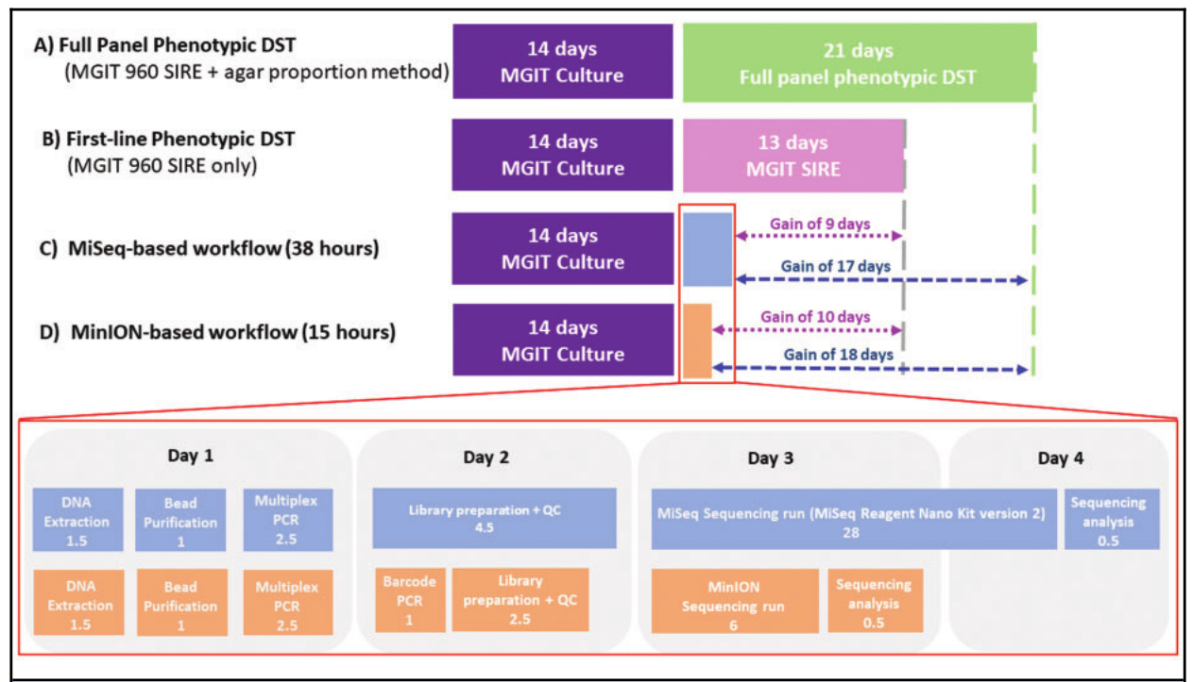
Reduced turnaround time of our sequence-based assays, compared with phenotypic drug susceptibility test (pDST)
The running costs per sample were $67.83 for MiSeq (24 samples/run) and $71.56 for MinION (12 samples/run)
Figure 3.
Archived M. tuberculosis strains were incubated in MGIT broth for 14days before subjecting to: (A), a full panel of pDST, including mycobacterial growth indicator tube (MGIT) 960 Streptomycin, Isoniazid, Rifampicin, and Ethambutol (SIRE) (13days), MGIT 960 PZA (21days) and agar proportion method for second line drugs (21days); (B), MGIT 960 SIRE only (13days); (C), MiSeq sequencing workﬂow (light blue), which requires about 4 days, and (D), MinION sequencing workﬂow (orange), which requires about 3 days. Note that the boxes are not to scale.

Slide 12
Question
The operative cost of sequencing technology is getting lower and lower. Can the sequencing technology replace other drug resistance detection methods such as pDST in future?

