Slide 1

Liquid Biopsy Hotspot Variant Assays: Analytical Validation for Application in Residual Disease Detection and Treatment Monitoring
A. Hallermayr, A. Benet-Pagès, V. Steinke-Lange, U. Mansmann, M. Rentsch, E. Holinski-Feder, J.M.A. Pickl
November 2021
https://doi.org/10.1093/clinchem/hvab124
© Copyright 2021 by the American Association for Clinical Chemistry

Slide 2
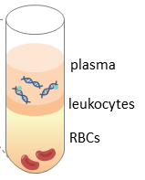

Tumor variants in plasma can be analyzed for a variety of clinical applications. Highly sensitive tumor variant analysis can be performed by digital droplet PCR.
diagnosis
surgery
recurrence
therapy
% Tumor variant
in plasma
Tumor variants in plasma
time
Residual
disease
Therapy
decision
Therapy
monitoring
Resistance
development
Residual disease
1 copy per droplet
20,000 droplets
Droplet Digital PCR (ddPCR)

Slide 3
Tumor variants with therapy relevance in non-small cell lung cancer (NSCLC), melanoma, and colorectal cancer can be analyzed using liquid biopsy
Tumor variant
NSCLC Melanoma Colorectal cancer
EGFR p.T790M
EGFR p.L858R
EGFR Exon 19 deletion
KRAS p.G12/p.G13
BRAF p.V600E

Slide 4
Technical challenges in liquid biopsy
Identification of tumor variants with very low frequency in plasma: Limit of Blank (LOB)
Precise tumor variant quantification in plasma: Limit of Quantification (LOQ)
Even very low frequency variants (<1%) serve as indicator for residual disease and response to EGFR-directed therapy
diagnosis
surgery
recurrence
therapy
≥ Limit of Blank (LOB)
% Tumor variant
in plasma
> Limit of Quantification (LOQ)
time
Residual
disease
Therapy
decision
Therapy
monitoring
Resistance
development
Residual disease
LOB and LOQ determination is required for accurate tumor variant identification and quantification

Slide 5
Introduction summary
Liquid biopsy is a promising tool for identification of genetic tumor status and real-time monitoring of evolutionary tumor dynamics in plasma.
Detection and quantification of pathogenic KRAS, BRAF, and EGFR variants in liquid biopsy may be used to detect therapy resistance, residual disease, and recurrence before clinical evidence, in different types of solid cancer.
In liquid biopsy, highly sensitive methods including ddPCR and in-depth validation of the lower end of the measurement scale are required to detect lowest amounts of variants in plasma, and to distinguish their signals from inherent background noise, since these are relevant for individual treatment decision.
QUESTION: What may be advantages of liquid biopsy compared to tissue biopsy?

Slide 6
Materials & Methods
Determination for each liquid biopsy assay whether a result was truly negative, positive (using LOB), and quantifiable (using LOQ) – according to CLSI guidelines
Further evaluation of parameters including total measurement error, trueness, precision, and linearity.
Positive controls: Dilution series of DNA reference material was generated (mutant variant allele frequency [VAF] range 0.05% to 100%)
Negative controls: gDNA from whole blood and cell-free DNA (cfDNA) from plasma pools of healthy individuals were used. All individuals provided written informed consent.
LOB: > 75 negative controls measurements
LOD: > 60 positive control measurements of very low mutant VAF positive control samples
LOQ: > 40 positive control measurements of very low mutant VAF positive control samples
Linearity: 7 positive control samples in 2-3 replicates from LOQ to 100% VAF
QUESTION: Which performance characteristics should be taken into account when accurately quantifying tumor variants in plasma?

Slide 7
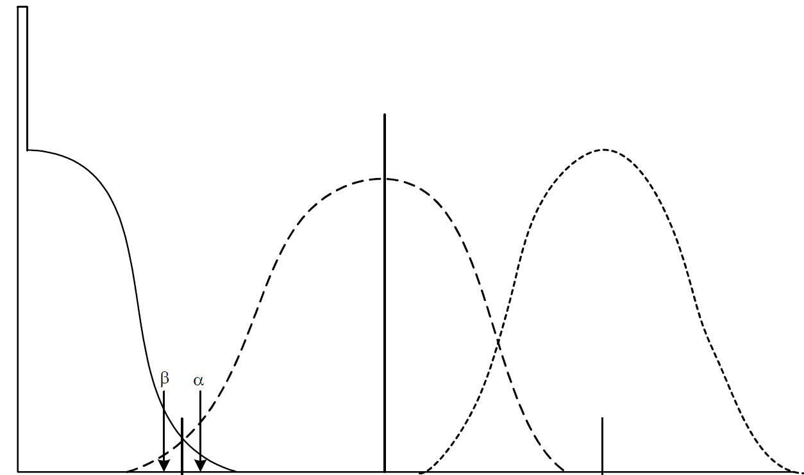
Technical challenges in liquid biopsy
When applying these methods for clinical interpretation, it is critical to understand and assess their performance characteristics at the lower end of the measurement scale.
Limit of Blank
Cutoff for presence of a tumor variant (95% specificity)
Measurement number
5% False Positive Rate
0.00%
% Tumor variant in plasma
0.75
Assay-specific dispersion
Determination of the LOB for each single assay to detect a tumor variant using negative control samples

Slide 8
Technical challenges in liquid biopsy
Limit of Blank
Limit of Detection
Limit of Quantification
≥ 95% Sensitivity
≥ 95% Specifity
Limit of Detection and ≤ Total Error Goal
Tumor variant frequency quantifiable
Measurement number
5% False Negative
Rate
5% False Positive Rate
5% Falsch Negativ
Rate
0.00%
% Tumor variant in plasma
0.75
Assay-specific dispersion
Determination of the LOQ for each single assay to precisely quantify a low frequency tumor variant using positive control samples

Slide 9
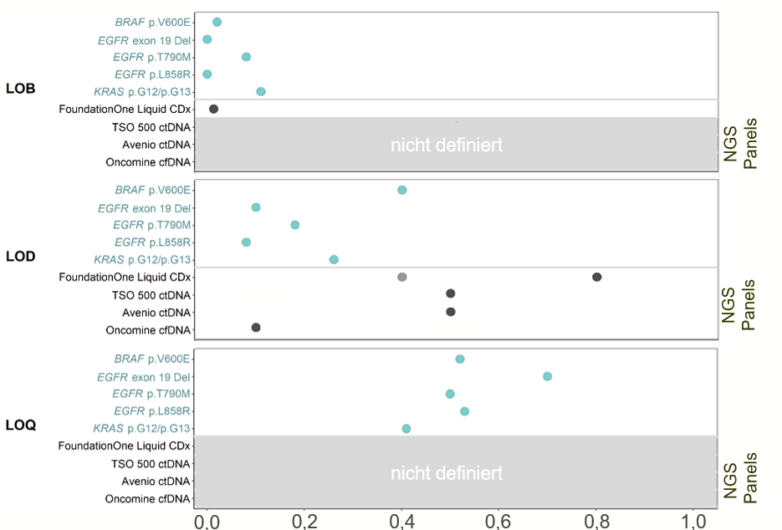
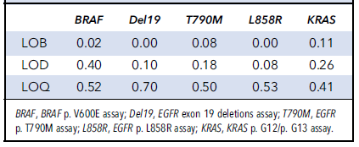
LOB, LOD & LOQ of five ddPCR assays
not defined
Each assay has different performance characteristics
Differences must be considered in clinical reporting
Clinically relevant LOB and LOQ are not commonly reported by liquid biopsy assay providers
not defined
% Tumor variant in plasma
Assay-specific performance characteristics for analysis of low-frequency tumor variants

Slide 10
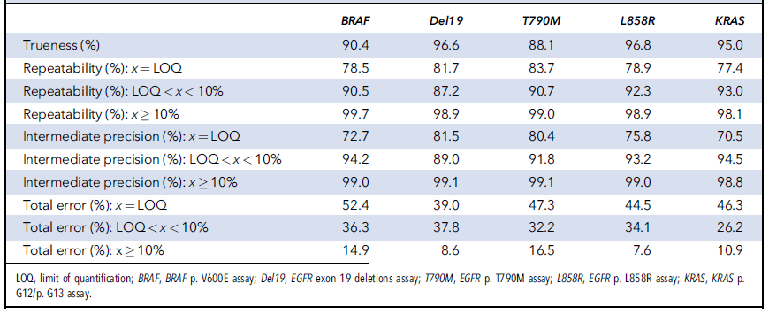
Performance characteristics differ between tumor variant frequencies and assays at LOQ, < 10% and ≥ 10%

Slide 11
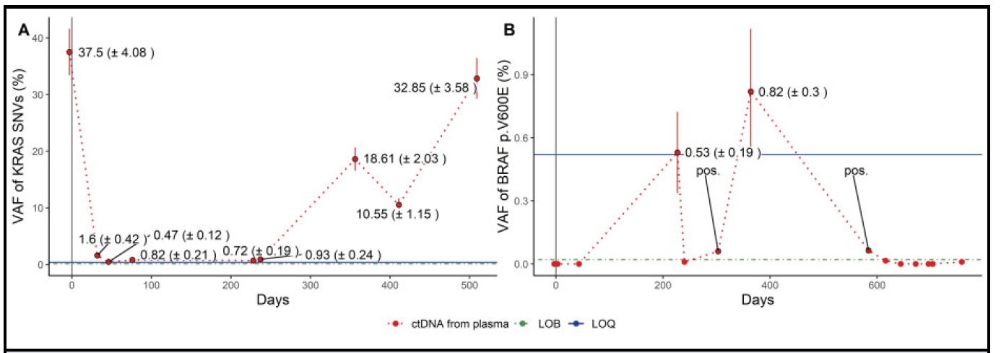
Application of LOB and LOQ thresholds in clinical use
Example: Follow-up circulating-free DNA (cfDNA) samples of two patients with colorectal cancer having either the KRAS p.G13D variant or the BRAF p.V600E variant present in tumor tissue were analyzed at different time points throughout the course of disease

Slide 12
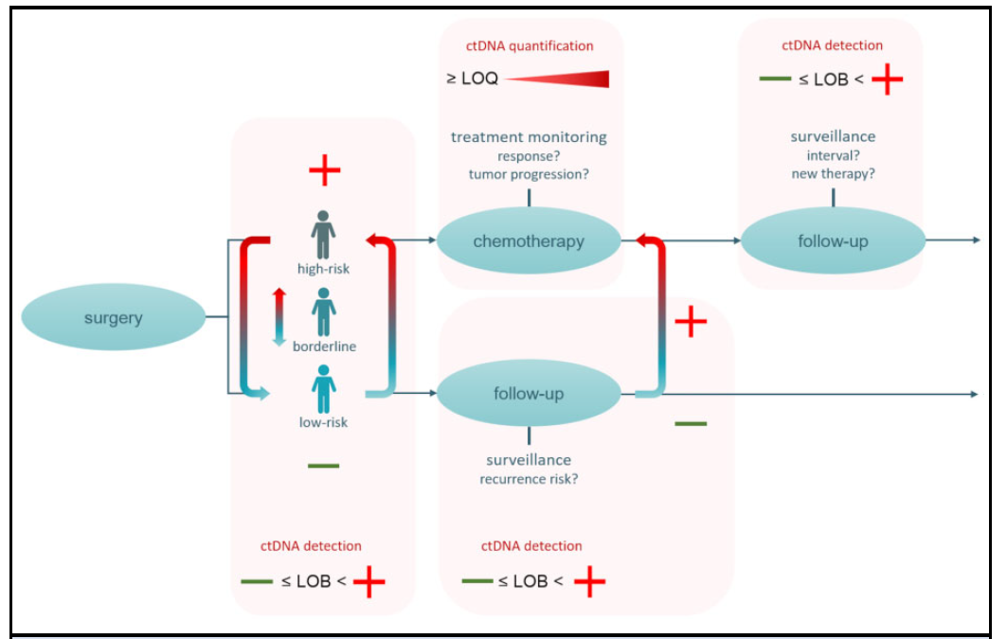
Guide for clinical interpretation of circulating tumor DNA (ctDNA) analysis results, dependent on determined LOB and LOQ.
An exemplary course of disease with several clinical decisions to be made.
During treatment and follow-up of patients with cancer, both ctDNA detection (negative ≤LOB, positive >LOB) and ctDNA quantification (possible ≤ LOQ) of mutant variants supports clinical decisions for treatment.

Slide 13
Summary
Determination of clinically relevant cutoffs LOB and LOQ is not common in commercial liquid biopsy testing
The analytical validation performed within this study enabled precise differentiation between negative and positive results (LOB) and quantification of the VAF (above the LOQ).
Applied liquid biopsy assays in this study were highly sensitive when compared to other liquid biopsy assays (LOD)
Applying the liquid biopsy, tumor progression and response to treatment in two exemplary clinical samples was oberved.
There are assay-specific cutoffs for tumor variant detection and quantification, highlighting the need for determining these performance characteristics for each single mutant variant assay individually to enable precise clinical interpretation for each variant.
Abilty to provide a comprehensive actionable report for patients and enable disease monitoring.
QUESTION: How can LOB and LOQ cutoffs help to guide clinical decisions?

