Slide 1
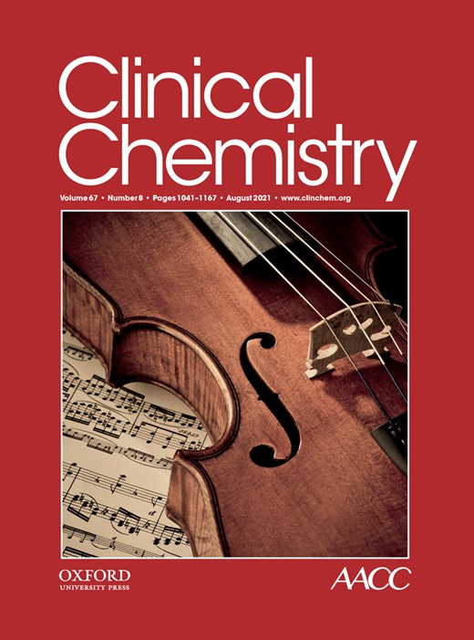
High-Sensitivity Cardiac Troponin T for the Detection of Myocardial Injury and Risk Stratification in COVID-19
L. De Michieli, O. Ola, J.D. Knott, A. Akula, R.A. Mehta, D.O. Hodge, M. Dworak, E.H. Yang, M. Gharacholou, G. Singh, R. Singh, R. Gulati, A.S. Jaffe, Y. Sandoval
August 2021
https://doi.org/10.1093/clinchem/hvab062
© Copyright 2021 by the American Association for Clinical Chemistry

Slide 2
INTRODUCTION
The coronavirus disease 2019 (COVID-19) pandemic caused by severe acute respiratory syndrome coronavirus 2 (SARS-CoV-2) has affected millions of people worldwide with substantial morbidity and mortality.
Different studies showed that myocardial injury is common, in particular among those with chronic cardiovascular conditions and more severe COVID-19 presentations
The presence and magnitude of myocardial injury is associated with worse outcomes

Slide 3
INTRODUCTION
  QUESTION FOR DISCUSSION, 1
  How do we define myocardial injury as per the most recent Guidelines? Which is the biomarker of choice and which are the most appropriate cutoffs to define abnormality?

Slide 4
INTRODUCTION
Cardiac troponin (cTn) is the preferred biomarker for the detection of myocardial injury, which is defined when there is at least one cTn concentration above the sex-specific 99th percentile upper-reference limit (URL) of a healthy reference cohort.
Limited data exist on the incidence of myocardial injury as determined with high sensitivity cardiac troponin (hs-cTn) using sex-specific 99th URLs and on the use of the hs-cTn for risk-stratification in patients with COVID-19.
Thygesen K, Alpert JS, Jaffe AS et al. Fourth Universal Definition of Myocardial Infarction (2018). J Am Coll Cardiol. 2018 Oct 30;72(18):2231-2264.

Slide 5
OBJECTIVES
To determine the incidence of myocardial injury and acute myocardial infarction (MI), including the frequency of type 1 and 2 MIs, following the recommendations from the Task Force for the Fourth Universal Definition of MI (UDMI) in a multicenter COVID-19 US cohort.
To evaluate the clinical features and outcomes of COVID-19 patients with and without myocardial injury.
To evaluate the prognostic role of hs-cTnT and its potential use as a risk-stratification tool.
Thygesen K, Alpert JS, Jaffe AS et al. Fourth Universal Definition of Myocardial Infarction (2018). J Am Coll Cardiol. 2018 Oct 30;72(18):2231-2264.

Slide 6
Methods
  Retrospective, multicenter (n=20), observational, US-based study of COVID-19 patients undergoing hs-cTnT measurements.
  For this assay, the limit of quantification (LoQ) is <6 ng/L and sex-specific 99° percentiles (F 10 ng/L, M 15 ng/L) were used to define myocardial injury.
  Outcomes included in-hospital and 30-days post discharge mortality, and a composite outcome of major adverse events including respiratory failure requiring mechanical ventilation, cardiac arrest, shock and/or in-hospital or 30-day post-discharge mortality.

Slide 7
METHODS
  QUESTION FOR DISCUSSION, 2
Is there a potential selection bias as not all COVID-19 patients underwent systematic hs-cTnT measurements? What are the data on hs-cTn values in non-selected COVID-19 patients?

Slide 8
RESULTS
Among 367 COVID-19 patients with hs-cTnT measurements, the incidence of myocardial injury was 46%.
Median baseline hs-cTnT concentrations were 11 (IQR 5, 29) ng/L, with men having significantly higher baseline concentrations than women (14 vs 7.5 ng/L, P<0.0001).
Most (95%) hs-cTnT increases were due to isolated myocardial injury, with only 5% (n=8) adjudicated as type 1 or type 2 MI.

Slide 9
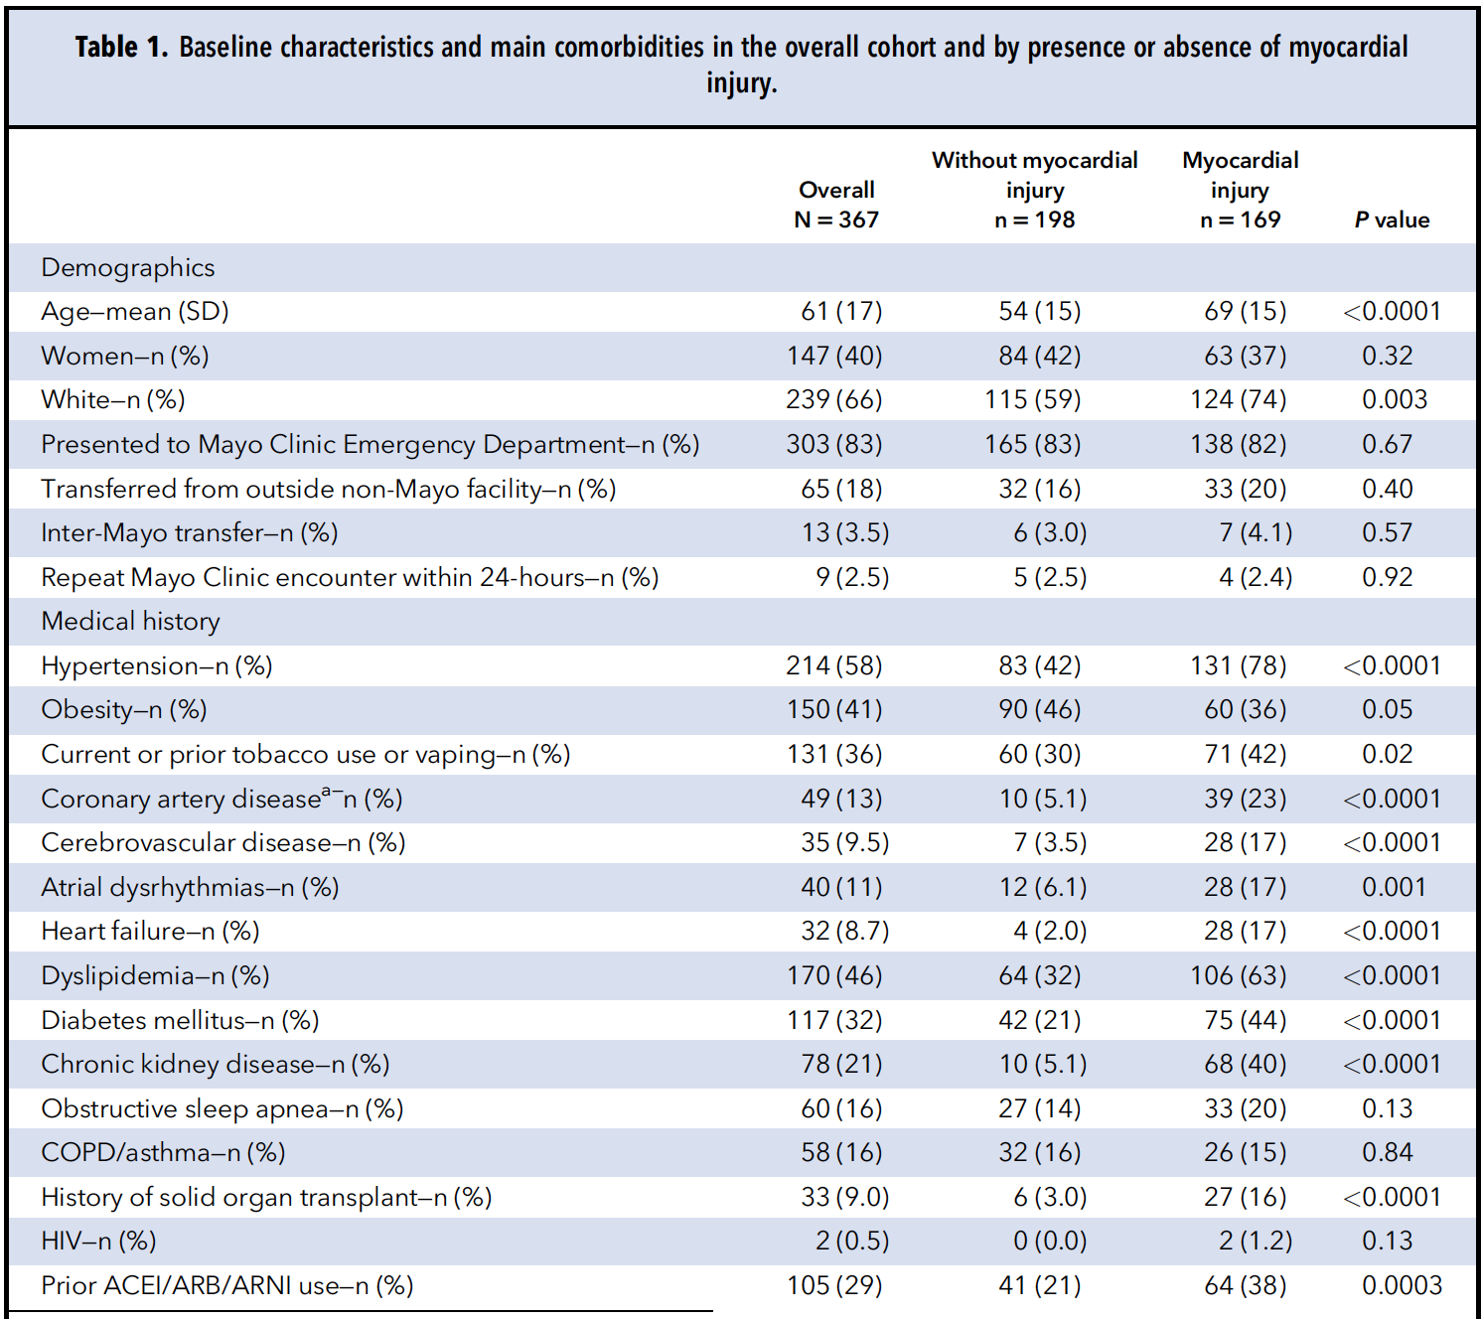
Baseline characteristics
Table 1. Baseline characteristics.

Slide 10
Distribution of hs-cTnT values
Figure 1. Histograms for the distribution of baseline (panel A) and maximum (panel B) hs-cTnT concentrations.

Slide 11
Distribution of hs-cTnT values
Figure 2. Distribution of baseline hs-cTnT concentrations for the overall study cohort and by sex using sex specific cut off values.

Slide 12
RESULTS
Patients with myocardial injury had a higher incidence of in-hospital (15% vs. 3.5%, P<0.0001) and post-discharge death (8.8% vs. 1.1%, P =0.0013) than patients without myocardial injury.
They were more likely to develop adverse events (35% vs. 11%, P<0.0001; adjusted OR 3.84, 95% CI 2.00-7.36, P <0.0001).
Both baseline (adjusted OR 1.003, 95% CI 1.00-1.007, P=0.047) and maximum (adjusted OR 1.005, 95% CI 1.001-1.009, P=0.0012) hs-cTnT were independent predictors of major adverse events.
A hs-cTnT value of <6 ng/L identified 26% of patients without short-term mortality or major adverse events, with a 94.9% (95% CI 87.5-98.6) negative predictive value and 93.1% sensitivity (95% CI 83.3-98.1) in those presenting to the ED.

Slide 13
Overall survival in patients with and without myocardial injury
Figure 3. Survival among COVID-19 patients with and without myocardial injury.

Slide 14
Overall survival according to analytical thresholds
Figure 4. Survival among COVID-19 patients according to baseline (Figure A) and maximum (Figure B) hs-cTnT concentrations based on sex specifc cut off values.

Slide 15
RESULTS
  QUESTION FOR DISCUSSION, 3
  If not related to myocardial infarction, what is the pathophysiology of cardiac troponin elevation in COVID-19 patients?

Slide 16
KEY MESSAGES AND CONCLUSIONS
Using the hs-cTnT assay with sex-specific 99th percentile URLs, myocardial injury was present in 46% of COVID-19 patients undergoing hs-cTnT measurements during hospitalization.
Myocardial injury had important prognostic implications with 20% of COVID-19 patients with myocardial injury having short-term-mortality and 35% major adverse events.
After adjudication using the Fourth Universal Definition of MI, most (95%) events were due to isolated myocardial injury (i.e. without clinical evidence of myocardial ischemia).
While hs-cTnT increases were modest, maximum hs-cTnT was an independent predictor of both mortality and major adverse events. Baseline hs-cTnT concentrations were also associated with the major adverse event composite endpoint.
A single hs-cTnT measurement <6 ng/L at presentation identifies 26% of COVID-19 patients with a more favorable prognosis and potentially may help with patient triage.

