Slide 1
Peripheral and Portal Venous KRAS ctDNA Detection as Independent Prognostic Markers of Early Tumor Recurrence in Pancreatic Ductal Adenocarcinoma
C. Nitschke, B. Markmann, P. Walter, A. Badbaran, M. Tölle,
J. Kropidlowski, Y. Belloum, M.R. Goetz, J. Bardenhagen, L. Stern,
J. Tintelnot, M. Schönlein, M. Sinn, P. van der Leest, R. Simon,
A. Heumann, J.R. Izbicki, K. Pantel, H. Wikman, F.G. Uzunoglu
March 2023
https://doi.org/10.1093/clinchem/hvac214
© 2023 American Association for Clinical Chemistry

Slide 2
Introduction
KRAS circulating tumor (ct)DNA
  KRAS is a driver gene in pancreatic ductal adenocarcinomas (PDAC) and mutated in about 80–90% of tumors.
  Liquid biopsy-based biomarker potential for PDAC
Study Aims
  To improve clinical applicability of ctDNA detection in PDAC.
  To study the impact of blood-draw site and time point on the detectability and prognostic role of KRAS mutations in ctDNA.
  → Could KRAS ctDNA serve as a future clinical biomarker for prognosis in PDAC?

Slide 3
Materials & Methods
Sample collection & procession
  221 EDTA blood samples from 108 PDAC patients (65 curative, 43 palliative patients)
  Including baseline peripheral and tumor-draining portal venous (PV), postoperative, and follow-up blood samples
  Plasma isolation was followed by cfDNA isolation, quantification and digital-droplet PCR (ddPCR) for KRAS G12D, G12V, G12R, G12C, and Q61H hot spot mutations
Clinical correlation
  Correlation with recurrence-free (RFS) and overall survival (OS)
  → Can we increase KRAS ctDNA detectability or increase prognostic impact by analyzing tumor-draining PV blood?

Slide 4
Main Results
Comparison of palliative and curative patients
Significantly higher KRAS mutant detection rates and copy numbers were observed in palliative patients’ baseline blood (58.1% vs 24.6%; P=0.002; and P<0.001)
Comparison of PV and baseline blood
Significantly higher KRAS mutant copies were found in PV blood samples (P<0.05)
KRAS as an independent prognostic marker for shorter recurrence-free survival (RFS)
KRAS ctDNA detection in pre-, postoperative, and PV blood was significantly associated with shorter RFS and identified as independent prognostic markers (all P<0.015)
KRAS as an independent prognostic marker for shorter overall survival (OS)
KRAS ctDNA detection in the palliative and curative cohorts was an independent unfavorable prognostic factor for shorter OS (hazard ratio [HR] 4.9, P=0.011; HR 6.9, P=0.008)
→ Could PV blood be an effective novel tool for identifying prognostic borderline patients?

Slide 5
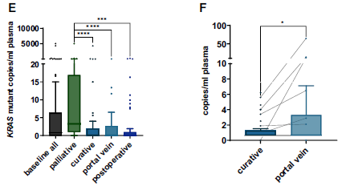
Site dependent KRAS ctDNA analyses
A
B
ctDNA copies per ml of plasma; significant difference between the palliative preoperative blood and all timepoints of the curative cohort (****P<0.0001; ***P<0.001).
B) The significant difference in ctDNA copies per ml of plasma in matched pairs of baseline and PV blood (*P<0.05).

Slide 6
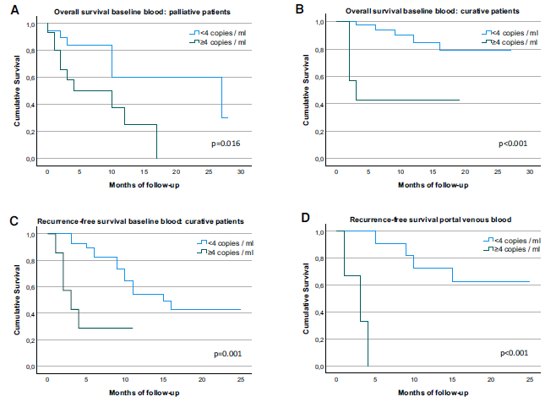
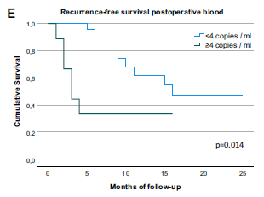
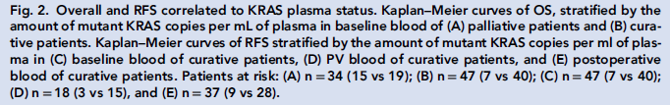
Overall and recurrence-free Survival
(OS; RFS) correlated to KRAS plasma status

Slide 7
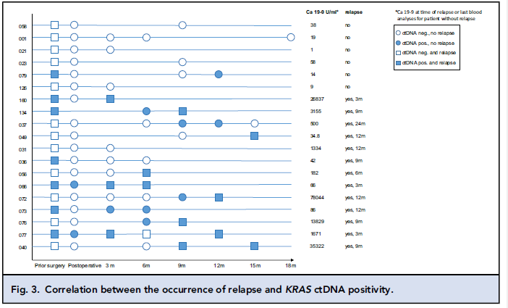
Correlation between the occurrence
of relapse and KRAS ctDNA positivity
→ In all resected patients, a KRAS ctDNA positivity before or at the time of relapse was observed.

Slide 8
Summary & Conclusions
KRAS ctDNA detection is an independent adverse prognostic marker in curative and palliative PDAC patients
  At all sites of blood draw and a strong follow-up marker
The most substantial prognostic impact was seen for PV blood, which could be an effective novel tool for identifying prognostic borderline patients
  Guiding future decision-making on neoadjuvant treatment despite anatomical resectability.
Higher PV mutant copy numbers contribute to an improved technical feasibility.

