Slide 1
A Digital PCR Assay for Fetal Fraction Quantification Using Multiplex SNP and Y Chromosome Detection
C. Tan, P. Dai, Z. Zhao, X. Chen, D. Wang, X. Ren, L. Zhu, T. Yan, J. Lou, X. Kong, Y. Guo
August 2026
https://doi.org/10.1093/clinchem/hvag017
© 2026 Association for Diagnostics & Laboratory Medicine

Slide 2
Introduction
Prenatal cfDNA screening is a safe and effective method for detecting fetal chromosomal aneuploidies, and the fetal fraction (FF) directly determines the reliability of the assay.
Digital PCR (dPCR) offers operational simplicity, flexible throughput, and absolute quantification, making it a promising alternative to NGS-based screening; however, its clinical adoption is restricted by the absence of an integrated FF quantification method within the dPCR workflow.
Existing FF strategies are limited: chrY detection is sex-dependent (male fetuses only); differential methylation requires complex enzymatic/bisulfite steps and is susceptible to biological variation; SNP-based methods typically require prior parental genotyping, making them inefficient for large-scale testing.
Research goal: To develop a multiplex dPCR assay that enables FF quantification independent of fetal sex and parental genotype.

Slide 3
Introduction
Question 1: The authors aimed to develop a fetal fraction (FF) quantification method that is both sex-independent and does not require parental genotyping. In your opinion, is this the most important unmet need preventing wider adoption of dPCR-based screening, or are there other technical or clinical barriers that may be equally or more significant?

Slide 4
Materials and Methods
Three-phase study design: (i) design and optimization of the multiplex assay; (ii) analytical validation using simulated DNA mixtures; (iii) clinical validation using 143 maternal plasma samples compared against an NGS reference standard.
Multiplex dPCR setup: Two reaction wells were used per sample: well 1 targeted 5 SNP loci, and well 2 targeted 4 SNP loci plus chrY. A single-probe, dual-allele discrimination design was used for SNP genotyping, generating distinct fluorescence-amplitude clusters for matched vs. mismatched alleles.
Triplex chrY assay: Three distinct chrY regions were targeted simultaneously to maximize informative droplets per reaction, thereby enhancing Poisson-based quantification accuracy.
FF calculation algorithms: chrY-based FF was normalized against cumulative autosomal reference loci (SNPs 6–8, three autosomal SNP loci in well 2 serving as internal copy-number references for chrY signal normalization); SNP-based FF was calculated from informative loci using biologically constrained formulas (0% < FF < 50%) and averaged across valid loci.

Slide 5
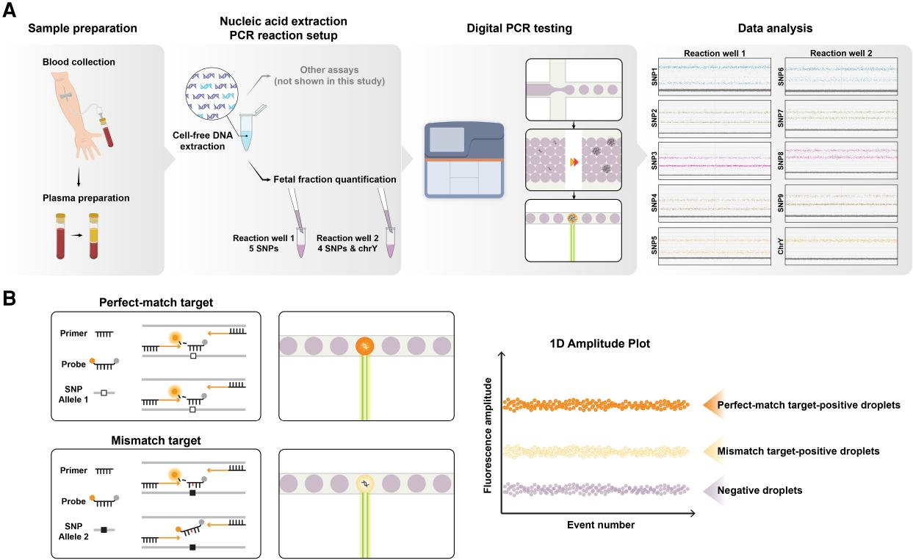
Workflow and principles of FF quantification using dPCR
Figure 1. (A), Overall workflow: plasma preparation, cfDNA extraction, PCR reaction setup, automated dPCR, and data analysis. FF quantification was performed in 2 wells: well 1 targeted 5 SNP loci; well 2 targeted 4 SNP loci and chrY; (B), Single-probe, dual-allele discrimination principle: a single primer-probe set detects both alleles. Perfectly matched probes yield strong fluorescence due to stable hybridization and efficient hydrolysis, whereas single-base mismatches generate weaker signals.

Slide 6
Materials and Methods
Question 2: The study validated the assay using fragmented genomic DNA mixtures before testing clinical plasma samples. What are the strengths and limitations of this analytical validation strategy, and how well do simulated samples reflect the biological complexity of maternal plasma cfDNA?

Slide 7
Main results and discussion
Analytical validation: The chrY-based assay demonstrated superior linearity (R² = 0.971), precision, and accuracy (MAE = 0.94%) compared with the SNP-based approach (R² = 0.924, MAE = 1.61%). Critically, the triplex chrY design enabled reliable detection at 1% FF, whereas the SNP method failed at this level.
Clinical validation: Testing of 143 maternal plasma samples showed a 92.3% informative SNP rate and a low 2.8% no-call rate. The two dPCR methods were internally consistent (chrY vs. SNP: r = 0.716, P < 0.0001), and dPCR-derived FF showed strong overall concordance with the NGS reference standard (r = 0.799, P < 0.0001).
Core design innovations: a 2-well setup simultaneously targeting 9 autosomal SNPs and 3 chrY loci for sex-independent measurement; a single-probe, dual-allele design with a standardized FF calculation algorithm to eliminate the need for parental genotyping; and a triplex chrY assay to boost sensitivity at low FF levels.

Slide 8
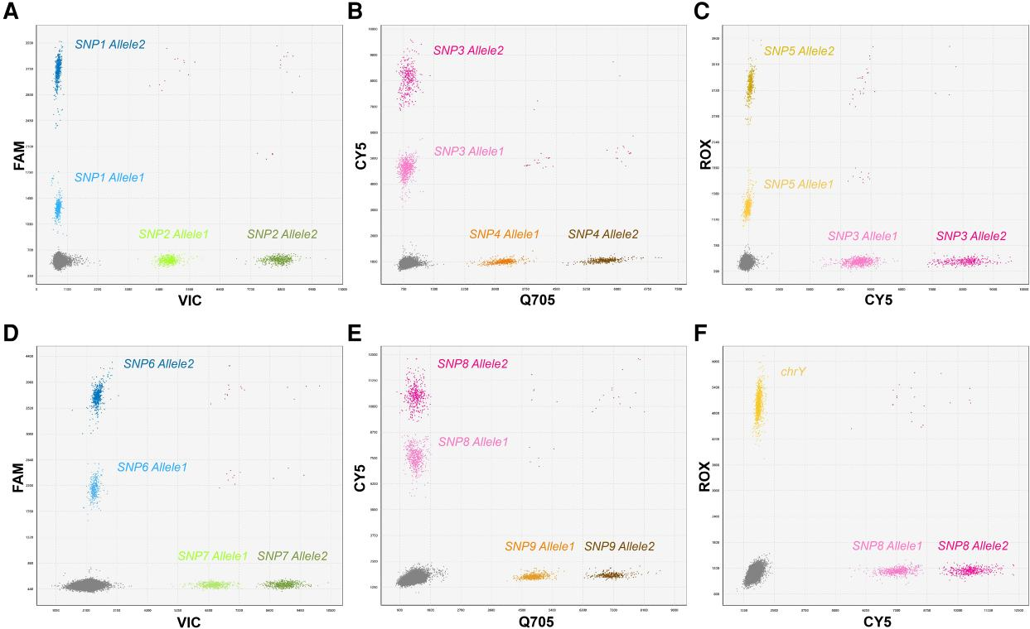
Representative 2-dimensional dPCR plots for SNP and chrY detection
Figure 2.(A–C), Typical heterozygous clusters for 5 SNP loci in well 1;
(D–F), Corresponding plots for 4 SNP loci and chrY in well 2. The x- and y-axes represent fluorescence amplitude in 2 detection channels. For SNP, 3 clusters are observed in each channel: 2 allele-specific positive clusters and one negative cluster (background). For chrY, 2 clusters are observed: one positive cluster and one negative cluster (background).

Slide 9
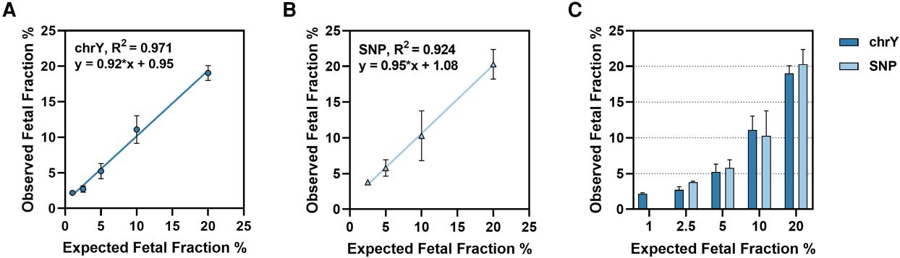
Analytical validation of dPCR-based FF quantification using simulated samples
Figure 3. Linear regression analysis of observed vs expected FF values at 1%, 2.5%, 5%, 10%, and 20% (n = 3 per level) for the (A) chrY-based and (B) SNP-based approaches. (C), Bar plot presentation of the same dataset shown in panels A and B.

Slide 10
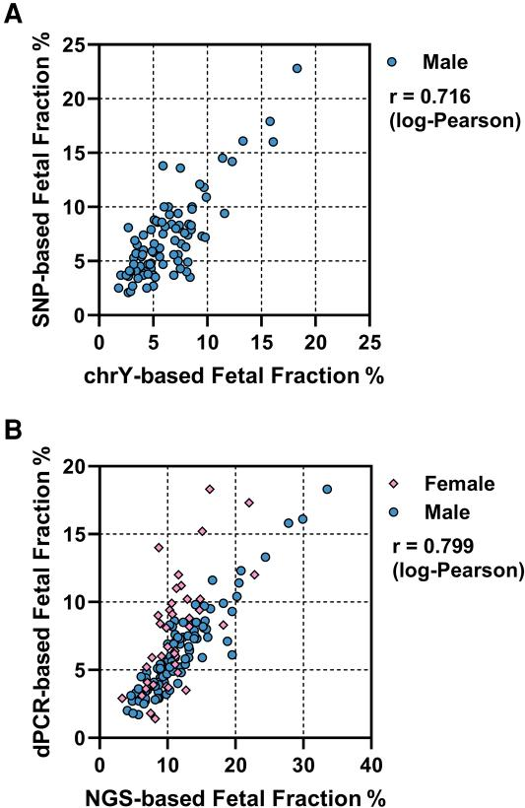
Clinical validation of dPCR-based FF quantification
Figure 4. (A), Correlation between chrY- and SNP-based FF values in 93 male samples. (B), Correlation between dPCR-derived FF (chrY for males, SNPs for females) and NGS-based estimates in 139 samples.

Slide 11
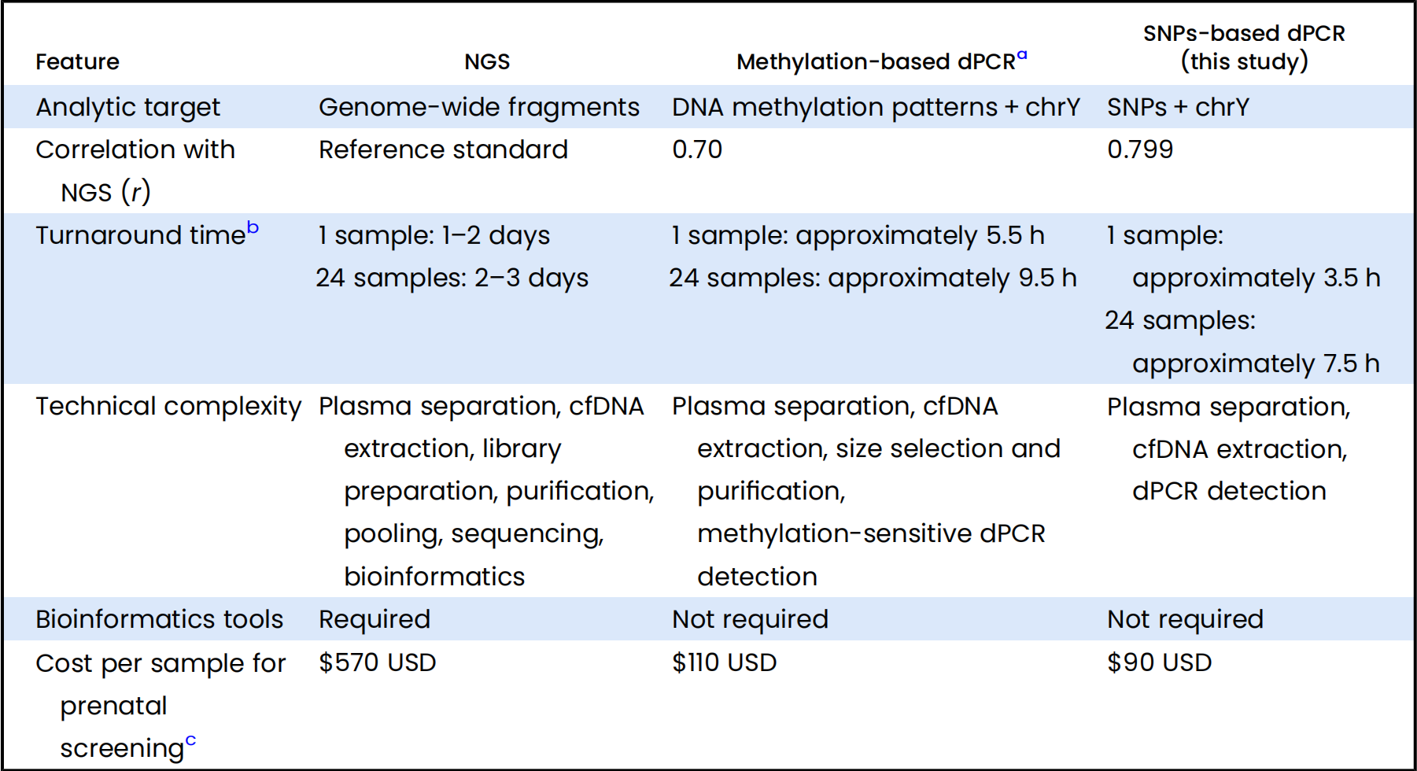
Methods Comparison
Table 1. Comparative characteristics of FF quantification methods.

Slide 12
Main results and discussion
Question 3: The assay achieves strong clinical concordance with NGS while using a much simpler, faster, and cheaper workflow. Do you see this dPCR-based FF quantification as a viable primary replacement for NGS-based FF estimation in certain clinical settings, or is it better positioned as a complementary QC tool within existing pathways?

