Slide 1
Laboratory Medicine Consultation: An Essential Component of Optimized Healthcare
Michael Laposata, M.D., Ph.D.
Professor and Chair
Department of Pathology
University of Texas Medical Branch
Galveston

Slide 2
I have no conflicts of interests related to this presentation.

Slide 3
This is a Look at Us:
Diagnostic Experts in the Clinical Laboratory
What We Have Done as a Profession
And How Our Professional Roles are Evolving

Slide 4
Part 1
Accurately describe the current state of affairs:
Internal forces within pathology and external forces upon pathology

Slide 5
The Basic Problem
Which Needs Fixed

Slide 6
Impact of Making an
Incorrect Diagnosis:
Something We Do Not Often Think About, Even Though We Generate Most of the Diagnostic Information

Slide 7
The First Step in a Patient Encounter is Obtaining the Correct Diagnosis
Treating an Illness a Patient Does Not Have Hurts the Patient at an Enormous Cost to the Healthcare System

Slide 8
Wrong Diagnosis
Ineffective Treatment
Improved Despite
Incorrect Treatment
Illness
Progressed
Major Cause of Chronic Disease
and Preventable Death

Slide 9
Why is Choosing the Correct Tests, and Only the Correct Tests, so Difficult?
  Physical Examination: Fewer than 50 things to note
  Imaging Studies: Fewer than 50 tests
  Microscopic Evaluations: Fewer than 50 tests
  Clinical Laboratory Tests: Greater than 5000 tests with many genetic results
Notes:
Tests are tricky. It is getting harder and harder to choose the right tests as this slide illustrates. Physicians have more and more tests to choose from and have less and less knowledge about the lastest ones.

Slide 10
How Much Information is There to Know?
1950
Amount of knowledge available about disease
Doctor does not know much about diagnosis
Doctor knows much about diagnosis
Department of Pathology

Slide 11
Today
Amount of knowledge available about disease
Less Informed
Doctor
Too much for even one very good doctor to know
More Informed
Doctor
Department of Pathology

Slide 12
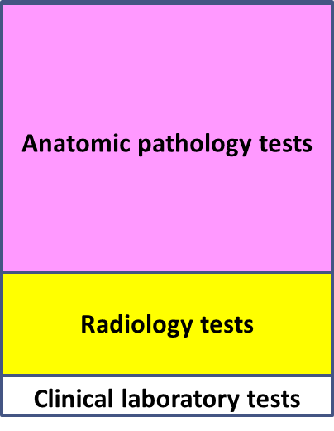
In the US, Test Selection and Result Interpretation are Barely Taught in Medical School
During Medical School
In Practice
Anatomic pathology tests
Radiology tests
Clinical laboratory tests

Slide 13
What is Happening Because the
Basic Problem is
NOT Fixed?

Slide 14
In 2014 it was Estimated that Annually US Doctors are:
  Unsure of correct tests to order for 27 million patient visits
  Unsure of proper interpretation of test results for 15 million patient visits and that, in objective analyses, the US is far behind Western Europe in the quality of healthcare
J Am Board Fam Med 27:268-274, 2014
Notes:
The CDC estimated that uncertainty is high for both ordering proper tests and interpretation of testing in the clinic setting.

Slide 15
Priorities for Test Selection by Most Doctors
Number 1: | Inexpensive
Number 2: | Quick
Number 3: | Simple to Perform
Number 4: | Provides Correct Test Result

Slide 16
Patients Too Often Think Their Doctors Know All About the Laboratory Tests When Health Care Providers Actually Have Major Knowledge Gaps About Test Selection and Result Interpretation

Slide 17
Patients Do Not Know:
The evidence for these conclusions is that 1 in 5 Americans believe they have been a victim of a diagnostic error.
In fact, virtually every adult in the US has been a victim of at least one diagnostic error

Slide 18
How Much Money is Wasted Because of This Unfixed Problem?

Slide 19
The Financial Consequences of an Incorrect or Delayed Diagnosis

Slide 20
$ Spent on Length of Stay (inpatient)
and
Supplies/
Personnel & Lab Tests
NO
Delay in Diagnosis
NO Increased
Length of Stay
NO Complications
$100+
Essential Tests Ordered Immediately

Slide 21
Delay in Diagnosis
Complications
$ Spent on Length of Stay (inpatient)
and
Supplies/
Personnel & Lab Tests
NO
Delay in Diagnosis
Increased
Length of Stay
Complications
Delay in
Diagnosis
NO Complications
$100,000+
$10,000+
$100+
Essential Tests Ordered Immediately
Essential Tests Ordered Late or Never Ordered

Slide 22
Relative to Length of Stay Costs at $2000 Per Day, a Useful $1000 Laboratory Test that Can Lead to a Diagnosis that Shortens Length of Stay Saves $1000 for Healthcare Institutions
$2000 (LoS)
- 1000 (Test)
$1000 (Saved)

Slide 23
This Can Be Confusing to Hospital Leaders Who Review the Performance of Individual Department Budgets and NOT the Cost of Individual Patient Encounters Across Budgets

Slide 24
General Hospital Budget
Lab Budget
$ Spent
(hundreds of thousands)
$ Spent
(thousands)
Does the Laboratory Director Lose Credibility
Because the Department Budget Increased?
Even with Financial Improvement for the Entire Institution?

Slide 25
Overutilization and Underutilization of Laboratory Tests
Leading to Worse Clinical Outcomes at Higher Cost

Slide 26
Take Clinical Context
and Diagnostic Goals
Obtain the Correct
Diagnosis Rapidly
and
Using All the Necessary Tests to Reduce Underutilization and No Unnecessary Tests to Reduce Overutilization

Slide 27
How Much Does Overutilization Add to the Cost of Laboratory Tests
Unnecessary Cost for a Test Not Needed (personnel costs substantial)
X
X
Cost to further evaluate an unnecessary test with abnormal result
Y

Slide 28
Cost of Laboratory Tests Not Needed Plus Unnecessary Follow-up
X + Y
And Quantitation of Savings
is Impossible Because Follow-up Costs are Difficult to Assess
Y ˃˃ X

Slide 29
Underutilization:
Failure to Order the Tests Required to
Establish the Diagnosis

Slide 30
Comparison with Studies on
Overutilization vs. Underutilization
 | Sarkar et al (2017) | Zhi M et al (2013) | McGlynn et al (2003)
Overutilization | 16% | 20.6% | Did Not Measure
Underutilization | 44% | 44.8% | 45.1%
Only 55% of the patients receive appropriate quality care because of underutilization of diagnostic tests
Sarkar et. al. 4, 21, 2017

Slide 31
Underutilization is Approximately Four Times More Common than Overutilization in Some Areas, Such as Coagulation and Anemia
While Overutilization is More Common in Other Areas, Such as Autoimmunity, Where Many Tests Can Be Ordered in Large Panels

Slide 32
Rapid Exome Sequencing in the Critically Ill:
Dramatic Improvements in Clinical Outcome and Costs
Rapid exome sequencing was provided to 42 hospitalized infants without a diagnosis:
43% of the newborns received a genetic diagnosis by rapid exome sequencing
72% of the diagnosed newborns had changes in clinical management, either medical or surgical, often with major clinical impacts
NPJ Genom Med 3:10, 2018
reviewed in Clin Chem 65:723, 2019

Slide 33
Despite the relatively high cost of rapid genome sequencing, the pediatric and neonatal intensive care ultimately reduced in-patient costs by $800,000 - $2,000,000
For just 6 infants when compared to matched controls
Clin Chem 65:723, 2019

Slide 34
Are Egos, Politics, and Money Preventing a Solution to this Problem?

Slide 35
Collaboration Among
Healthcare Professionals
Oval represents all current medical knowledge about one disease
Knowledge of Patient-facing Doctor is Only a Small Fraction
Knowledge Required to Make Diagnosis

Slide 36
Collaboration Among
Healthcare Professionals
Doctoral Lab Director/Clinical Lab Scientist/Pathologist
Patient-facing Doctor
Radiologist
Pharmacist
Many Others
Nurse
Collaboration Brings Greater Knowledge
and Skills to Diagnostic Process
Department of Pathology

Slide 37
Acceptance of a Healthcare System Full of Diagnostic Errors with Enormous Clinical and Financial Consequence
Failure to Recognize Expertise of
Non-MD Laboratorians, Even if Other Medical Disciplines Practice that Way
In US Healthcare Today, We Have:

Slide 38
How Many Deaths Occur as a Result of Medical Error of the Following Types:
Procedural
Pharmaceutical
Diagnostic
Others

Slide 39
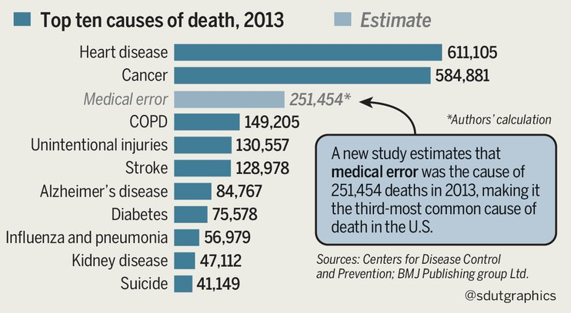
Department of Pathology

Slide 40
ICD-10 Coding System
Cannot Capture Medical Errors
Myocardial infarction | X
Stroke | X
Cancer | X
Diabetes | X
Myocardial infarction thought to be anxiety 3 days earlier | ?
Department of Pathology

Slide 41
Recognition of
Medical Errors in the US

Slide 42
1999: “To Err is Human”
~ 100,000 Preventable Deaths in the US
Subgrouping Types of Medical Errors:
Procedural and Pharmaceutical Which are Possible to Estimate
What about diagnostic errors?

Slide 43
The National Academy of Medicine Report on Diagnostic Errors:
This 2015 Report is the Enabler Pathology has Long Needed to Address Our Involvement in Increasingly Serious Problem of Obtaining an Accurate Diagnosis Quickly at the Lowest Cost

Slide 44
There are an estimated
64,000 deaths annually
due to diagnostic error,
This is the largest subgroup of medical errors
Department of Pathology

Slide 45
Four Major Conclusions of the National Academy of Medicine Report on Diagnostic Error in the US 2015
Diagnostic error is the major contributor to preventable death of all medical errors |  | Diagnosis should be a “team sport”
Diagnostic error has been poorly recognized for decades |  | No practitioner can be current without input of expert diagnosticians

Slide 46
Selected Quotes from Distinguished Practitioners on the Committee Who Have Studied Diagnostic Error
When Hearing About the Impact of an Effective Diagnostic Team

Slide 47
“I had no idea what I did not know.”
“I realize in this moment I have personally made many diagnostic errors.”
“What are the obstacles to widespread implementation of expert diagnostic teams?”
“Doctors almost never know which test methods are used to generate results, even it has great clinical significance.”

Slide 48
How Easy is it for a Bright, Well-intentioned Clinician to Create a Diagnostic Error?

Slide 49
Examples:
Cystic Fibrosis
Venous thrombosis
Child Abuse

Slide 50
Cystic Fibrosis

Slide 51
How Well Can a New Doctor Recognize Cystic Fibrosis?
How Well Can a Specialized Pulmonologist Understand the Complex Genetics of
˃ 2000 Mutations?

Slide 52
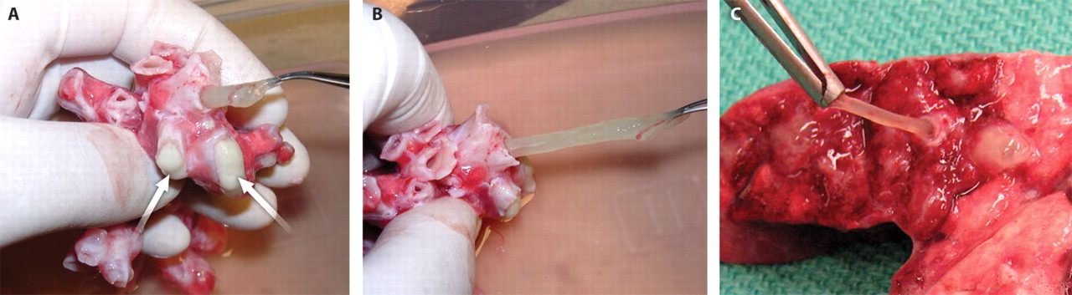

These airways, obtained during a lung transplantation performed on a 15-year-old CF patient, show mucus obstructions observed in the removed CF lungs
Published by AAAS
Notes:
(A and B) These airways, obtained during a lung transplantation performed on a 15-year-old CF patient, show two kinds of mucus obstructions observed in the removed CF lungs: a more common form of purulent, ivory, semi-liquid mucus [see arrows in (A)] and a less common form of translucent, resilient, elastic mucus, shown here being stretched and pulled from a bronchus [(A) and (B)]. Compare with (C), in which translucent mucus is being pulled from the airway of a CF pig described in Stoltz et al. and shown in their Fig. 3B, right panel (11).

Slide 54
Child Abuse

Slide 55
What Happens When a Bleeding Disorder is Missed by a Pediatrician, and a Loving Caregiver is Accused of Child Abuse?

Slide 56
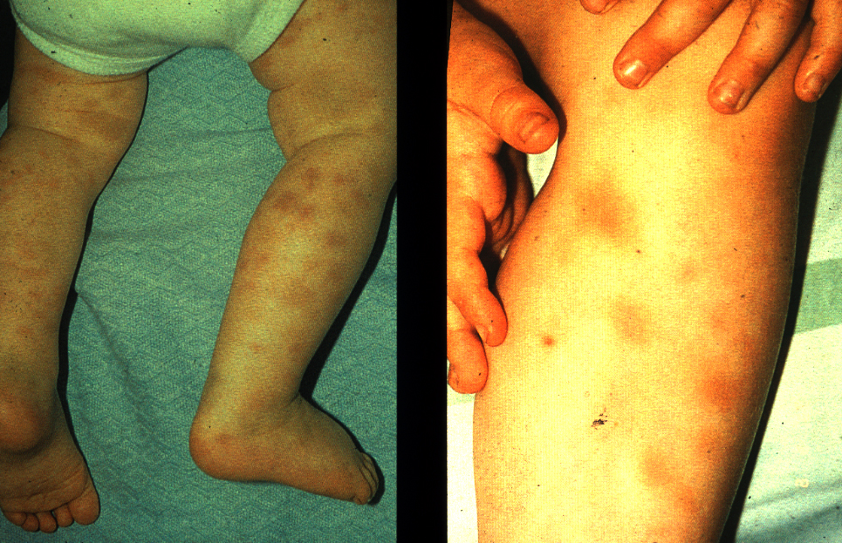
Physical Signs of Child Abuse, Saunders, 1996

Slide 57
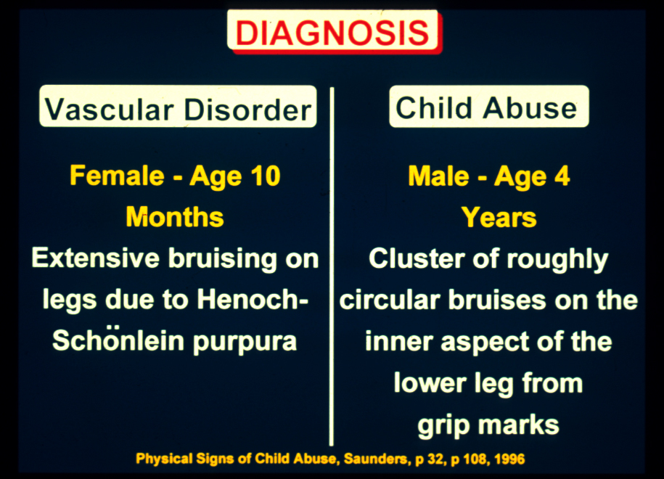

Slide 58
The Child Abuse DMT Effort
Number of Cases:
˃ 130
Innocent Parents and Loving Children Reunited in Some Way:
˃ 100

Slide 59
Part 2
Devise a solution to the problem which is effective and feasible

Slide 60
What is the Diagnostic Management Team?

Slide 61
Conventional Approach
Ordering
Doctors
Diagnostic
Doctors
Isolated Diagnostic
Bits of Data -
Assembly by Ordering Physician
Minimally Trained in Test Selection
and Interpretation

Slide 62
Diagnostic Management Team (DMT) Approach
Conferring
Diagnostic Doctors
Ordering
Doctors
!!!!
!!!!
o
Caring for More
Patients While
Diagnostic
Puzzle is Being
Assembled
Isolated Diagnostic Bits of Data
Being Merged with Clinical Data
about the Patient by the Diagnostic Doctors

Slide 63
Diagnostic Management Team Approach
Ordering
Doctors
Conferring
Diagnostic Doctors
Solved Diagnostic Puzzle
!!!!
!!!!
o
There Is No Wall
between the Ordering Doctors
and the Diagnostic Doctors
Receives Accurate
Diagnosis Quickly
as a Completed Puzzle

Slide 64
Diagnoses in Which Consultative Information Can Be Provided by Laboratory Experts in
Real-time, Unlike Those Where a Diagnosis Must Be Made in Minutes
This is the Vast Majority of Diagnoses Beyond the Common Illnesses

Slide 65
Instead of Providing Information that is a Set of Numbers,
Difficult to Understand Abbreviations of Test Names,
or Simple “Positive” or “Negative” Answers, an Understandable Narrative Report is Delivered

Slide 66
Data Presentation in the Medical Record for Coagulation Studies Prior to Initiation of the Patient-specific,
Expert-driven Coagulation Interpretations
JUNE 30, 2010
Pat-PT: 13.9 PT-inr: 1.1 PTT-pt: 43.6* PoolNP: 28.1 P+N0Hr: 38.3 P+N1Hr: 36.2 P+N2Hr: 35.9 Pat-TT: 15 F8Act: 95 F9Act: 102 RVVT: 1.5* DRVVT: Lupus Anticoagulant Confirmed DMX: 1.3 F11Act: 96 F12Act: 54

Slide 67
Report in the Medical Record After Initiation of the Daily Rounds to Interpret All Complex Evaluations from the Special Coagulation Laboratory

Slide 68
JULY 1, 2010
This patient has an elevated PTT, with a normal PT/INR and normal thrombin time.
A PTT mixing study failed to correct into the normal range. These results were consistent with the presence of an inhibitor (such as a lupus anticoagulant) in the sample.
The Dilute Russell Viper Venom time (dRVVT) is used for detection of Lupus Anticoagulant, and the test was positive, indicating the presence of Lupus Anticoagulant.

Slide 69
Conclusion
Taken together, this is a patient with a prolonged PTT based upon the presence of a lupus anticoagulant. There is no increased bleeding risk in this patient, despite the prolonged PTT.

Slide 70
Official Definition: Diagnostic Management Team (DMT)
Unless all four of the following are met,
a group cannot be designated as a DMT
1. Team must meet frequently and regularly and provide patient-specific reports with no request required to provide an interpretation
2. Report must be delivered before or during the time when treatment decisions are made

Slide 71
Official Definition: Diagnostic Management Team (DMT)
Unless all four of the following are met,
a group cannot be designated as a DMT
3. Report must consider the clinical context in which the diagnostic tests are ordered, and attempt to synthesize all relevant diagnostic test results
4. Report must be entered into the patient’s medical record

Slide 72
Goals of a DMT
Involve diagnostic experts
with high-level content knowledge to:
Shorten the time to diagnosis
Increase the accuracy of diagnosis
Optimize the utilization of laboratory tests

Slide 73
An expert can be anyone in our specialty or another one, independent of degree, who can contribute valuable clinical information to a diagnosis under consideration

Slide 74
Can Non-MD Experts Lead a DMT?
A major problem is that non-MD experts feel uncertain about their knowledge of clinical medicine
The perception by non-MDs that MD experts have in-depth knowledge into all clinical presentations and all diagnostic procedures is incorrect
Expert level information can be learned by
non-MDs in a matter of months, and then as more cases are encountered, the expertise grows

Slide 75
How does a DMT save money?
BETTER UTILIZATION
Experts Know Better Which Tests to Select and Can Minimize Overutilization and Underutilization of Diagnostic Tests and Reach a Definitive Diagnosis Sooner
with Fewer Studies

Slide 76
For Those Departments with Active DMTs, the question is often posed “How Much Did the DMT Save by Establishing the Correct Diagnosis Accurately with the Right Number of Tests?”

Slide 77
That Number is Only Able to Be Estimated, But Can Provide a Clear Answer That It Saves Money

Slide 78
Quantitation of Savings by the DMT is a Common Challenge to Not Invest in Diagnostic Teams
Missing the Diagnosis
of Deep Vein Thrombosis
How much does it cost?
It depends upon what might happen, and the cost of the different outcomes varies widely
Cannot “Roll the Camera Forward and
then Wind It Back”

Slide 79
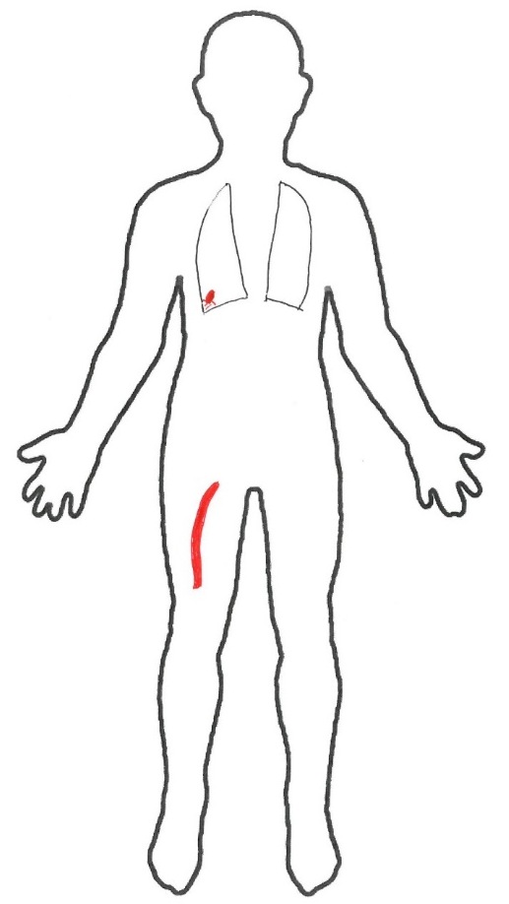
Options 1 and 2
Option 1:
Clot stays in leg
Active fibrinolysis and clot dissolves on its own
Cost: < $2000
Option 2:
Small embolism-asymptomatic
Cost: < $2000
Option 2
Option 1

Slide 80
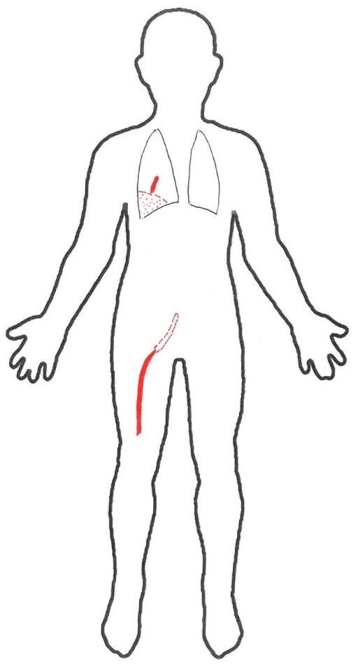
Options 3 and 4
Option 3:
DVT enlarges inducing permanent post-phlebitic syndrome
Cost: $100k to 150k/yr
for up to 2-3 years and $20-50k for decades
Option 4:
Symptomatic pulmonary embolism: Major lung infarction
Cost: $100k to 200k/yr for 2-3 years, and $20-50k for decades
Option 4
Option 3

Slide 81
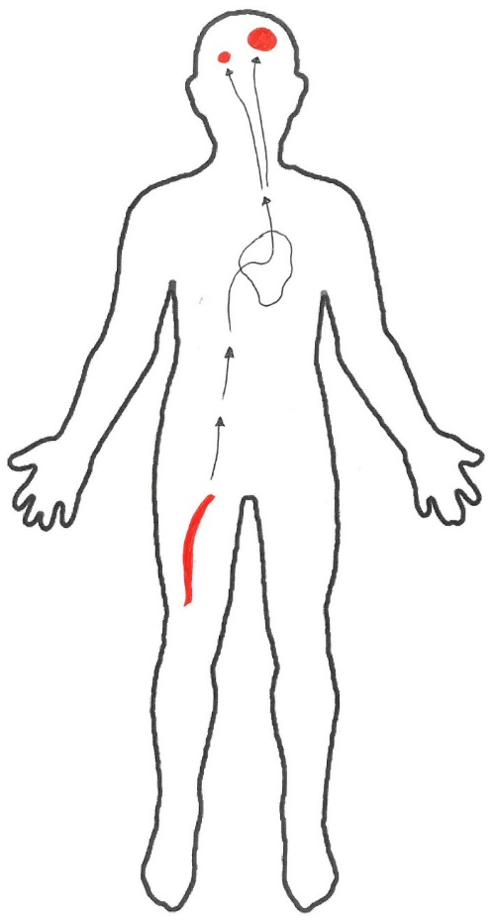
Options 5 and 6
Option 5:
Patient has patent foramen ovale (PFO)
DVT goes to brain instead of lungs
Minor-to-moderate stroke
Cost: $100k to 200k/yr for 2-3 years and $20-50k for decades
Option 6:
Patient has PFO
Large embolus produces major disabling stroke
Cost: $200-500k/yr for 2-3 years, and $50-100k for decades
Option 6
Option 5

Slide 82
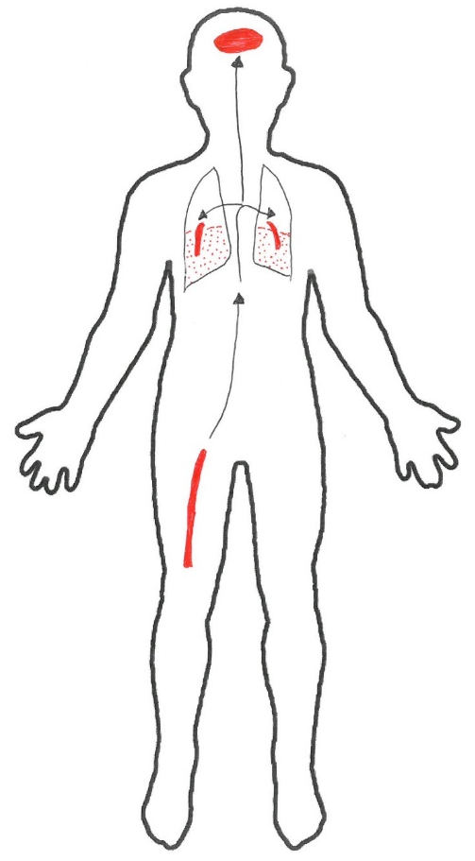
Options 7 and 8
Option 8
Option 7:
Lethal pulmonary embolism
One time cost: < $2000
Option 8:
Lethal stroke
One time cost: < $2000
Option 7

Slide 83
Deep Vein Thrombosis
Becomes an Asymptomatic Pulmonary Embolism
$
Becomes a
Life-threatening Pulmonary Embolism
$$$$
Resolves
Spontaneously
$
Enlarges
Within a Leg Vein
$$$
How much did the diagnostic error of missing the deep vein thrombosis cost?
Becomes a Treatable Thromboembolic Stroke
$$$$
Becomes a Devastating Stroke with Debilitation
$$$$$
$$$$$
Distribution of These Six Different Outcomes Varies Greatly Between Institutions

Slide 84
The immediate effect of omitting an imaging study and a D-Dimer test is a savings of $375 to $800
But what are the costs?
Impossible to know exactly,
but is it possible to show it’s larger than $800/case?

Slide 85
Approximate Financial Analysis for 500 Bed Hospital with One DVT Complication
Options 3, 4, and 5 | 182 events x $50k/year = $ 9,100,000
Option 6 | 12 events x $500k/year = 6,000,000
 | $15,100,000
If 10% of Complications are Prevented,
By Expert Input, $1,500,000 Saved

Slide 86
MSDRG 176: PE
Aquino AC, Cap Today, October 2017

Slide 87
MSDRG 65 Intracranial Hemorrhage
Aquino AC, Cap Today, October 2017

Slide 88
Patient-facing
Healthcare Providers,
Talented and
Dedicated or Not,
Make Many Diagnostic Errors

Slide 89
Important Parameters of Our Consultative Role

Slide 90
American Football has Offensive and Defensive Teams
Medicine Across the Globe Needs Teams that Focus on Diagnosis and Teams that Focus on Treatment

Slide 91
US
Contribution
to Correct Diagnosis
Contribution
to Correct
Treatment
- - - - - - - - - - - - - - - - - - - - - - - - - - - - -
US
Treating Physicians
Diagnostic Physicians and Scientists

Slide 92
Clinical Laboratory Leaders
Anatomic Pathologists
Radiologists
Who know far more about a focused diagnostic evaluation
A block here is catastrophic
Need to Inform:
Physician, Mid-level Provider, or Nurse
Who have limited knowledge about the tests a patient will undergo

Slide 93
The Concept that “If We Don’t Do It, Someone Else Will” Has Not Turned Out to be True
Instead
It is Clear that if We Do Not Greatly Improve the Transmission of Diagnostic Information, the Quality of Care will Continue to Deteriorate While it Becomes Even More Expensive

Slide 94
Why Have Diagnostic Laboratory Experts Primarily Been Standing on the Sideline Since Our Specialty was Created?
Is the Reason External to
Us in Laboratory Medicine?
Is it Because of Us?

Slide 95
In the 1990s Clinicians Could Read
X-rays and Understand the Clinical Significance of Results for Common, Inexpensive Tests
Society and Most Healthcare Providers Think This is Still True, Even Though the Test Menu has Increased, From Less than a Hundred Tests to Greater Than 5,000!

Slide 96
Is There Payment for the Consultative Service of Directing Test Selection and Providing Test Result Interpretation?

Slide 97
We Need to FIRST Become Diagnostic Experts to Meet Current Needs, Showing that it Makes a Clinical and Financial Difference
Even if These Needs are Not Currently Recognized by Most Providers, Administrators, and Patients
What Comes First?

Slide 98
There is Great Skepticism Inside and Outside Our Field that Laboratory Directors Can Be Effective Consultants Who are Perceived as Managers with Little or No Clinical Knowledge

Slide 99
Payment Options
for DMT Services
Insurance (MD/DO)
Fee for Service
Contract with an Institution or Pathology Practice

Slide 100
Savings Impact is Greater than Revenue Impact
The DMT Impacts Savings Much More Than Revenue
and
No Credit is Offered by Most Healthcare Institutions for Saving Money
Only for Generating Revenue
Chief Financial Officers Often
Disbelieve Savings will Occur or Attribute Savings to Others

Slide 101
Changes in Clinical Needs that Significantly Affect Our Profession

Slide 102
There are Major Changes Ongoing with the Sister Diagnostic Specialties of Radiology and Anatomic Pathology

Slide 103
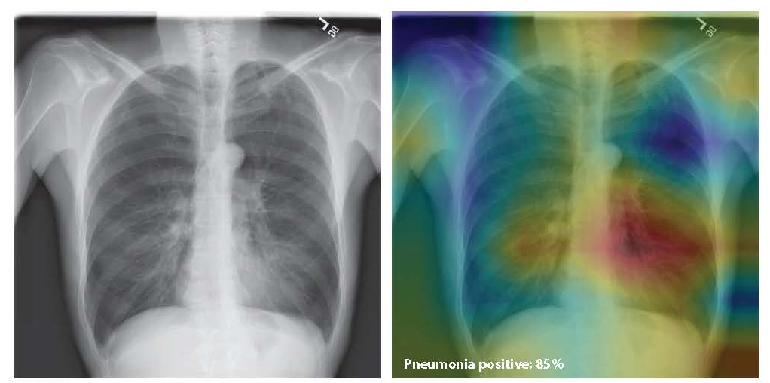
In this demonstration from the Stanford ML Group, researchers built a 121-layer convolutional neural network that inputs a chest X-ray image and outputs the probability of pneumonia along with a heatmap. After training on an NIH dataset, the CheXNet network was tasked with a new set of 420 Images. It outperformed four practicing Stanford University radiologists in diagnostic accuracy.
Kwon S. Managed Care. July/August 2019, pg. 18

Slide 104
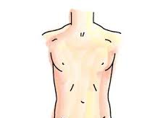
Do This Thousands of Times:
Then Computer Knows It Is a Hepatoma
Electronic Image:
Electronic Report:
Hepatoma,
Not hepatitis
Features of the mass:
Granularity
Size
Shape
Density

Slide 105
What are Current Management Responsibilities for Laboratory Directors and What is a Practical and Feasible Approach to Change?

Slide 106
Implementation of a Global DMT Service Provided by Experts Who are Paid for Their Services

Slide 107
Our Current Responsibilities as Laboratory Directors Include:
Test Implementation
Personnel Management
Financial Management
Leadership on Regulatory Issues
Consultation with Clinical Lab Scientists
Consultation with Healthcare Providers, when asked
Provision of Information/
Data to Institutional Leadership

Slide 108
Our Current Management Responsibilities Include:
AND THERE ARE MANY MORE
IT IS A FULL TIME JOB

Slide 109
Are There Two Hours in
Each Day for Each of Us to Become a True Diagnostic Expert Over Three to Six Months in a
Field of Special Interest?
Even a clinical area?
Not Just for Your Institution, but Globally!

Slide 110
Starting Point:
Create a starting “book” of comments used frequently to efficiently formulate patient-specific interpretations in the disease category with your expertise
Initiate a pilot Diagnostic Management Team locally that meets often enough to provide expert diagnostic advice in real-time

Slide 111
Begin to enter interpretations of test results and recommendations for diagnostic testing into the chart at your institution
Become an expert locally and then nationally and globally to assist colleagues and get paid to do it
YOU WILL ENHANCE THE REPUTATION OF LABORATORY MEDICINE BY SERVING AS A DIAGNOSTIC EXPERT

Slide 112
How Will a Consult Service in Laboratory Medicine, on Test Selection and Result Interpretation, Evolve?
Can the AACC Lead the Implementation with Its Global Presence?

Slide 113
What Cannot Work
One medical center with laboratory experts in dozens of clinical areas
No institution has a diagnostic expert for all diseases
X

Slide 114
One Plan is to Create Regional, National or Global Diagnostic Management Teams,
with Experts Passing a Certifying Exam, Independent of Doctoral Degree

Slide 115
One Solution is to Provide Consults with Enough
Experts to Cover Most Clinical Diagnoses
Combine experts within different hospitals in a healthcare enterprise
Utilize a regional DMT, with payment for services, can be made similar to payment for send-out testing

Slide 116
The Number of DMTs in an
Institution is Unrelated to Its Size
 | Relative Size (1-10) | Number of DMTs by Topic
Hospital A | 10 | 3
Hospital B | 6 | 5
U Texas Galveston (UTMB) | 5 | 8

Slide 117
A Team of National Experts Can Be Created for Those Who Want to Use It
 | Location | Accepted # of Cases/Day | Days of the Week
Expert A | TX | 10 | Mon-Tue
Expert B | MA | 5 | Wed-Fri
Experts C-X | Anywhere | 5-10 | Any day

Slide 118
Possibility 1 for Creation of National Expert Teams
Create a Large Independent Company Paying Content Experts and Managing Influx and Outflux of Data?
Model: Best Doctors

Slide 119
Possibility 2 for Creation of National Expert Teams
Diagnostic Service Managed at a Selected/Willing Academic Medical Center
Model: UTMB with its Experience in Initiating DMTs

Slide 120
Possibility 3 for Creation of National Expert Teams
A Consulting Arm is Built within an Existing Large Commercial Laboratory that Performs Testing, with a Nationwide/Global
Team of Experts
Model: Pick Your Large
Reference Lab

Slide 121
Dramatic Increases in the Number of Accurate Diagnoses Will Occur Within a Much Shorter Timeframe of the Patient’s Illness
Rapid and Accurate Diagnosis will Significantly Reduce the Number of Patients Who Would Otherwise Develop Painful and Expensive Chronic Disease
What Will Surely Happen
if Done Well

Slide 122
With Diagnostic Expertise From Us, Fewer Diagnoses are Delayed or Missed, and, as a Result . . .
Fewer Preventable Deaths
Fewer Patients with Preventable Chronic Disease

Slide 123
A Great Improvement in
Test Utilization
Not by Creating Rigid Rules for Test Use
But by Utilizing Experts Evaluating the Records of Patients Presenting in a DMT Meeting

Slide 124
Concluding Remarks

Slide 125
Where Are We Now?
Diagnostic Error is Widely Recognized
We are Identified as Technical Experts on Laboratory Testing and Less so as Diagnostic Experts
Medicine Has Not Rolled Out a Red Carpet
for Us, But the Barbed Wire Preventing
Our Participation is Gone

Slide 126
It Has Been Difficult Up to Now to Be Heard, Even if We Know the Most Essential Information
Little-to-no Pay for Consultation on Diagnostic Evaluation
Little-to-no Recognition of
Expert Knowledge Base
Perception of Us

Slide 127
We Need to Contribute More Than Just a Test Result
We Need to Provide Information that Helps Patients Get a Rapid and Accurate Diagnosis with Only the Correct Tests

Slide 128
The Door is Formally and Publicly Opened for Expert Laboratorians to Participate and to Lead
A Team of Providers Who Provide an Accurate
Diagnosis Rapidly

Slide 129
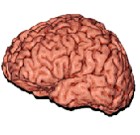
Has the right test
been ordered?
Error between result
receipt and action?
Action
Ordering
Interpretation
A New Most Important Role is Off the Original
Brain-to-Brain Loop
Collection
Reporting
Identification
Analysis
Transportation
Preparation
The nine steps in the performance of any laboratory
test. The brain-to-brain turnaround time loop.
Department of Pathology
Lundberg, 1981

Slide 130
Who Can Provide this Consultation on the Diagnosis?
Someone Who Knows the Correct Tests and the Diagnostic Parameters of the Tests in Use
Someone Who Can Expedite a Clinical Diagnostic Evaluation Because They Are In Charge of Diagnostic Testing in the Laboratory

Slide 131
THE MOST QUALIFIED GROUP
OF INDIVIDUALS in healthcare to make this essential contribution and rapid diagnosis
IS US!

Slide 132
We Must be Ready for the Moment When Millions of Patients Realize that Their Complex Diagnosis Could Have Been Made with Less Suffering and Less Cost

Slide 133
The History of Medicine Has Its Eyes Upon Us
Today

