Slide 1

Cancer Genome Scanning in Plasma:
Detection of Tumor-Associated Copy
Number Aberrations, Single-Nucleotide
Variants, and Tumoral Heterogeneity by
Massively Parallel Sequencing
K.C.A. Chan, P. Jiang, Y.W.L. Zheng, G.J.W. Liao,
H. Sun, J. Wong, S.S.N. Siu, W.C. Chan, S.L. Chan,
A.T.C. Chan, P.B.S. Lai, R.W.K. Chiu, and Y.M.D. Lo
January 2013
www.clinchem.org/content/59/1/211.full
© Copyright 2013 by the American Association for Clinical Chemistry

Slide 2
Introduction
Tumor DNA in plasma
  Present in patients with cancer
  Detected using mutations, DNA methylation changes and viral nucleic acids
  Previous studies typically based on one or a small number of nucleic acid markers
New approach
  Shotgun DNA sequencing
  Scanning of entire genome

Slide 3
Introduction
Shotgun sequencing of plasma DNA
  Based on massively parallel DNA sequencing
  Random sequencing of millions to billions of
  DNA molecules in plasma
  Requires extensive bioinformatics support
  Similar method previously used for noninvasive prenatal diagnosis

Slide 4
Question 1
What types of tumor-associated molecular aberrations can be detected in the plasma of patients with cancer?

Slide 5
Materials and Methods
Samples:
  4 patients with hepatocellular carcinoma (HCC)
  4 patients with chronic hepatitis B infection without HCC
  1 patient with synchronous breast and ovarian cancers
  16 healthy control subjects
Massively parallel DNA sequencing
  Performed on plasma DNA, buffy coat and tumor tissues
Fractional concentrations of tumor DNA in plasma
  Measured by summing up allelic counts of single nucleotide polymorphisms showing allelic losses in tumors

Slide 6
Materials and Methods
Copy number aberrations:
  Divided genome into approximately 3,000 windows of 1Mb each
  Compared each window in each cancer patient and chronic hepatitis B carrier with the corresponding window of the 16 controls
Single nucleotide variants (SNVs)
  Compared sequencing data from tumor tissues and buffy coat DNA from the same patient
  Worked out tumor-associated SNVs, i.e. point mutations
  Looked for such tumor-associated SNVs in the sequencing data of the plasma DNA from the same patient

Slide 7
Question 2
What statistical procedure can be used for detecting copy number aberrations in the plasma of patients with cancer?

Slide 8
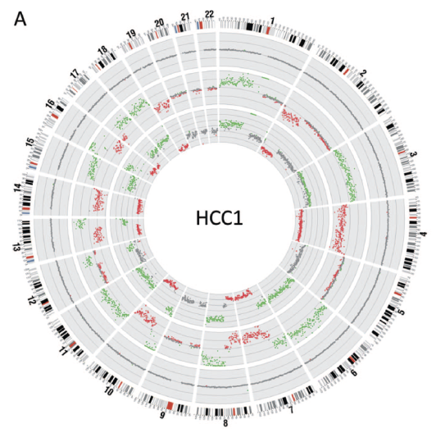
Main results
Figure 1. Copy number aberrations in the tumor (inner-most circle), pre-surgery plasma (middle circle) and post-surgery plasma (outer-most circle) of one of the HCC patients. Note that the pre-surgery plasma contains the copy number gains (green) and losses (red) patterns of the tumor.

Slide 9
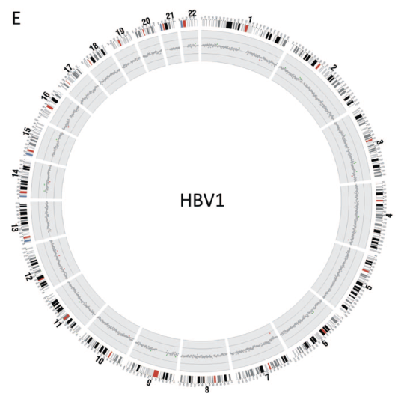
Main results
Figure 2. Copy number analysis in the plasma of a chronic hepatitis B carrier without HCC. Note the striking difference between these results and those of the pre-surgery plasma of the HCC patient shown in Figure 1.

Slide 10
Main results
Tumor-associated copy number aberrations in plasma
  Larger tumors were associated with higher fractional concentrations of tumor DNA in plasma
  More aberrations were detectable in patients with larger tumors
  2-copy gains were more readily detectable than 1-copy gains and 1-copy losses
  Fractional concentrations of tumor DNA in plasma decreased after surgical removal of HCC

Slide 11
Main results
Applications to complex oncologic scenarios
  Plasma receives DNA from tumors from multiple sites, including from multiple tumor types
  Contribution from each site and tumor type can be measured by shotgun sequencing of plasma DNA
  Useful for noninvasive monitoring of tumoral heterogeneity (see Editorial by Swanton. doi:10.1373/clinchem.2012.197053)

Slide 12
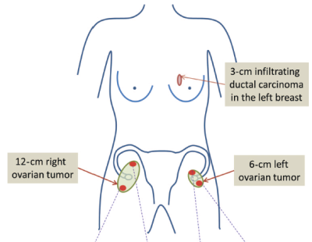
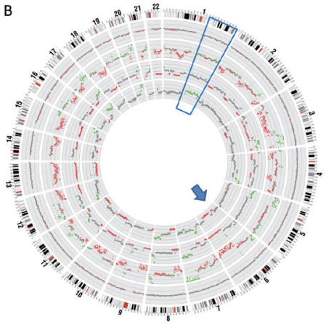
Main results
B
A
Figure 3. Copy number analysis in the plasma of the patient with synchronous breast and bilateral ovarian cancers. (A) shows locations of the tumors. (B) shows copy number aberrations in breast (inner-most circle), one region of the ovarian cancer (second circle from inside), pre-surgery plasma (third circle from inside) and post-surgery plasma (outer-most circle). Note that the pre-surgery plasma contains the composite copy number gains (green) and losses (red) patterns breast and ovarian tumors. Genomic regions containing the copy number aberrations specific to either the breast (marked by quadrangle) or ovarian cancer (marked by arrow) can be used to measure the tumor DNA in plasma contributed by each tumor.

Slide 13
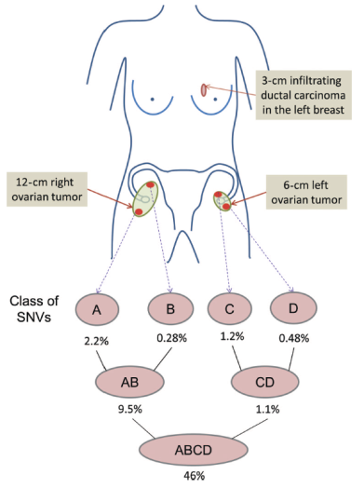
Main results
A
Figure 3. Contribution of SNVs associated with different regions of the ovarian cancer in plasma. A, B, C and D represent SNVs present in only one of the 4 sampled regions. AB represents SNVs present in both regions A and B. CD represents SNVs present in both regions C and D. ABCD represents SNVs present in all 4 regions. The percentages indicate the proportion of plasma DNA contributed by each class of SNVs.

Slide 14
Question 3
What are the advantages and disadvantages of detecting tumor-associated copy number aberrations versus single nucleotide variants?

Slide 15
Conclusions
Shotgun sequencing of plasma DNA in cancer patients allows the genome-wide profiling of cancer-associated genomic aberrations
This technology allows tumor detection, serial monitoring, prognostication and analysis of tumoral heterogeneity
Validation on more cases and more tumor types needed

Slide 16



Thank you for participating in this month’s
Clinical Chemistry Journal Club.
Additional Journal Clubs are available at
www.clinchem.org
Follow us

