Slide 1
Electronic Medical Record–Based Performance Improvement Project to Document and Reduce Excessive Cardiac Troponin Testing
S.A. Love, Z.J. McKinney, Y. Sandoval,
S.W. Smith, R. Kohler, M.M. Murakami,
and F.S. Apple
March 2015
www.clinchem.org/content/61/3/498.full
© Copyright 2015 by the American Association for Clinical Chemistry

Slide 2
Introduction
Rising costs of US healthcare is of major concern
  Per-day hospital costs have increased
    $1400 in 1997
    $2000 in 2009
  Tightening hospital budgets and changes in reimbursements
  Impacts felt by patients, providers, and hospitals
Improving value in healthcare through resource management
  ‘Choosing Wisely’
    Initiative to reduce unnecessary tests/procedures
    Recommendations from 70 participating societies
  Recently ACC/AHA addressed need for resource and value considerations during guideline creation

Slide 3
Introduction
Cardiac troponin (cTn) is a biomarker of myocardial injury
  Preferred biomarker for diagnosis of myocardial infarction
  Elevations can be due to acute coronary syndrome (ACS) or non-ACS conditions
  Clinical context is key to appropriate interpretation
Primary objectives of study
  Identify overutilization of cTn after diagnosis had been made
  Identify reasons was excessive orders occur
    Providers ordering cTn beyond initial 4 results
    Clinical context for additional cTn orders

Slide 4
Question 1
Cardiac troponin testing has come under scrutiny due to its overuse in non-ACS related emergency department visits¹
How does clinical sensitivity and specificity of cardiac troponin
testing impact its use:
  In the emergency department?
  By cardiologists?
  For measuring in the central laboratory?
  For measuring by POC testing
  ¹See accompanying editorial on this article:
  Clin Chem 2015;61:456-8.

Slide 5
Materials & Methods
Implemented changes to cTn ordering in EHR
  Hospital-wide serial orders for 4 cTnI results at: 0, 3, 6, and 9 hours
    0 hour = presentation in ER or new suspicion of ACS in hospital
    Uncollected samples could be canceled if not needed
  New best practice alert (BPA) to providers
  Providers could select answer or override BPA

Slide 6
Materials & Methods
Measurement of cTnI using
  Abbott Architect i1000_{SR} (ER lab) and i2000_{SR} (central lab)
  99th percentile upper reference limit = 0.025 mg/L
    Contemporary assays
Data collection and analysis
  Using standard query language from EHR relational database
  Alert variables collected over two months in 2013
  All instances of BPA triggering were included in the study

Slide 7
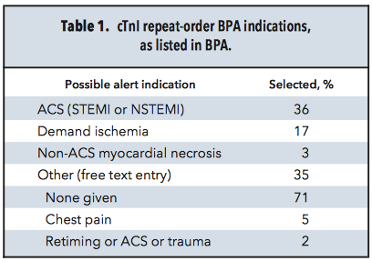
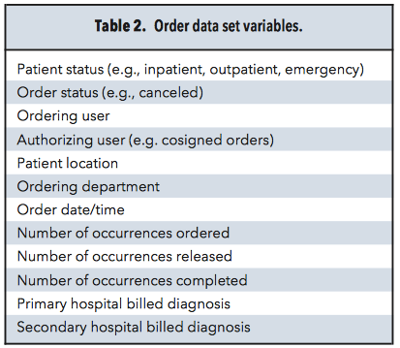
BPA Indications & Collected Variables
Table 1 & 2. cTnI repeat-order BPA indications (as listed in BPA) and Order data set variables, respectively.

Slide 8
Question 2
The Abbott cTnI assays used were contemporary assays. How would the use of the high sensitivity cTnI Abbott assay have affected
  data collection?
  results interpretation by providers?

Slide 9
Results
The BPA was triggered 1477 times by 423 providers who cared for 702 patients
There were a mean of 3.6 cTnI results per patient, 2.1 BPAs per patient, and 1.2 visits per patient
Providers (42% of whom were residents) acknowledged and overrode the BPA 97% of the time

Slide 10
Results
In response to the BPA, 65% of providers selected a
prepared rationale
  64% ACS/ST-elevation MI/non–ST-elevation MI
  30% demand ischemia
  6% non-ACS myocardial necrosis
Of the remaining 35% of providers, 71% listed no rationale
for their additional cTnI orders

Slide 11
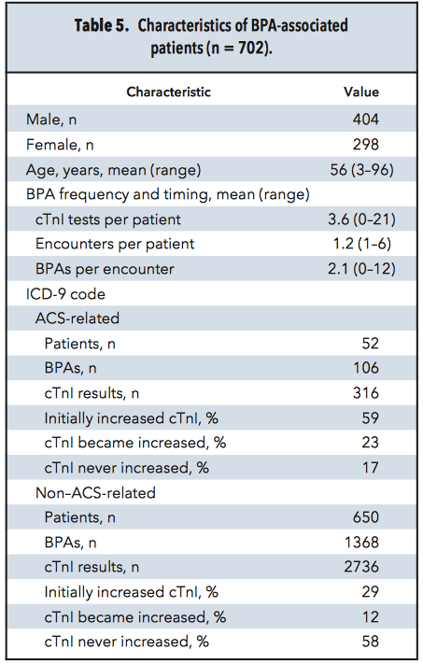
Patient Characteristics
Table 5. Characteristics of BPA-associated patients (n= 702).

Slide 12
Results
Of patients with a BPA, 93% had non–ACS-related primary International Classification of Diseases, Revision 9 diagnosis
  >58% of the time, patients' cTnI results never increased during their stay
  >In 53% of cases, BPAs were generated by a request for an additional cTnI series when <2 results were available

Slide 13
Mean Number of cTnI Results Per Patient
Figure 2. Box-and-whisker plot of number of cTnI results per patient, in ACS and Non-ACS (A) patients and number of cTnI results per patient, by BPA alerting primary provider’s clinical role (B). PGY, postgraduate year; RN, nurse; MD, doctor; PA, physician assistant.

Slide 14
Question 3
What approach has your lab tried to change ordering cTn practices and thereby decrease the overuse of cTn testing to rule in or rule out MI?

Slide 15
Conclusions
cTnI testing for diagnosis and exclusion of AMI is over-utilized
2. Visual alerts did not result in a decrease in excessive cTnI orders by providers, even after a diagnosis was determined
3. The largest number of ignored alerts was in non-ACS patients
4. Even providers treating patients already diagnosed with AMI practiced excessive cTnI ordering
More appropriate cTnI utilization could provide substantial financial savings without compromising patient care. Effective means of encouraging appropriate utilization need to be explored.

