Slide 1
MicroRNA In Vitro Diagnostics by
Use of Immunoassay Analyzers
A. Kappel, C. Backes, Y. Huang, S. Zafari,
P. Leidinger, B. Meder, H. Schwarz,
W. Gumbrecht, E. Meese, C.F. Stähler, and
A. Keller
April 2015
www.clinchem.org/content/61/4/600.full
© Copyright 2015 by the American Association for Clinical Chemistry

Slide 2
Overview
Challenge
  Translation of molecular markers into tools that are clinically useful requires standardization and simplicity of their measurement
  microRNAs are currently on the brink of moving from research to application
  For clinical routine, highly automated and widely available laboratory methods are needed to measure microRNA panels
microRNA Immunoassays
  Translate measurement of microRNAs from NGS / array / qRT-PCR to an established immunoassay format
  Measure microRNAs on a system that is installed and in routine use in many central labs

Slide 3
Introduction
Novel markers frequently require novel technologies for clinical application.
Single markers are increasingly combined into signatures.
microRNAs are currently migrating from basic research to application.
Often, sets of 4-20 selected microRNAs need to be tested.
Respective test systems (microarray, qRT-PCR, NGS) are usually not established in routine care.
➔ An inexpensive, standardized, and widely available assay format with multiplexing capacity – such as immunoassay - could foster the translation of microRNAs into clinical care.

Slide 4
Introduction – Key Questions
How “integrated” must a respective test be? From blood sample to diagnosis in one system?
How fast will complex systems like NGS migrate to routine care - if migration happens at all?
Will respective tests be done predominantly at the point of care or in central labs?

Slide 5
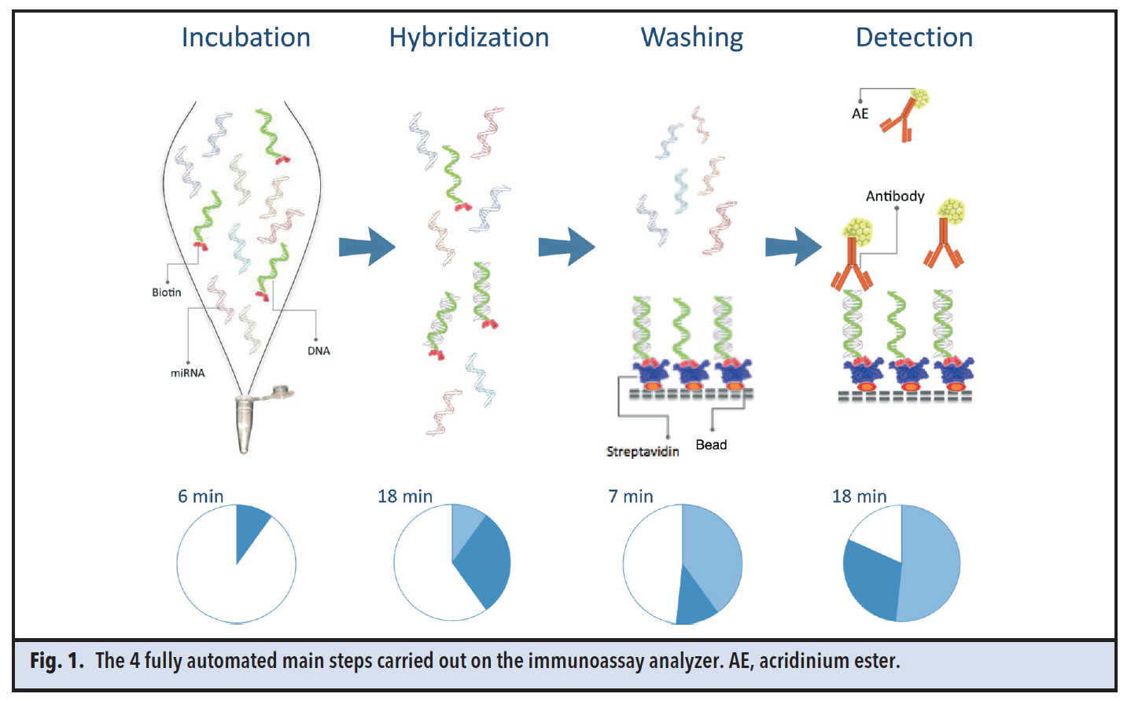
Materials & Methods
Starting material: total RNA from 2.5 ml PAXgene blood samples
Assay is performed on the Advia Centaur® immunoassay analyzer
Assay principle (Figure 1):
Total RNA is hybridized to biotinylated catcher oligonucleotide, generating DNA/RNA heterohybrids
Heterohybrids bind to streptavidin-labeled solid phase
Acridinium ester–labeled antibody is added to DNA/RNA heterohybrids
Chemiluminescence detection
Figure 1. The 4 fully automated main steps carried out on the immunoassay analyzer. AE, acridinium ester.

Slide 6
Materials & Methods – Key Questions
Is the runtime of the assay (~1 hour) acceptable?
Is the 3 hour time-to-result acceptable?
What degree of multiplexing is required / acceptable?

Slide 7
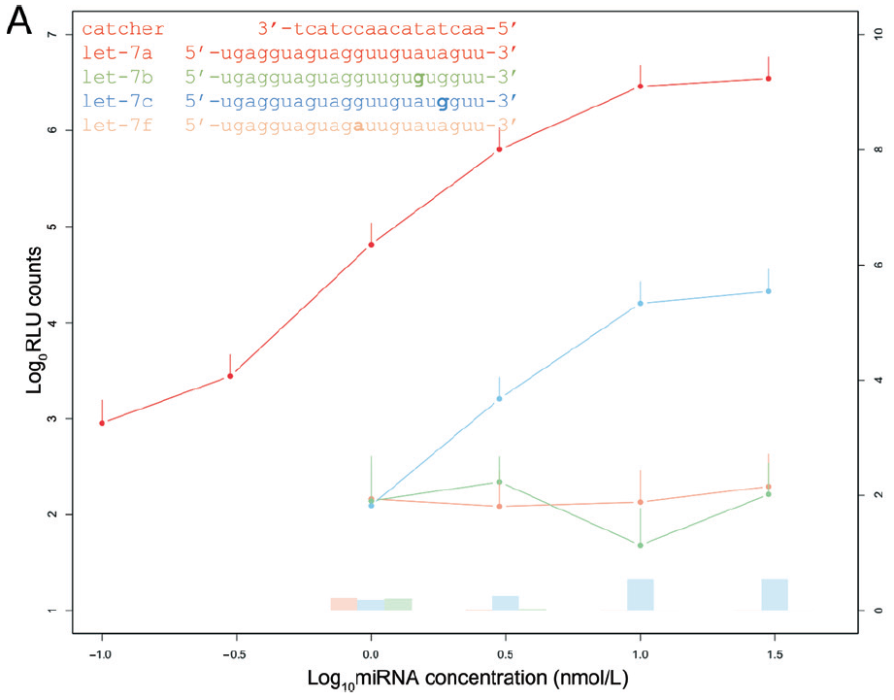
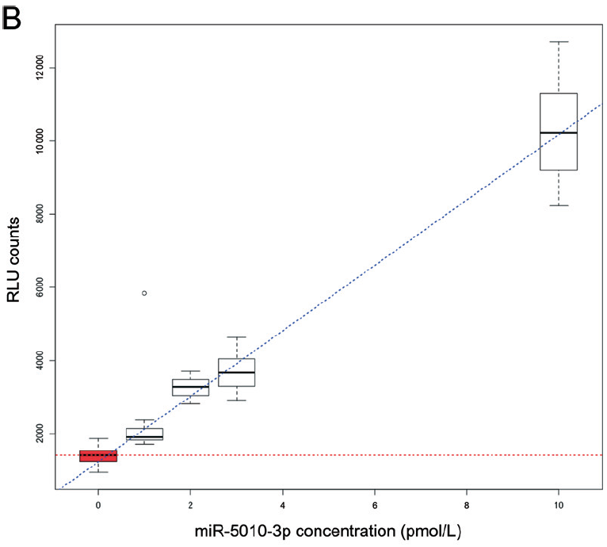
Results
Assay characteristics:
  Technical specificity: 99.4% (upper right panel)
  Limit of detection: 1 pmol/L (lower right panel)
  dynamic range of 4 orders of magnitude
  10% change in concentration can reliably be measured
  serial 8-plex measurement allows for detecting profiles of up to 8 microRNAs
Figure 2. Technical specificity and analytical sensitivity.

Slide 8
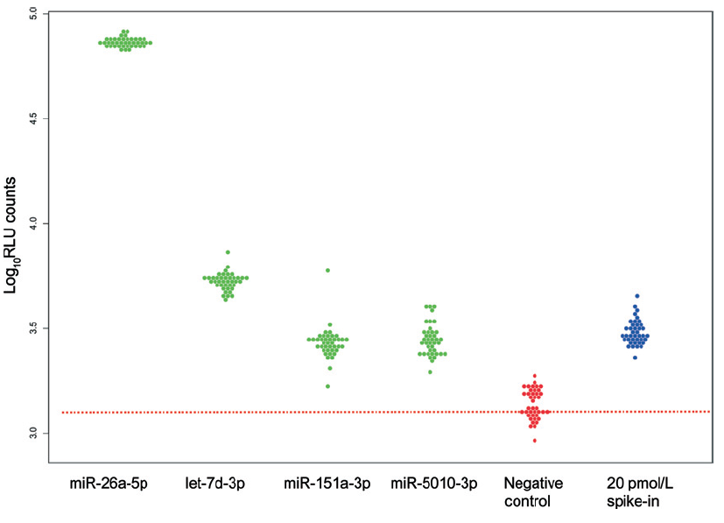
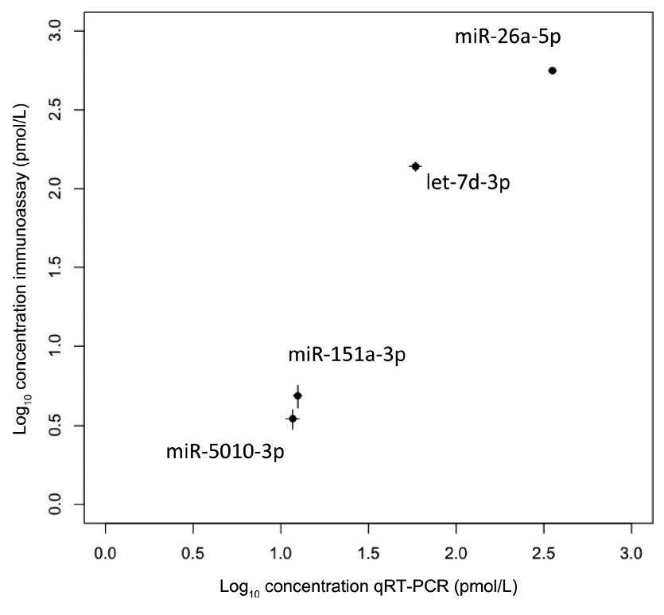
Results
Proof-of-Concept:
  Profiling of 4 Alzheimer microRNAs: miR-5010-3p, miR-26a-5p, miR-151a-3p, let-7d-3p
  AUC for detecting Alzheimer: 0.92
  40 replicates of 4 miRNAs, spike-in, blank samples (upper right panel)
  0.8% outliers among all measurements
  Correlation with qRT-PCR of 0.994 (lower right panel)

Slide 9
Results – Key Questions
Are the technical specificity & sensitivity acceptable?
Is the dynamic range sufficient?
What are the remaining key hurdles for application of respective tests in clinical care?

