Slide 1
Optimizing Early Rule-Out Strategies for Acute Myocardial Infarction: Utility of 1-Hour Copeptin
P. Hillinger, R. Twerenbold, C. Jaeger, K. Wildi, T. Reichlin, M.R. Gimenez, U. Engels, O. Miró, J. Boeddinghaus, C. Puelacher, T. Nestelberger, M. Röthlisberger, S. Ernst, K. Rentsch, and C. Mueller
December 2015
www.clinchem.org/content/61/12/1466.full
© Copyright 2015 by the American Association for Clinical Chemistry

Slide 2
Introduction
Early rule-out of acute myocardial infarction (AMI)
  3 cornerstones: clinical assessment, 12-lead ECG, biomarkers of cardial necrosis (troponin)
  High-sensitivity cardiac troponin (hs-cTnT) assays → earlier and more accurate diagnosis of AMI
  Safe rule-out of AMI is still time-consuming, especially in early presenters
  new strategy for the early rule-out of AMI: dual marker approach (copeptin+hs-cTnT)

Slide 3
Introduction
Dual marker strategy
  Combination of copeptin (marker of endogenous stress) and hs-cTnT (myocardial necrosis) at presentation
  → ↑ sensitivity and ↑ negative likelihood ratio for AMI diagnosis
  Very high (but still imperfect) negative predictive value (NPV) for rule-out of AMI (NPV 96-98%) ⃰
⃰ Lipinski et al. Am J Cardiol 2014;
Raskovalova et al. Eur Heart J 2014;
Wildi et al. Int J Cardiol 2015

Slide 4
Introduction-Objectives
Evaluation of a second copeptin measurement at 1 hour compared to a second hs-cTnT measurement in
  low-risk patients (hs-cTnT <14ng/l + copeptin <10pmol/L)
  intermediate-risk patients (hs-cTnT <14ng/l BUT copeptin ≥ 10pmol/L)

Slide 5
Questions
Why are patients with levels of hs-cTnT within reference intervals but positive copeptin levels at presentation challenging to manage?

Slide 6
Materials and Methods
Advantageous Predictors of Acute Coronary Syndrome Evaluation (APACE) study
prospective international diagnostic multicenter study
Inclusion criteria
  chest pain / symptoms suggestive of AMI <= 12 hours
Exclusion criteria
  chronic kidney failure requiring dialysis
Additional exclusion criteria for the present analysis
  ST-elevation MI
  Unclear diagnosis and at least one hs-cTnT level ↑
  Incomplete laboratory measurements

Slide 7
Materials and Methods
Advantageous Predictors of Acute Coronary Syndrome Evaluation (APACE) study
prospective international diagnostic multicenter study
Goldstandard Diagnosis
  centrally adjudicated by two independent cardiologists blinded to copeptin levels
  including serial measurements of two sets of cTn levels: first, the ones determined as part of clinical care, and second, serial hs-cTnT levels from study blood samples
Investigational Biomarkers (measured at presentation and at 1 hour):
  Roche High-Sensitivity Cardiac Troponin T (cut-off 14 ng/L)
  Copeptin B.R.A.H.M.S. (cut-off 10 pmol/L)

Slide 8
Question
How are the specific cut-off levels for copeptin and hs-cTnT derived?

Slide 9
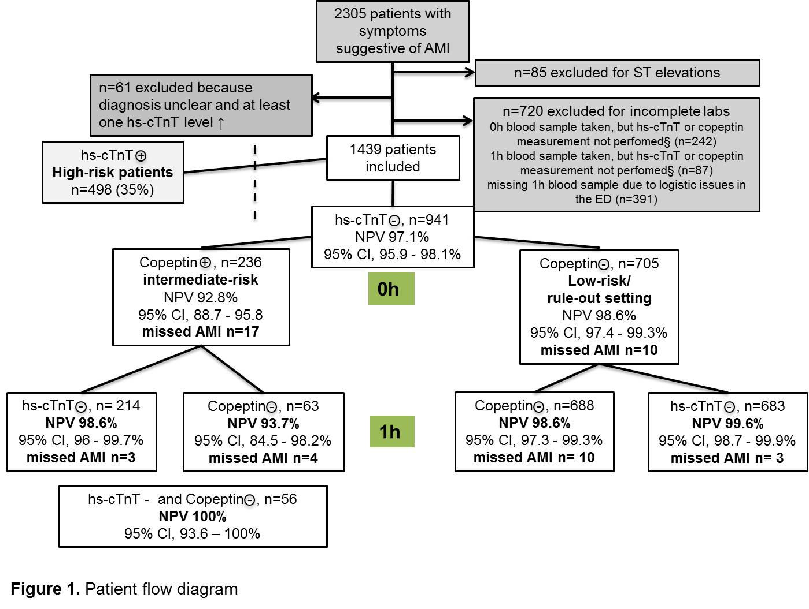
Results
§e.g. too little volume, sample lost, error in shipment of samples to the core lab doing the measurement
Figure 1. Patient flow diagram.

Slide 10
Results
Predictive values for the rule-out setting
705 low-risk patients (hs-cTnT <14ng/l + copeptin <10pmol/L)
0h: NPV 98.6% (95% CI 97.4-99.3%)
1h: hs-cTnT <14ng/l → NPV 99.6% (95% CI 98.7-99.9%), P*=0.008
1h: copeptin < 10pmol/L → NPV 98.6% (95% CI 97.3-99.3%), P*=ns
*P-value compared to baseline
Figure 3. Number of patients with a final adjudicated diagnosis of AMI in low-risk patients based on laboratory findings at 1 hour after presentation (n=705).

Slide 11
Results
Predictive values for the intermediate-risk setting
236 intermediate-risk patients (hs-cTnT <14ng/l + copeptin ≥10pmol/L)
0h: NPV 92.8% (95% CI 88.7-95.8%)
1h: hs-cTnT <14ng/l → NPV 98.6% (95% CI 96-99.7%), P*<0.001
1h: copeptin < 10pmol/L → NPV 93.7% (95% CI 84.5-98.2%), P*=ns
1h combined → NPV 100% (95% CI 93.6-100%)
Figure 4. Number of patients with a final adjudicated diagnosis of AMI in intermediate-risk patients based on laboratory findings at 1 hour after presentation (n=236).
*P-value compared to baseline

Slide 12
Question
  What are possible advantages of serial hs-cTnT testing (e.g. ADP with 1h-algorithm) compared to a dual-marker approach with copeptin and
  (hs-)cTnT?¹
¹See accompanying Editorial on this article:
Scirica BM, Morrow DA. In Search of the 1-Hour Rule-Out for Acute Myocardial Infarction. Clin Chem 2015; 61: 1427-9.

Slide 13
Limitations
The APACE study was conducted in the ED setting - it is unclear whether results would be similar in a setting with lower pretest probability (General Practitioner)
We cannot generalize these findings to patients with terminal kidney failure requiring dialysis as recruitment was independent of renal function, but did not include patients on chronic hemodialysis
Not all patients with acute chest pain had a second set of labs drawn at 1 hour (Baseline characteristics did not differ)
The two independent cardiologists were only blinded to the patients’ copeptin level - hs-cTnT measurements were available during the adjudication of the final diagnosis of acute chest discomfort to apply the universal definition of MI

Slide 14
Conclusions
No additional value of a second copeptin measurement at 1 hour in low-risk patients (hs-cTnT <14ng/l + copeptin <10pmol/L at presentation)
A second copeptin measurement did not significantly increase the NPV to rule-out AMI in intermediate-risk patients (hs-cTnT <14ng/l but copeptin ≥ 10pmol/L)
Additional value of a second hs-cTnT measurement in both settings

