Slide 1
Relationship between Serum Testosterone and Fracture Risk in Men: A Comparison of RIA and LC-MS/MS
T.S. Tran, J.R. Center, M.J. Seibel, J.A. Eisman,
M.M. Kushnir, A.L. Rockwood, and T.V. Nguyen
September 2015
www.clinchem.org/content/61/9/1182.full
© Copyright 2015 by the American Association for Clinical Chemistry

Slide 2
Testosterone and fracture
Lower serum concentration of total testosterone (TT) is a risk factor for fracture in men (*)
TT is commonly used for diagnosis of hypogonadism.
(*) Cawthon PM. J Clin Endocrinol Metab 2009; Meier C. Arch Intern Med 2008

Slide 3
Research questions
Two common methods available to measure TT:
RIA: lower cost, high throughput
LC-MS/MS: high specificity and sensitivity
Research questions:
Concordance of RIA and LC-MS/MS methods for measurement of TT
Impact of concordance (or lack of concordance) on assessment of fracture risk and diagnosis of hypogonadalism

Slide 4
The Dubbo Osteoporosis Epidemiology Study
Setting: City of Dubbo, approx 400 km from Sydney, Australia
Design: Population based, random recruitment from community
Participants: Men aged 60 and above as of 1989. N = 602.
Follow-up from 1989 until now: Biannual follow-up visits
    Outcome measurement: Fragility fracture ascertained by X-ray report. Exclusions: high trauma, pathological fractures, or fractures of digits, skull, cervical spine.

Slide 5
Laboratory analysis
    Non-fasting blood samples collected in morning in plain tube, centrifuged at 14000×g
    Serum samples stored in 2 mL Eppendorf tube at -80ºC
    Sex Hormone Binding Globulin (SHBG) determined by RIA (ANZAC Laboratory, Australia)
    Serum concentration of TT determined by:
  RIA (TT_{RIA}), Delfia; PerkinElmer, Wallac Oy (ANZAC)
  LC-MS/MS (TT_{LC-MS/MS}), ARUP Laboratories (Utah)

Slide 6
Statistical analyses
    Concordance between measured TT_{RIA} and TT_{LC-MS/MS}
    Descriptive analysis: Bland-Altman plot
    Relation analysis: Deming regression model
    Association between measured TT and fracture
  Cox regression model: fracture as outcome, TT_{RIA} or TT_{LC-MS/MS} as predictor;
  Calculated predicted probability of fracture using TT by RIA (P_{RIA}) and LC-MS/MS (P_{LC-MS/MS}) based on Cox model;
  Assess correlation between P_{RIA} and P_{LC-MS/MS}

Slide 7
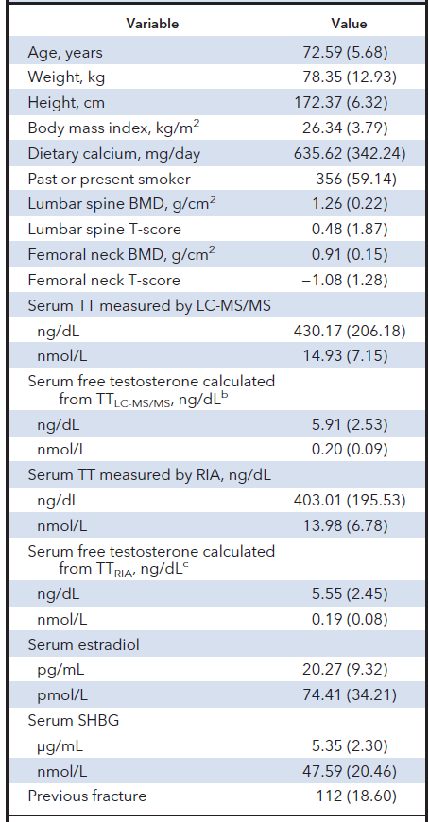
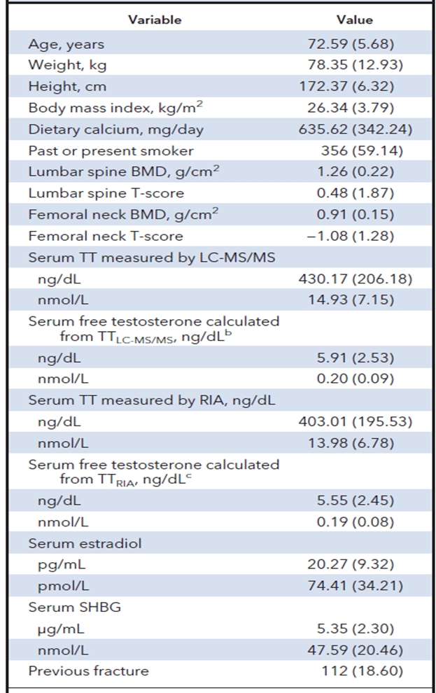
Baseline characteristics
Data from 602 men analyzed
Mean age: ~73 yr
BMD = bone mineral density

Slide 8
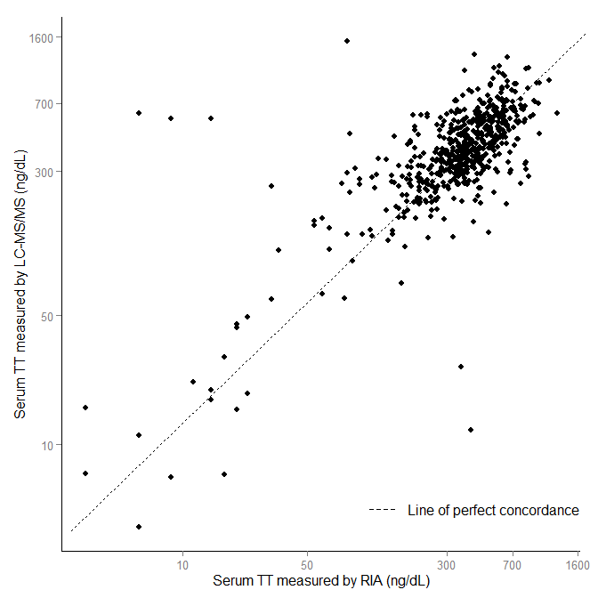
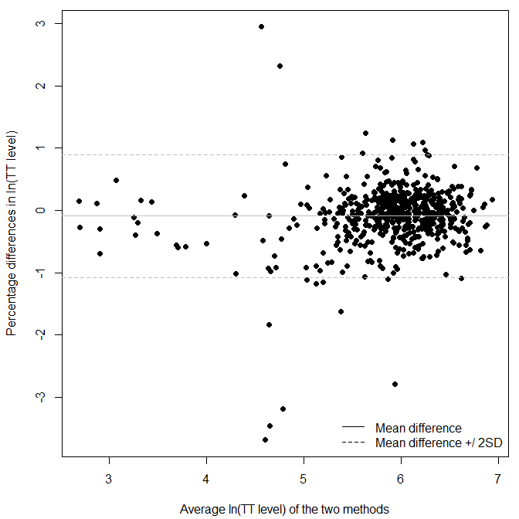
Concordance in TT measurements
Mean difference TT_{LC-MS/MS} vs TT_{RIA}: 27ng/dL (95%CI: 13-41)
Concordance coefficient: 0.72 (95%CI: 0.67-0.76)
RIA overestimated TT level by 13%
Deming regression: ln(TT_{LC-MS/MS}+10) = 0.87+0.87 x ln(TT_{RIA}+10)

Slide 9
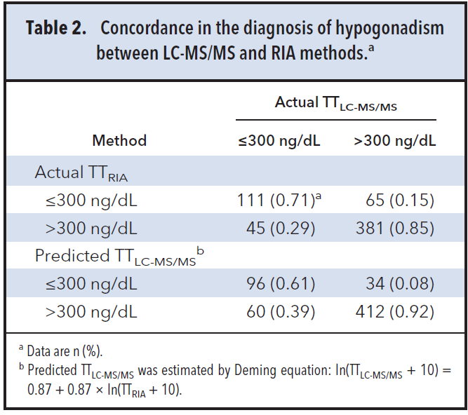
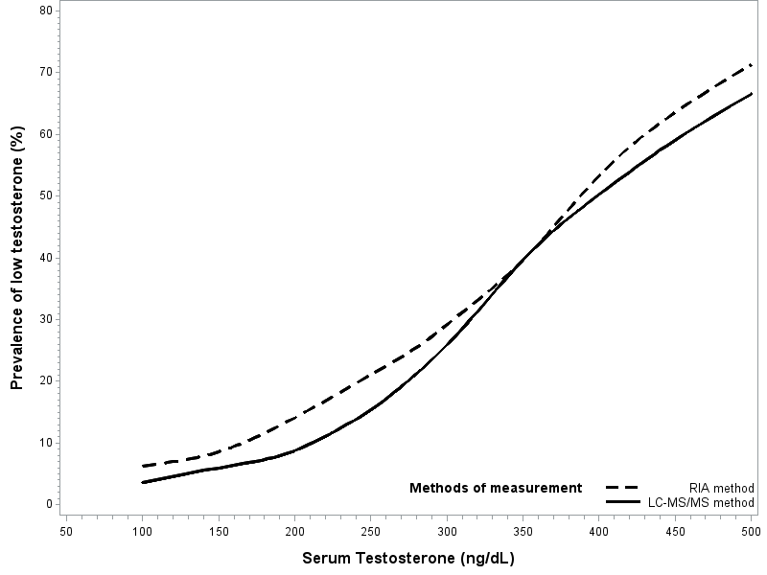
Concordance in diagnosis of hypogonadism or low testosterone
TT ≤300 ng/dL criterion: prevalence of “low testosterone”
RIA method: 29%
LC-MS/MS: 26%
Modest concordance in diagnosis of hypogonadism:
  Φ coefficient: 0.55
  K statistic: 0.57

Slide 10
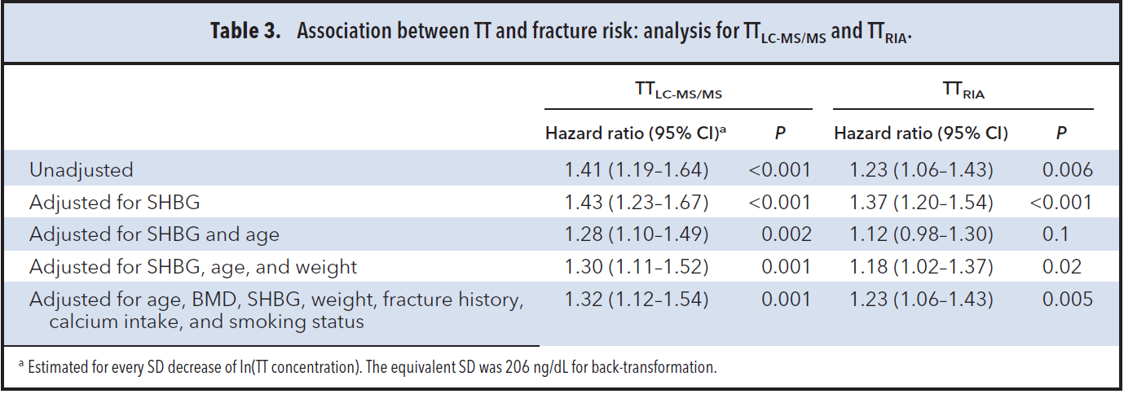
Table 3. Each SD lower TT associated with a 32% (LC-MS/MS) and 23% (RIA) increase in hazard of fracture (after adjusting for covariates).

Slide 11
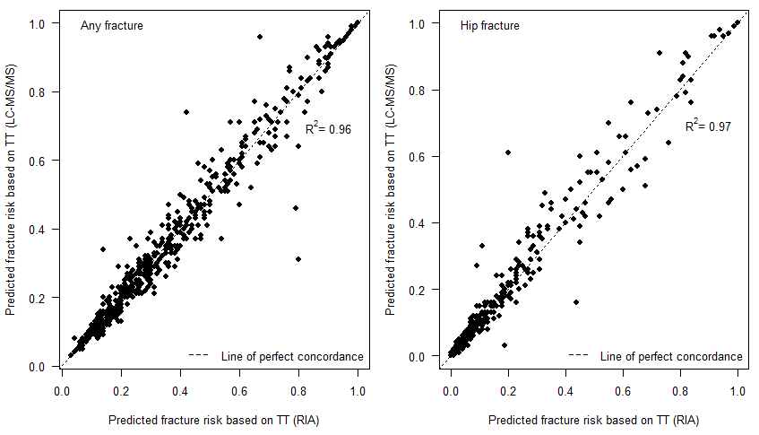

Predicted risk of any fracture, hip, clinical vertebral, and non-vertebral fractures
Figure 3. Correlation between predicted probabilities of fracture by TT_{RIA} and TT_{LC-MS/MS} concentration

Slide 12
Concordance in predicted fracture risk
Coefficient of correlation in predicted probabilities of fracture based on RIA and LC-MS/MS: r > 0.95
Mean difference in predicted probabilities of any fracture:
  0.01% (95% CI: -6.1 to 6.1%)

Slide 13
Measurement of TT by RIA and LC-MS/MS
Moderate concordance in TT measurement (r = 0.72).
At the individual level, modest concordance can result in misclassification of hypogonadism status.
At the population level, modest concordance in TT has no significant effect on the magnitude of assocation between TT and fracture risk.

Slide 14
Questions
Can total testosterone (TT) be used for assessing the risk of fracture in elderly men?
If a man is diagnosed to have hypogonadism (TT = 250 ng/dL) by RIA. Do you need to repeat the measurement by LC-MS/MS?
If you want to investigate the association between testosterone and fracture, does it matter whether RIA or LC-MS/MS is used?
Why did the authors use the Deming regression method (instead of ordinary linear regression model) to assess the concordance between RIA and LC-MS/MS?

