Slide 1
Extreme PCR: Efficient and
Specific DNA Amplification in
15–60 Seconds
J.S. Farrar and C.T. Wittwer
January 2015
www.clinchem.org/content/61/1/145.full
© Copyright 2015 by the American Association for Clinical Chemistry

Slide 2
Introduction
PCR is a fundamental technique in molecular biology and diagnostics
  Temperature cycling allows 3 distinct but overlapping in vitro events to occur:
    DNA denaturation
    Primer annealing
    Polymerase extension
  Repeated temperature cycling results in exponential DNA amplification
Despite its origin over 30 years ago, details about the kinetic limits of PCR are poorly understood
  PCR initially took hours to perform
  However, research in the early 1990s was able to reduce the time required for PCR down to 10-30 minutes

Slide 3
Introduction
In the last 20 years, many groups have tried to reduce PCR times to <5 minutes using a variety of methods to temperature cycle
  Hot and cool water for heat transfer through metal blocks
  Infrared-mediated temperature cycling
  Vapor pressure-augmented continuous flow PCR
  PCR within glass capillaries submerged in heated and cooled liquid gallium
Despite these efforts, practical PCR amplification in < 5 minutes from complex genomic DNA has been elusive
  Previous efforts have focused on simple targets (previously amplified PCR products, plasmids, viruses, bacteria) with high initial template concentrations
  As PCR cycle times were reduced from 20 to 2 s, efficiency and yield were compromised and then PCR typically failed entirely

Slide 4
Question 1
What factors limit the speed of PCR and why?

Slide 5
Materials and Methods
Prototype instruments were developed to temperature cycle 1-to 5-µL samples at extreme speeds from 0.4 to 2.0 s/cycle
  Combined annealing/extension temperatures were 62-76°C
  Denaturation temperatures were 85-92°C
Primer and polymerase concentrations were increased 10-to 20- fold above typical concentrations
  This was done to match the kinetics of primer annealing and polymerase extension to the faster temperature cycling

Slide 6
Materials and Methods
Analytical specificity and yield were assessed on agarose gels and by high resolution melting analysis
Analytical sensitivity and amplification efficiency were demonstrated by real-time optical monitoring

Slide 7
Question 2
Why is real-time optical monitoring of PCR more informative than simple end-point analysis?

Slide 8
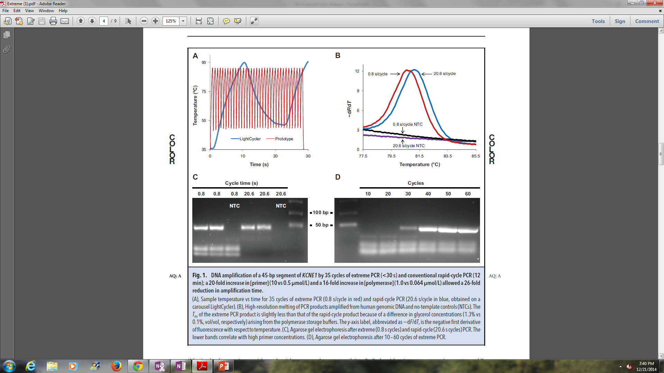
Results
DNA amplification of a 45-bp segment of KCNE1 by 35 cycles of extreme PCR (<30 s) and conventional rapid-cycle PCR (12 min)
A 20-fold increase in [primer] (10 vs 0.5 μmol/L) and a 16-fold increase in [polymerase] (1.0 vs 0.064 μmol/L) allowed a 26-fold reduction in amplification time
Figure 1. (A), Sample temperature vs time for 35 cycles of extreme PCR (0.8 s/cycle in red) and rapid-cycle PCR (20.6 s/cycle in blue, obtained on a carousel LightCycler). (B), High-resolution melting of PCR products amplified from human genomic DNA and no-template controls (NTCs). The Tm of the extreme PCR product is slightly less than that of the rapid-cycle product because of a difference in glycerol concentrations (1.3% vs 0.1%, vol/vol, respectively) arising from the polymerase storage buffers. The y-axis label, abbreviated as−dF/dT, is the negative first derivative of fluorescence with respect to temperature. (C), Agarose gel electrophoresis after extreme (0.8 s cycles) and rapid-cycle (20.6 s cycles) PCR. The lower bands correlate with high primer concentrations. (D), Agarose gel electrophoresis after 10 – 60 cycles of extreme PCR.

Slide 9
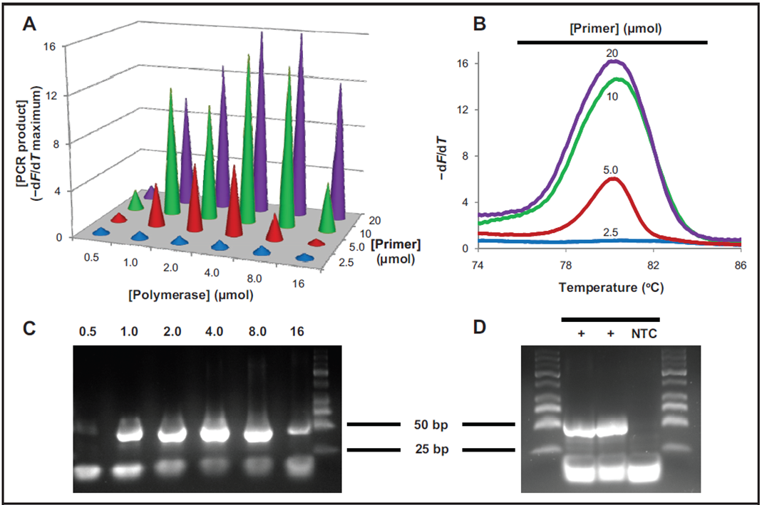
Results
Polymerase and primer optimization for extreme PCR amplification of a 49-bp segment of IL10RB
Figure 2. (A), Polymerase and primer optimization for product yield after 35 cycles of 0.73 s each. PCR product yield was measured as the peak of derivative melting curve plots. (B), Derivative melting curves demonstrate the effect of primer concentration on product yield when using 4 μmol/L polymerase. (C), Agarose gel showing the effect of polymerase concentration on amplification yield using 10 μmol/L of each primer. (D), Sixteen-second amplification of the 49-bp segment of IL10RB (35 cycles, 0.45 s/cycle) using 19-gauge hypodermic needles as reaction containers with 20 μmol/L of each primer and 8 μmol/L polymerase. NTC, no-template control.−dF/dT, negative first derivative of fluorescence with respect to temperature.

Slide 10
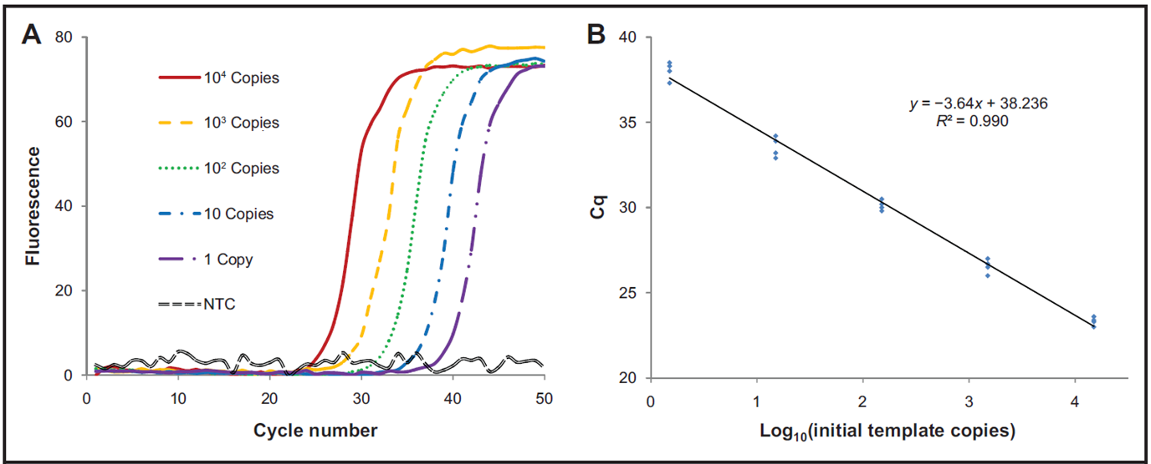
Results
Efficiency and sensitivity are not compromised by extreme PCR
Figure 3. (A), Fluorescence versus cycle number. (B), Cq versus log10 (initial template copies) plots for amplification of a 102-bp fragment of NQO1 (50 cycles, 1.93 s/cycle). Reactions were performed in quadruplicate with 2 μmol/L polymerase and 8 μmol/L of each primer. The calculated efficiency was 95.8%.

Slide 11
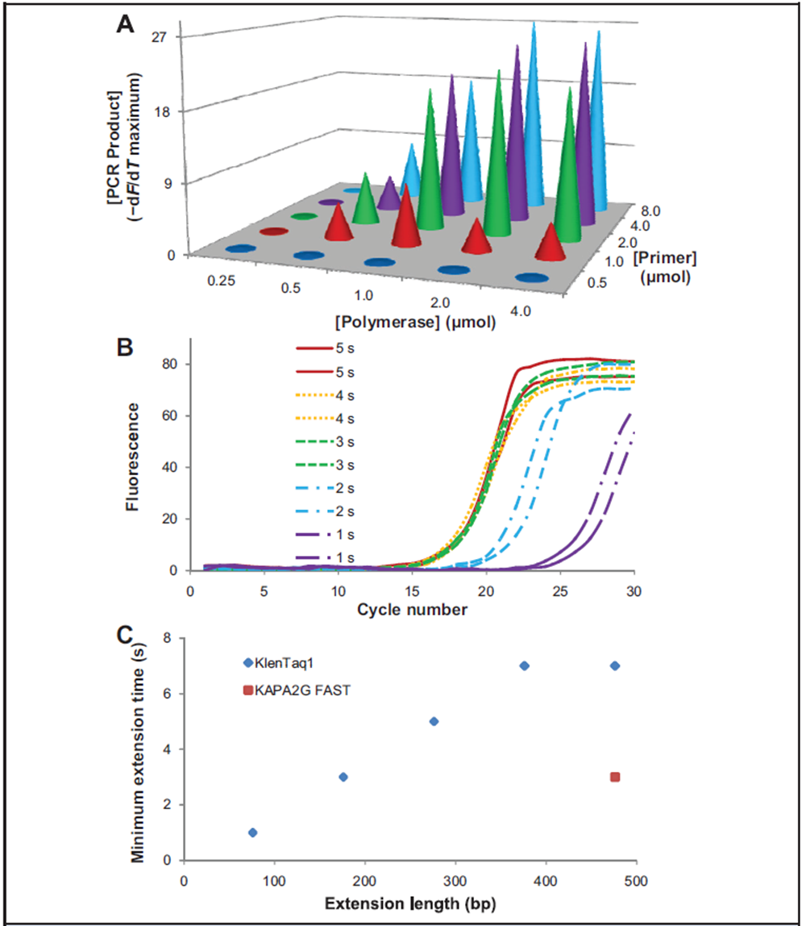
Results
Required extension times depend on PCR product length and the type of polymerase used for amplification
Figure 4. (A), Polymerase and primer optimization for the amplification of a 300-bp synthetic template (20 cycles, 4.9 s/cycle). A combined annealing/extension step of 4 s at 76 °C was used for amplification. (B), Fluorescence vs cycle number plots for PCR amplification of a 500-bp synthetic template using KAPA2G FAST polymerase and 1- to 5-s extension times. (C), Minimum observed extension times required for efficient amplification of 100- to 500-bp synthetic templates using 2 μmol/L polymerase and 4 μmol/L of each primer. The extension lengths are smaller than the product lengths to account for the primers. An approximate equation that relates product size (p) in base pairs to the predicted minimal extension time (t) in s is t=0.016p−0.2 with 2 μmol/L KlenTaq polymerase and 4 μmol/L of each primer at 76 °C. −dF/dT, negative first derivative of fluorescence with respect to temperature.

Slide 12
Question 3
This study did not use a “hot-start” method. Instead, reactions were prepared on ice and quickly transferred to the instrument.
What aspects of extreme PCR improve specificity and help prevent primer-dimers from amplifying?

Slide 13
Conclusions
Increasing primer and polymerase concentrations to match temperature cycling speeds results in efficient, specific, high-yield PCR from human genomic DNA in 15-60 s
Extreme PCR demonstrates the feasibility of while-you-wait testing for any application where time to results is critical
Practical implementation of extreme PCR will require further innovations in instrumentation and sample preparation methods*
*See Editorial by Mackay JF. Taking it to the Extreme: PCR at Wittwerspeed. Clinical Chemistry 2015; 61: 4-5. http://www.clinchem.org/content/61/1/4.full

