Slide 1
Bloodborne Viral Pathogen Contamination in the Era of Laboratory Automation
A. Bryan, L. Cook, E.E. Atienza, J. Kuypers,
A. Cent, G.S. Baird, R.W. Coombs, K.R. Jerome, M.H. Wener, and S.M. Butler-Wu
July 2016
www.clinchem.org/content/62/7/973.full
© Copyright 2016 by the American Association for Clinical Chemistry

Slide 2
Introduction
Risks of laboratory acquired infections
Laboratory-acquired bacterial/fungal risks primarily from culture,
e.g. Meningococcus and Brucella
Several studies document risks and agents of laboratory acquired infections, but most comprehensive are pre-1980
Bloodborne viral infections substantially reduced following
HBV vaccine and HIV post-exposure prophylaxis
Healthcare occupationally-acquired HIV 1985-2013 (MMWR):
Laboratory staff second in number of cases only to nursing
(NOT adjusted for larger RN workforce)
Bloodborne Pathogens Standard (29 CFR 1910.1030)
“Universal Precautions is an approach to infection control. According to the concept of Universal Precautions, all human blood and certain human body fluids are treated as if known to be infectious for HIV, HBV, and other bloodborne pathogens.”
Joyce. 2015. MMWR. 63: 1245-6.
Dingle, Butler-Wu, Abbott. 2014. JCM. 52:3490-1.
Singh. 2011. Nat Med. 17:919.
Baron. 2008. Diagn Microbiol Infect Dis. 60:241-6.
Editorial. Gonzalez MD and Burnham CD. Can’t Touch This! Contamination of Laboratory Equipment with Bloodborne Pathogens. Clinical Chemistry 2016; 62: 910.

Slide 3
Introduction
Risks and guidance for handing Ebola in clinical laboratories
Ebola virus is highly infectious (infectious dose ~10 particles)
Patients with Ebola virus disease (EVD) can have very
high-titers (≥10⁸ PFU/mL)
No known occupational transmission of viral hemorrhagic fevers (VHF)
in resource-rich clinical laboratories
Controlled studies of Ebola viability suggest it can
remain infectious for several days on environmental surfaces
CDC has stated that clinical laboratories can safely perform
routine tests for persons under investigation for Ebola virus disease
Evidence assessing contamination in contemporary clinical laboratories is critical to develop risk-mitigation strategies, but is largely lacking
Lanini et al. 2015. J Clin Invest. 125:4692-8.
Fischer. 2015. Emerg Infect Dis. 21:12431246.
Bausch. 2007. JID. 196: S142-7.
Sagripanti. 2010. Arch Virol. 155:2035-2039.
Editorial. Gonzalez MD and Burnham CD. Can’t Touch This! Contamination of Laboratory Equipment with Bloodborne Pathogens. Clinical Chemistry 2016; 62: 910.

Slide 4
Question
What is the risk of laboratory acquired Ebola
versus other pathogens?
Bonus question: How do CDC guidelines for processing and testing samples from patients under investigation for Ebola virus disease differ from Universal Precautions?

Slide 5
Methods
Assessing bloodborne pathogen contamination
Establish swab efficiency of viral nucleic acids from a representative
non-porous surface (glass slides):
- Hepatitis B virus (HBV)
- Hepatitis C virus (HCV)
- Respiratory syncytial virus (RSV)
Establish baseline contamination of automation line with common
bloodborne pathogens HBV and HCV
Establish contamination after processing a high-titer RNA virus (HCV)
- Distinguish from baseline by placement of clean glass slides on line
- Similar to Ebola, HCV is enveloped RNA virus, bloodborne, high-titer
- Viability cannot be assessed, but capturing “immediate” contamination is time frame when most likely infectious

Slide 6
Questions
How can we ethically and safely assess pathogen contamination in our main clinical laboratories?
Specifically, is it possible to model the risk of high-consequence pathogen viability in our main clinical laboratories?

Slide 7
Control experiments demonstrate linear recovery of viral nucleic acids from glass slides and lower recovery of RNA viruses than a DNA virus
Results
P < 0.001
n.s.
DNA
RNA
Figure 1.

Slide 8
Results
Automation line risk assessment
Aerosols or droplets during centrifugation
Testing/travel of uncapped tubes
Tubes dislodging/falling from line
Contamination during decapping
Cross-contamination from external surface

Slide 9
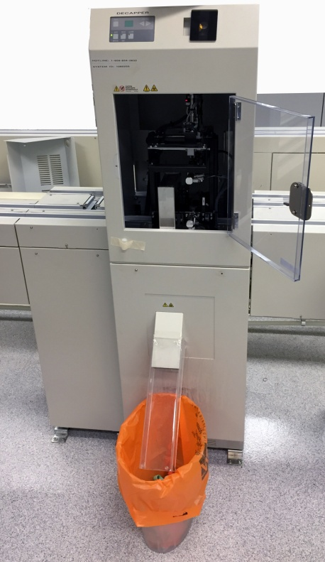
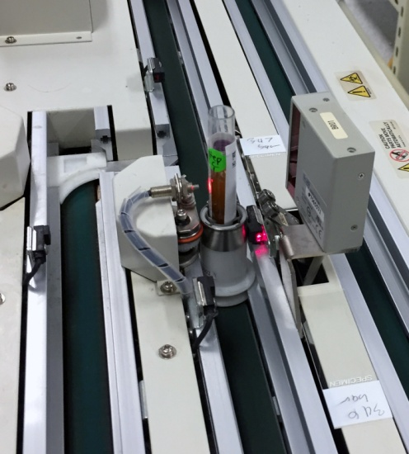
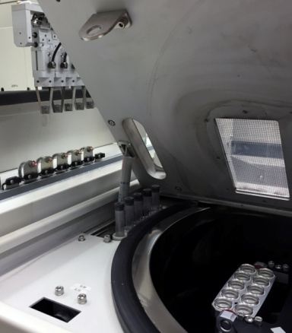
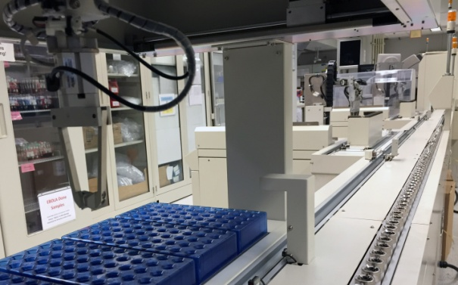
Automation line is contaminated by bloodborne pathogens
from routine clinical use
Baseline contamination
Positive swab for HBV, “B,” or HCV, “C”
B
Negative swab for both HBV and HCV
B
B
B
B
C
B
C
C
B
B
C
C
C
C
B
C
Specimen receiving counter
Start
Centrifuge tube handler
Decapper
DXI
Centrifuge:
Inside wall, rotor
4 ºC Storage
(End)
Recapper
DXC connect/
tube handler
DXC
B
Figure 2.

Slide 10
Contamination occurs following processing of a small number of high-titer HCV samples
Positive clean glass slide placed during experiment, far right
Positive equipment surface swab
Negative glass slide
Negative equipment surface swab
C
C
C
C
C
C
Specimen receiving counter
Start
Centrifuge tube handler
Decapper
DXI
Centrifuge:
Inside wall, rotor
4 ºC Storage
(End)
Recapper
DXC connect/
tube handler
DXC
Figure 2.
C

Slide 11
Result summary
Low-level bloodborne pathogen contamination occurs following both routine use and after processing a small number of high-titer samples
10/79 (HBV) and 8/79 (HCV) baseline swabs of automation
line positive for nucleic acid
Areas adjacent to decapper most contaminated
Rare positives on exposed surfaces, centrifuge, other tube handling areas
Rare positive on exposed surface following processing of a small number of high-titer samples
Nearly all samples below limit of quantification, except
decapper chute

Slide 12
Question
From phlebotomy to incineration, what are the highest risk areas or procedures for clinical laboratories?

Slide 13
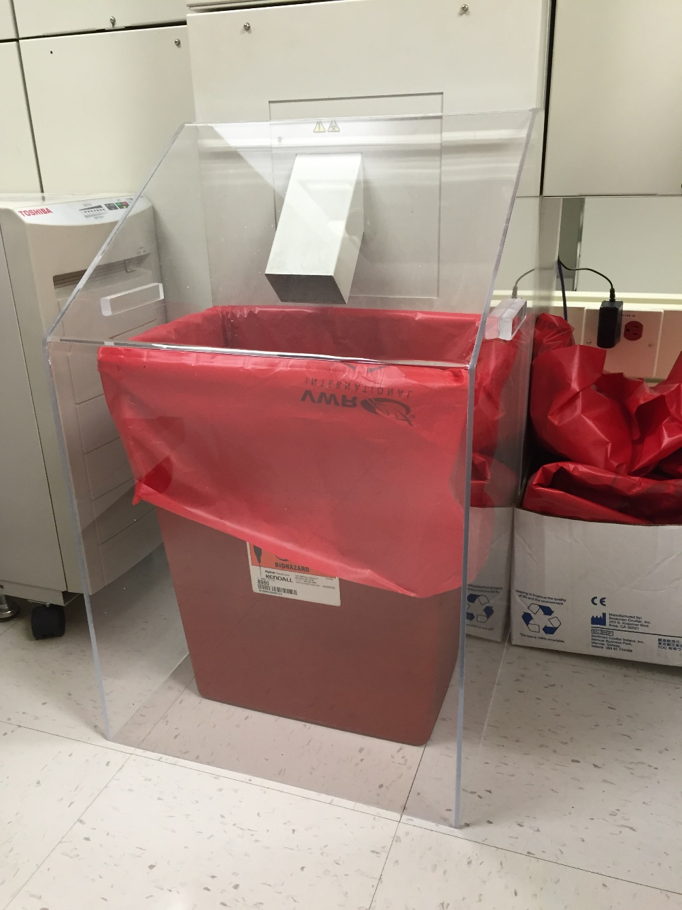
Discussion
What’s the best risk mitigation strategy?
Target engineering controls
at highest risk areas
Manual loading
Point-of-care
Decline testing

Slide 14
Considerations for risk mitigation strategies
Discussion
Risk reduction must balance risks and impacts on:
- Patient under investigation, including risks from delayed or declined routine testing, e.g. malaria
- Other patients, e.g. diverted staff and instruments
- Health care workers
Critical role of formal communication protocols,
education, and training
Challenges of sustaining infrastructure, training, and
QA/QC for rare events
Need for leadership and resources from CDC and instrument manufacturers

