Slide 1
Mass Spectrometry-Based Adrenal and Peripheral Venous Steroid Profiling for Subtyping Primary Aldosteronism
G. Eisenhofer, T. Dekkers, M. Peitzsch, A.S. Dietz, M. Bidlingmaier, M. Treitl, T.A. Williams, S.R. Bornstein, M. Haase, L.C. Rump, H.S. Willenberg, F. Beuschlein, J. Deinum, J.W.M. Lenders, and M. Reincke
March 2016
www.clinchem.org/content/62/3/514.full
© Copyright 2016 by the American Association for Clinical Chemistry

Slide 2
Background – Primary aldosteronism
Primary aldosteronism, also known as Conn’s syndrome, is a form of endocrine hypertension resulting from excess production of aldosterone by the adrenals. Diagnosis is important for several reasons:
  It is relatively common, responsible for 4-15% of all cases of hypertension
  It can cause severe treatment-resistant hypertension with high morbidity
  Its diagnosis can lead to effective therapeutic intervention, even cure
The diagnostic work-up involves several key steps:
  Initial clinical suspicion
  Assessment of the plasma aldosterone to renin ratio (ARR)
  Confirmatory tests – e.g., saline infusion test
  CT or MRI imaging of the adrenals, but imaging is unreliable for distinguishing different forms of disease so that adrenal venous sampling (AVS) is generally mandated, particularly in patients older than 40 years

Slide 3
Background – AVS
Adrenal venous sampling (AVS) is recommended by the Endocrine Society clinical practice guidelines to discriminate two forms of primary aldosteronism, involving unilateral versus bilateral adrenal production of excess aldosterone, each form benefiting from different therapeutic interventions.
Unilateral (APA)
Bilateral (BAH)
• Unilateral aldosterone-producing
adenoma (APA)
• Unilateral nodular hyperplasia
• Unilateral multiple adenomas
• Bilateral diffuse adrenal nodular
hyperplasia (BAH)
• Bilateral adenomas with or without
hyperplasia
AVS
Adrenalectomy
Mineralocorticoid receptor
antagonist (MRA)

Slide 4
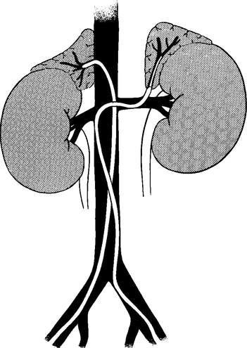
Background – AVS methodology
Right adrenal
Left adrenal
vein (RAV)
vein (LAV)
Step 2: Establish
lateralization
Step 1: Verify AVS
selectivity
Measure
cortisol (C)
Measure
aldosterone (A)
Aldosterone also
measured in PV
to assess
contralateral
suppression
RAV A:C / LAV A:C or
LAV A:C / RAV A:C > 4.0
indicates lateralization
AV to PV ratio
of cortisol >2.0 or 3.0
indicates selectivity
From NEJM, Melby et al., Diagnosis and Localization of Aldosterone-Producing Adenomas by Adrenal-Vein Catheterization, Vol 277, Page 1050-6. Copyright © 1967 Massachusetts Medical Society. Reprinted with permission from Massachusetts Medical Society.
Peripheral
vein (PV)

Slide 5
Background – AVS problems
  AVS is a complex, difficult, and time-consuming procedure
  Cortisol provides an unreliable indicator of AVS selectivity and can be problematic for assessment of lateralized aldosterone secretion in tumors that co-produce both cortisol and aldosterone
  Commonly used immunoassay measurements can suffer from inaccuracies
  Lateralization ratios below or above certain thresholds may not always accurately discriminate bilateral from unilateral disease

Slide 6
Objectives
  Establish impact of any differences between LC-MS/MS and immunoassay measurements on aldosterone lateralization ratios determined in AVS studies on patients with primary aldosteronism
  Investigate utility of other steroids besides aldosterone and cortisol to distinguish bilateral from unilateral forms of primary aldosteronism
  Characterize the presence of differences in adrenal steroid production that might translate to differences in peripheral plasma concentrations potentially useful for subtype classification

Slide 7
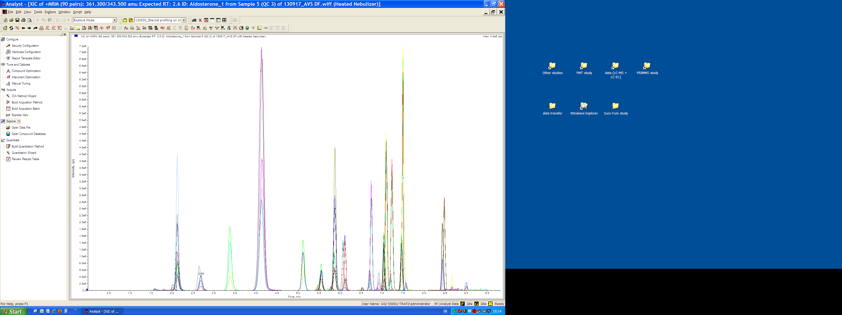
Methods
216 patients with primary aldosteronism diagnosed by measurements of aldosterone to renin ratios and saline infusion tests at three centers
Nijmegen
Munich
Düsseldorf
n=69
n=128
n=19
APA vs BAH diagnosis based on AVS using immunoassay
measurements of aldosterone and cortisol
126 APA & 90 BAH
648 peripheral & adrenal
venous plasma samples
Aldosterone
18-Oxocortisol
18-Hydroxycortisol
Corticosterone
11-Deoxycorticosterone
Pregnenolone
Progesterone
17-Hydroxyprogesterone
11-Deoxycortisol
Cortisol
Cortisone
21-Deoxycortisol
Androstenedione
DHEA
DHEA-SO4
Dresden
LC-MS/MS
steroid profiling

Slide 8
Treatment and therapeutic outcome
A The 126 patients defined by AVS as having unilateral disease underwent adrenalectomy (ADX).
The 90 patients with bilateral disease received mineralocorticoid receptor antagonist therapy.
A
Patients with primary aldosteronism (n=216)
AVS immunoassay-based decision
ADX n=126
MRA treatment n=90
B
ADX, cure & improvement n=119
ADX, failure n=7
MRA treatment n=90
B Follow-up ARRs, saline infusion tests, blood pressure measurements and use of antihypertensives
were used to establish therapeutic outcome in the 126 patients who were adrenalectomized.
Most patients showed cure or improvement, but 7 (5.6%) failed to show improvement indicating
incorrect diagnosis by AVS using immunoassay measurements of aldosterone and cortisol.

Slide 9
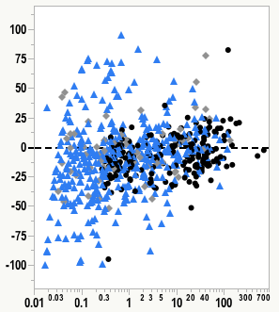
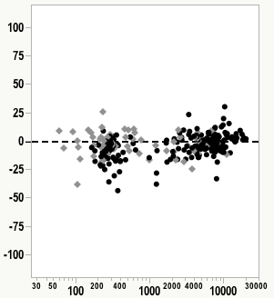
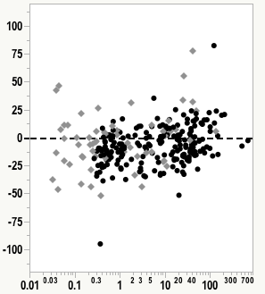
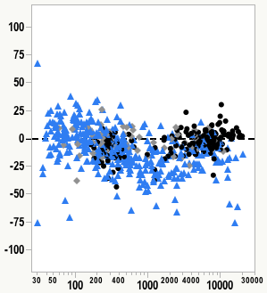
LC-MS/MS vs Immunoassays
Cortisol
Aldosterone
3 Centers
3 Centers
2 Centers
2 Centers
%
%
∆ LC-MS/MS – IA
∆ LC-MS/MS – IA
Mean of IA & LC-MS/MS
Mean of IA & LC-MS/MS
Figure 1. Bland-Altman plots for LC-MS/MS versus immunoassay measurements of plasma cortisol and aldosterone concentrations according to center.

Slide 10
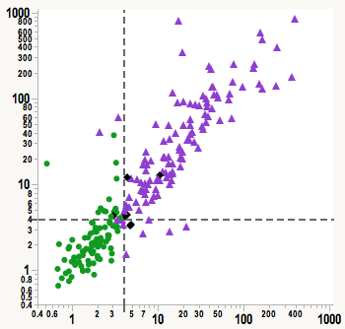
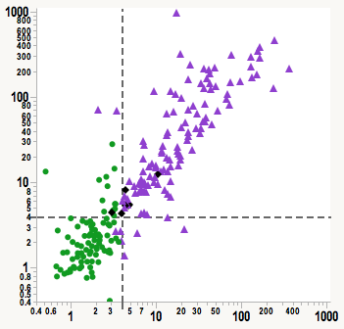
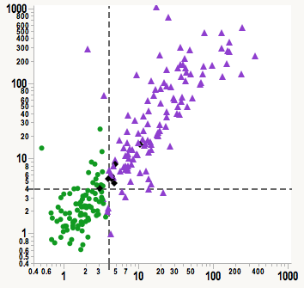
AVS-derived aldosterone lateralization ratios
c
a
b
LC-MS/MS A : Cortisol
LC-MS/MS A : Androstenedione
LC-MS/MS A:DHEA
APA
BAH
APA Failure
Immunoassay A : Cortisol
Immunoassay A : Cortisol
Immunoassay A : Cortisol
Lateralization ratios for aldosterone (A) to cortisol by immuno-assay vs LC-MS/MS (a) with denominators shown also for DHEA (b) and androstenedione (c) as alternatives to cortisol.

Slide 11
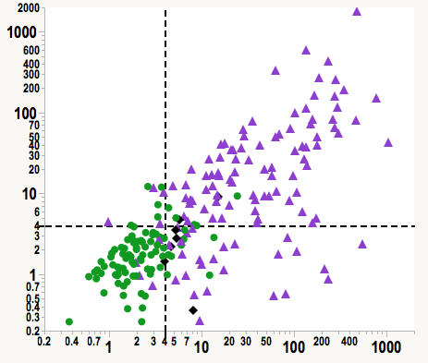
Lateralization ratios – 18-oxocortisol vs aldosterone, both normalized to DHEA
APAs or BAH?
LC-MS/MS 18-oxocortisol:DHEA ratio
BAH
APA
APA Failure
LC-MS/MS Aldosterone:DHEA ratio

Slide 12
Plasma concentrations (ng/mL) of steroids in peripheral veins (PV) and adrenal veins (AV) of patients with APAs (n = 119) and BAH, n =90)
Results are shown as medians and interquartiles. †Adrenal venous concentrations are shown for dominant and non-dominant AVs, reflecting lateralization ratios for aldosterone relative to cortisol respectively larger and smaller than 1.0. • P<0.05; ** P<0.01, *** P<0.001 ****P<0.0001 differences between APA and BAH.

Slide 13
Use of peripheral steroid profiles for classification
APA BAH
Actual
diagnosis/
outcome
BAH APA
97 22
22 75
97/119
68/90
7/7
Discriminant analysis using peripheral plasma concentrations of 12 adrenal steroids for classification according to outcome.

Slide 14
Use of peripheral steroid profiles for classification and therapeutic decision making
Decision (A) outcome (B) and peripheral steroid classification (C) tree and use of the peripheral steroid classification for theoretical decision-making (D). For that decision-making (D), 22 of the patients designated as BAH had APAs and would have benefited from adrenalectomy. However, this decision tree avoided 7 unnecessary adrenalectomies and reduced requirements for AVS by 44%.

Slide 15
Questions
  Why is AVS recommended by Endocrine Society clinical practice guidelines for the diagnostic work-up of patients with primary aldosteronism?
  Why is patient follow-up necessary to confirm diagnosis of an aldosterone-producing adenoma after adrenalectomy?
  Why are lateralization ratios for aldosterone higher when measured by mass spectrometry than by immunoassay?
  Why are peripheral plasma concentrations of 18-oxocortisol higher and those of corticosterone, cortisol, DHEA, and DHEA-sulfate lower in patients with unilateral than bilateral disease?
  How might differences in peripheral venous steroid profiles assist with diagnosis of patients with primary aldosteronism and minimize requirements for AVS?
  What are the limitations of the study and what next steps might be taken to address those limitations?

