Slide 1
A Nanoparticle-Lectin Immunoassay Improves Discrimination of Serum CA125 from Malignant and Benign Sources
K. Gidwani, K. Huhtinen, H. Kekki, S. van Vliet,
J. Hynninen, N. Koivuviita, A. Perheentupa,
M. Poutanen, A. Auranen, S. Grenman,
U. Lamminmäki, O. Carpen, Y. van Kooyk, and
K. Pettersson
October 2016
www.clinchem.org/content/62/10/1390.full
© Copyright 2016 by the American Association for Clinical Chemistry

Slide 2
Introduction (1)
Epithelial Ovarian Cancer (EOC)
  EOC lacks specific symptoms in early stages
  Most patients diagnosed with advanced disease
CA125 glycoprotein is the established marker for EOC
  Also increased (>35 U/mL) in benign conditions
  CA125 has aberrant glycan(s) in EOC, offering improved cancer specificity

Slide 3
Introduction (2)
Lectins (carbohydrate binding proteins)
  Used as probes for recognizing changed glycosylation
  Lectins have generally low affinities to their glycans
Tools to improve the lectin binding affinity
  Europium nanoparticle-aided approach whereby the strength of lectins can be greatly enhanced

Slide 4
Question
  How can the aberrant glycosylation be used
  for cancer specific diagnostics?

Slide 5
Materials and Methods
  Anti-CA125 monoclonal antibodies (mAbs)
  -biotinylated mAbs immobilized on streptavidin-coated wells were used to capture CA125
  Lectins
  -different plant and human lectins included in this study
  Europium Nanoparticles
  -lectins were conjugated on 97 nm polystyrene nanoparticles
  -each nanoparticle contained 30000 fluorescent Eu3+ chelates

Slide 6
Materials and Methods
Lectin Name (abbreviation) | Major Carbohydrate binding specificity
Soybean agglutinin (SBA) | Terminal α-or β linked GalNAc
Sambucus nigra agglutinin (SNA) | sialic acid α (2-6) Gal
Peanut agglutinin (PNA) | Galβ1-3 GalNAc (terminal)
Maackia amurensis agglutinin II (MAA II) | α2-3-linked sialic acids
Aleuria aurantia lectin (AAL) | α1-6Fuc
Ulex europaeus agglutinin (UEA) | Fucα1-2Gal
Phaseolus vulgaris agglutinin-erythroagglutinin (PHA-E) | bisecting GlcNAc
Ricinus communis agglutinin (RCA) | Gal-β1-4GlcNAc
Wheat germ agglutinin (WGA) | Terminal N-acetylglucosamine or chitobiose
Wisteria floribunda agglutinin (WFA) | GalNAcα or β- 3 or 6 position of galactose
Pisum sativum agglutinin (PSA) | α-Mannose
Vicia villosa lectin (VVL) | Terminal α-or β-linked GalNAc (Tn antigen)
Helix pomatia agglutinin (HPA) | GalNAc (Tn antigen)
Trichosanthes japonica agglutinin (TJA-II) | Fuc α 1-2Gal and β-GalNAc
Macrophage galactose-type lectin (MGL) | Terminal α-or β-linked GalNAc
Dendritic Cell-Specific Intercellular adhesion molecule-3-Grabbing Non-integrin (DC-SIGN) | Nonsialylated Lewis antigens and high mannose-type structures
Table 1. Different plant and human lectin with their glycan binding specificities

Slide 7
Methodology
Streptavidin coated microtiter wells
B
Biotinylated capture antibody
Eu-Chelate labelled antibody
OvCa-CA125 antigen
Non-OvCa-CA125 antigen
B
B
B
B
B
Lectin coated nanoparticle
A B
Figure 1. A) Conventional CA125 immunoassay, detect protein epitope. B) A nanoparticle–based immuno-lectin assay, the lectins are coated on Eu⁺³-nanoparticles, which bind to glycan moieties of CA125

Slide 8
Question
  How do the lectins conjugated on Eu³⁺-nanoparticle improve the analytical specificity
  of conventional CA125 immunoassay?

Slide 9
Results
Figure 2. Screening for OvCa specific CA125 lectin NPs: Among a panel of lectin NPs tested, only MGL discriminate OvCa from non-cancerous origin of CA125 (Pla, placenta; LC, liver cirrhosis)

Slide 10
Results
CA125^{MGL}-assay
A B
Figure 3. A) OvCa-CA125 resulted in markedly higher signal to background ratio as compared to that observed for CA125 of benign origin. B) Calibration curve (solid line) and precision profiles (dashed line) of CA125 MGL assay for OvCa-CA125

Slide 11
Discrimination of high grade serious ovarian cancer (HGSOC) from benign and healthy controls using CA125^{MGL}-assay
Conventional CA125 assay
CA125^{MGL} assay
A
B
P<0.001
P<0.001
P=0.960
P<0.001
P<0.001
P=0.025
(N=50) (N=44) (N=38)
(N=50) (N=44) (N=38)
Figure 4. A) Endometriosis and marginally increased high grade serous ovarian cancer (35-100U/ml) samples did not differ with CA125 immunoassay, but B) separated well with the CA125^{MGL} assay.

Slide 12
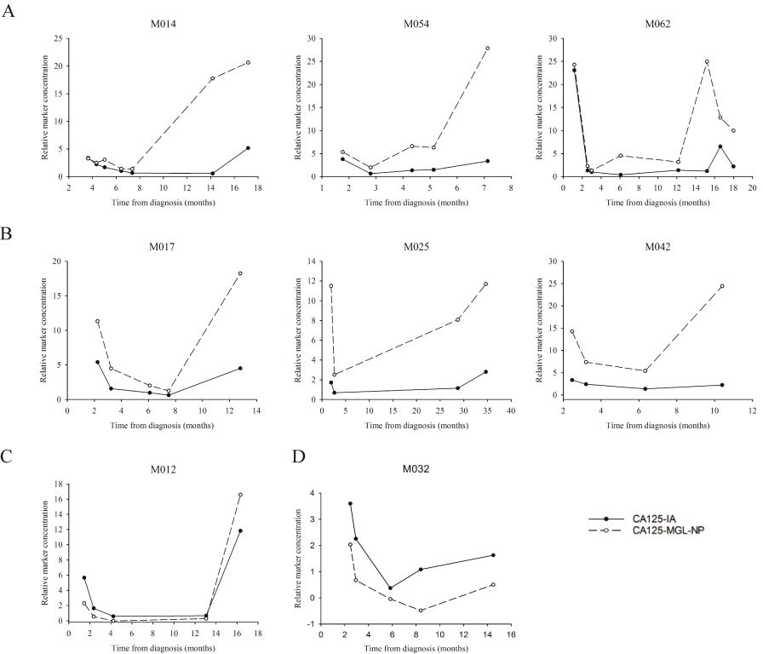
Conventional CA125 assay Vs CA125^{MGL} assay in EOC progression cases
New assay could alarm clinicians much
earlier (4-6 months) than conventional
CA125 assay about disease relapse as
shown from the testing of 27 ovarian
patients in progression of the disease
Figure 5. Relative serum CA125 concentrations during early EOC progression after response to primary treatment

Slide 13
Conclusion
The novel CA125MGL assay helps to reduce the false positive
rate of conventional CA125 immunoassays.
Based on the improved differentiation of benign and malignant
conditions at low marker concentration range and earlier detection
of EOC progression, we hypothesize that the CA125MGL assay
may have potential for earlier detection of EOC.
Combinations of lectins and antibodies, test concept presented here
can also be explored for other diagnostic targets, where changes in
glycosylation are indicative of an ongoing disease process.

