Slide 1
A Novel N-Tetrasaccharide in Patients with Congenital Disorders of Glycosylation Including Asparagine-Linked Glycosylation Protein 1, Phosphomannomutase 2, and Phosphomannose Isomerase Deficiencies
W. Zhang, P.M. James, B.G. Ng, X. Li, B. Xia, J. Rong, G. Asif, K. Raymond, M.A. Jones, M. Hegde, T. Ju, R.D. Cummings, K. Clarkson, T. Wood, C.F. Boerkoel, H.H. Freeze, and M. He
January 2016
www.clinchem.org/content/62/1/208.full
© Copyright 2016 by the American Association for Clinical Chemistry

Slide 2
Introduction
Congenital Disorders of Glycosylation (CDG)
  2% of the human genome encodes proteins for glycosylation
  >10 distinct glycan biosynthesis pathways
  >100 disease causing genes discovered
Common CDG Subtypes
  Protein glycosylation disorders
    PMM2-CDG (CDG-Ia), 75% of CDG type I cohort
    ALG1-CDG (CDG-Ik)
    MPI-CDG (CDG-Ib)

Slide 3
Introduction
Diagnostic Methods
  Molecular Genetics Methods
    Severe mutations are often not compatible with life
    Predominantly mild and rare missense mutations
    Variant of Unknown Significance (VOUS)
  Protein-specific Glycoprofiling Methods
    Carbohydrate deficient transferrin
      Established screening test
      Growing numbers of CDG subtypes can not be diagnosed by transferrin alone
    N-glycan profile of total serum/plasma glycoproteins
      Newly developed test
      Apply to both CDG type I and type II

Slide 4
Introduction-Objectives
  Discovery of Novel N-Tetrasaccharide
    N-Tetrasccharide arise from deficient mannosylation during the initial steps of glycan assembling
    It is present in patients with PMM2-CDG (CDG-Ia), MPI-CDG (CDG-Ib) and ALG1-CDG (CDG-Ik)
  Using N-Man3GlcNAc2 and Man4GlcNAc2 to differentiate N-glycan profile of PMM2-CDG or MPI-CDG from ALG1-CDG
  Application of measuring N-Tetrasaccharide level
    Diagnostic value
    Potential biomarker for monitoring mannose treatment

Slide 5
Questions
  How is N-Tetrasaccharide made in human?
  What are the intermediate glycosylation species detected in PMM2-CDG or MPI-CDG?
  Which treatment strategy that could be monitored by measuring N-Tetrasaccharide level in cells or plasma?

Slide 6
Materials and Methods
  Purification and permethylation of N-glycans from plasma or cellular total protein lysate
    Denature total protein
    Release N-linked glycans by PNGaseF digestion
    Purify released glycan using C18 and carbograph SPE columns
    Permethylate purified glycans
    Desalt glycans using chloroform/water extraction

Slide 7
Materials and Methods
  Analysis of N-glycan profile by MALDI-TOF-MS
    Positive reflect mode for MALDI-TOF profiling
    TOF/TOF mode for MS fragment analysis
  Quantification of N-glycans by LC-MS/MS
    Synthesis of N-tetrasaccharide
    Raffinose as internal standard
    External standard curves with purified standards

Slide 8
Question:
  Why was LC-MS/MS used for quantification?

Slide 9
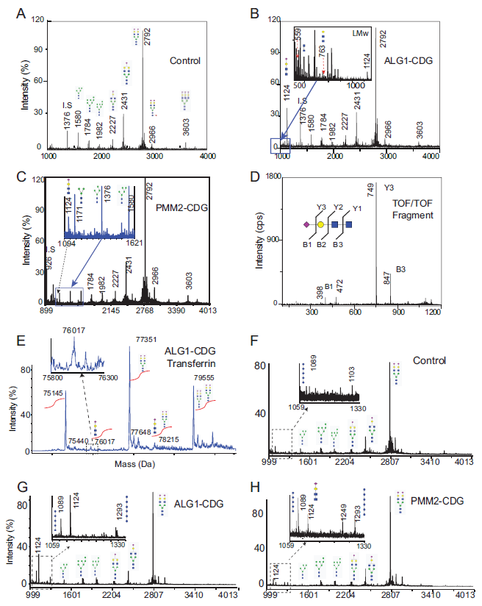
Results
N-glycan profiling of plasma total protein and transferrin
N-linked tetrasccharide (Sial1Gal1GlcNAc2) were present in both ALG1-CDG and PMM2-CDG plasma (A-D)
N-linked tetrasccharide can be detected on purified transferrin (E-H)
N-linked Man3GlcNAc2 and Man4GlcNAc2 are increased in PMM2-CDG, but not ALG1-CDG plasma total protein N-glycan profiles(C)
N-linked Man3GlcNAc2 or Man4GlcNAc2 was not detected in transferrin N-glycan profile (H).
Figure 1. Glycoprotein profiling of
plasma total protein and transferrin

Slide 10
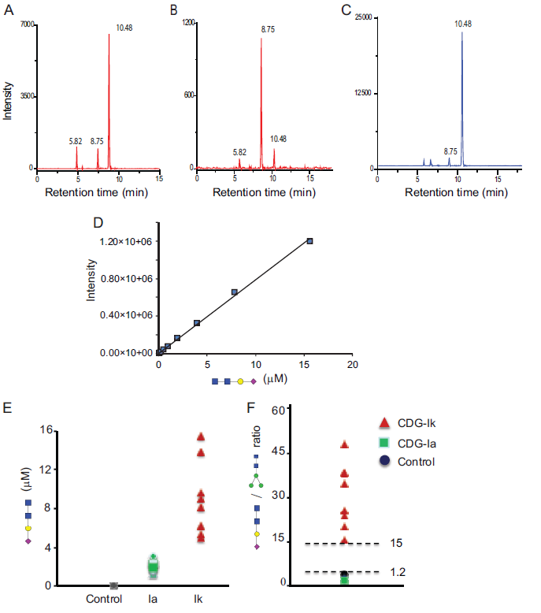
Results
Quantification of N-Tetrasccharide in PMM2-CDG and ALG1-CDG by LC-MSMS
Tetrasaccharide (Sial1Gal1GlcNAc2) were synthesized using 1,4 galactosyltransferase and 2,6 (A) or 2,3 (B) sialyltransferase to add sialic acid and galactose to chitobiose (A-C)
N-Tetrasaccharide levels in N-glycans from plasma total protein are increased in ALG1-CDG (n=10) and PMM2-CDG (n=20) patients comparing to controls (n=20) (D-E)
N-linked tetrasaccharide / N-linked Man3GlcNAc2 ratio is increased in ALG1-CDG (CDG-Ik) but normal or decreased in PMM2-CDG (CDG-Ia)(F).
Figure 2. Synthesis and quantification of N-Tetrasaccharide

Slide 11
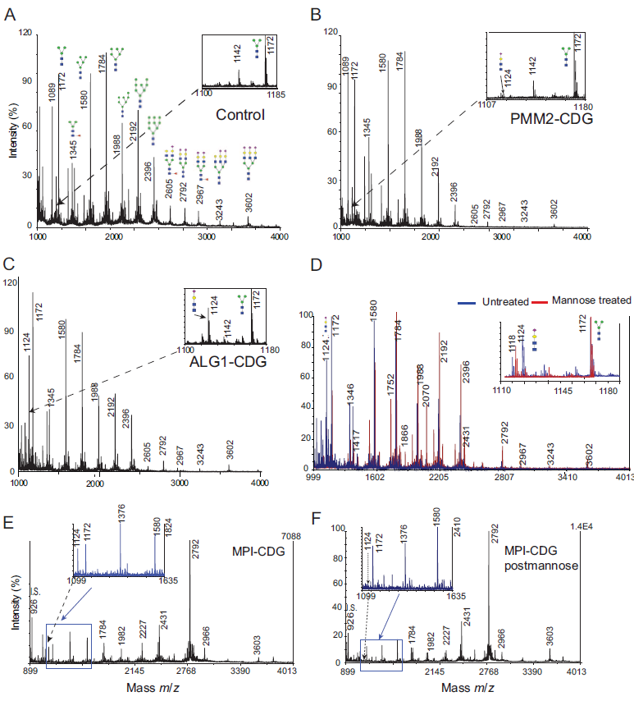
Results
Effect of mannose treatment on N-Tetrasccharide level in ALG1-CDG fibroblast and MPI-CDG plasma
N-Tetrasccharide was increased in N-glycan profiles of ALG1-CDG and PMM2-CDG fibroblast (A-C)
N-Tetrasccharide level reduced 85% with 500uM mannose treatment with ALG1-CDG fibroblast (D).
N-Tetrasccharide, N-Man3GlcNac2 and N-Man4GlcNac2 are increased in MPI-CDG (CDG-Ib) plasma (E).
N-Tetrasccharide level reduced in MPI-CDG patient after 6M of oral mannose treatment, but not N-Man3 GlcNAc2 and N-Man4GlcNAc2 levels (F).
Figure 3. Effect of mannose treatment

Slide 12
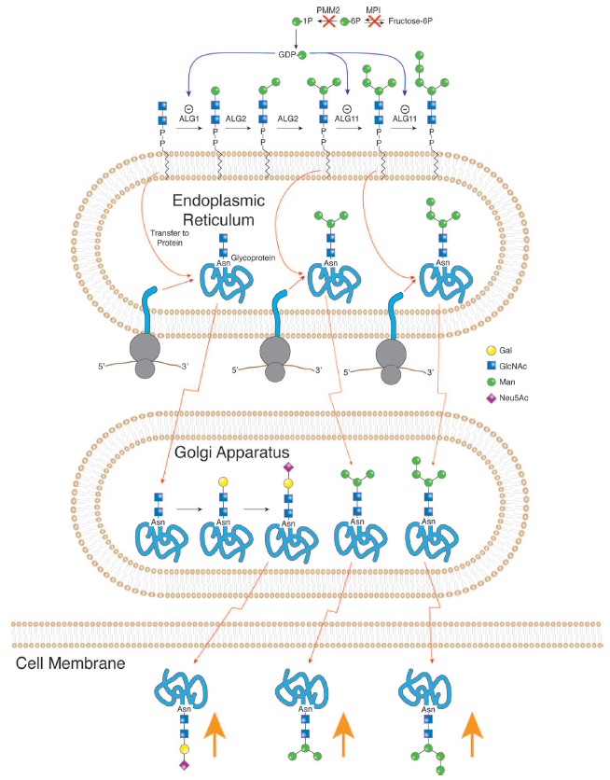
Results
Figure 4. Alternative glycosylation pathways in PMM2-CDG and MPI-CDG

Slide 13
Questions:
  How to use N-glycan profile to differentiate PMM2-CDG, MPI-CDG and ALG1-CDG from normal population?
  How to use N-glycan profile to differentiate PMM2-CDG and MPI-CDG from ALG1-CDG?
  Does oral mannose treatment completely normalize plasma N-Glycan profile in MPI-CDG?

Slide 14
Limitations
Not all the ALG1-CDG fibroblast lines respond to mannose treatment with reduced N-Tetrasccharide level. ALG1-CDG Cells with homozygous p.S258L mutations do not response to mannose
N-Man3GlcNAc2 and Man4GlcNAc2 do not respond to mannose treatment in the plasma from a MPI-CDG patient.
N-Glycan profiling of plasma total glycoproteins can not differentiate between PMM2-CDG and MPI-CDG
Clinical correlation and molecular genetics confirmation is required for the diagnoses of ALG1-CDG, PMM2-CDG and MPI-CDG

Slide 15
Conclusions
N-glycan profiling of total plasma protein can be used as a fast 1st tier screening for PMM2-CDG, ALG1-CDG and MPI-CDG, comprising 80% type I CDG patients
N-Tetrasccharide arises from defective initial mannosylation step due to either mannosyltransferase deficiency or GDP-mannose deficiency
N-Tetrasccharide and N-linked small high mannose species are important biomarkers for the diagnosis of type I CDG

