Slide 1
Measurement by a Novel LC-MS/MS Methodology Reveals Similar Serum Concentrations of Vitamin D–Binding Protein in Blacks and Whites
C.M. Henderson, P.L. Lutsey, J.R. Misialek, T.J.
Laha, E. Selvin, J.H. Eckfeldt, and A.N. Hoofnagle
January 2016
www.clinchem.org/content/62/1/179.full
© Copyright 2016 by the American Association for Clinical Chemistry

Slide 2
Introduction
Vitamin D
  Upregulates intestinal uptake of calcium ions
  Deficiency results in bone softening diseases
  Potentially associated with other adverse heath outcomes
Vitamin D binding globulin (VDBG)
  Member of the albumin superfamily of proteins
  Synthesized mainly in the liver
  Major transporter of vitamin D and its metabolites

Slide 3
Introduction
VDBG is a polymorphic protein
  Three major haplotypes/isoforms
  Gc1f, Gc1s (E416D) and Gc2 (T420K)
Isoforms have different ethnic distributions
  Gc1f: predominant in those of African descent
  Gc1s: most abundant in those of European descent
  Gc2: similar frequencies in individuals of African, European, and Asian ancestry
  Isoforms also have differing affinity for vitamin D metabolites

Slide 4
Introduction
Plasma Vitamin D concentration varies by ethnicity
  Majority of African-Americans (81%) have lower than recommended plasma vitamin D concentrations, while most whites (72%) have an adequate concentration (NHANES)
  However, evidence suggests African-Americans have better bone health than whites
  And the association between vitamin D concentration and cardiovascular disease is weaker in African-Americans
Bioavailable vitamin D may be the same or higher in African-Americans
  Recent study reported similar bioavailable vitamin D concentrations between blacks and whites
  Monoclonal immunoassay used in that study indicated genotype influences protein concentration¹
  These results were contrary to those reported in other studies²
¹Powe et al., NEJM 2013 20:1991-2000
²Lauridsen et al., Clin Chem 2001, 47:753-756

Slide 5
Experimental Objective
To determine if trypsin digestion coupled with LC-MS/MS would provide isoform-independent concentrations of VDBG as well as reveal a genotypic bias in immunoassay measurements of VDBG.

Slide 6
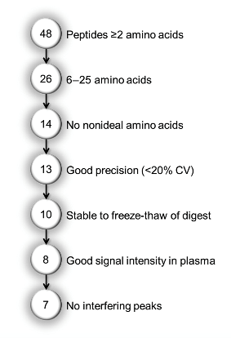
Materials and Methods
Empirical peptide selection process
  Tryptic peptide isolation lists were generated in silico using VDBG isoform FASTA sequences imported into Skyline
  Peptides were selected by analysis of proteolyzed pure recombinant VDBG and human plasma using parallel reaction monitoring (PRM)-MS
Figure 1. Peptides were excluded in a stepwise fashion to identify a final list of peptides to be synthesized as stable isotope–labeled peptides.

Slide 7
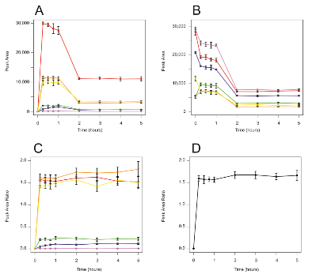
Materials and Methods
Time course analysis of digestion
  Pooled human serum measured in triplicate
  Optimal digestion time was determined to be 30 minutes
  Internal standard (IS) peptide addition after digestion introduced negative bias
  Bias was overcome by the addition of the IS peptides prior to digestion
Figure 2. (A) Peak areas of the endogenous peptides. (B) Peak areas of the internal standard peptides spiked before digestion. (C) Peak area ratios of the endogenous peptides. (D) Average peak area ratio for peptides VLEPTLK and ELPEHTVK, (Red) VLEPTLK. (Orange) ELPEHTVK. (Yellow) THLPEVFLSK. (Green) LPEATPTELAK. (Blue) LPDATPTELAK. (Purple) LPDATPK.

Slide 8
Materials and Methods
Method validation using recently proposed criteria¹
  A significant majority of pre-clinical biomarker assays are not reproducible
  The fundamental characteristics of a reliable assay:
    Imprecision
    Linearity
    Specificity
    Stability
  These parameters can be assessed using relatively low number of injections
¹Grant and Hoofnagle, Clin Chem 2014; 60:941-944

Slide 9
Materials and Methods
Study population
  Atherosclerosis Risk in Communities study (ARIC)
  Serum samples from 200 study participants
  Two samples collected 4 to 8 weeks apart
Genotyping to confirm polymorphisms
  Single nucleotide polymorphisms (SNP) on chromosome 4 of GC gene (rs7041 and rs4588)

Slide 10
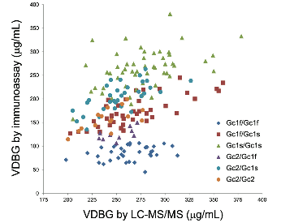
Results
Correlation between LC-MS/MS and immunoassay
  Comparison of LC-MS/MS and immunoassay (R&D Systems) performed on subset of ARIC participants
  VDBG concentrations were higher using LC-MS/MS
Figure 3. Correlation of the measured
concentration of VDBG in the ARIC cohort by
R&D Systems immunoassay vs LC-MS/MS by
genotype, as determined by DNA sequencing.

Slide 11
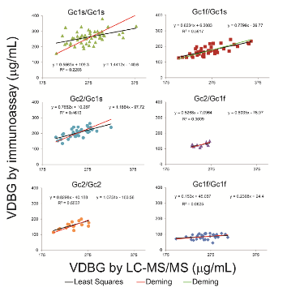
Results
VDBG method comparison by genotype
  Influence of the haplotype on VDBG concentrations varied by measurement method
  Isoforms explained 81% of the variation in concentration in immunoassay-measured VDBG concentrations
  Only 12% of the variability in LC-MS/MS measurements of concentration were due to VDBG isotypes
Figure 4. Multivariable linear regression
(left equation) and univariate Deming regression (right equation) were performed for VDBG by R&D Systems Immunoassay vs. LC-MS/MS.

Slide 12
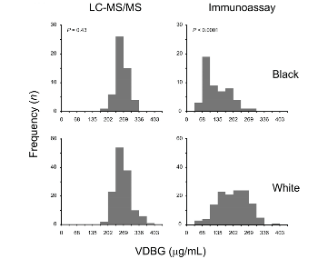
Results
Racial distribution of VDBG
  Concentrations of VDBG were distributed normally using LC-MS/MS and skewed or bimodal when measured by immunoassay
  VDBG concentrations differed between blacks and whites when measured using immunoassay, but did not differ significantly when measured using LC-MS/MS
Figure 5. The distribution of VDBG
concentrations is illustrated as a histogram for
Blacks and whites as determined by each assay.

Slide 13
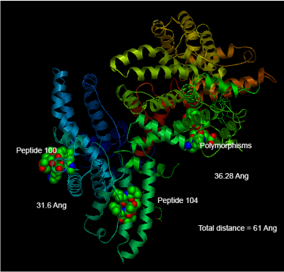
Results
Potential for isoform-specific bias
  Due to possibility for variation in the liberation of peptides based on VDBG isoform
  Quantifying peptides were >25Å away from polymorphic amino acid residues
Figure 6. Three-dimensional representation of vitamin D binding globulin. (RCSB PDB entry 1J7E)

Slide 14
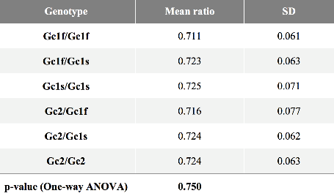
Results
Peptide ratio of genotypes
  Ratio of the 2 quantifying peptides across ARIC cohort were examined
  No significant differences were observed between genotypes
  Suggests peptides were liberated similarly
Table 1. Quantifying peptide ratios observed for each genotype.

Slide 15
Questions
How could polymorphisms in the peptide sequence of a protein affect immunoassay measurements?
What are some potential reasons for the introduction of bias based upon the addition of IS peptides pre- or post-digestion?
What experiment(s) should be performed to directly determine if bias exists due to the variable release of peptides during tryptic digestion of the different isoforms of VDBG?

