Slide 1
Plasma Branched-Chain Amino Acids and Incident Cardiovascular Disease in the PREDIMED Trial
M. Ruiz-Canela, E. Toledo, C.B. Clish, A. Hruby, L. Liang, J. Salas-Salvadó, C. Razquin, D. Corella, R. Estruch, E. Ros, M. Fitó, E. Gómez-Gracia, F. Arós, M. Fiol, J. Lapetra, L. Serra-Majem, M.A. Martínez-González, and F.B. Hu
April 2016
www.clinchem.org/content/62/4/582.full
© Copyright 2016 by the American Association for Clinical Chemistry

Slide 2
Introduction
Metabolomics, diet, and cardiovascular disease (CVD)
  Metabolomic profiling using high-throughput techniques
  Identification of novel biomarkers of CVD risk
  Better understanding of underlying biological mechanisms
Branched-chain amino acids (BCAAs)
  Essential amino acids: leucine, isoleucine, and valine
  Predominant source: dietary protein intake
  Essential for normal growth and function of cells and organisms

Slide 3
Introduction
BCAAs and cardiometabolic risk
  Altered BCAA catabolism in cardiometabolic diseases
  ↑ BCAA baseline concentrations ⇒ ↑ risk of diabetes
  Similar association with CVD
Diet modification, BCAAs and CVD
  Association and potential effect of a Mediterranean Diet (MedDiet) on plasma BCAA concentrations

Slide 4
Question
What is the relationship between dietary intake and BCAA metabolism?

Slide 5
Objectives
whether baseline BCAA concentrations predict future risk of CVD;
whether the MedDiet interventions counteract the presumed deleterious effects of BCAAs on CVD risk;
whether the beneficial effect of the MedDiet on CVD is partially explained by its effects on plasma BCAA concentrations.

Slide 6
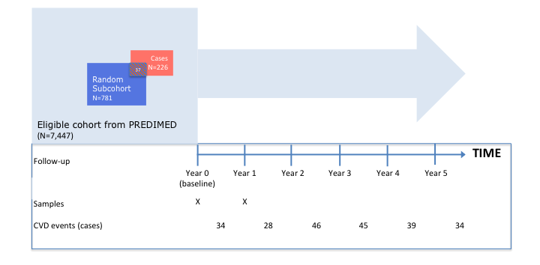
Methods
Design: case-cohort study within the PREDIMED trial

Slide 7
Methods
Metabolite profiling
  Fasting plasma EDTA pairs of samples (baseline and first-year visit)
  LC-MS/MS techniques (Broad Institute)
  Raw data processed with MultiQuant software
Statistical analysis
  Multivariable weighted Cox regression analysis (Barlow method)
  Association between baseline levels of individual metabolites and a BCAA score with CVD or stroke risk
  Association between 1-year change in BCAAs and the effect of MedDiet intervention on the CVD/stroke risk

Slide 8
Question
What is the advantage of using a case-cohort study design?

Slide 9
Results
Incident composite CVD by baseline plasma BCAA concentrationsª (leucine, isoleucine, and valine)
Table 1. ª An inverse normal transformation was applied to raw values.
^{b} Model 1: Adjusted for age, sex and intervention. Model 2: plus BMI, smoking, physical activity and family history of premature coronary heart disease.

Slide 10
Results
Incident composite CVD by baseline plasma BCAA scoreª
Table 2. ª A weighted sum of these 3 transformed values was computed to calculate the BCAA score. ^{b} Model 1: Adjusted for age, sex and intervention. Model 2: plus BMI, smoking, physical activity and family history of premature coronary heart disease.

Slide 11
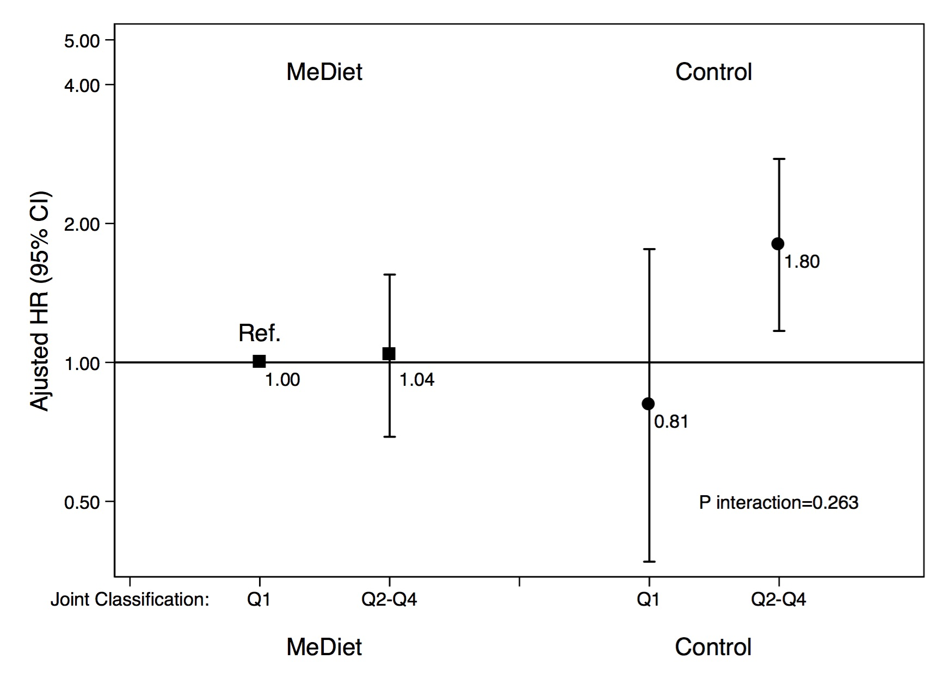
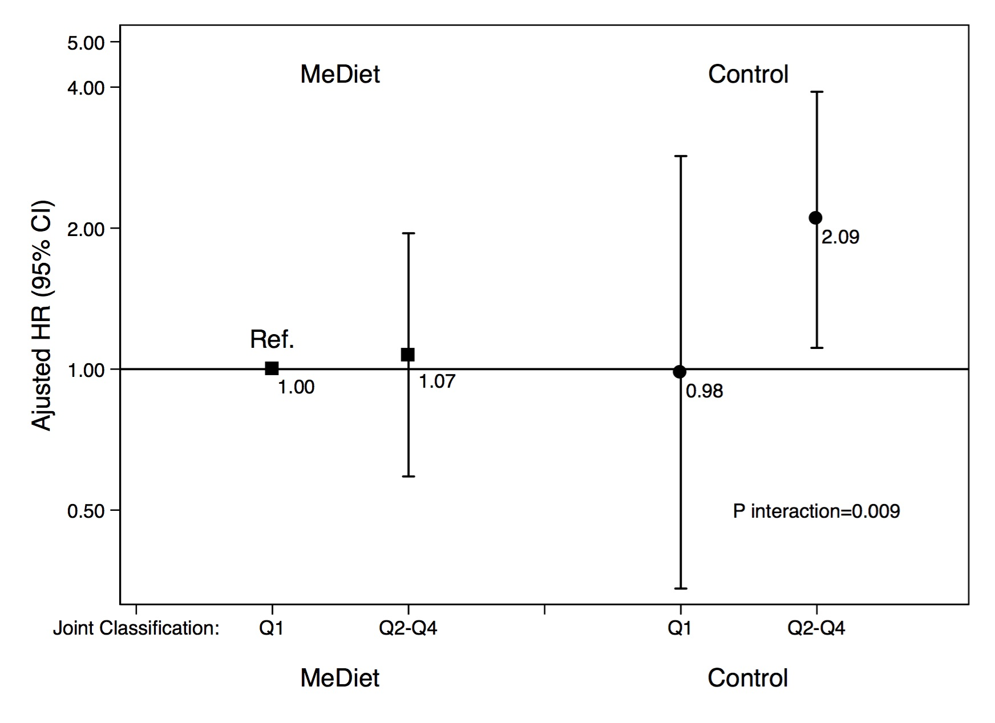
Results
Multivariate-adjusted Hazard Ratios (95%CI) of incident CVD and quartiles of BCAA score at baseline, stratified by intervention group (MedDiet versus control group)
CVD
Stroke
Figure 1. A weighted sum of these 3 transformed values was computed to calculate the BCAA score. Hazard ratios adjusted for age, sex, intervention group, BMI, smoking, physical activity and family history of premature coronary heart disease. P for interaction with 2 degrees of freedom between each MedDiet intervention group and the BCAA score.

Slide 12
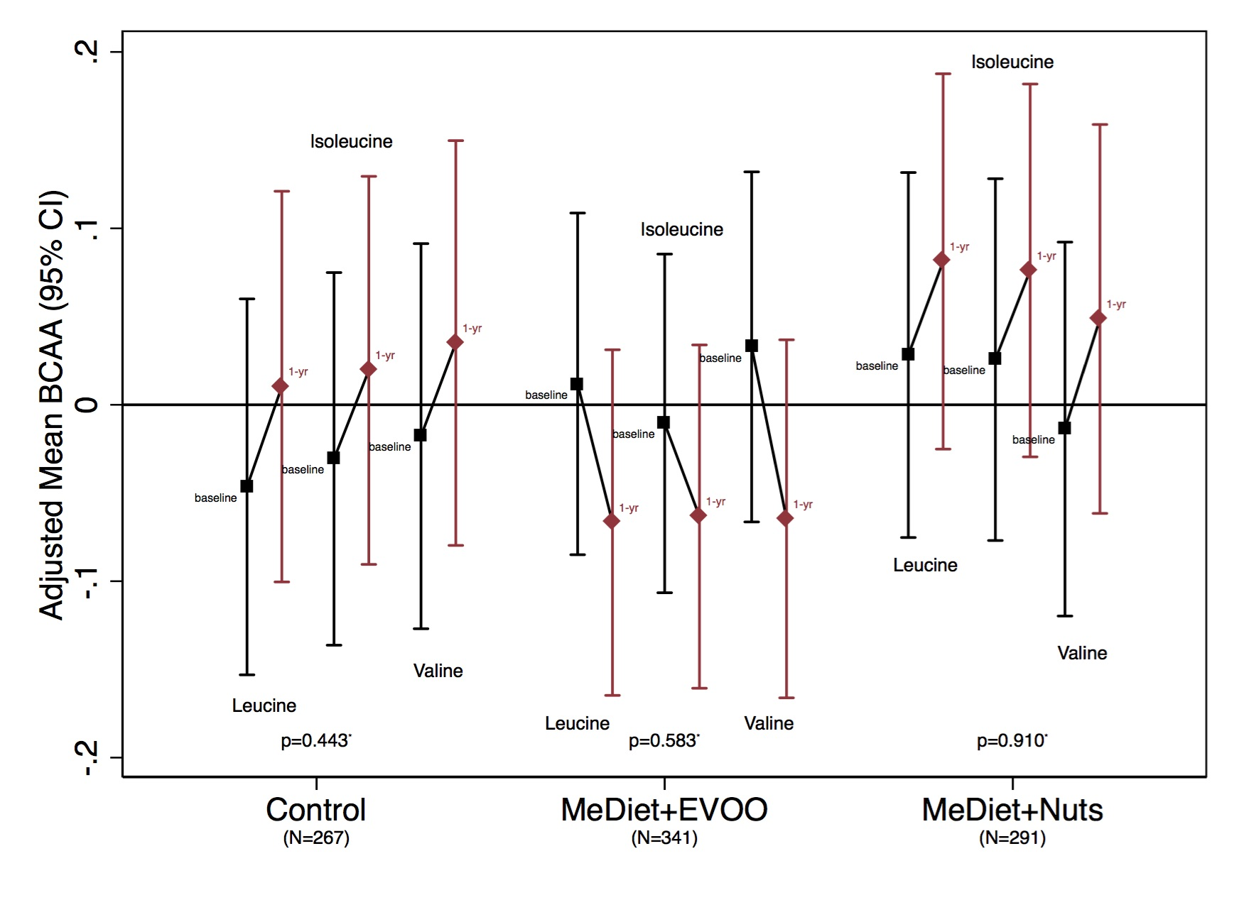
Results
Changes in leucine, isoleucine, and valine after 1 year of intervention, by intervention group.
Figure 2. Changes are adjusted for age (years), sex (male, female), and body mass index (kg/m2). *Baseline means comparison between intervention groups.

Slide 13
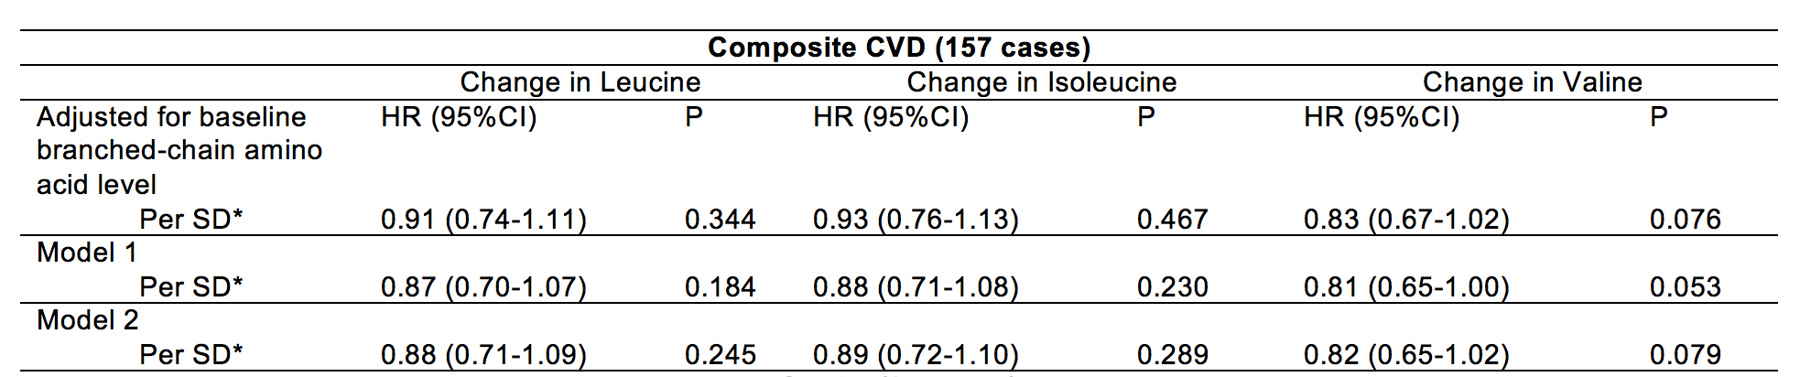
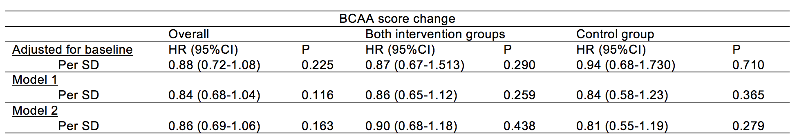
Results
Associations of 1-yr changes in branched-chain amino acid concentrations with the risk of the composite cardiovascular primary end-point
Supplemental Tables 6 and 7.
Model 1: Adjusted for age, sex and intervention group
Model 2: additionally adjusted for BMI, smoking, leisure-time physical activity and family history of premature coronary heart disease

Slide 14
Question
Are BCAAs in the causal pathway of CVD risk or are they just intermediate biomarkers of an underlying metabolic dysfunction?

Slide 15
Conclusions
There is a direct association between higher concentrations of BCAAs at baseline and increased risk of CVD. This association was even stronger with stroke.
A Mediterranean-style diet appears to offset the risk associated with increased BCAAs, especially when the diet was enriched with nuts.
A MedDiet had a negligible effect of on 1-year changes in BCAAs.
The cardioprotective effects of a MedDiet may be exerted via alternative pathophysiological processes.
Editorial:
Fergusson JF, Wang TJ. Branched-chain amino acids and cardiovascular disease: Does diet matter. Clin Chem 2016; 62: 545.

