Slide 1
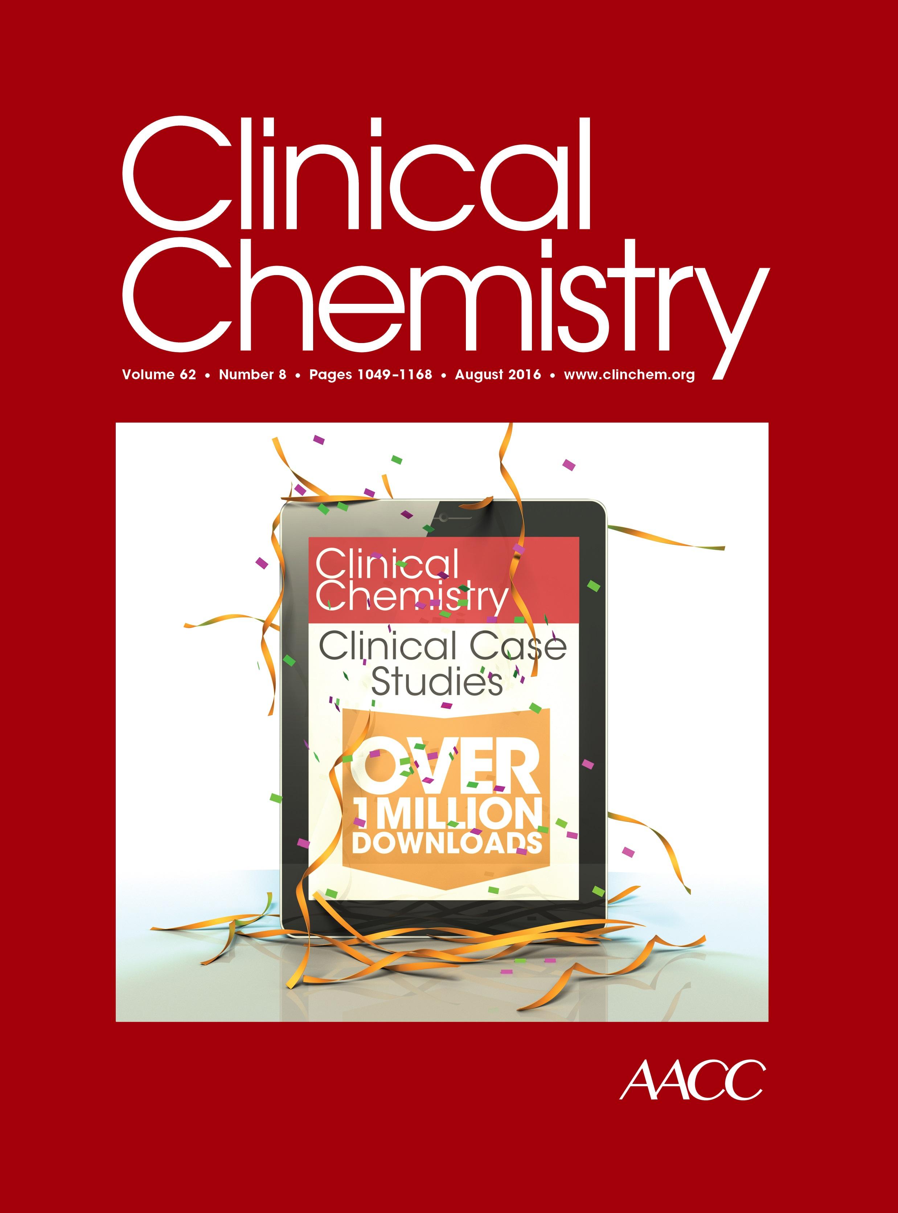
Incidence of Undetectable, Measurable, and Increased Cardiac Troponin I Concentrations Above the 99th Percentile Using a High-Sensitivity Versus a Contemporary Assay in Patients Presenting to the Emergency Department
S.A. Love, Y. Sandoval, S.W. Smith, J. Nicholson,
J. Cao, R. Ler, K. Schulz, and F.S. Apple
August 2016
www.clinchem.org/content/62/8/1115.full
© Copyright 2016 by the American Association for Clinical Chemistry

Slide 2
Introduction
Cardiac Troponin (cTn) I and T
  Biomarkers of choice to diagnose myocardial infarction (MI)
  Neither assay is standardized
  MI decision limit defined by 99th percentile upper reference limit (URL)
High sensitivity (hs) assays
  In use outside the US
  US laboratories awaiting FDA clearance
  US clinicians concerned about potential of increased number of cTn concentrations >99th percentile with transition to hs-assays

Slide 3
Question
  What are the clinical implications if high-sensitivity cTn assays find more increases >99th percentile than contemporary assays?

Slide 4
The UTROPIA Study
Primary goal
Examine differences in hs- v. cTnI within US clinical population
All comers (18+) presenting to ED with clinically ordered cTnI
  cTnI order set = 0 (presentation), 3, 6, and 9 hours
  Clinical decision making based on contemporary cTnI assay
  hs-cTnI assay completed subsequent to cTnI
Adjudicated MI diagnosis
  Utilized 3rd Universal Definition of MI
  Reviewed by two clinicians
    Emergency medicine or cardiology physicians
    Discrepancies were decided by third adjudicator
  Evaluated using each of the cTnI and hs-cTnI associated results separately

Slide 5
The UTROPIA Study
Utilized Abbott Architect_{Stat} assays
  EDTA plasma
Other study details
  hs-cTnI testing directly after cTnI clinical measurements
  hs-cTnI tested for all available samples from order set
  Not all order sets were completed through all 4 time points
assay | LOD (ng/L) | 99th percentile URL (men & women) ng/L
cTnI | 10 | 30 (both sexes)
hs-cTnI | 1.9 | 34 (men) | 16 (women)

Slide 6
Question
  What is the expected impact of using
  sex-specific cut-offs?

Slide 7
Results
Enrollment included
  2100 participants
  42% were women
  Median (IQR) age was 57 (47-67) years

Slide 8
Concentration at Baseline
Figure 1 (A). Median (IQR) concentrations for hs-cTnI and contemporary cTnI assays by sex

Slide 9
Concentration over Serial Measurements
Figure 1 (B). Median (IQR) concentrations for hs-cTnI and contemporary cTnI assays by sex (for non-baseline)

Slide 10
Concentration Distribution by Sex
Table 1. Characteristics of cTnI concentrations at baseline and over serial measurements for high-sensitivity and contemporary assays

Slide 11
cTnI Near LOD & 99th Percentile (0-12h)
Figure 2. Individual cTnI concentrations near the respective LoD and 99th percentile for hs (A) and contemporary (B) cTnI assays

Slide 12
Concordance
Table 2. Concordance between the hs-cTnI and contemporary cTnI assays for women and men at baseline and over serial measurements.

Slide 13
Conclusions
hs-cTnI assay provided
  Similar number of increases for women compared to contemporary cTnI assay
  Decreased number of increases for men compared to contemporary cTnI assay
  More numeric concentrations measureable due to fewer below LoD compared to contemporary cTnI assay

