Slide 1
Postmarket Surveillance of Point-of-Care Glucose Meters through Analysis of Electronic Medical Records
L.F. Schroeder, D. Giacherio, R. Gianchandani,
M. Engoren, and N.H. Shah
May 2016
www.clinchem.org/content/62/5/716.full
© Copyright 2016 by the American Association for Clinical Chemistry

Slide 2
Introduction
Strict glycemic control protocols in critically ill patients (see editorial)
  Critically ill patients have a high incidence of hyperglycemia
  Several observational studies and RCTs found maintenance of normoglycemic states (strict glycemic control, SGC) reduces mortality significantly
  After widespread adoption of SGC, many larger studies found no benefit and increased frequency of hypoglycemia under SGC
SGC study designs
  Several differences in design of the early vs later SGC trials may account for different findings, e.g., differences in control blood glucose targets
  Another difference was that early studies utilized blood gas analyzers to measure glucose while later studies (and most clinical implementations) utilized glucose meters
  FDA has not approved most glucose meters for use in the critically ill
Editorial. van Hooijdonk RTM, Krinsley JS, and Schultz MJ. DETECT the Extremes That Usually Remain Undetected in Conventional Observational Studies. Clin Chem 62; 5: 668.

Slide 3
Introduction
Maltose interference with GDH-PQQ glucose meters
  Between 1997-2009, FDA received 13 reports of death associated with meters using GDH-PQQ methodology
  Maltose, or other non-glucose sugars that metabolize to maltose, used in some medications including peritoneal dialysis fluid and immunoglobulin therapies, reacted with these meters
  Measurements were falsely increased up to 15 times the actual glucose value, triggering unnecessary and dangerous insulin administration
FDA and CMS regulation
  01/2014: FDA released draft guidance to the test manufacturing industry on increased accuracy requirements for approval in critically ill patients
  09/2014: FDA approved first (and so far only) glucose meter for use in critically ill
  11/2014: CMS memorandum (since reverted to draft status) that off-label use of glucose meters in critically ill patients would be considered laboratory developed testing and regulated as high complexity requiring institutional validation studies

Slide 4
Introduction
Current US regulatory mechanisms to ensure safety of medical devices
  FDA premarket approval (studies on the order of thousands of samples; likely not large enough to cover the heterogeneous populations and polypharmacy to be encountered once the meter is offered to the public)
  FDA postmarket surveillance: passive adverse event reporting into the Maude database
  Proficiency testing programs: however, proficiency testing material for point of care glucose is non-commutable (may introduce matrix-effects) and thus, cannot be used to compare bias between different meters
Data mining EMRs To Evaluate Coincident Testing (DETECT)
  Routine hospital draws for basic metabolic panels often occur simultaneously with POC glucose meter measurements in ICU patients
  In these patients, arterial or venous line blood is used typically for both measurements (i.e., no fingersticks)
  These events represent an opportunity to assess accuracy of POC glucose meters; this coincident testing analysis is occasionally employed by laboratories, but has never been validated

Slide 5
Objectives
Conduct a gold standard study to validate DETECT
Refine DETECT through successive use of filters to obtain the cleanest set of coincident events
Compare the ability of DETECT to match the gold standard estimates of bias, random error, and percent of events outside quality goals

Slide 6
Method
Gold standard study to validate DETECT (bedside ICU study)
  Nurses asked to flag events where an arterial draw was obtained for central laboratory glucose testing near in time to a POC glucose measurement on arterial blood from the same patient (+/- 5 minutes), without contemporaneous patient management changes (e.g., insulin or glucose infusion changes)
  We also compared DETECT estimates of accuracy to a laboratory validation study in critically ill patient samples

Slide 7
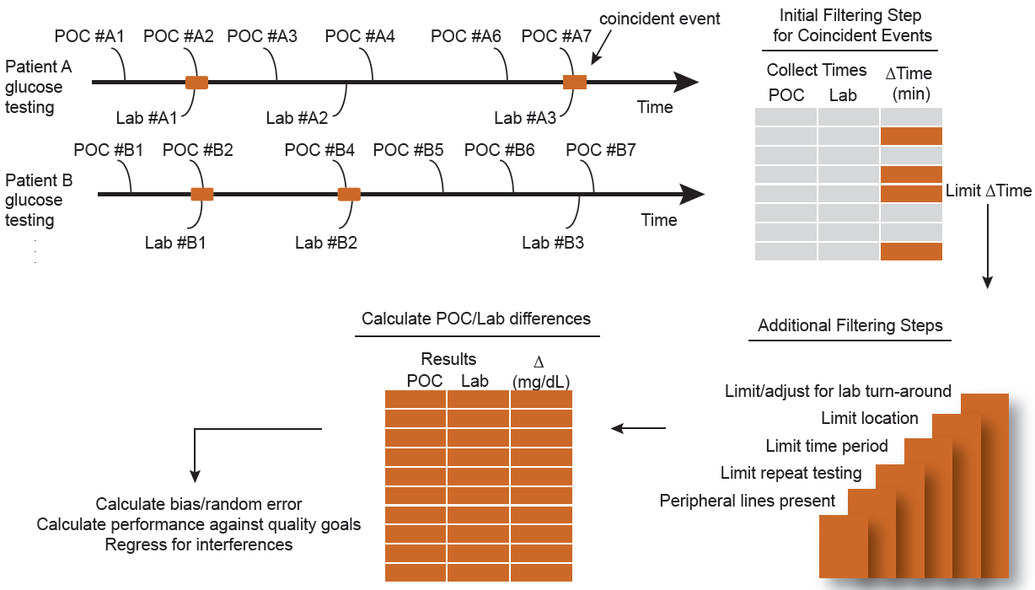
DETECT method
Figure 1. Routine orders for POC and central laboratory glucose in hospital settings occasionally occur in the same patient at nearly coincident times. DETECT queries the EMR for these events. Additional filtering steps are performed on these coincident events, on the basis of laboratory turnaround times, location, time period, presence of central laboratory repeat testing, and presence of peripheral lines.

Slide 8
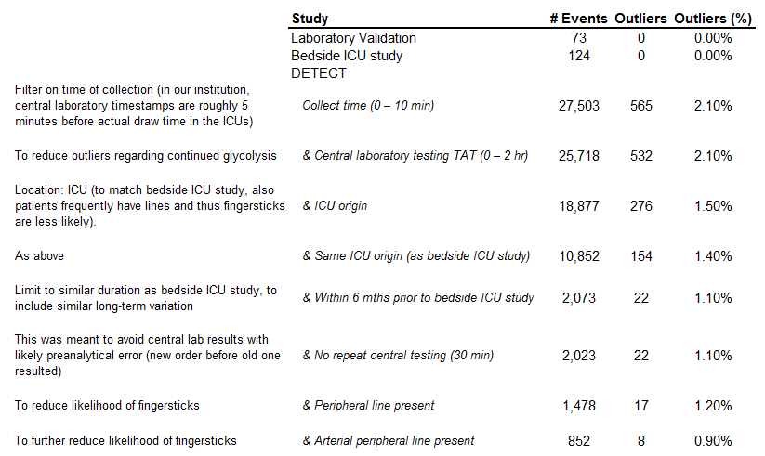
DETECT method: filters
Outliers: events with large differences between POC and central laboratory glucose, calculated using median absolute deviation
Table 1. Study size and outlier analysis.

Slide 9
Bias and random error
Bias: average difference between the POC glucose measurement and central laboratory method
Random error (composed of the two sources below)
  Imprecision: dispersion of results due to repeated testing of the same sample
  Random bias: this is actually a patient-specific bias (due to, e.g., hematocrit interferences) that appears as random noise in a cohort study
Only random error is estimable by DETECT (as dispersion of POC and central laboratory differences); repeated measurements of the same sample do not occur in routine clinical practice.
Note: outliers were excluded when calculating bias and random error

Slide 10
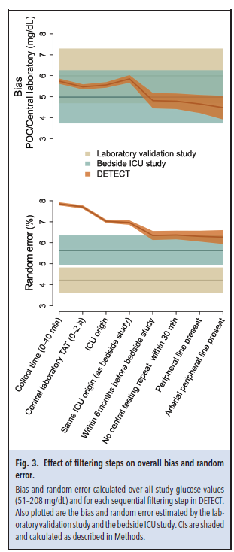
Results
Bias estimates between DETECT, bedside ICU study, and laboratory validation study were indistinguishable even with minimal filtering
Random error estimates from DETECT continued to converge on those from the bedside ICU study with increased filtering (up to a point)
Figure 3. Effect of filtering steps on overall bias and random error.
Bias and random error calculated over all study glucose values (51–208 mg/dL) and for each sequential filtering step in DETECT. Also plotted are the bias and random error estimated by the laboratory validation study and the bedside ICU study. CIs are shaded and calculated as described in Methods.

Slide 11
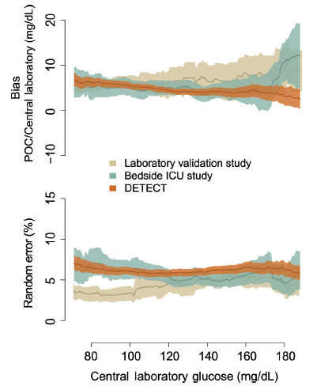
Results
Throughout glucose range
  Bias estimates between fully filtered DETECT, bedside ICU study, and laboratory validation study were largely overlapping throughout the range of glucose studied (range was limited by availability in the bedside ICU study)
  Random error estimates from fully filtered DETECT overlapped with bedside ICU study estimates, although at low glucose, laboratory validation estimates were lower
Figure 2. Moving average estimates of bias and random error.
Bias and random error are plotted with a ±20 mg/dL glucose window. Bias is calculated as the mean difference between POC and central laboratory testing results for all coincident events in a window. Random error is calculated as the SD of the percent POC and central laboratory differences in each window. CIs are shaded.

Slide 12
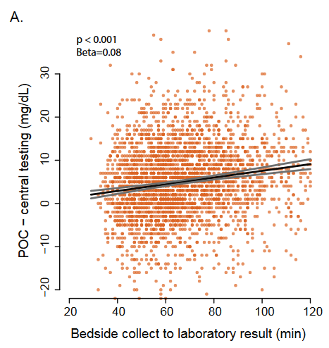
Results
Glycolysis due to specimen transport and processing
Central laboratory testing includes a period of time in which blood cells are in contact with plasma
The longer blood cells are in contact with plasma, the more glucose they metabolize
This can cause a positive bias in accuracy studies comparing POC glucose to the central laboratory.
Supplemental Fig 2. Associations of central testing time delay with POC bias. Linear regression of POC & central laboratory testing result differences vs central laboratory testing bedside collection to result time delay, to assess for continued glycolysis in the collection tube.

Slide 13
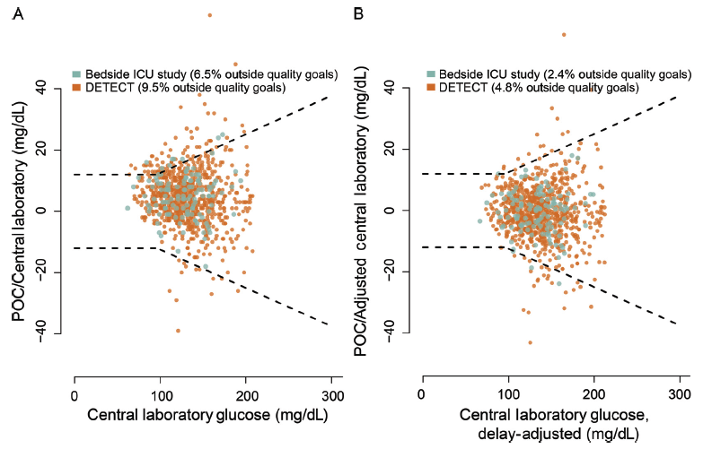
Results
Performance of meters compared to quality goals:
DETECT vs bedside ICU (unadjusted and adjusted for central laboratory delay)
Note: outliers included in this analysis
Figure 4. Effect of central laboratory testing delay on POC quality measures.
Bland–Altman plot showing differences between POC and central laboratory results, plotted against central laboratory results. Dashed lines represent CLSI quality goals. (A), Based on unadjusted central laboratory values. (B), Based on central laboratory values adjusted for time delay between blood collection and result verification, showing a reduction in the number of events outside quality goals.

Slide 14
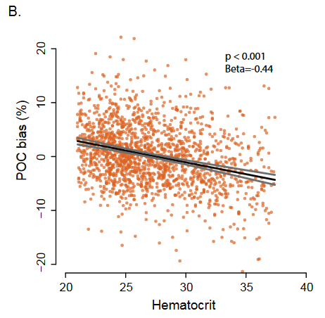
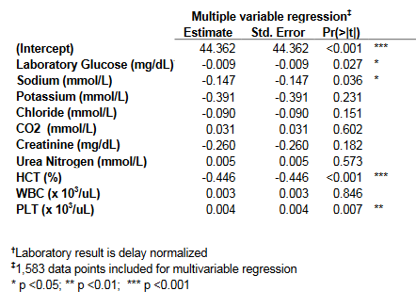
Results
Physiological interference
  In multivariable regression against analytes from the basic metabolic panel and CBC, only hematocrit displayed clinically significant interference
Supplemental Fig 2. Associations of hematocrit with POC bias. Linear regression of POC bias (%) vs hematocrit to characterize interference.

Slide 15
Questions
How likely is it that inaccuracies in glucose meter performance hindered latter RCTs of strict glycemic control?
Which filters are most important to implement when using DETECT? How does this vary by application? Which filters are the easiest to implement?
With the large data sets provided using DETECT, what novel analyses could be performed?

