Slide 1

Specificity of B-Type Natriuretic Peptide Assays: Cross-Reactivity with Different BNP, NT-proBNP, and proBNP Peptides
A. K. Saenger, O. Rodriguez-Fraga, R. Ler, J. Ordonez-Llanos, A. S. Jaffe, J. P. Goetze, F. S. Apple
January 2017
www.clinchem.org/content/63/1/351.full
© Copyright 2017 by the American Association for Clinical Chemistry

Slide 2
Introduction
  B-type natriuretic peptide (BNP) and N-terminal pro-BNP (NT-proBNP) are globally endorsed in clinical guidelines as biomarkers to aid in the diagnosis of heart failure and to monitor disease progression
  Intracellular processing produces the propeptide proBNP [amino acid (aa) 1–108], which is subsequently cleaved by furin into equimolar amounts of the active peptide BNP (proBNP 77–108 or BNP 1–32) and the biologically inert NT-proBNP (proBNP 1–76 or NT-proBNP 1–76)
  Multiple plasma proBNP-derived peptides are present in heart failure patients, of which the truncated BNP 3–32, BNP 4–32, and BNP 5–32 peptides and the glycosylated form of NT-proBNP are most prevalent. Very small amounts of intact BNP 1–32 remain in the circulation.

Slide 3
Introduction
  The multiple circulating NP fragments, along with proBNP and NT-proBNP, collectively form the B-type natriuretic peptide family.
  Immunoassays for NPs utilize a variety of antibodies, both monoclonal and polyclonal, and diverse calibrator materials and therefore substantial differences in patient specimens between NP methods have been identified.
  There are currently no formal efforts to standardize or maintain harmonization of BNP or NT-proBNP assays, primarily owing to the known differences in antibodies used and lack of a primary reference standard material.
  As new heart failure therapeutic modalities are gaining regulatory approval, such as angiotensin receptor-neprilysin inhibitors (ARNI) it will be important not only to understand the mechanism of action of these drugs but also to ensure the natriuretic peptide assays used clinically are designed to measure the most relevant peptides.

Slide 4
Introduction- Question
  What criteria did your laboratory use to decide
  whether a BNP or NT-proBNP assay was the better
  assay for patient care?

Slide 5
Purpose
  The purpose of this study was to comprehensively and systematically evaluate the specificity of BNP, NT-proBNP, and proBNP assays by determining cross-reactivity with a variety of glycosylated and nonglycosylated natriuretic peptides and NP fragments.
  This study built upon previously reported preliminary results from the International Federation of Clinical Chemistry (IFCC) Committee for Standardization of Markers of Cardiac Damage.

Slide 6
Materials and Methods
  EDTA plasma samples were collected from healthy donors in accordance with standard laboratory practices
  To ensure stability throughout the sample processing and analytical phases, we added a protease inhibitor cocktail.
  Plasma pools were analyzed with all BNP, NT-proBNP, and proBNP assays to determine the baseline concentration and then individually spiked with 100 ng/L BNP, 300 ng/L proBNP, or 450 ng/L NT-proBNP peptides and reanalyzed.
  BNP peptides were obtained as synthetic BNP (aa 1–32; Shionogi, Peptide Institute), human recombinant BNP (aa 1–32; Scios), human recombinant BNP (aa 3–32; courtesy of John Burnett, Mayo Clinic, Rochester, MN).

Slide 7
Materials and Methods
  NT-proBNP peptides included human recombinant NT-proBNP (aa 1–76; HyTest), human recombinant glycosylated NT-proBNP (aa 1–76; HyTest), and synthetic amidated NT-proBNP; aa 1–76; Roche Diagnostics).
  Peptides for proBNP included HyTest human recombinant proBNP (aa 1–108; expressed in Escherichia coli), HyTest human recombinant glycosylated proBNP (aa 1–108; expressed in mammalian cells), and human recombinant glycosylated proBNP from Scios (aa 3–108).
  Assays used for BNP and NT-proBNP are shown in the tables, while research assays were provided by the manufacturer or by an independent researcher's laboratory (JPG) for proBNP and included: Bio-Rad, Goetze, and Biosite (Alere).
  We used the mean of duplicate NP measurements on each sample for all statistical analyses and comparisons and calculated the percentage recovery as the analyte concentration at the concentration of the peptide divided by the NP concentration of the unspiked sample

Slide 8
Analytical Characteristics of BNP Assays
Manufacturer | Platform | Capture Antibody | Detection Antibody | Standard Material | CV (Conc) | Limit of Detection
Abbott | Architect | NH2 terminus and part of the ring structure (Scios), murine monoclonal Ab, aa 5-13 | COOH terminus, murine monoclonal Ab, aa 26-32 | Synthetic BNP 32 | 4.1% (92 ng/L) | ≤10 ng/L
Abbott POC | i-STAT | NH2 terminus and part of the ring structure (Scios), murine monoclonal Ab, aa 5-13 | COOH terminus, murine monoclonal Ab, aa 26-32 | Synthetic BNP 32 | 9.0% (126 ng/L) | 15 ng/L
Alere | Triage | NH2 terminus and part of the ring structure (Scios), murine monoclonal Ab, aa 5-13 | BNP (Biosite), murine Omniclonal Ab, epitope not characterized | Recombinant BNP | 4.1% (77 ng/L) | 5 ng/L
Beckman Coulter | Access 2 | BNP (Biosite), murine Omniclonal Ab, epitope not characterized | NH2 terminus and part of the ring structure (Scios), murine monoclonal Ab, aa 5-13 | Recombinant BNP | 6.7% (1344 ng/L) | <1 ng/L
Siemens | Advia Centaur | COOH terminus (BC-203) (Shionogi), murine monoclonal Ab, aa 27-32 | Ring structure (KY-hBNPII) (Shionogi), murine monoclonal Ab | Synthetic BNP | 9.9% (29 ng/L) | <2 ng/L

Slide 9
Analytical Characteristics of NT-proBNP Assays
Manufacturer | Platform | Capture Antibody | Detection Antibody | Standard Material | % CV (Conc) | Limit of Detection
bioMerieux | VIDAS | Murine monoclonal Ab, aa 27-31 | Central molecule, polyclonal sheep Ab, aa 42-46 | Synthetic NT-proBNP 1-76 | 3.8% (117 ng/L) | 20 ng/L
Mitsubishi Chemical | PATHFAST | NH2 terminus polyclonal sheep Ab, aa 1-21 | Central molecule, polyclonal sheep Ab, aa 39-50 | Synthetic NT-proBNP 1-76 | 4.7% (101 ng/L) | 15 ng/L
Ortho Clinical Diagnostics | Vitros ECi | NH2 terminus polyclonal sheep Ab, aa 1-21 | Central molecule, polyclonal sheep Ab, aa 39-50 | Synthetic NT-proBNP 1-76 | 1.8% (80 ng/L) | 5 ng/L
Response Biomedical | RAMP | Murine monoclonal Ab, aa 27-21 | Central molecule, polyclonal sheep Ab, aa 39-50 | Synthetic NT-proBNP 1-76 | 12.1% (113 ng/L) | 35 ng/L
Roche | Elecsys | Murine monoclonal Ab, aa 27-31 | Central molecule, monoclonal sheep Ab, aa 42-46 | Synthetic NT-proBNP 1-76 | 3.2% (175 ng/L) | 5 ng/L
Siemens (Dade Behring) | Stratus CS | NH2 terminus monoclonal sheep Ab, aa 22-28 | Central molecule, monoclonal sheep Ab, aa 42-46 | Synthetic NT-proBNP 1-76 | 5.1% (153 ng/L) | 15 ng/L
Siemens (Dade Behring) | Dimension | NH2 terminus monoclonal sheep Ab, aa 22-28 | Central molecule, monoclonal sheep Ab, aa 42-46 | Synthetic NT-proBNP 1-76 | 5.7% (159 ng/L) | 10 ng/L
Siemens (DPC) | Immulite 2000 | NH2 terminus polyclonal sheep Ab, aa 1-21 | Central molecule, polyclonal sheep Ab, aa 39-50 | Synthetic NT-proBNP 1-76 | 4.4% (146 ng/L) | 10 ng/L

Slide 10
Materials & Methods - Question
  Does your laboratory medical director, manager or supervisor understand the analytical characteristics
  of the BNP or NT-proBNP assay used for patient care
  in your hospital?

Slide 11
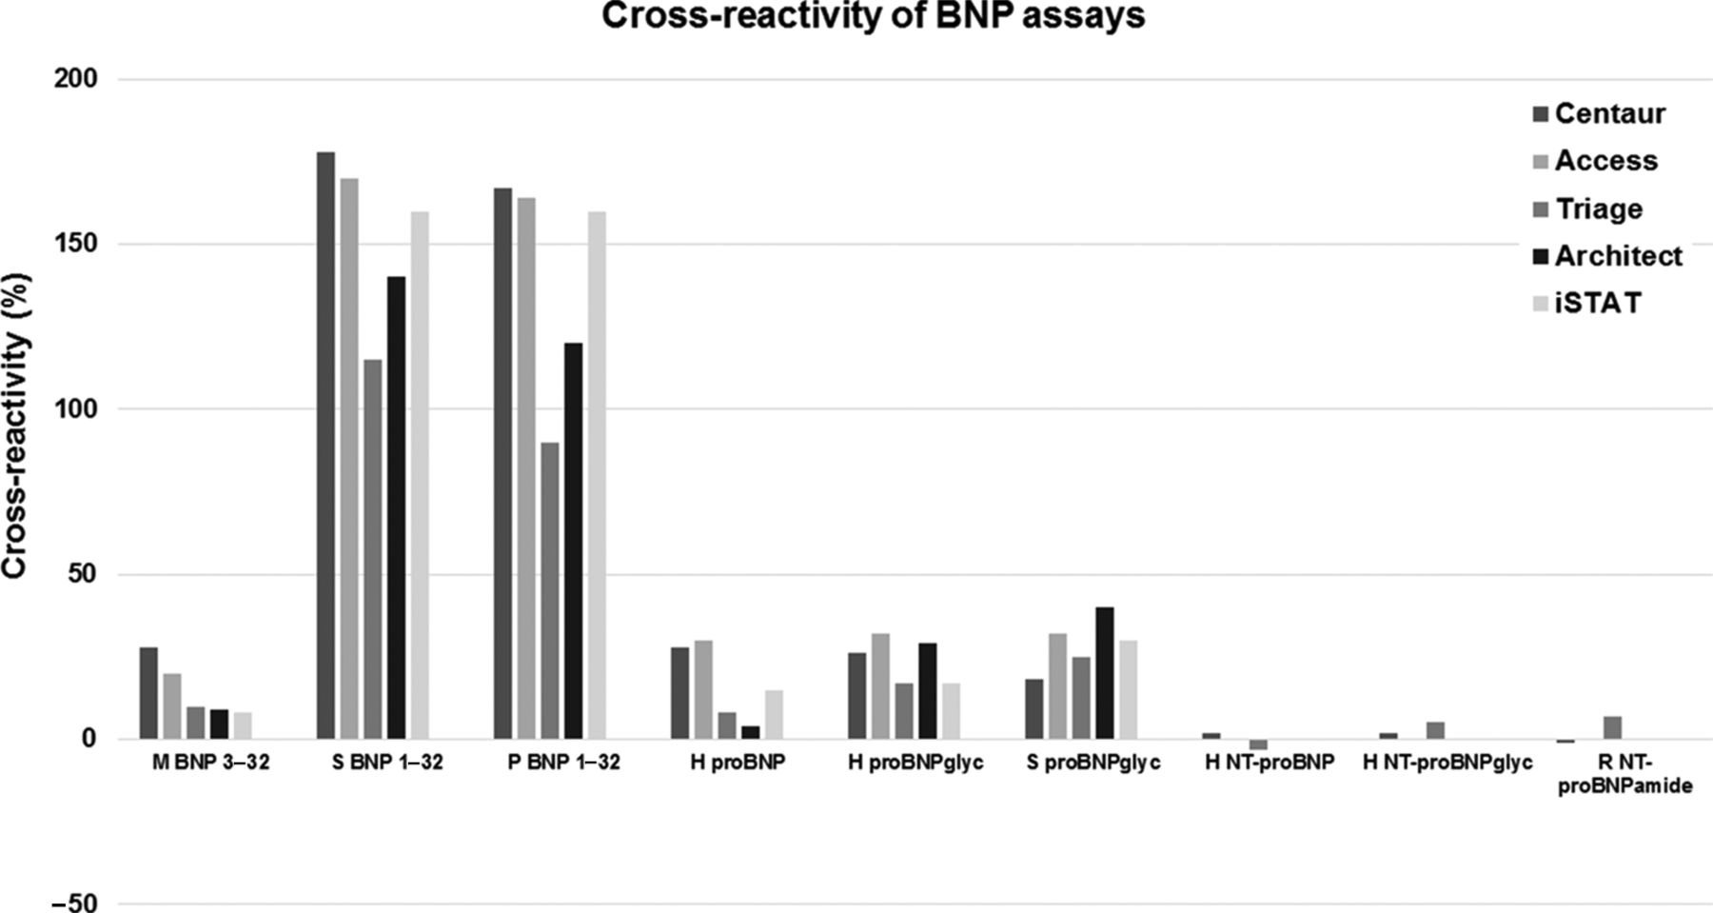
Results
  Cross-reactivity of BNP assays with BNP, proBNP, and NT-proBNP peptides is shown.
  BNP assays demonstrated substantial cross-reactivity with proBNP peptides.
  None of the NT-proBNP peptides had cross-reactivity with any of the BNP assays.

Slide 12
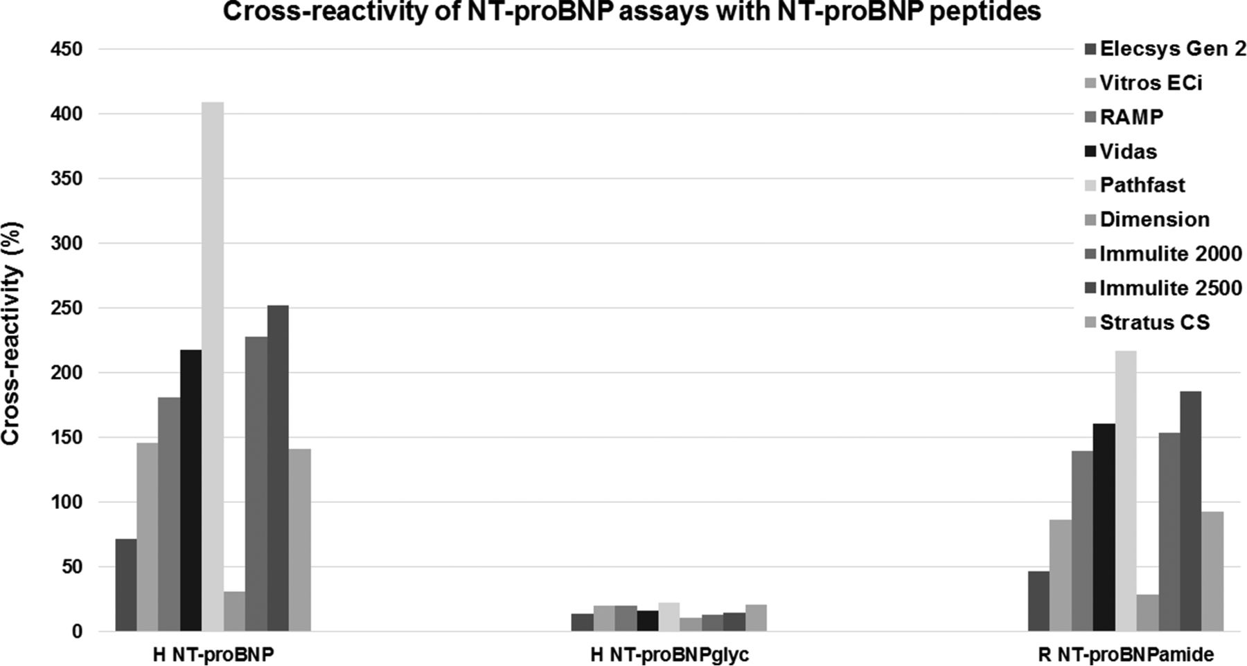
Results
  There was minimal cross-reactivity of NT-proBNP assays with BNP peptides.
  NT-proBNP assays demonstrated substantial cross-reactivity with proBNP peptides.
  NT-proBNP assays do not detect glycosylated forms of either NT-proBNP or proBNP

Slide 13
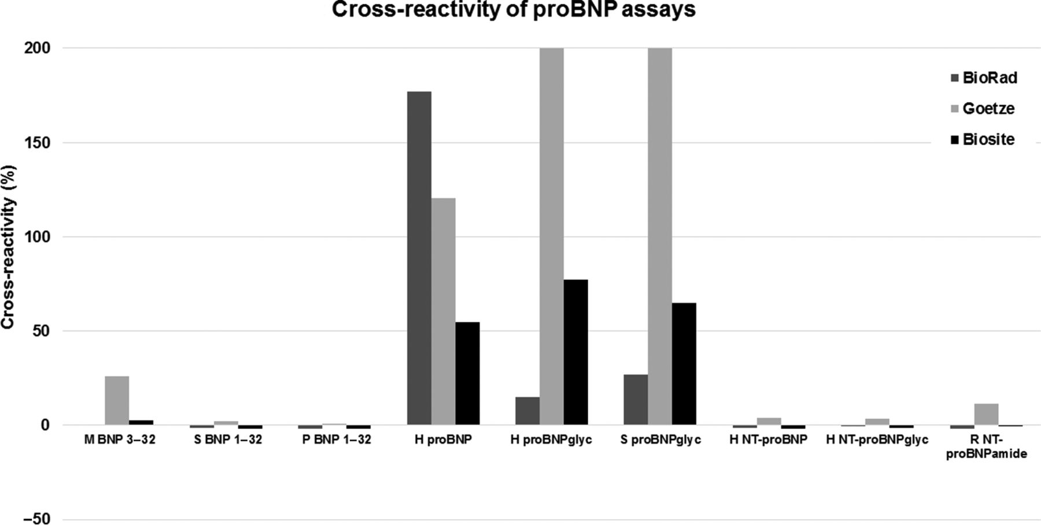
Results
  Percent cross-reactivity of proBNP assays with BNP, proBNP, and NT-proBNP peptides is shown.
  Goetz assay was the only assay to demonstrate substantial cross-reactivity with BNP.
  None of the proBNP assays demonstrated significant cross-reactivity with any of NT-proBNP.

Slide 14
Results - Question
  Now knowing that substantial crossreactivities
  to multiple natriuretic peptides that circulate in
  patients with heart failure exist for your assay,
  would this provoke a thought of changing assays ?

Slide 15
Conclusions
  The study confirms there is significant cross-reactivity between proBNP peptides and BNP and NT-proBNP assays used in clinical practice.
  There is no cross-reactivity between NT-proBNP peptides in BNP assays.
  NT-proBNP assays do not detect BNP peptides or glycosylated proBNP-derived peptides, the major form seen in heart failure.
  proBNP assays are highly specific for the various forms of proBNP peptides that may have utility in elucidating peripheral processing of proBNP 1–108, particularly in heart failure patients and individuals with diabetes mellitus where glycosylation patterns are highly variable.
  Despite lack of standardized natriuretic peptide assays, clinical cardiovascular and heart failure guidelines recommend uniform cutpoints for BNP and NT-proBNP assays.
  This study demonstrates there are opportunities to improve standardization and harmonization efforts for natriuretic peptide assays and ultimately to improve clinical care for heart failure patients, particularly on the advent of new pharmacologic agents.

