Slide 1
Rapid, Secure Drug Testing Using Fingerprint Development and Paper Spray Mass Spectrometry
C. Costa, R. Webb, V. Palitsin, M. Ismail, M. de Puit, S. Atkinson, M.J. Bailey
November 2017
www.clinchem.org/content/63/11/1745.full
© Copyright 2017 by the American Association for Clinical Chemistry

Slide 2
Introduction
Current drug testing methods rely on biological matrices such as blood, urine and oral fluid and analytical techniques such as liquid chromatography-mass spectrometry (LC-MS).
The use of fingerprints as a testing matrix and paper spray-mass spectrometry (PS-MS) as the analysis technique result in a procedure with the following advantages:
  Non-invasive sample collection
  No known biohazards
  Possibility for donor identification from the fingerprint pattern
  No sample preparation
  High sample throughput (4 mins per sample)
  Low cost (per sample)
In this article, the authors report on the application of PS-MS for the rapid detection of cocaine and respective metabolites from a single fingerprint.

Slide 3
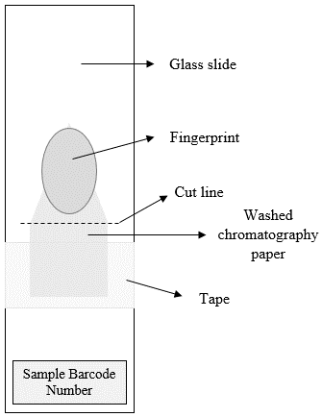
Method
The sample was collected in a cartridge (right). The triangular area of the collection kit was removed and placed in the instrument for analysis.
An internal standard (isotopically labelled analyte) was added to the sample followed by solvent and voltage, which lead to the extraction of the fingerprint components into the mass spectrometer.
Qualitative identification of cocaine and metabolites was achieved through the use of tandem MS. Quantitative potential of the technique was explored using full scan measurements.
In order to visualize the fingerprint pattern prior to analysis, silver nitrate can be added to the substrate (prior to sample collection). Upon collection of the sample, exposure to UV light will reveal the fingerprint ridge detail, that can be photographed.

Slide 4
Paper spray analysis procedure
20 µL of calibration standard or fingerprint sample
20 µL of internal standard (isotopically labelled analyte)
Air dry for 5 minutes
Place on paper spray source
Add 100 µL of 80:20 ACN:H₂O and apply 4.0 kV
Acquire data for 2 minutes in full scan
Stop voltage and add 100 µL of 80:20 ACN:H₂O
Restart voltage (4.0 kV) and acquire for 2 minutes in MS/MS mode

Slide 5
Results
The method was evaluated for its analytical performance:
  Limits of detection were calculated to be 1, 2 and 31 ng/mL for cocaine, benzoylecgonine and ecgonine methyl ester.
  Relative standard deviation >33%
239 fingerprint samples were successfully analyzed. Out of those:
  159 were collected from known drug users and results were corroborated with oral fluid testing, yielding a 99% true positive rate.
  Out of the 159, 20 samples were developed using silver nitrate while still enabling the detection of cocaine and metabolites.
  80 were collected from non-drug users, yielding a 2.5% false-positive rate.

Slide 6
Silver nitrate developed fingerprints

Slide 7
Questions:
How many other substances can be detected in fingerprints using this method?
Are quantitative results essential for a confirmatory drug test?

