Slide 1
Synthetic Circulating Cell-free DNA as Quality Control Materials for Somatic Mutation Detection in Liquid Biopsy for Cancer
R. Zhang, R. Peng, Z. Li, P. Gao, S. Jia, X. Yang, J. Ding, Y. Han, J. Xie, and J. Li
September 2017
www.clinchem.org/content/63/9/1465.full
© Copyright 2017 by the American Association for Clinical Chemistry

Slide 2
Introduction
The analysis of circulating tumor DNA (ctDNA) for somatic genomic alterations has become an important tool for the management of cancer patients.
There is a growing demand for quality control materials for ctDNA analysis for assay development, test validation, internal quality control, and proficiency tests.
Here we have developed a set of synthetic cell free DNA quality control materials (SCQCMs) which comprise spike-in cfDNA based on micrococcal nuclease (MNase) digestion and matched genomic DNA.
  See Editorial by Tsang JCH. Quality Materials for Quality Assurance in the Analysis of Liquid Biopsy Samples. Clin Chem 2017.

Slide 3
Question
What are the major concerning issues in the design of ctDNA quality control materials?

Slide 4
Materials & Methods
MNase enzyme was used to digest HEK293T cells in order to produce wild-type DNA pieces.
PCR-based site-directed mutagenesis was done to introduce KRAS G12D and five kinds of EGFR mutations including T790M, L858R, G12D, deletion in exon 19 and insertion in exon 20.
HEK293T cells were edited to introduce EML4-ALK rearrangements by the CRISPR/Cas9 system.
The DNA fragments were mixed with the digested edited HEK293T cell-line DNA segments containing EML4-ALK rearrangements and sheared DNA segments with SNVs and indels respectively to generate synthetic cell-free DNA quality control materials.

Slide 5
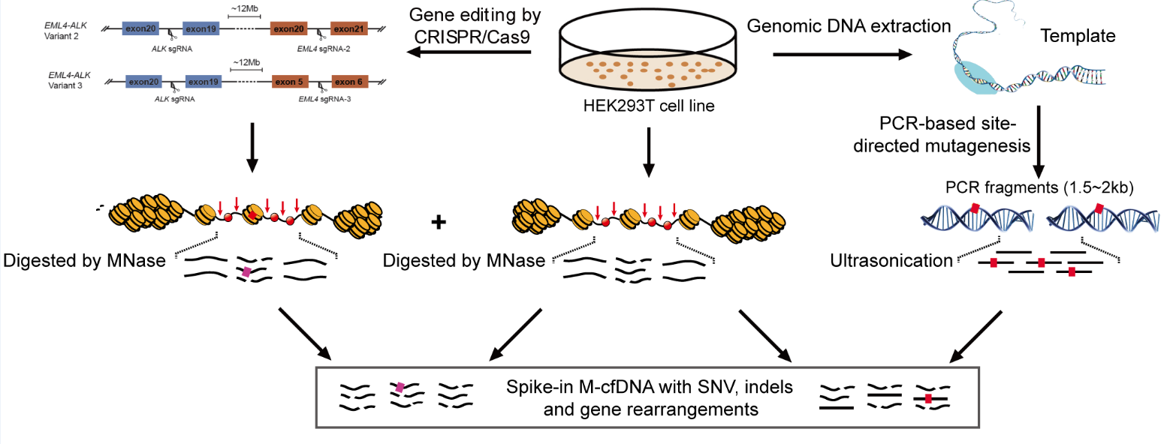
Materials & Methods
Figure 1. A schematic illustration of the preparation of SCQCMs

Slide 6
Materials & Methods
The SCQCMs were compared with patient-derived plasma as an effective substitute for clinical samples to evaluate their reliability.
The SCQCMs containing cancer-associated alterations at different fractional concentrations were distributed to 11 laboratories, covering a broad range of methodologies and informatics techniques to evaluate the generalizability of the quality control materials.

Slide 7
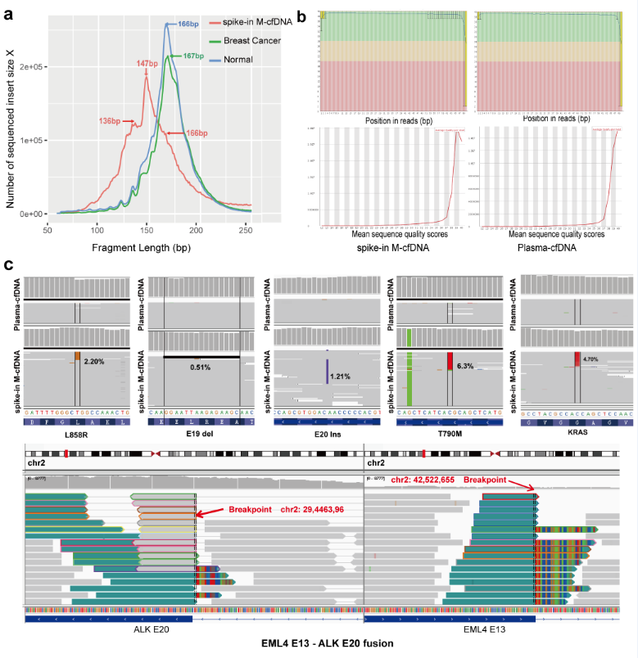
Results
Comparison of the performance of SCQCMs with plasma samples:
The fragment lengths derived from cell-free DNA based on MNase digestion (M-cfDNA) were generally shorter than the fragment lengths present in the patients and healthy controls, respectively.
spike-in M-cfDNA derived reads were similar to the reads derived from tumor patient plasma cfDNA in the sequencing quality pattern.
The introduced genetic variations (including SNV, indel, gene fusion) were identified in the spike-in M-cfDNA samples with the expected allelic fraction (AF).
Figure 2. Sequencing quality of sequenced reads derived from spike-in M-cfDNA samples and plasma cfDNA samples

Slide 8
Table 1. The intended results, validation results from 24 datasets of the SCQCMs
Sample No. | Gene | Transcript ID | Variant | Intended AF | Validated using NGS
 |  |  |  |  | Variant | AF
A | EGFR | NM_005228.3 | c.2369C>T (p.Thr790Met) | 2.5% | NM_005228.3(EGFR):c.2369C>T(p.Thr790Met) (p.Thr790Met) | 1.64%
 | EGFR | NM_005228.3 | c.2573T>G (p.Leu858Arg) | 2.5% | NM_005228.3(EGFR):c.2573T>G (p.Leu858Arg) | 1.85%
B | EGFR | NM_005228.3 | c.2369C>T (p.Thr790Met) | 2.5% | NM_005228.3(EGFR):c.2369C>T (p.Thr790Met) | 3.04%
C | EGFR | NM_005228.3 | c.2235_2249del15 (p.Glu746_Ala750del) | 2.5% | NM_005228.3(EGFR):c.2235_2249del15 (p.Glu746_Ala750del) | 1.32%
D | EGFR | NM_005228.3 | c.2310_2311insGGT (p.Asp770_Asn771insGly) | 1.0% | NM_005228.3(EGFR): c.2310_2311insGGT(p.Asp770_Asn771insGly) | 1.60%
E | EGFR | NM_005228.3 | c.2369C>T (p.Thr790Met) | 5% | NM_005228.3(EGFR):c.2369C>T (p.Thr790Met) | 6.64%
F | KRAS | NM_033360.3 | c.35G>A (p.Gly12Asp) | 2.5% | NM_033360.3(KRAS):c.35G>A (p.Gly12Asp) | 2.64%
G | EGFR | NM_005228.3 | c.2235_2249del15 (p.Glu746_Ala750del) | 2.5% | NM_005228.3(EGFR):c.2235_2249del15 (p.Glu746_Ala750del) | 1.07%
H | EML4-ALK | NR | EML4 exon20-ALK exon20 fusion | 1.0% | EML4 exon20-ALK exon20 fusion | 0.72%
I | EML4 -ALK | NR | EML4 exon6-ALK exon20 fusion | 1.0% | EML4 exon6-ALK exon20 fusion | 0.74%
J | NR | NR | Wild-type | NR | Wild-type | NR
NR: Not Related.

Slide 9
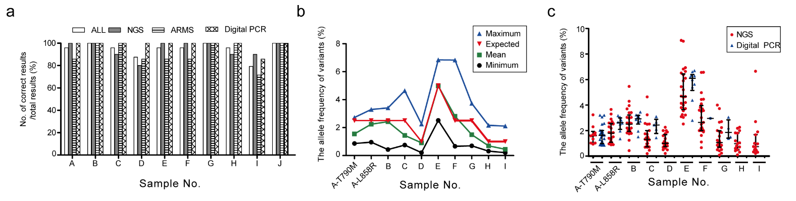
Results
Consistency across laboratories and methods:
More than 95% of laboratories correctly detected the synthetic quality control materials with KRAS G12D SNVs, EGFR T790M, L858R, and a deletion in exon 19, as well as EML4-ALK variant 2.
The majority of laboratories correctly detected the synthetic quality control materials with the insertion in exon 20 and EML4-ALK variant 3 (87.5% or 21/24 and 79.2% or 19/24, respectively).
The mean values of mutant allele percentage reported by the laboratories were close to those expected when the samples were prepared.
AFs of SNVs in NGS group were similar to those in dPCR group.
Figure 3. Summary of the results from the synthetic quality control materials carrying different somatic mutations.

Slide 10
Questions
What is the possible difference of the synthetic quality control materials compared with the plasma DNA of cancer patients?

Slide 11
Conclusions
SCQCMs should be desirable as quality control materials for ctDNA testing, considering their similar biological properties to those of plasma cfDNA species and wide suitability for various ctDNA testing methods.
SCQCMs can be prepared at precise ratios in order to generate a standard to assess quantitative features such as allelic fractions.
SCQCMs can be applied for monitoring false-positive and false-negative results in the quality control of ctDNA testing workflow in laboratories.

Slide 12
Final Comment in Editorial
The work of Zhang and colleagues will add to the ongoing efforts to develop robust and commutable quality control materials by commercial and quality assurance program providers. Such materials will be critical for ensuring laboratory quality and patient safety.
Tsang JCH. Quality Materials for Quality Assurance in the Analysis of Liquid
Biopsy Samples. Clin Chem 2017.

