Slide 1
Single-Stranded DNA Library Preparation Preferentially Enriches Short Maternal DNA in Maternal Plasma
J.S.L. Vong, J.C.H. Tsang, P. Jiang, W.-S. Lee, T.Y. Leung, K.C.A. Chan, R.W.K. Chiu, Y.M.D. Lo
May 2017
www.clinchem.org/content/63/5/1031.full
© Copyright 2017 by the American Association for Clinical Chemistry

Slide 2
Introduction
Background
Recent studies have suggested that single-stranded DNA (ssDNA) library preparation can enrich short DNA species from the plasma of healthy individuals, cancer patients, and transplant recipients.
Fetal DNA molecules in the maternal plasma are shorter than maternal DNA molecules, ssDNA library preparation may potentially enrich fetal DNA and provide substantial improvement in non-invasive prenatal testing.
Aim
To examine the genomic characteristics of ssDNA and dsDNA libraries in the profiling of circulating DNA in first- and third-trimester maternal plasma samples.
To compare the performance of ssDNA and dsDNA libraries in the detection of fetal aneuploidy in non-invasive prenatal testing

Slide 3
Question
Why is fetal fraction enrichment important in non-invasive prenatal testing by cell-free fetal DNA analysis?

Slide 4
Materials & Methods
Study population
  Euploid maternal plasma from male fetus singleton pregnancy
    Third-trimester (Pre-delivery) maternal plasma (n=4)
    First-trimester (13th week) maternal plasma (n=6)
  Trisomy 21 maternal plasma (n=2)
Library preparation methods
  dsDNA: Double-stranded DNA library (KAPA HTP Library Preparation Kit for Illumina, KAPA Biosystems)
  TS-ssDNA: Template-switching based single-stranded DNA library (DNA SMART ChIP-Seq Kit, Clontech)
  LIG-ssDNA: Adaptor-ligation based single-stranded DNA library (Accel-NGS 1S Plus DNA Library Kit, SWIFT Biosciences)

Slide 5
Materials & Methods
Parameters for evaluation
  Fetal fraction by fetal-specific SNPs and chrY fraction estimation
    Total fetal fraction
    Size-range specific fetal fraction
  Coefficients of variation of chromosomal representation
  Euploid-T21 pregnancy separation by Z score

Slide 6
Question
What are the differences among the various library preparation methods
in terms of their molecular principles?

Slide 7
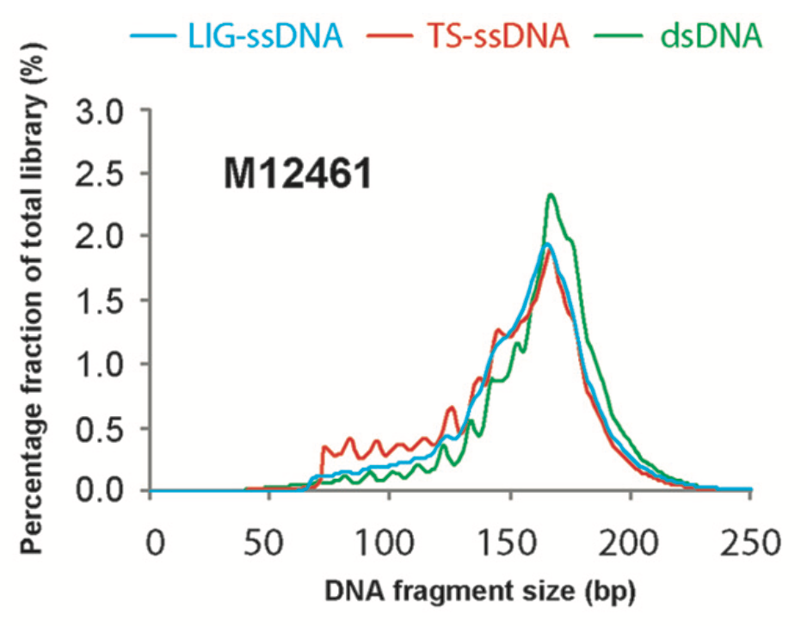
Figure 2. (A) The DNA size profiles of ssDNA and dsDNA libraries of third-trimester maternal plasma
  dsDNA: Double-stranded DNA library
  TS-ssDNA: Template-switching based single-stranded DNA library
  LIG-ssDNA: Adaptor-ligation based single-stranded DNA library

Slide 8
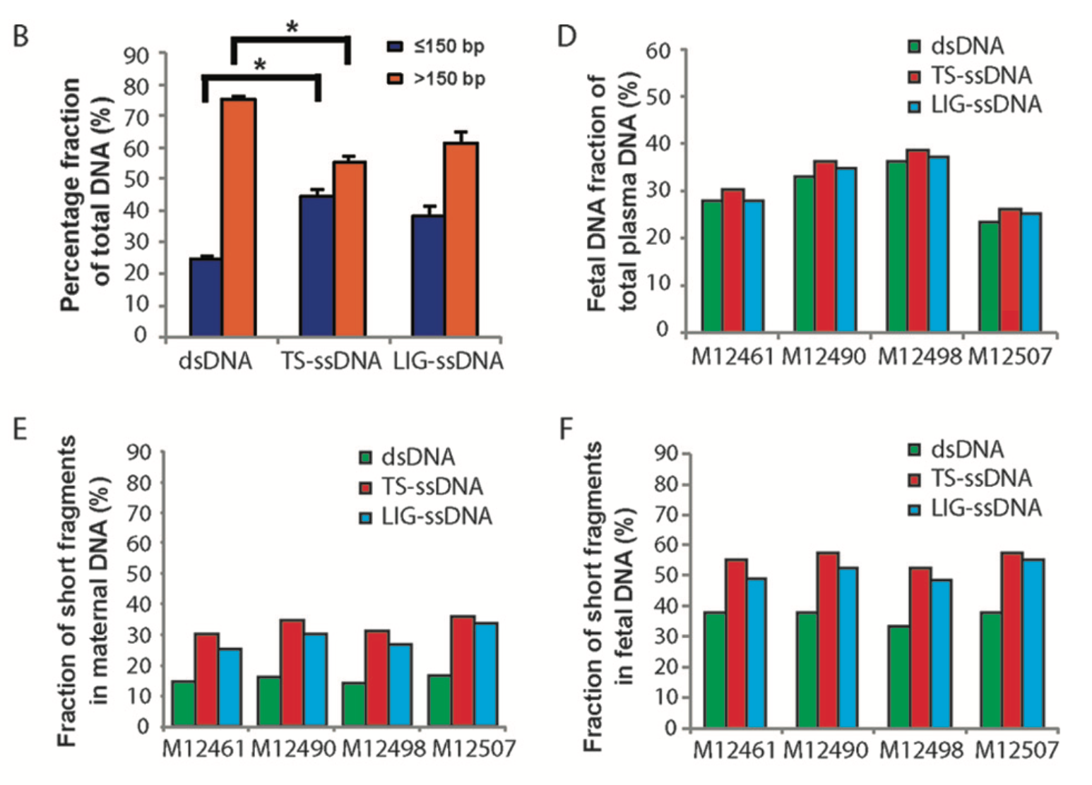
Figure 2. (B), The short DNA fraction; (D), overall fetal fraction; (E,F), short DNA fraction in maternal/fetal-specific DNA of ssDNA and dsDNA libraries of third-trimester maternal plasma

Slide 9
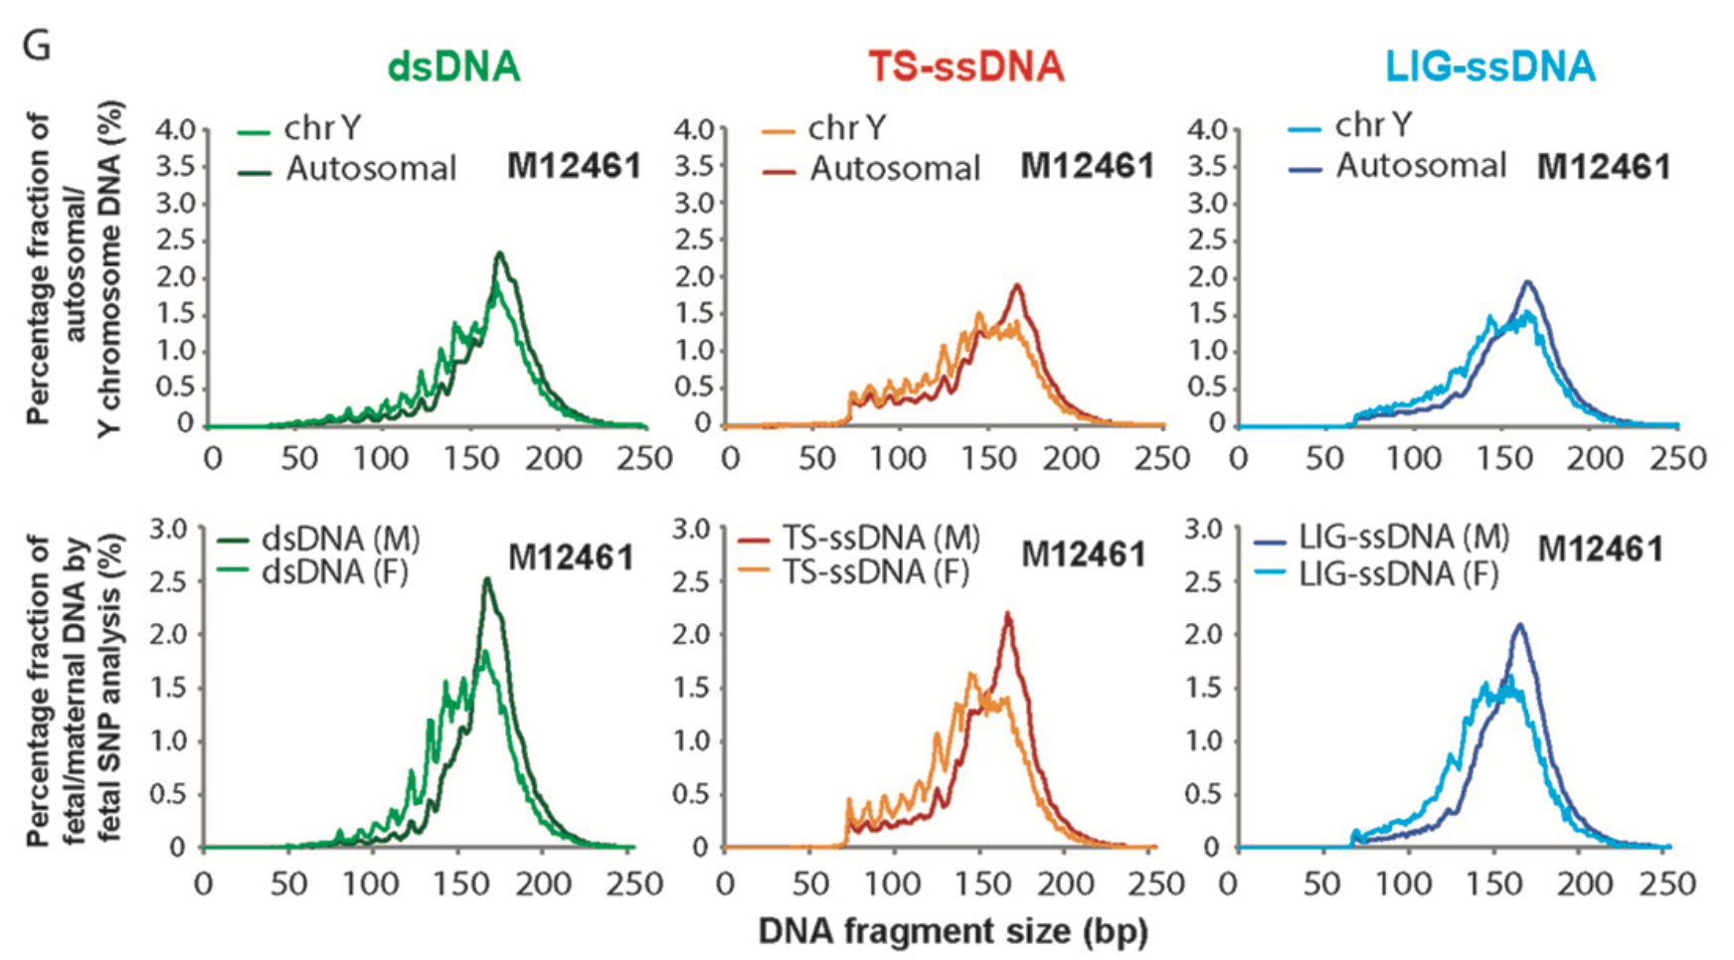
Figure 2. (G), DNA size profiles of autosomal/chromosome Y and maternal/fetal DNA in maternal/fetal-specific DNA of ssDNA and dsDNA libraries of third-trimester maternal plasma

Slide 10
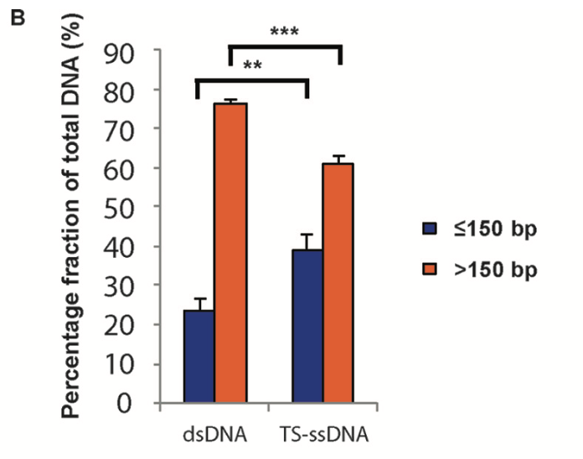
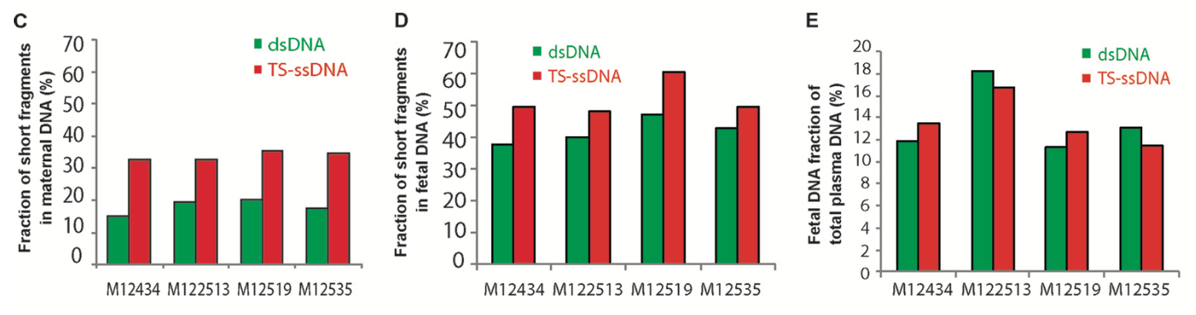
Figure 3. (B), Overall short DNA fraction; (C, D), Short DNA fraction in maternal/fetal DNA; (E), Overall fetal fraction of ssDNA and dsDNA libraries of first- trimester maternal plasma

Slide 11
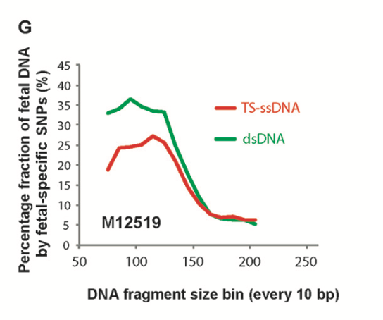
Figure 3. (G), Size-specific fetal fraction of ssDNA and dsDNA libraries of first-trimester maternal plasma

Slide 12
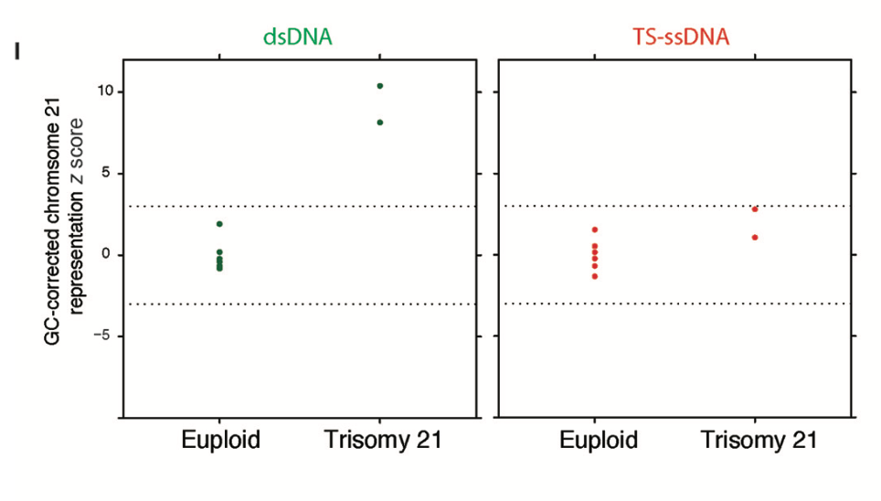
Figure 3. (I), Separation of trisomy 21 samples by z scores in ssDNA and dsDNA libraries

Slide 13
Question
What contributes to the preferential enrichment of short maternal DNA in ssDNA library preparation methods?

Slide 14
Conclusions
ssDNA library preparation methods, irrespective of their chemistry, enrich short DNA species in maternal plasma
ssDNA libraries preparation preferentially enriched short maternal DNA over short fetal DNA
dsDNA library preparation provide better performance than ssDNA methods in trisomy 21 detection in count-based non-invasive prenatal testing by massively parallel sequencing.

