Slide 1
High-resolution, accurate-mass (HRAM) mass spectrometry urine steroid profiling in the diagnosis of adrenal disorders
J.M. Hines, I. Bancos, C. Bancos, R.D. Singh, A.V. Avula, W.F. Young, S.K. Grebe, R.J. Singh
December 2017
www.clinchem.org/content/63/12/1824.full
© Copyright 2017 by the American Association for Clinical Chemistry

Slide 2
Introduction
Adrenal Steroid Analysis
  Important in diagnosis of adrenal disorders:
    Cushing syndrome
    Disorders of steroidogenesis
    Adrenal tumors
  Current testing protocols for adrenal tumors are sometimes inconclusive
    Biopsy
    Imaging
  Diagnostic capabilities may increase by measuring multiple steroids and their metabolites in biological fluids
  Assays such as a GC-MS 32-analyte urinary steroid metabolite profile have shown promising results as diagnostic tools¹⁻³
Arlt, et al. J Clin Endocrinol Metab 2011;96:3775– 84
Kerkhofs et al. Horm Cancer 2015;6:168 –75.
Velikanova et al. Horm Cancer 2016;7:327–35.

Slide 3
Introduction
Steroid analysis in the laboratory
  Isobaric and isomeric compounds may impede accurate detection of targeted analytes
  Chromatography is imperative for separating these compounds
  Gas chromatography has several limitations
    Time consuming
    Technically demanding
    Labor-intensive
  Liquid chromatography (LC) may overcome these limitations while allowing chromatographic separations of isomers.

Slide 4
Objectives
Combine liquid chromatography with high-resolution, accurate-mass (HRAM) mass spectrometry to develop a 26-analyte, urine-based steroid panel.
Determine sex- and age-based control reference ranges.
Evaluate the method for a cohort of patients with adrenal diseases.

Slide 5
Materials and Methods
  Volunteer and Patient recruitment (24-h urine collections)
  114 controls
    66 female (age 25-83)
    48 male (age 24-83)
  71 patients with adrenal disease
    4 ACTH-dependent pituitary hypercortisolism
    1 Congenital adrenal hyperplasia, newly diagnosed
    5 Adrenocortical carcinoma (ACC)
    61 Adrenocortical adenoma (ACA)

Slide 6
Materials and Methods
Sample hydrolysis and extraction:
150 µL of urine, calibrator, or quality control combined with 50 µL of working internal standard
50 µL of sodium acetate (3 mol/L, pH 5.2) and 10 µL of Glusulase added to the tubes and incubated for 2 h at 50°C in a dry heat block
50 µL of potassium carbonate added to halt the hydrolysis reaction
3mL of ethyl acetate added to each tube followed by a five minute vortex
After a 15 min centrifugation, 2 mL of the organic layer removed and pipetted into a clean tube, which was dried down at 40°C under nitrogen for 30 min
Extracts resuspended with 50% acetonitrile and transferred to a 96 deep-well plate for injection

Slide 7
Materials and Methods
HRAM LC-MS Method
  Thermo Uni-Cell Dionex UPLC system
  Thermo Q Exactive Plus
Full scan, 70,000 resolution (at 200 m/z)
Reversed-phase chromatography
Zorbax Extend-C18, Rapid Resolution HT, 2.1 x 50 mm, 1.8 µm analytical column

Slide 8
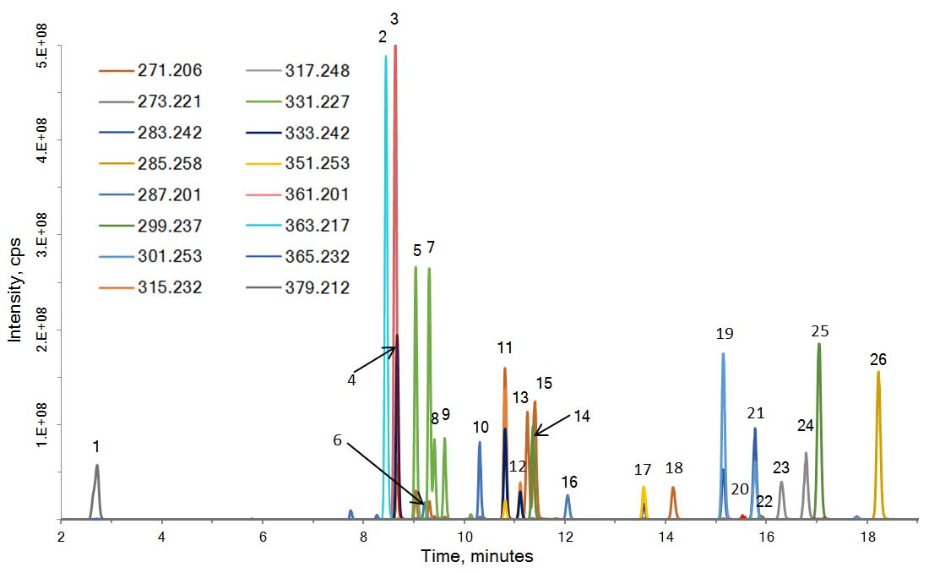
Results
Figure 1
Representative chromatogram indicating retention time and color-coded m/z used for analysis. Peaks are numbered as listed in Table 1. Of note, 12 isobaric peaks required chromatographic separation. The region without peaks between peak #1 (6B-OH-Cortisol) and peak #2 (cortisol) reflects use of the flow-divert valve mentioned in the main text, which was used to improve instrument robustness during gradient elution.

Slide 9
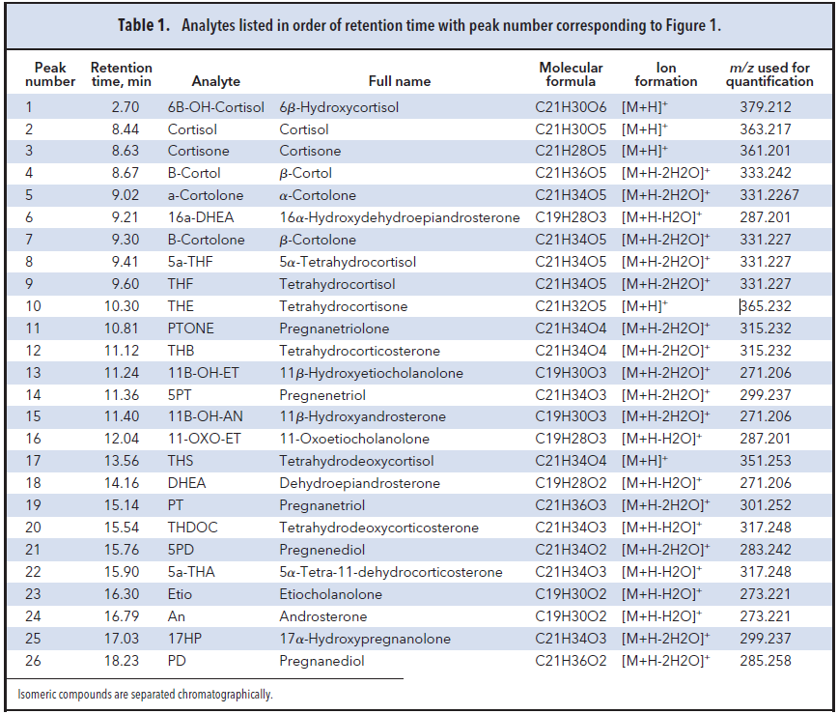
Results
Table 1.
Analytes listed in order of retention time with peak number corresponding to Figure 1. Isomeric compounds are separated chromatographically.

Slide 10
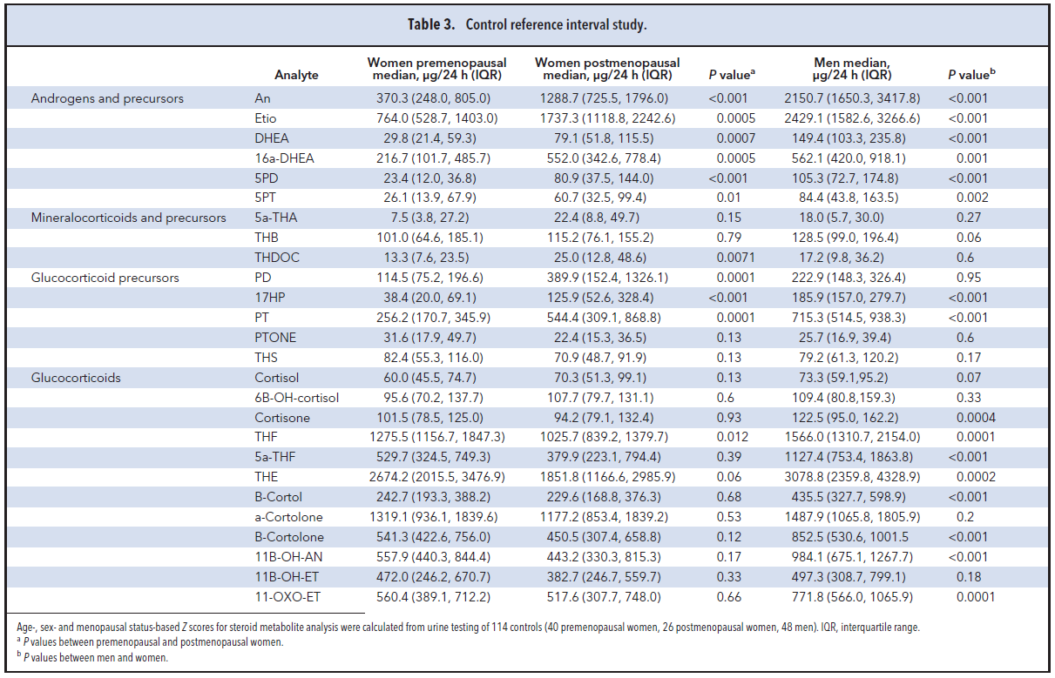
Results
Table 3.
Control reference interval study
Age-, sex- and menopausal status-based Z-scores for steroid metabolite analysis were calculated from urine testing of 114 controls (40 pre-menopausal females, 26 post-menopausal females, 48 males). Androgens and androgen precursors showed significant difference across sex and menopausal status.
ª p values between pre- and post-menopausal women. ^{b} p values between males and females.

Slide 11
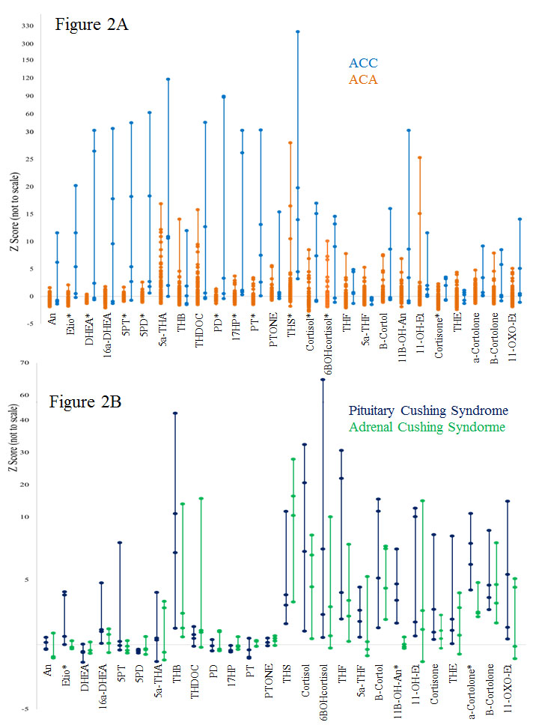
Results
Figure 2.
Significance of steroid metabolite profiling in adrenal disease states. Comparison of Z-score (y-axis) between ACC and ACA (A) using HRAM LC-MS steroid profiling established 11 of 26 metabolites as statistically significant (*) in distinguishing ACC from ACA. Adrenal Cushing syndrome versus pituitary Cushing syndrome (B) showed 3 analytes with statistical significance (*). See Supplemental Tables 3 and 4 for details.

Slide 12
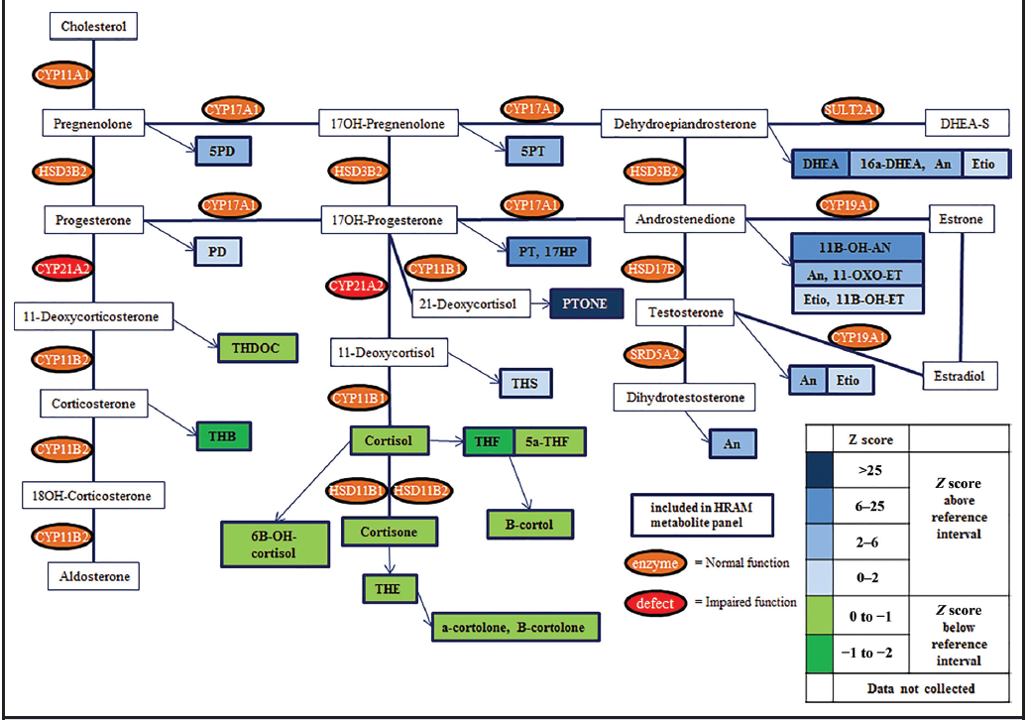
Results
Figure 3.
Steroid pathway diagram indicating the observed changes in steroid metabolite concentrations in a patient with a CYP21A2 enzyme deficiency. As expected, steroids and metabolites upstream from the CYP21A2 deficiency (confirmed through genetic testing) give increased Z scores (above reference interval), whereas those downstream of the enzyme deficiency showed a decrease compared with the reference interval.

Slide 13
Editorial:
Steroid Profiling for Adrenocortical Disorders:
A Pathway for Omics-Based Diagnostics
Graeme Eisenhofer and Martin Fassnacht, Clin Chem 2017;63:1787-9.
This editorial supports the potential for steroid metabolite analysis using mass spectrometry to improve care for patients with certain adrenal diseases, particularity for aggressive ACC, and suggests that these assays may even provide prognostic information that could impact treatment decisions.
Work published by Taylor et. al. describes a serum-based 13-steroid panel using LC-MS/MS that also shows potential in diagnosing ACC from ACA. This technique uses instrumentation more common to the clinical laboratory and also analyzes serum, which may offer advantages in terms of collection and clinician familiarity.
The editorial’s authors note the methodologies developed by Hines et. al. and Taylor et. al. are promising steps towards clinical acceptance of steroid metabolite profiling for adrenal disorders, yet both are limited by small patient studies. Large, multicenter, prospective trials would improve findings.

Slide 14
Questions
How might LC-HRAM mass spectrometry be advantageous in steroid metabolite analysis? What are the challenges associated with this methodology?
Why might urinary steroid metabolites be more useful than traditional serum steroid measurements in the diagnosis of some adrenal diseases?
How might a clinical laboratory effectively report results/interpretation from such a large series of data to a physician?

