Slide 1
Harmonization of Serum Thyroid-Stimulating Hormone Measurements Paves the Way for the Adoption of a More Uniform Reference Interval
L.M. Thienpont, K. Van Uytfanghe, L.A.C. De
Grande, D. Reynders, B. Das, J. D. Faix,
F. MacKenzie, B. Decallonne, A. Hishinuma,
B. Lapauw, P. Taelman, P. Van Crombrugge,
A. Van den Bruel, B. Velkeniers, P. Williams
July 2017
www.clinchem.org/content/63/7/1248.full
© Copyright 2017 by the American Association for Clinical Chemistry

Slide 2
Introduction
Measurement of serum thyroid hormone concentrations is an indispensable tool to confirm and follow-up thyroid disease
Reference intervals (RI) reported along with the laboratory data are an integral part of the interpretation process
The IFCC Committee for Standardization of Thyroid Function Tests (C-STFT) developed a global harmonization approach for thyroid-stimulating hormone (TSH) measurements
Here we describe the Phase IV method comparison and RI studies conducted with the objective to recalibrate the participating assays and establish the proof-of-concept
See Editorial by Miller WG. Harmonization: Its Time Has Come. Clin Chem 2017.

Slide 3
Questions
What is unique in the design of the harmonization and proof-of-concept/RI studies?

Slide 4
Materials and methods – Study design
Harmonization based on a multiassay method comparison study
Two panels of clinically relevant samples used in the Phase IV method comparison study: the harmonization (n = 101) and first follow-up panel (n = 95)
Targets set with a robust factor analysis method and use of the results of 4 IVD manufacturers who measured both panels in the same run (n = 196) (target referred to as “APTM-4”)
Harmonization (= recalibration to the targets) directly done by the participating IVD manufacturers (n = 14): see Table 1
Proof-of-concept/RI study done with a panel of 120 samples donated by “apparently healthy” American volunteers

Slide 5
Table 1. Phase IV study participants (ordered by code given), inclusive the platforms/TSH assays.
IVD manufacturer - Platform/Assay | Code
Siemens Healthineers (Tarrytown, NY) - Advia Centaur XP | A^{c}
Abbott Diagnostics (Abbott Park, IL) - Architect i2000 | B^{c}
ªShenzhen Mindray Bio-Medical Electronics Co., Ltd. (Shenzhen, China) - CL-2000i | C
Ortho-Clinical Diagnostics (Buckinghamshire, UK) - Vitros Eci | D
bioMérieux SA (Marcy-l’Etoile, France) – Vidas | E
Beckman Coulter Inc. (Brea, CA) - Access 2 | F
DiaSorin S.p.A (Saluggia, Italy) - Liaison® Analyser | G
ªSichuan Maccura Biotechnology Co., Ltd (Chengdu, China) - IS1200 | H
Roche Diagnostics GmbH (Mannheim, Germany) - Elecsys (Cobas e 601) | I^{c}
Tosoh Corporation (Tokyo, Japan) - AIA-2000 | J^{c}
ªSnibe Co., Ltd. (Shenzhen, China) - Maglumi 2000 | K
ªFujirebio Inc. (Tokyo, Japan) - Lumipulse G1200 | L
^{b}LSI Medience Corporation (Tokyo, Japan) - STACIA | N
^{b}Sysmex Corporation (Kobe, Japan) - HISCL-5000 | O
^{a,b} Manufacturers who only joined in 2015ª and/or 2016^{b} for participation in the Phase IV method comparison study
^{c} Data from these manufacturers were used to calculate the APTM-4

Slide 6
Materials and methods – Measurement protocol
Phase IV method comparison study
Samples measured in singlicate, on each of 2 days
Individual results reported
Master calibrators included
Recalibration of the assays
Master calibrators of each assay value reassigned to the APTM-4 by use of the company’s in-house mathematical procedure
Results for the patient samples recalculated as if the revised master calibrators were used for calibration
RI study
Samples measured in singlicate, within run
Results mathematically transformed using the value reassigned master calibrators
Pre- and postrecalibration results reported

Slide 7
Materials and methods – Data treatment
Demonstrate/validate the suitability of the recalibrated results to meet analytical specifications based on biological variation (bias: 7.8%; total error: 23.8%)
Estimate the pre- and postrecalibration RI characteristics (2.5th, 50th and 97.5th percentiles, each with their 90% CIs)
For each assay and the overall results (after applying the robust factor analysis model on the results of the 14 participating assays)
RI characteristics estimated with the nonparametric bootstrap procedure (n = 500)
Investigate the effect of recalibration on the uniformity of the RI characteristics (= proof-of-concept)

Slide 8
Questions
What were the main findings of the study?

Slide 9
Results – Method comparison/RI studies
The concentration ranges (based on the APTM-4) covered by the panels are:
Harmonization panel: 0.002 – 193 mIU/L
First follow-up panel: 0.002 – 169 mIU/L
The overall relative uncertainty of the targets ranges from 0.7% to 1.0%
The first follow-up panel is linked/traceable to the harmonization panel (because measured in parallel) and has an identical uncertainty
Can be used to harmonize new assays in the future
Assures the sustainability of the traceability anchor established with the harmonization panel
Recalibration of the assays by the IVD manufacturers is successful (see Figures 1, 2 and 3)

Slide 10
Figure 1. Combined difference (%) plots to the APTM-4 before (A) and after recalibration (B).
For each assay and sample, the difference of the mean from duplicate measurements is plotted
Filled and colored circles: differences of the assays that were most discrepant before recalibration
Open black circles: all other assays
Red broken lines: 7.8% bias limits
Blue broken lines: 15th and 85th centiles of the differences
Recalibration eliminates the calibration differences between the assays

Slide 11
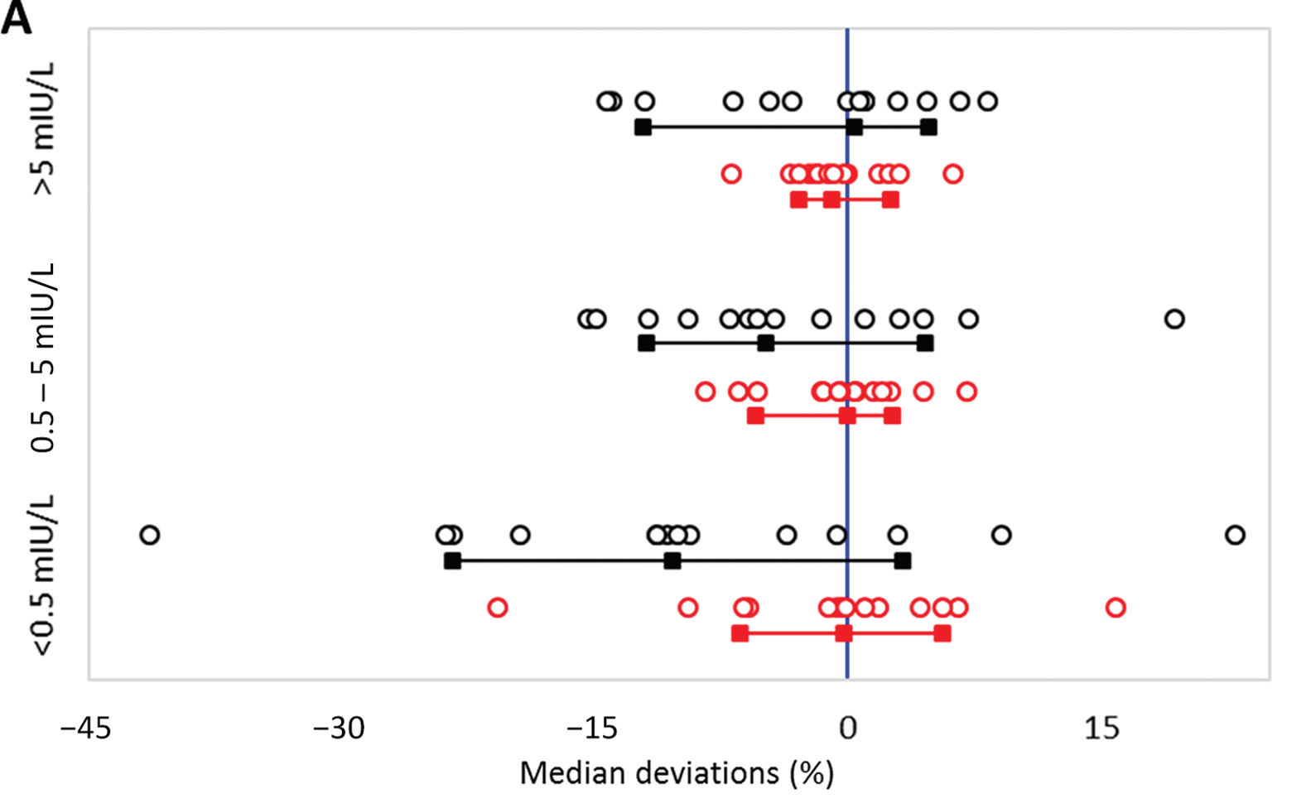
Figure 2. Median deviations (%) of the assays to the APTM-4 before and after recalibration in 3 concentration intervals: low: < 0.5 mIU/L, mid: ≥ 0.5 < 5.0 mIU/L, high: ≥ 5.0 mIU/L.
For each concentration interval, 2 pairs of data are shown
Black and red dots: the combined assay-specific median deviations before and after recalibration, respectively
Black and red lines: 15th, 50th, and 85th centiles
Recalibration reduces the range of the median deviations (%)

Slide 12
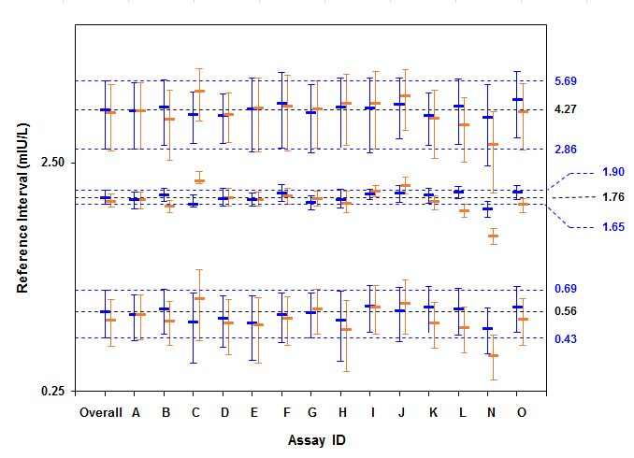
Figure 3. Comparison of the pre- and postrecalibration reference intervals of the assays to the overall RI.
Pre-recalibration RI: orange
Post-recalibration RI: blue
Thick horizontal bars: the 2.5th, 50th and 97.5th percentiles
Thin vertical lines: the 90% CIs of the respective percentiles
Grey and blue broken horizontal lines: the post-recalibration 2.5th, 50th and 97.5th reference percentiles and their respective 90% CIs
After recalibration the uniformity of the RIs is improved

Slide 13
Conclusions
The C-STFT global approach for TSH harmonization shows improved comparability between assays and gives evidence that more uniform RIs may be achieved in the near future
The presented postrecalibration RI is not the final one but a good starting point for IVD manufacturers to verify their RIs in accordance with accepted consensus standards
The follow-up panel warrants that in the future new assays can be harmonized to the traceability anchor established in this Phase IV study
The traceability anchor needs to be sustained by developing new follow-up panels and target setting always in overlap with the previous one before it is depleted

Slide 14
Final Comment in Editorial
“This report of a successful harmonization protocol is an important advance in laboratory medicine because it demonstrates an approach to achieve fit-for-purpose agreement among patient results measured by different measurement procedures when a certified reference material or reference measurement procedure is not available for calibration traceability.”
Miller WG. Harmonization: Its Time Has Come. Clin Chem 2017.

