Slide 1

Anti–Cardiac Troponin Autoantibodies Are Specific to the Conformational Epitopes Formed by Cardiac Troponin I and Troponin T in the Ternary Troponin Complex
A. V. Vylegzhanina, A. E. Kogan, I. A. Katrukha,
O. V. Antipova, A. N. Kara, A. V. Bereznikova,
E. V. Koshkina, A. G. Katrukha
January 2017
www.clinchem.org/content/63/1/343.full
© Copyright 2017 by the American Association for Clinical Chemistry

Slide 2
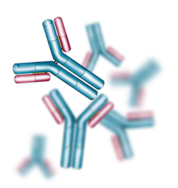
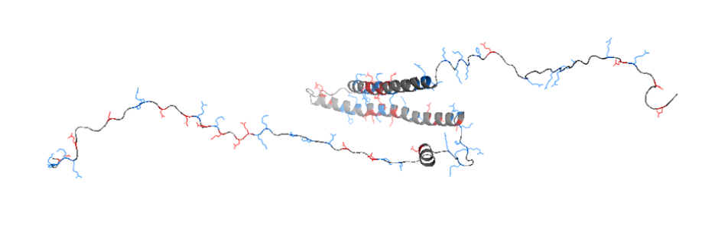
Autoantibodies to cardiac troponins – TnAAbs
Autoantibodies specific to cardiac troponins are found in the blood of 6-7% of healthy individuals
TnAAbs could negatively affect cardiac troponin measurements by immunoassays directed to stable portions of cTnI
Why are autoantibodies to cardiac proteins generated in healthy individuals?
See accompanying editorial “Troponin Autoantibodies:
From Assay Interferent to Mediator of Cardiotoxicity”

Slide 3
Study goal
Investigate the influence of TnAAbs on the measurements of four different forms of cardiac troponins: I–T–C, I–C, cTnI, and cTnT, by different cTnI- and cTnT-specific assays
Do you know if you have seen the problem of low cardiac troponin recovery in your practice?

Slide 4
Methods
Sandwich immunoassays performed using different
anti-cTnI and anti-cTnT monoclonal antibodies from HyTest Ltd.
Two types of anti-cTnI immunoassays were used:
TnAAbs-sensitive assay to the mid-fragment of cTnI
(TnI19C7-TnI560)
TnAAbs-insensitive assay to the C-terminus of cTnI
(TnI625-TnIMF4)
Gel filtration experiments performed on Superdex 200
16/60 column from GE
Influence of TnAAbs on measurements of endogenous troponin studied in 35 plasma samples from 15 patients with acute myocardial infarction (AMI)

Slide 5
Subunit specificity of TnAAbs
cTnI, binary I-C or ternary I-T-C complexes were spiked into TnAAbs-containing plasma samples
After spiking, the recoveries of cTnI in TnAAbs-sensitive assay were low only for the ternary
I-T-C complex (next slide)
Suggested that the presence of cTnT in the ternary I-T-C complex is necessary for the inhibitory effect of TnAAbs on cTnI

Slide 6
Recoveries of cTnI spiked in a form of I-T-C, I-C or free cTnI
Figure 1. The ternary I-T-C complex, binary I-C complex and free cTnI were spiked into the control (n=179) or TnAAbs-containing plasma samples (n=12) and were then measured by the TnAAbs-sensitive TnI19C7-TnI560 immunoassay

Slide 7
cTnT epitope sensitivity to TnAAbs
Since the presence of cTnT in the ternary I-T-C complex was necessary for the inhibitory effect of TnAAbs on cTnI, the authors tried to find cTnT epitopes influenced by TnAAbs
Only one cTnT epitope – 223-242 aar – was significantly influenced by TnAAbs
The inhibitory effect of TnAAbs on cTnT detection was found only when ternary I-T-C complex (but not free cTnT) was spiked into TnAAbs-containing plasma

Slide 8
Gel filtration studies
Free cTnT, I-C or I-T-C complexes were spiked into the TnAAbs-containing or into the control plasma samples and further analyzed in gel filtration studies
Only the I-T-C peak in TnAAbs-containing plasma samples shifted to the area of higher molecular weight proteins compared to the control samples (next slide)
This demonstrated that TnAAbs form the high molecular weight complex only with the I-T-C complex but not with the binary I-C complex or free cTnT

Slide 9
Gel filtration profiles of I-T-C
Figure 3. The immunoreactivity of the cTnI in the I-T-C was measured by the TnAAbs-insensitive TnI625-TnIMF4 immunoassay in TnAAbs-containing and control plasma samples

Slide 10
Putative epitope of TnAAbs within I-T-C
The data suggested that TnAAbs were specific to structural epitopes formed by closely located cTnI and cTnT polypeptide chains

Slide 11
Endogenous troponin less affected by TnAAbs than purified I-T-C
Figure 4. Plasma samples (AMI) were mixed with TnAAbs-containing samples and recoveries of cTnI measured by the TnAAbs-sensitive TnI19C7-TnI560 and TnAAbs-insensitive TnI625-TnIMF4 immunoassays

Slide 12
TnAAbs and the measurement of endogenous troponins
If samples from patients with AMI were mixed with TnAAbs samples, the mean recovery of cTnI in the mixed samples was 61.4%, considerably higher than the mean recovery of I-T-C standard of 10.4%, spiked in the same TnAAbs-containing samples
The negative influence of TnAAbs on the cTnI recovery was most pronounced during the first hours after the onset of AMI symptoms and became weaker at later stages (see the next slide)

Slide 13
Influence of TnAAbs on the recovery of endogenous cTnI
Figure 5. Plasma samples from patients with AMI were collected at different times following the onset of AMI symptoms. AMI samples were mixed 1:1 with TnAAbs-containing plasma samples. Recoveries of cTnI were measured by the TnAAbs-sensitive immunoassay

Slide 14
Conclusions
TnAAbs are specific to the conformational epitopes formed by polypeptide chains of cTnI and cTnT that are closely located in the IT-arm of I-T-C
cTnI in samples from patients with AMI is present as a mixture of I-C and I-T-C complexes, for which only I-T-C is negatively affected by TnAAbs
The negative effect of TnAAbs on cTnI detection is high in the early AMI samples and decreases as the disease progresses
In which forms, do you think, troponins circulate in the blood of patients with AMI throughout the disease?

