Slide 1

Comparability of Lipoprotein Particle Number Concentrations across ES-DMA, NMR, LC-MS/MS, Immunonephelometry, and VAP: in search of a candidate Reference Measurement Procedure for apoB and non-HDL-P standardization
V. Delatour, N. Clouet-Foraison, F. Gaie-Levrel,
S.M. Marcovina, A.N. Hoofnagle, Z. Kuklenyik,
M.P. Caulfield, J.D. Otvos, R.M. Krauss, K.R. Kulkarni, J.H. Contois, A.T. Remaley, H.W. Vesper, C.M. Cobbaert, P. Gillery
October 2018
http://clinchem.aaccjnls.org/content/64/10/1485
© Copyright 2018 by the American Association for Clinical Chemistry

Slide 2
Preamble : importance of standardization / harmonization
  Medical decisions are often based on an in vitro diagnostic test
  Medical test results are not always traceable to internationally recognized references (eg. reference methods & reference standards)
  Test results (and medical decisions) will not always be equivalent depending on where and when measurements were performed
Regulation (EU) 2017/746 on in vitro diagnostic medical devices
« metrological traceability of values assigned to calibrators
and/or control materials shall be assured through
suitable reference measurement procedures and/or
suitable reference materials of a higher metrological order »
Establishing metrological traceability of results is a regulatory requirement that allows assessing and improving reliability & comparability of medical tests

Slide 3

Introduction: estimating Cardiovascular Disease Risk
Since the Framingham study on cardiovascular diseases (CVD), correlation
between lipid disorders and increased CVD risk is well established and
evidenced the multifactorial origins of CVD.
Evaluation of CVD Risk implies identifying the major risk factors
(eg. age, gender, smoking or arterial hypertension), and measuring
the concentrations of circulating lipid markers such as total cholesterol,
LDL-cholesterol (LDLc) and HDL-cholesterol (HDLc)
However, a considerable number of patients with low risk profiles still experience cardiovascular events, even after reaching optimum cholesterol concentrations
Despite the usefulness of standard lipid parameters for CVD risk assessment, undiagnosed residual risk remains high
In an era of precision medicine, Advanced Lipoprotein Testing (ALT) was developed to provide physicians with more predictive diagnostic tools.

Slide 4
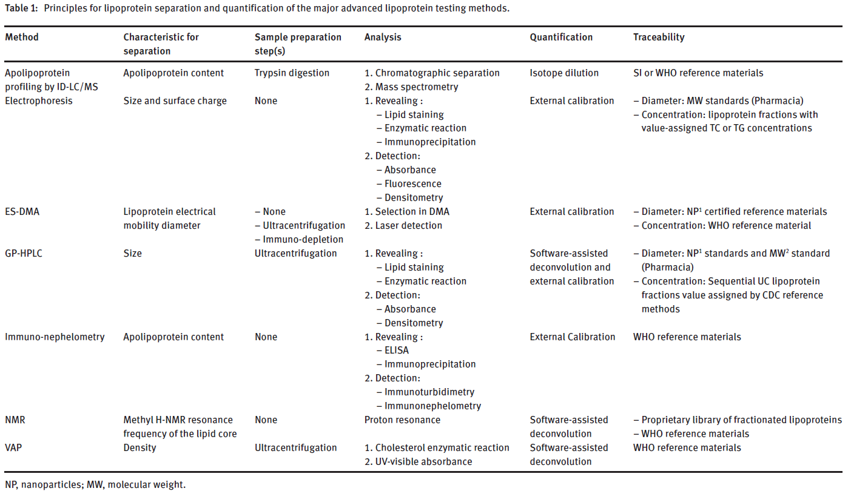
Introduction: advanced lipoprotein testing methods
Advanced lipoprotein testing for cardiovascular diseases risk assessment: a review of the novel approaches in lipoprotein profiling
Clouet-Foraison N, Gaie-Levrel F, Gillery P, Delatour V. Clin Chem Lab Med. 2017;55(10):1453-1464.

Slide 5
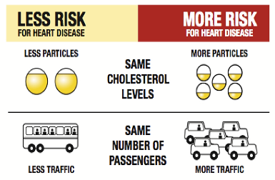

Introduction : advanced lipoproteing testing
Strong correlation was found between CVD risk and increased concentrations of apoB-100, an apolipoprotein present in all atherogenic lipoproteins (VLDL, IDL, LDL & Lp(a))
These lipoproteins, also referred to as non-high-density lipoproteins (non-HDL), contain a unique molecule of apoB-100 per particle → apoB-100 concentration can be converted to a number of circulating non-HDL particles (non-HDL-P).
LDL particle size and high concentrations of LDL particles (LDL-P), have been found to be good predictors of increased risk of premature CVD
CVD Risk is more strongly correlated with particle number concentration than with cholesterol

Slide 6
Introduction : advanced lipoproteing testing
With the growing interest in lipoprotein analysis for CVD risk prediction, ALT methods have been increasingly used in clinical trials and prospective studies to evaluate their added value in patient risk stratification.
However, results are conflicting and many believe there is insufficient evidence to support the widespread use of these biomarkers in routine clinical practice.
Since different ALT methods were involved in these studies, it was suggested that the lack of agreement of clinical outcomes could be, in part, the result of a lack of agreement between analytical methods
Lipoproteins are supramolecular assemblies of heterogeneous size and constitution that can be defined as function of their density, size, electro-phoretic mobility, apolipoprotein content, etc…
The different ALT methods rely on different physical principles and probably don’t measure the same thing!

Slide 7
Objectives of the study
To assess comparability of the major ALT methods available for the measurement of apoB-100 and non-HDL-P concentrations, with the intent to evaluate the current state-of-the-art.
To evaluate the possibility of establishing a higher order reference measurement system for apoB-100 and non-HDL-P measurements consisting of a robust candidate reference method that would provide SI-traceable results

Slide 8
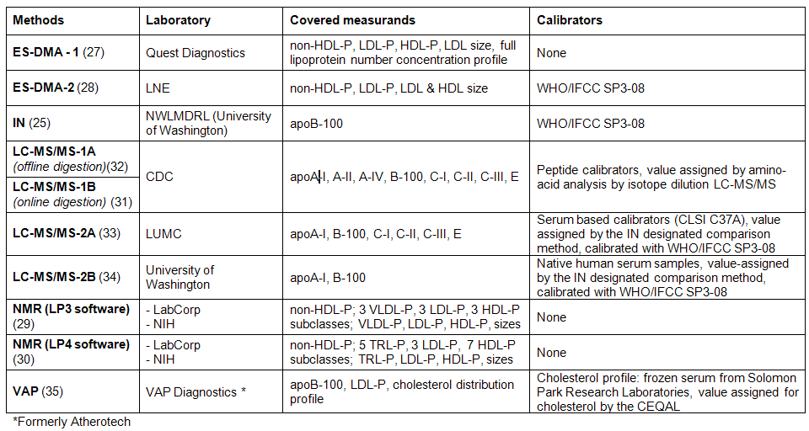
Materials and Methods
Through a split-sample study, 25 clinical specimens (CSs) were assayed in 10 laboratories before and after freezing using the major ALT methods for non-HDL-P or apoB-100 measurements with the intent to assess their comparability

Slide 9
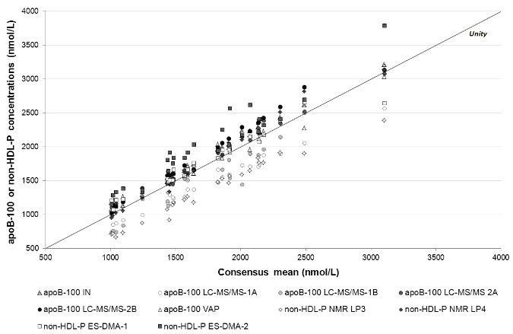
Results
Comparison between non-HDL-P and apoB-100 concentrations measured by IN, LC-MS/MS, NMR, ES-DMA and VAP in 25 frozen CSs against the consensus mean concentrations expressed in nmol/L.
Between-methods RSD = 14.1%
The different methods do not yet provide equivalent results for the measurement of non-HDL-P and apoB-100

Slide 10
Results
Comparison between non-HDL-P and apoB-100 concentrations measured by IN, LC-MS/MS, NMR, ES-DMA and VAP in 25 frozen CSs against the consensus mean concentrations
Poor comparability could be explained by :
the different measurands targeted : some methods target lipids (NMR, VAP), some others target proteins (IN targets epitopes, LC/MS/MS targets proteotypic peptides) and others the whole particle (ES-DMA)
the fact that these methods rely on highly different physical principles :
Lipoproteins are separated as function of size, density, charge or content
3) the different calibration strategies chosen
Even similar methods can be calibrated in different ways that strongly affect results, e.g. LC/MS/MS calibrated with peptides or with secondary calibrators values assigned by IN.

Slide 11
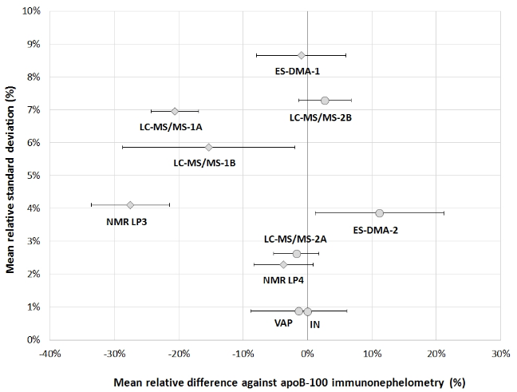
Results
Precision and accuracy of 10 methods for non-HDL-P determination

Slide 12
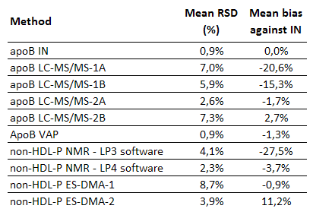
Results
Precision and accuracy of 10 measurement procedures for non-HDL-P
Peptide-based calibration
→ Traceability to the SI
Matrix calibration
→ Traceability to IN
data post-treatment!
→ Traceability to the SI
→ Traceability to IN
How to select a suitable candidate reference measurement procedure?

Slide 13
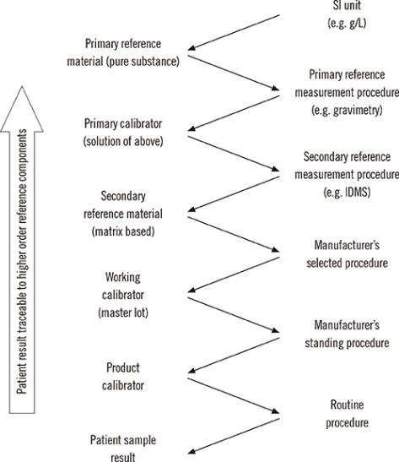
Results
Miller et al. Ann Lab Med. 2014;34(3):187-197
How to select a suitable candidate reference measurement procedure?
To improve measurement comparability, a preferred means consists in standardizing assay calibration through the establishment of a higher order reference measurement procedure (RMP) and the production of higher
order reference materials (RMs).

Slide 14
Results
How to select a suitable candidate reference measurement procedure?
A candidate RMP needs to meet several requirements, the most important ones being : 1) the measurand, i.e. the entity intended to be measured, be well-defined,
2) results be traceable to the international system of units (SI),
3) precision and accuracy of the method fit the clinical needs

Slide 15
Results
How to select a suitable candidate reference measurement procedure?
IN: Current reference method for apoB but traceability to the SI is NOT achieved
VAP : the entity intended to be measured is not well-defined because lipoproteins are separated as function of their density (by UC) → a mixture of undefined entities is measured
NMR: Traceability to the SI NOT achieved
ES-DMA: Traceability to the SI OK but too high imprecision
LC/MS/MS : Traceability to the SI OK, well-defined measured thanks to high selectivity

Slide 16
Discussion
What does a change in traceability chains imply? Think about the consequences!
Implementing a new reference system takes time for different reasons :
  Time needed to develop and validate reference method with appropriate analytical performance (accuracy, precision) and robustness
  Time needed to develop primary calibrators with low measurement uncertainties
  (eg. in the case of LC/MS/MS: highly purified peptides / proteins of certified purity)
Implementing a new reference system can create confusion!
  If a non-negligible difference exists between the old and the new reference method, reference interval and decision limits will need to be revised, thereby requiring to educate physicians who are used to some cutoffs. Good news: none of these apply to ApoB!

Slide 17
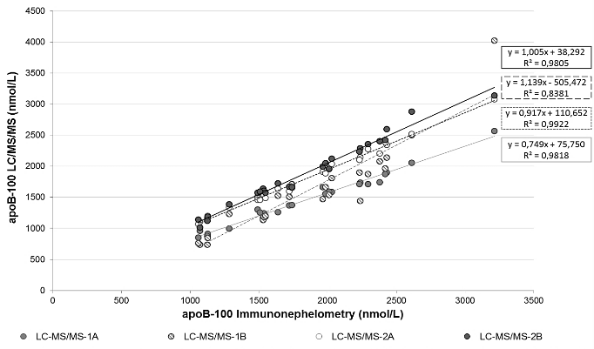
Discussion
So, is everything simple and straightforward?
  Different LC/MS/MS labs do not yet provide equivalent results due to different calibration strategies : need to standardize calibration with primary calibrators
→ Ongoing work conducted within IFCC WG-ApoMS
http://www.ifcc.org/ifcc-scientific-division/sd-working-groups/wg-apo-ms/

Slide 18
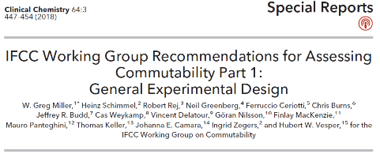
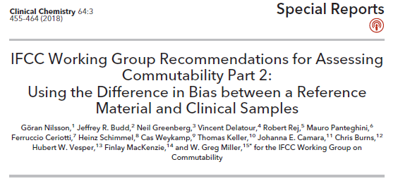
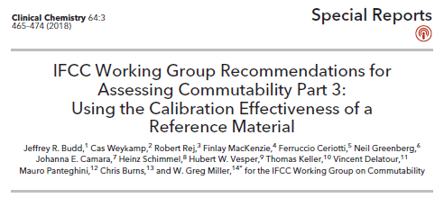
Discussion
So, is everything simple and straightforward?
  Need for commutable secondary calibrators to calibrate routine methods
  Commutability = ability of a material to mimic the behavior of patient samples
  Using a non-commutable calibrator can result in the inability to harmonize results
  → New recommendations from the IFCC WG on commutability
http://www.ifcc.org/ifcc-scientific-division/sd-working-groups/commutability-wg-c/

Slide 19
Discussion
So, is everything simple and straightforward?
  LC/MS/MS is a suitable method for standardization of apoB and other apolipoproteins but what to do for other parameters like LDL-P, HDL-P?
  ApoB is equivalent to non-HDL-P because there is one apoB molecule per non-HDL particle but the number of ApoA-I molecules per HDL particle is not constant
  Also, apoB measurement doesn’t allow estimating particle number concentration of sub-populations of non-HDL particles (eg. LDL-P, VLDL-P, IDL-P) that can only be measured with ES-DMA and NMR
  → specific reference methods needed for these measurands

