Slide 1
Plasma Steroid Metabolome Profiling for Diagnosis and Subtyping Patients with Cushing Syndrome
G. Eisenhofer, J. Masjkur, M. Peitzsch, G. Di Dalmazi, M. Bidlingmaier, M. Grüber, J. Fazel, A. Osswald, F. Beuschlein, M. Reincke
March 2018
www.clinchem.org/content/64/3/586.full
© Copyright 2017 by the American Association for Clinical Chemistry

Slide 2
Background – Cushing syndrome
Endogenous Cushing syndrome results from tumors that secrete either ACTH (rarely CRH) or cortisol. There are three principal subtypes that reflect different tumor locations and secretion of ACTH versus cortisol.
Normal
Pituitary
Ectopic
Adrenal
ACTH-dependent
ACTH-independent
All subtypes lead to hypercortisolism, a condition with poor quality of life, high morbidity and survival of less than 5 years if untreated.

Slide 3
Background – Current diagnostic options
Diagnosis of Cushing syndrome requires a multistep process involving numerous inaccurate tests to verify hypercortisolism and identify the cause of adrenocortical hyperfunction.
Current guidelines stipulate initial screening with one or more of three tests:
• 24 hr urinary excretion of free cortisol
• midnight salivary free cortisol
• low dose dexamethasone suppression test - measurements of serum cortisol
Identification of ACTH dependent and independent forms of Cushing syndrome is facilitated by measurements of plasma ACTH
For ACTH-dependent Cushing syndrome numerous dynamic tests and imaging procedures are further required to distinguish pituitary from ectopic sources of ACTH.

Slide 4
Background - Question
What distinguishes ACTH-dependent from ACTH-independent forms of Cushing syndrome and what is the main location of tumors responsible for ACTH-dependent Cushing syndrome?

Slide 5
Objective
Assess whether pituitary, ectopic and adrenal forms of Cushing syndrome are characterized by distinct plasma steroid profiles that might assist diagnosis.

Slide 6
Materials and Methods
SUBJECTS
Cushing syndrome tested for in 222 patients. Confirmed in 84 and excluded (conventional testing & follow-up) in 138.
Pituitary…………..…..
n = 51
Ectopic………………..
n = 12
Patients with subclinical
or iatrogenic CS excluded
Adrenal………………..
n = 21
Rule outs……………..
n = 138
Age- and gender-matched reference population of hypertensives and
normotensives.
Reference…………….
n = 277
Blood sampling
morning hours

Slide 7
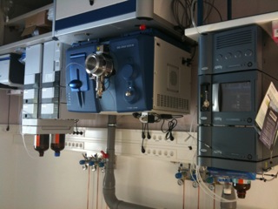
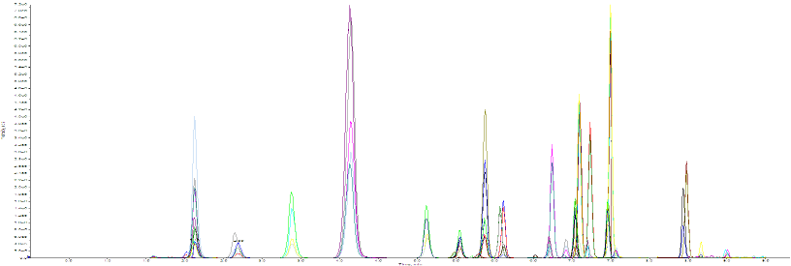
Materials and Methods
LC-MS/MS STEROID PROFILING
Aldosterone
18-Oxocortisol
18-Hydroxycortisol
Corticosterone
11-Deoxycorticosterone
Pregnenolone
Progesterone
17-Hydroxyprogesterone
11-Deoxycortisol
Cortisol
Cortisone
21-Deoxycortisol
Androstenedione
DHEA
DHEA-SO4
Testosterone
Off-line positive pressure supported SPE sample
preparation on 96 well-plates
Peitzsch M et al. J Steroid Biochem Mol Biol 2015; 145: 75-84

Slide 8
Methods - Question
2. In what ways do plasma concentrations of adrenal steroids vary with
age, gender and time of day, for what individual steroids are these
various influences most important and is it important to consider these
influences when establishing reference intervals for adrenal steroids?

Slide 9
Results – Screening
Conventional tests for hypercortisolism
Artifact
of
patient
selection
Subclinicals
excluded
Key
Excluded
Ectopic
Pituitary
Adrenal
Excluded Cushings
Excluded Cushings
Excluded Cushings
…………………………………………………………………………………………………………………………………
Three selected steroids from the panel
Steroids of the panel were normalized according to age- and gender-specific upper cut-offs (rel UC) of reference intervals.
Eisenhofer et al. Clin Chim Acta. 2017;470:115-124.
Excluded Cushings
Excluded Cushings
Excluded Cushings
………………………………………………………………………………………………………………………………………………………………………………………………….……………
Extensive overlap for patients with and without Cushings

Slide 10
Results – Screening ROC curves
Seven steroid panel (11-deoxycortisol, 11-deoxycorticosterone, cortisol, aldosterone, 21-deoxycortisol, DHEA and DHEA-SO₄) similarly effective as 24-hour urinary free or midnight salivary free cortisol for screening of patients with hypercortisolism.

Slide 11
Results – Subtype patterns
The various steroids (medians in ng/mL) show distinct patterns of increases and decreases among patients with adrenal, pituitary and ectopic subtypes of Cushing syndrome relative to reference and rule-out populations.

Slide 12
Results – Discriminant analyses of subtypes
Canonical plots illustrate separation of subtypes according to the four routine tests and 10-selected steroids of the panel.

Slide 13
Results – Discriminant analyses of subtypes
Routine
tests
Steroid
profile
The 10 steroid panel provides utility for subtype classification with areas under ROC curves and rates of misclassification similar to those of routine tests.

Slide 14
Results - Questions
3. What single plasma steroid in the panel provides the best biomarker for
diagnosis of hypercortisolism and why is plasma cortisol inferior to both
urinary and salivary free cortisol as a biomarker of hypercortisolism?
4. Why are plasma concentrations of androgens suppressed in ACTH-
independent Cushing syndrome compared to the higher concentrations
in ACTH-dependent Cushing syndrome, what are the potential reasons
for the lower plasma concentrations of mineralocorticoids in ACTH
dependent than independent Cushing syndrome and why might there
be further differences in ectopic and pituitary subtypes?

Slide 15
Conclusions
Patients with different subtypes of Cushing syndrome show distinctive plasma steroid profiles that may offer a supplementary alternative test for screening.
The method has potential for offering a single test for both screening of Cushing syndrome and initial subtype classification.
Specimen preparation is simple and the entire panel takes 12 minutes to run.
Different selections of steroids from the same panel may be used for diagnosis of other disorders of adrenal steroidogenesis.

