Slide 1
Noninvasive Detection of Cocaine and Heroin Use with Single Fingerprints: Determination of an Environmental Cutoff
M. Ismail, D. Stevenson, C. Costa,
R. Webb, M. de Puit, M. Bailey
June 2018
www.clinchem.org/content/64/6/909.full
© Copyright 2017 by the American Association for Clinical Chemistry

Slide 2
Introduction
A few reports have shown the possibility to detect drugs in fingerprints from drug users. However, no study (to our knowledge) has explored the significance of the detection of drugs in fingerprints and the robustness of fingerprint testing.
Here we explored:
the presence of drugs in fingerprints from a background population (from environmental exposure) in relation to drug users
the use of different fingerprint sampling strategies
the possible transfer of drugs between individuals
the requirement for an environmental cut-off level

Slide 3
Questions
Why use fingerprints for drug testing?
Are there advantages and limitations of using fingerprints as a drug testing matrix?

Slide 4
Materials and Methods
Study Populations
Fingerprint sampling strategies
Samples were collected on Whatman® chromatography paper (2 x 2 cm) as presented and after washing hands with soap and water.
Analytical performance
The limits of detection for extracted samples were 10 pg, 30 pg, 40 pg and 40 pg for cocaine, benzoylecgonine, heroin and 6-acetymorphine respectively.
50 non-drug users
n=100 fingerprint samples
15 drug users
n=26 fingerprint samples from cocaine users
n=24 fingerprint samples from heroin users

Slide 5
Materials and Methods
Sample preparation method
Extraction and evaporation
  Sample placed in a 2 mL microcentrifuge tube with 1.5 mL extraction solution (10% dichloromethane in methanol)
  Sample centrifuged for 2 min at 9500 g centrifugal force
  Sample substrate removed and discarded
  Sample dried under a stream of nitrogen at room temperature (20°C)
Dilution
  Sample reconstituted in 100 µL mobile phase solution containing 50 ng/ml deuterated internal standard
  Sample vortex-mixed and transferred to an autosampler vial
  5 µL injection volume
LC-MS analysis

Slide 6
Results
Cocaine detection rate – fingerprints collected as presented
50 individuals from a background population (n = 100 fingerprint samples)
As mentioned in an accompanying Editorial (Willie S. Clin Chem 2018;64:879-81), it is important to exclude environmental contamination as a possible source for fingerprint testing. Due to the prevalence of cocaine in the background population (non-drug users) there is a requirement to a establish cut-off level to differentiate drug users from the background population.
Fingerprint collection method | Study Population
As presented | Background population
Cocaine Benzoylecgonine | 13% 5%

Slide 7
Results
Cocaine detection rate using proposed cut-off levels
(based on a 99% confidence level of the background samples)
13 individuals who admitted to have taken cocaine (n = 26 fingerprint samples)
Cut-off levels (ratio analyte-to-internal standard): cocaine 0.026, benzoylecgonine 0.018
The proposed cut-off levels allowed for the differentiation between drug users and non-drug users based on the presence of cocaine and benzoylecgonine above the cut-off.
Fingerprint collection method | Study Population
As presented | Drug users | Background population
Cocaine Benzoylecgonine | 100% 85% | 1% 0%

Slide 8
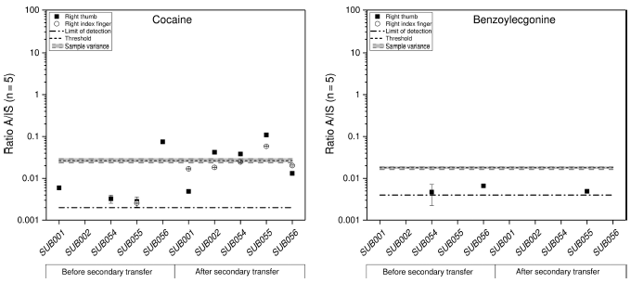
Results
Transfer of cocaine between drug users and non-drug users
Fingerprints were collected from 5 non-drug users before and after shaking hands with drug users to explore the possibility of secondary transfer of drugs and its influence on drug testing.
Cocaine is easily transferred by shaking hands and exceeded the proposed cut-off level for several non-drug users. However, benzoylecgonine never exceeded the proposed cut-off level and the presence of the metabolite was thus toxicologically more important.

Slide 9
Results
Cocaine detection rate – fingerprints collected after handwashing
8 individuals who admitted to have taken cocaine (n = 16 fingerprint samples)
With the use of a handwashing procedure prior to sample collection there was no need for a cut-off level to differentiate drug users from the background population, since the prevalence of cocaine in the background population was reduced. Detection of cocaine and its metabolite in fingerprints above the detection limit would already be significant.
Fingerprint collection method | Study Population
Soap | Drug users | Background population
Cocaine Benzoylecgonine | 100% 87.5% | 1% 0%

Slide 10
Results
Heroin detection rate in fingerprint samples
In contrast to cocaine, heroin is not prevalent in fingerprints from the background collected as presented or after handwashing. There then is no requirement to establish cut-off levels to differentiate drug users from non-drug users.
Secondary transfer of heroin was investigated using 3 non-drug users before and after contact with heroin users. Heroin exceeded the limit in 1 fingerprint sample after working at the drug rehabilitation clinic and in 1 fingerprint sample after contact with a heroin users.
Fingerprint collection method | Background Population |  | Fingerprint collection method | Drug users
 | Heroin | 6-Acetylmorphine |  | Heroin | 6-Acetylmorphine
As presented (n = 100) | 0% | 1% | As presented (n = 24) | 100% | 100%
Soap (n = 100) | 0% | 0% | Soap (n = 16) | 94% | 100%

Slide 11
Results
Challenges associated with fingerprint testing have been discussed in the paper and have also been highlighted in an accompanying Editorial, and include (but are not limited to):
Fingerprint sampling strategy
Lack of matrix matched standards
Universal validation
Influence of the presence of contact residue

Slide 12
Questions
How could the challenges associated with fingerprint testing be overcome?
Is there a potential for fingerprint testing to be made quantitative? How might this be validated?

