Slide 1
Resolution of Spurious Immunonephelometric IgG Subclass Measurement Discrepancies by LC-MS/MS
G. van der Gugten, M.L. DeMarco, L.Y.C. Chen, A. Chin, M. Carruthers, D.T. Holmes, A. Mattman
April 2018
www.clinchem.org/content/64/4/735.full
© Copyright 2017 by the American Association for Clinical Chemistry

Slide 2
Introduction
IgG subclasses are typically measured to assess for
primary or secondary immunodeficiency or
IgG4-related disease (IgG4-RD)
Serum IgG4 is a biomarker of IgG4-RD
Higher serum IgG4 concentrations have higher likelihood ratios for the presence of IgG4-RD
IgG subclasses are typically measured as a panel by means of immunonephelometry (IN)
Multiple validation studies indicate reliable performance of commercial methods

Slide 3
Introduction
However, two analytic errors have been noted with IN IgG subclass measurement
  The error of antigen excess (now resolved)
  An IgG4 dependent discrepancy between the sum of the individual subclasses and the independent total IgG measurement
  An ancillary finding associated with the latter error was the association of elevated IgG2 results in patients with IgG4-RD (those with high IgG4 results).
As the unexplained errors could pertain to vendor specific test reagents, or test methodology, an alternate methodology to measure subclasses was developed
  LC-MS/MS

Slide 4
Question:
Why might an IgG4 concentration dependent analytic error be undetected in a multiplex assay for immunoglobulins?
What explanation might explain the apparent utility of both IgG2 and IgG4 as biomarkers of IgG4-RD?

Slide 5
Materials & Methods
LC-MS/MS IgG subclass method validation
  Method measures each of the four IgG subclasses based on subclass specific tryptic digest peptides
  For each subclass, the method was calibrated to the same standard as one of the existing commercial IgG subclass IN methods (Binding SiteTM immunonephelometry (BSIN))
  Method validation included a method comparison study in a cohort of patients investigated for IgG4-RD (n = 73 comparison with BSIN & N = 38 comparison with SiemensTM immunonephelometry (SIN)
LC-MS/MS was considered the gold standard given the known errors in the BSIN method
  Multivariate analysis used to describe the individual IN subclass measurements in terms of coefficients of the respective LC-MS/MS IgG subclass measurements

Slide 6
Question:
Why is multivariate linear regression a valuable tool in understanding the analytic errors associated with the IN subclass measurements?

Slide 7
Results
LC-MS/MS subclass method gave acceptable performance as compared to immunonephelometry in patients with normal concentrations of IgG4.
Typical chromatogram for a patient sample with IgG subclass concentrations within the associated reference intervals.

Slide 8
Results
Method comparison with immunonephelometry showed IgG4 dependent bias affecting:
The BSIN IgG2 subclass method:
  The BSIN IgG2 concentration was best predicted by the sum of the LC-MS/MS IgG2 and IgG4 concentrations
  IgG2 = 0.94*IgG4 + 0.89*IgG2 AND
Another BSIN subclass (IgG1) method, and the SIN IgG2 subclass methods. These latter subclasses were best predicted by the following equations:
      IgG1 = 0.89*IgG1 + 0.40*IgG4
      IgG2 = 0.72*IgG2 + 0.24*IgG4
Note: All displayed coefficients were significantly different from 0 (p < 0.00001)

Slide 9
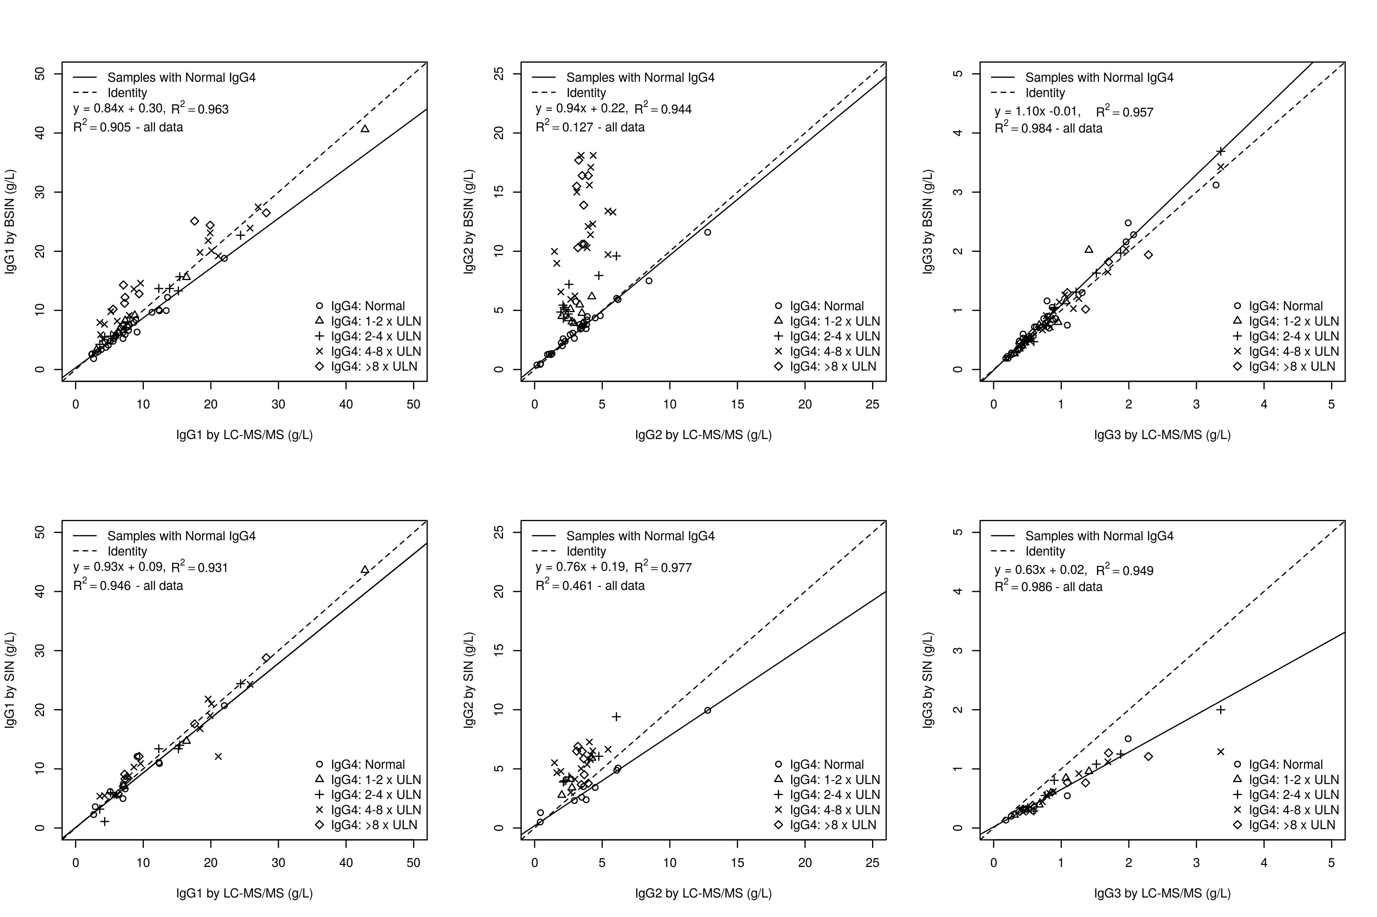
Results
Linear regression of IN IgG1, IgG2, and IgG3 vs LC-MS/MS subclasses
Figure 1. Each plot shows a differential display of data points for each of 5 categories of samples demarcated by IgG4 concentration. The trend line and regression equation are plotted only for those data points that are within the normal IgG4 reference interval.

Slide 10
Results
Linear Regression (enlarged)
Legend:
BSIN: Binding Site immunonephelometry
SIN: Siemens Immunonephelometry

Slide 11
Results
a
b
Bias plots displaying the difference between the respective IN method, and the LC-MS/MS method, for a given subclass as a function of the IgG4 concentration as measured by LC-MS/MS. The data points representing the BSIN and IN method are indicated by the blue diamond and red squares, respectively. (a) IgG1, (b) IgG2. There are significant relationships between the IgG4 concentration and the inter-method subclass bias for BSIN IgG1 (R² = 0.53, p<0.001), BSIN IgG2 (R² = 0.90, p<0.001), and SIN IgG2 (R² = 0.16, p = 0.01).

Slide 12
Question:
How could one explain the presence of IgG4 dependent errors affecting three IgG subclasses from two distinct immunonephelometry vendors?

Slide 13
Results
a
c
Normal IgG4:
y = 1.13 – 0.44
R² = 0.954
Normal IgG4:
y = 1.03 - 0.06
R² = 0.994
All data:
R² = 0.898
All data:
R² = 0.983
b
d
Normal IgG4
y = 1.00x + 0.54
R² = 0.957
Normal IgG4
y = 0.89x + 1.07
R² = 0.962
All data:
R² = 0.829
All data:
R² = 0.939
Linear regression of the total IgG methods against the SumIgG methods. Each plot shows differential display of data points for each of five categories of samples demarcated by IgG4 concentration: within the normal reference interval, 1 – 2 times the upper limit of normal (1 – 2 * ULN), 2 – 4 * ULN, 4 – 8 * ULN, and > 8 * ULN. The trend line is plotted only for those data points that are within the normal IgG4 reference interval.

Slide 14
Question:
Before 2014, there was a common IgG4 dependent error affecting the Binding Site IgG4 method (the hook effect) on certain analytical platforms. In addition, there was an IgG4 dependent error affecting IgG2 and IgG1 (as shown in this article). How might the co-occurrence of the these errors obscure their respective detection via an internal QC program based on monitoring the discrepancy between the sum of the IgG subclasses and the independent total IgG measurement?

