Slide 1
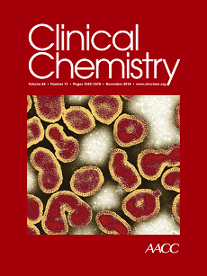
Direct Comparison of Cardiac Troponin T and I using a Uniform and a Sex-specific Approach in the Detection of Functionally Relevant Coronary Artery Disease
D. Mueller, C. Puelacher, U. Honegger, J.E. Walter, P. Badertscher, N. Schaerli, I. Strebel, R. Twerenbold, J. Boeddinghaus, T. Nestelberger, C. Hollenstein, J. Du Fay de Lavallaz, R. Jeger, C. Kaiser, D. Wild, K. Rentsch, A. Buser, M. Zellweger, T. Reichlin, and C. Mueller
November 2018
www.clinchem.org/content/64/11/1596.full
© Copyright 2018 by the American Association for Clinical Chemistry

Slide 2
Introduction
Coronary artery disease
  …is a major cause of death and morbidity worldwide
  …has a heterogenous presentation often requiring additional testing
  …generates substantial healthcare costs
High-sensitivity cardiac troponin T and I
  …have revolutionized the early diagnosis of AMI, the acute life-threatening phenotype of CAD.
  …have been shown to be higher in patients with functionally relevant CAD as compared to patients without functionally CAD
  …might improve the risk-stratification of patients with suspected functionally relevant CAD

Slide 3
Several questions need to be addressed before a possible clinical use of hs-cTn.
  Do hs-cTnI and hs-cTnT concentrations provide comparable diagnostic accuracy in the detection of functionally relevant CAD?
  Should hs-cTnI and hs-cTnT concentrations be assessed uniformly in women and men or does a sex-specific approach provide higher diagnostic accuracy?
  Do hs-cTnI and hs-cTnT concentrations provide comparable prognostic accuracy in the prediction of future major adverse cardiac events?

Slide 4
Question 1
  What role could blood biomarkers play in the risk-stratification of patients with suspected stable angina?

Slide 5
Materials & Methods
Patient Population.
  Consecutive patients with suspected functionally relevant CAD referred for MPI-SPECT/CT
  For the primary analysis, patients with known clinically relevant structural heart disease other than CAD at the time of examination were excluded and patients with terminal kidney failure on chronic dialysis were excluded
  The secondary analysis included all patients
Adjudication of functionally relevant CAD and blood sampling.
  The presence of functionally relevant CAD based on rest/stress MPI-SPECT/CT and coronary angiography
  hs-cTnI (ARCHITECT High Sensitive STAT Troponin I assay) and hs-cTnT concentrations (Elecsys System or Cobas e 602) were measured in a blinded fashion

Slide 6
Question 2
Why is the distinction between mere anatomical and functionally relevant coronary artery disease so important?

Slide 7
Results
Patient characteristics
  2062 patients, 1/3 women
  35% of men and 17% of women were diagnosed with functionally relevant CAD
Troponin and clinical assessment
  hs-cTnI concentrations were half as high as hs-cTnT
  For both (hs-cTnI and T) concentrations were about 50% higher in men
  Male patient, known CAD and presentation of chest discomfort increases the accuracy of clinical assessment for the presence of functionally relevant CAD

Slide 8
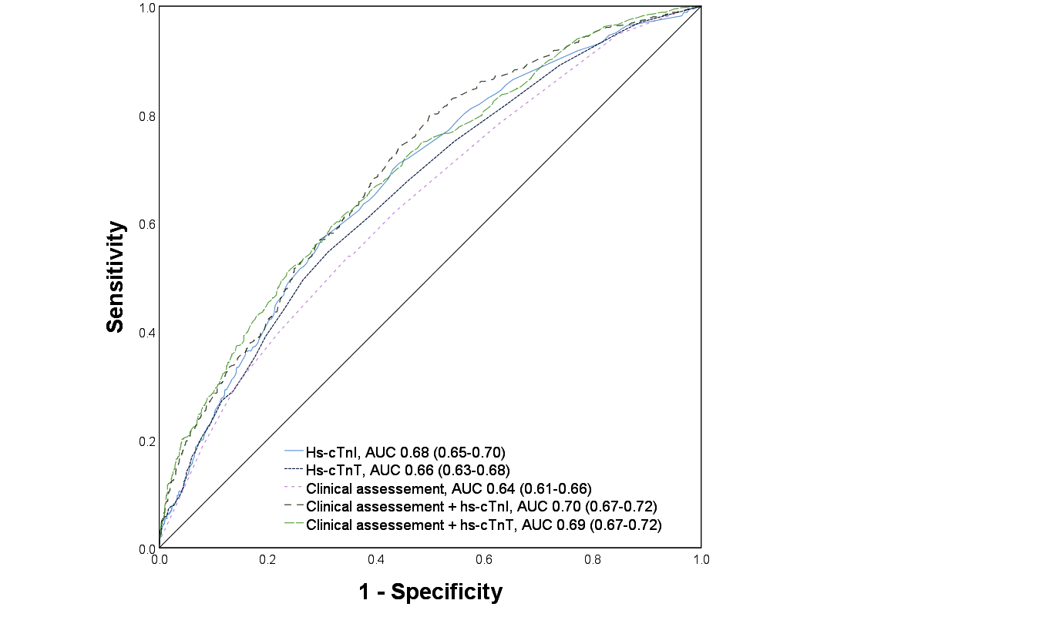
Figure 1. Diagnostic accuracy quantified by area under the receiver operating characteristics curve (AUC) of hs-cTn, clinical assessment and combinations with their corresponding 95% confidence intervals for the detection of functionally relevant coronary artery disease. hs-cTn = High-sensitivity cardiac troponin.

Slide 9
 | hs-cTnI |  |  | hs-cTnT
Rule-out | Uniform 95% sensitivity cut-off: ≤1.3 ng/L |  |  | Uniform 95% sensitivity cut-off: ≤3 ng/L
 | Sensitivity (95%CI) | NPV (95%CI) | Incidence of criteria % (95%CI) | Sensitivity (95%CI) | NPV (95%CI) | Incidence of criteria % (95%CI)
Whole population | 95 (93-96) | 89 (84-92) | 13 (11-14) | 95 (93-97) | 88 (84-92) | 12 (11-13)
Women | 88 (81-93) | 91 (85-95) | 22 (19-25) | 91 (84-95) | 93 (88-96) | 22 (19-25)
Men | 97 (95-98) | 85 (77-90) | 8.1 (6.8-9.6) | 96 (94-98) | 81 (72-87) | 7.0 (5.8-8.5)
Rule-in | Uniform 95% specificity cut-off: >15.1 ng/L |  |  | Uniform 95% specificity cut-off: >24 ng/L
 | Specificity (95%CI) | PPV (95%CI) | Incidence of criteria % (95%CI) | Specificity (95%CI) | PPV (95%CI) | Incidence of criteria % (95%CI)
Whole population | 95 (94-96) | 53 (45-60) | 7.5 (6.4-8.7) | 95 (94-96) | 54 (46-62) | 7.7 (6.6-8.9)
Women | 98 (96-99) | 50 (33-67) | 4.2 (2.9-6.0) | 98 (97-99) | 84 (81-87) | 2.9 (1.8-4.4)
Men | 93 (92-95) | 53 (45-62) | 9.0 (7.6-11) | 93 (91-95) | 56 (47-64) | 10 (8.6-12)
Table 1. Performance of the uniform 95% sensitivity/specificity cut-offs of hs-cTnI and hs-cTnT for a rule-out/in strategy in patients with suspected functionally relevant CAD in the whole population as well as in women and men separately. CAD = Coronary artery disease; CI = Confidence interval; hs-cTn = High sensitivity cardiac troponin; NPV = Negative predictive value.

Slide 10
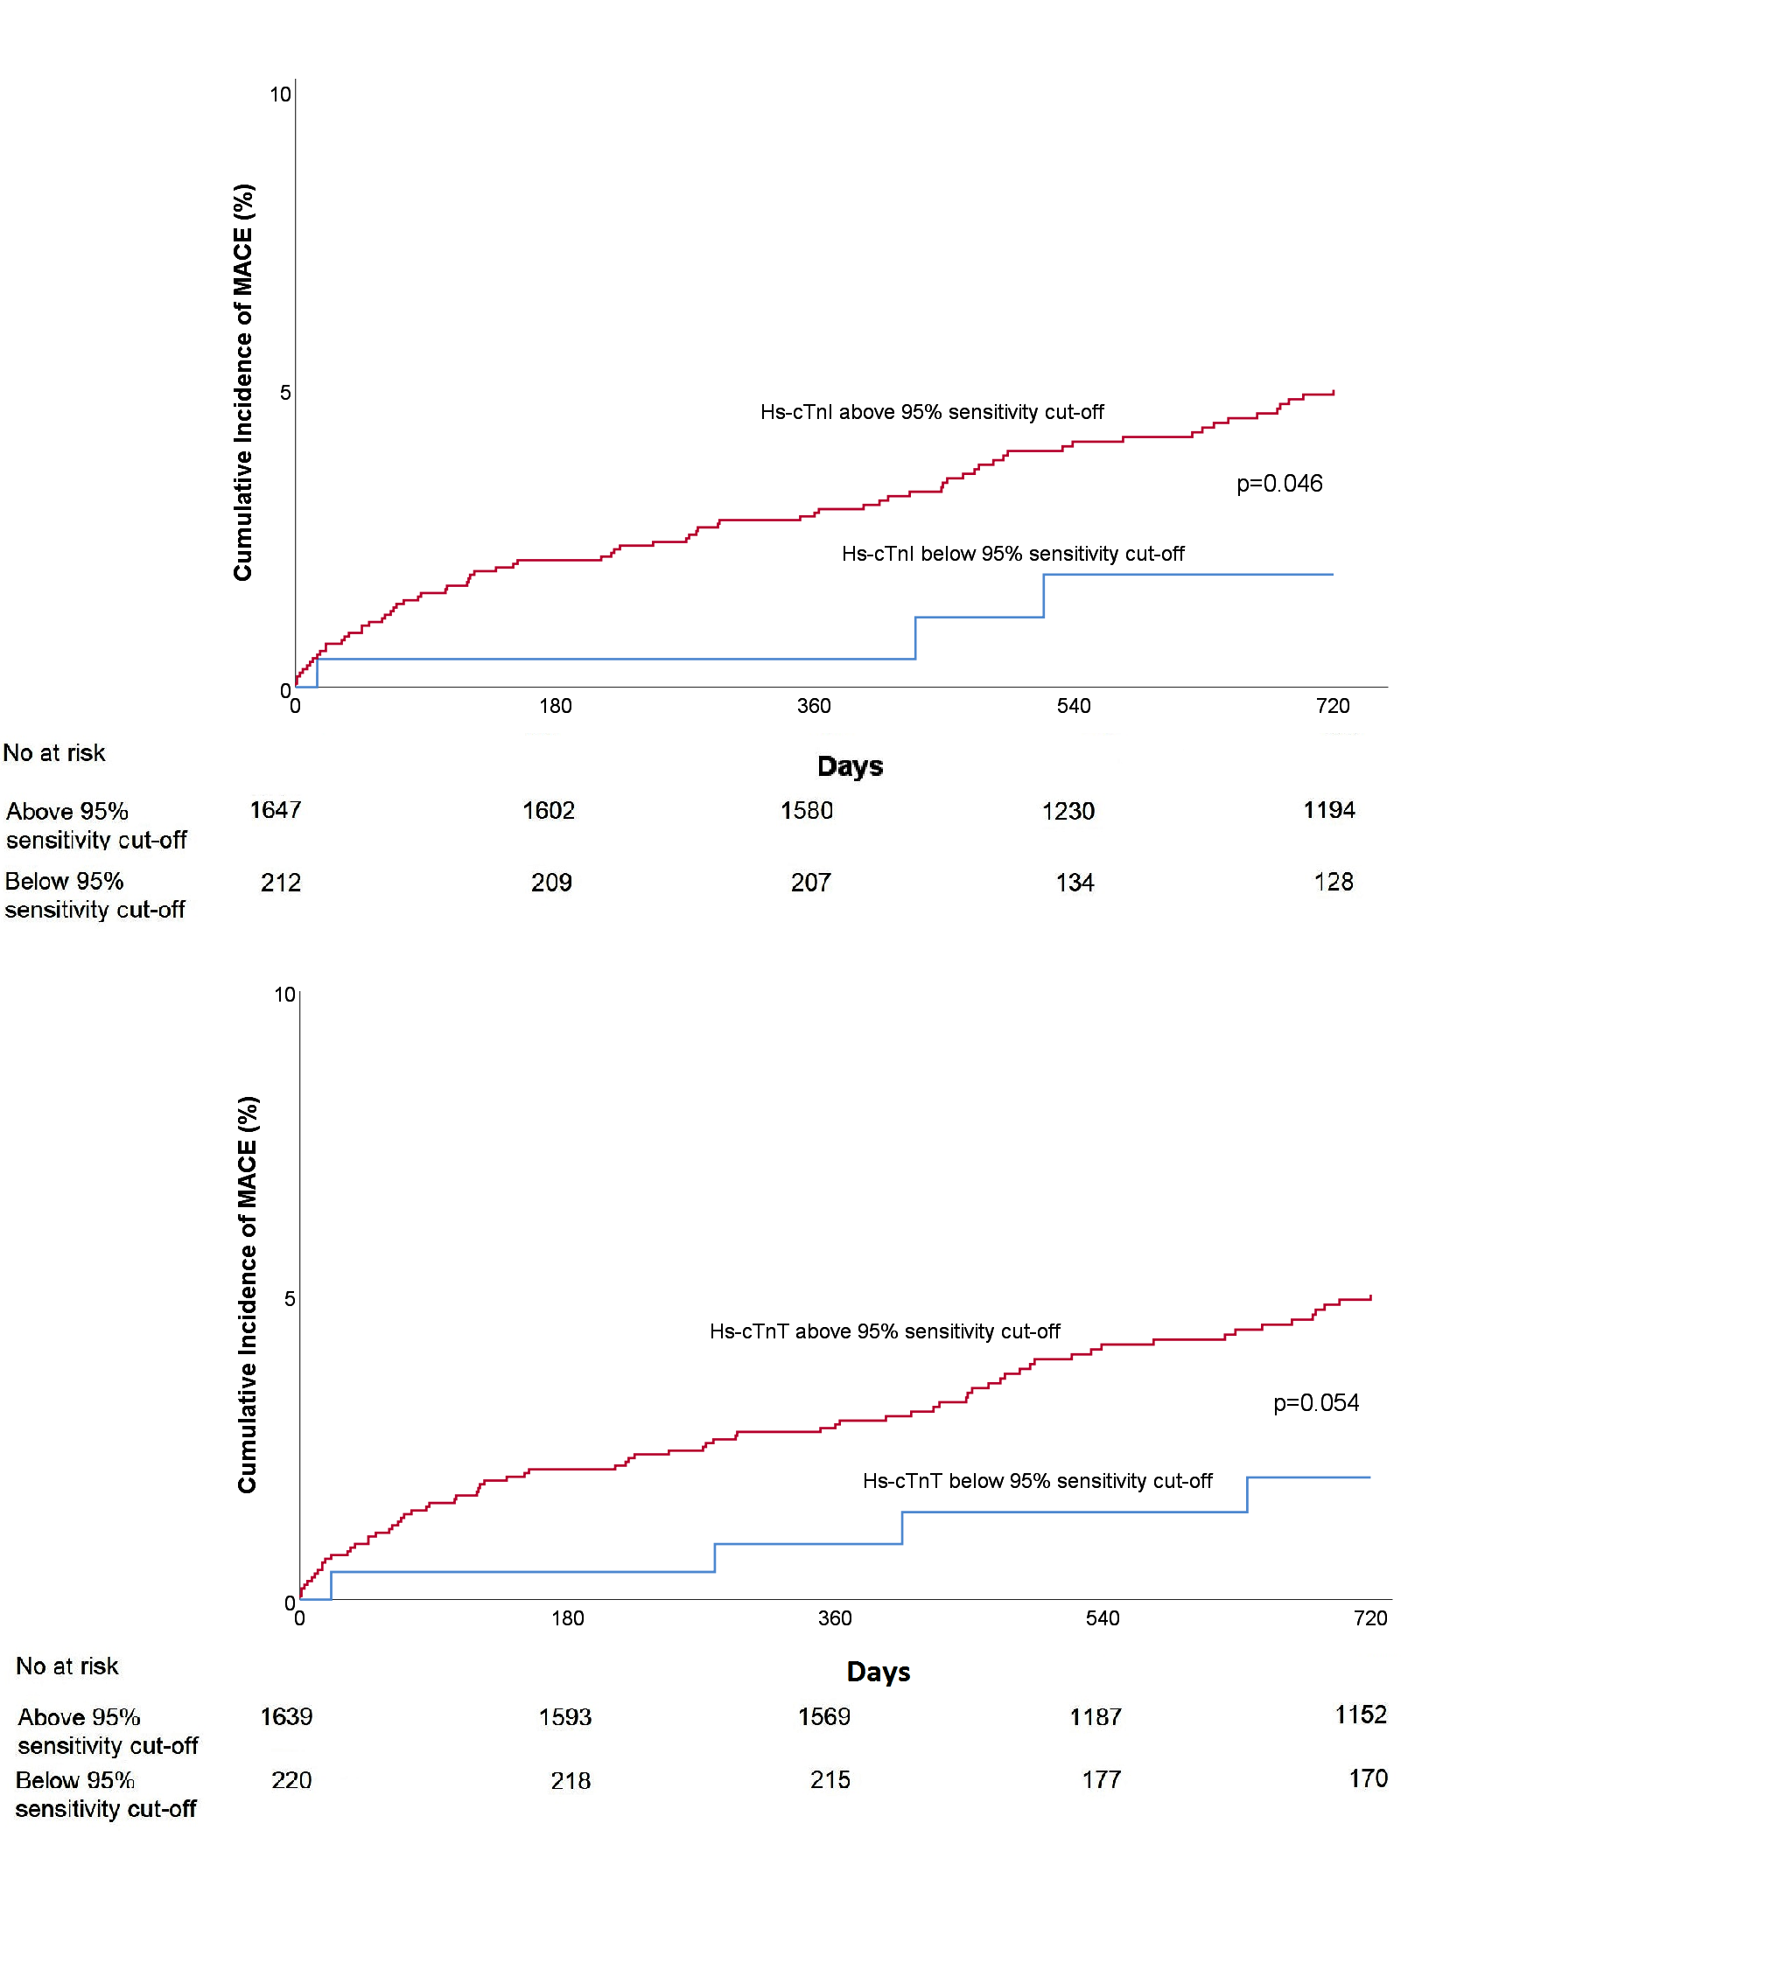
Figure 2. Cumulative incidence of MACE, defined as MI and cardiovascular death, stratified by the diagnostic cut-off of hs-cTnI above and hs-cTnT below for the rule-out of functionally relevant coronary artery disease. hs-cTn = High-sensitivity cardiac troponin; MACE = Major adverse cardiac event; MI = Myocardial infarction.

Slide 11
Question 3
  What are strengths and weaknesses of sex specific cut-offs?

Slide 12
Discussion
Limitations
  Single center study
  Cut-offs need to be externally validated
  Derived cut-off concentrations for the rapid rule-out are in a very low range
Conclusion
  hs-cTnI and hs-cTnT provide moderate and comparable diagnostic accuracy
  Sex-specific cut-offs may be preferred
  The prognostic utility of both troponins is comparable

Slide 13
Editorial: High-Sensitivity Troponin and the Selection of Patients for Cardiac Imaging in the Outpatient Clinic
Philip D. Adamson & Nicholas L. Mills
  There is a clinical need to improve selection of patients presenting with suspected angina for further testing
  Additional evaluation in an “all-comers” population is necessary to further increase the generalizability to the outpatient clinic
  To advance application to clinical practice an extended CADC model including troponin is required
  Troponin T and I certainly provide important and independent information concerning the pathophysiological processes in the cardiovascular system; however, the appropriate clinical application needs to be further elucidated.

