Slide 1

A Padlock Probe Assay for Detection and Subtyping of Seasonal Influenza
F. Neumann, I. Hernández-Neuta, M. Grabbe, N. Madaboosi, J. Albert, and M. Nilsson
December 2018
www.clinchem.org/content/64/12/1704.full
© Copyright 2018 by the American Association for Clinical Chemistry

Slide 2
Introduction
Background
  Influenza remains as a constant threat worldwide and WHO estimates that it affects 5-15 % of the global population each season, with an associated 3-5 million severe cases and up to 500,000 deaths
  Modern influenza diagnostics are dominated by nucleic acid tests especially polymerase chain reaction (PCR), owing to its high sensitivity, specificity and short turnaround times
  Due to the genetic variation and drift of influenza, PCR-based assays require continuous assay validation and occasional optimization to reliably detect all relevant influenza variants
Objective
  To evaluate the performance of a new diagnostic test based on padlock probes (PLPs) and isothermal rolling circle amplification (RCA) for detection and subtyping of seasonal influenza

Slide 3
Introduction – Questions:
Why are RNA viruses, such as Influenza showing such high mutation rates?
What is the benefit of an approach targeting all 8 genome segments of Influenza virus when compared to classical methods that target only a single gene?
Why should influenza viruses be subtyped?

Slide 4
Methods
Methods
  A PLP-based assay to simultaneously target all eight genome segments of the four circulating influenza variants, A(H1N1), A(H3N2), B/Yamagata and B/Victoria was developed
  PLPs are linear oligonucleotides that are circularized by ligation in a strictly target-dependent manner and upon combination with the digital RCA create a powerful tool for highly multiplexed assays
  We use two consecutive rounds of RCA (RT-C2CA)* to increase sensitivity and combine it with a prototype cartridge for inexpensive digital quantification
Study Design
  Analytical performance of the PLP-based approach was demonstrated on isolated RNA from cell culture
  Diagnostic performance to detect and subtype influenza was assessed by blinded testing of 50 nasopharyngeal patient samples
*Reverse transcription circle-to-circle amplification

Slide 5
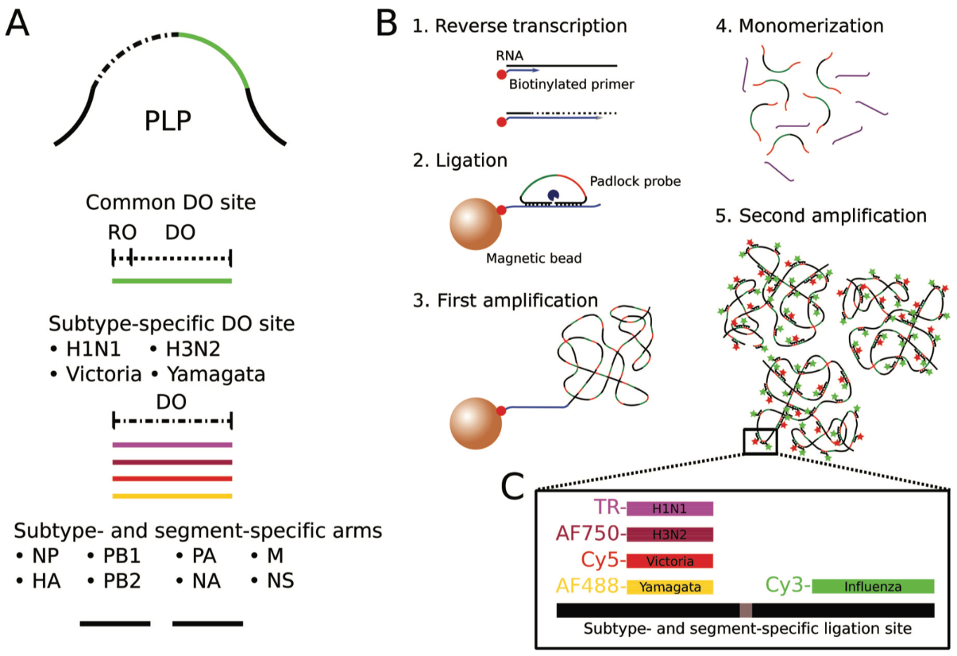
Padlock probe and assay design
Figure 1. (A) PLPs comprised of: i) complementary sequences to the target at the 5´ and 3´ ends, ii) a backbone including a restriction oligonucleotide (RO) sequence, and iii) pan-influenza and subtype-specific barcodes (detection oligonucleotide site - DO). (B) Reverse transcription and capturing on beads (1). PLP hybridization and ligation (2). First RCA reaction (3) and the subsequent restriction-digestion (4). Second round of ligation and amplification (5). Labeling and detection of RCA products (RCPs). (C) Dual-labeling scheme.

Slide 6
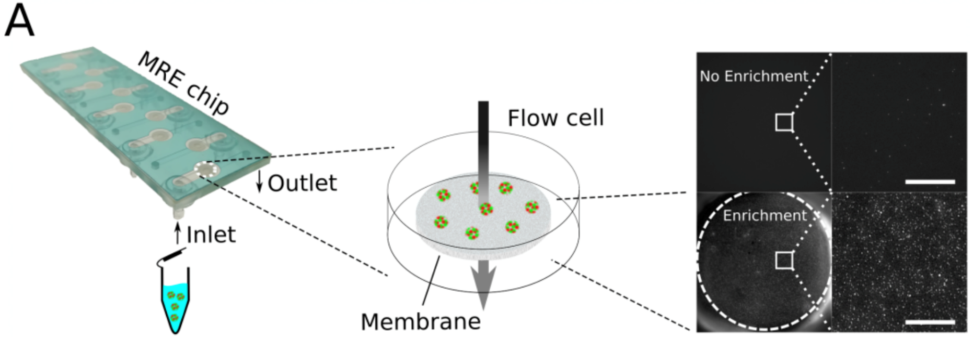
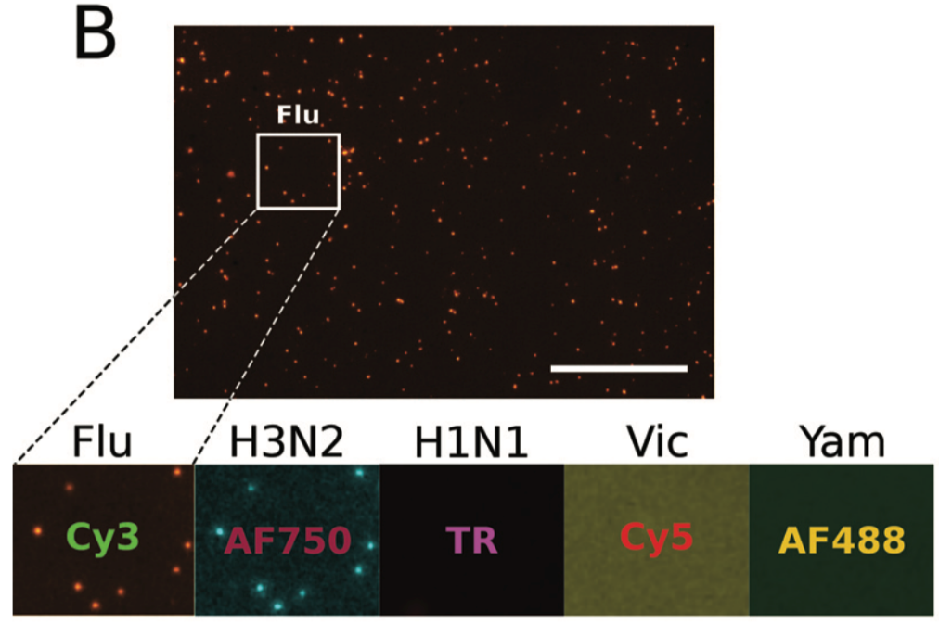
Microfluidic enrichment and barcoding principle
Figure 2. (A) Principle of microfluidic enrichment (MRE). (B) Principle of MRE-based influenza detection and subtyping using 5 different fluorophore barcodes; here, H3N2 as an example. Scalebars: 20 µm.

Slide 7
Methods – Questions:
What are the advantages and limitations when compared to other isothermal amplification methods, such as LAMP* or RPA**?
How could the fluorophore-based detection strategy be changed to increase multiplexing capabilities?
* LAMP : Loop-mediated isothermal amplification
** RPA : Recombinase polymerase amplification

Slide 8
Results – Analytical Performance
Figure 3. Comparison of 8-plex and 1-plex. Error bars correspond to the standard deviation from the mean (n=3). (B) Subtyping using dual-labeling and 32 PLPs in combination with MRE. Subtype percentage of total RCP count after subtracting the channel-specific limit of detection (n=2). The conditional color coding relative to RCP counts of the samples is shown in green.

Slide 9
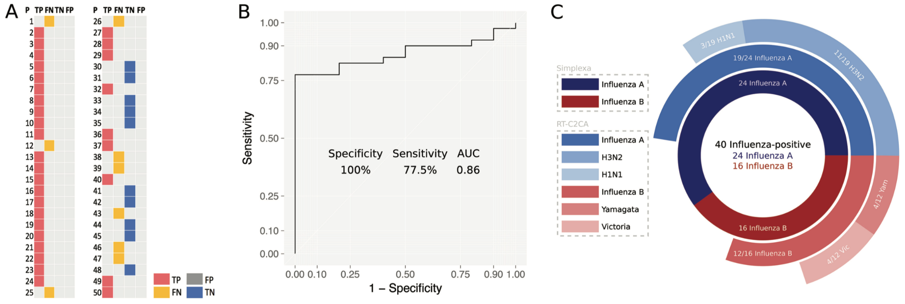
Results – Clinical Performance
Figure 4. (A) Raw data of the RT-C2CA results for influenza A and B detection using the Simplexa™ assay (RT-PCR) as gold standard. TP: true positive, FN: false negative, TN: true negative, FP: false positive. (B) ROC analysis (n=50) of the RT-C2CA results. (C) Sunburst chart of assay performance including all fluorescence channels.

Slide 10
Results – Questions
What appears to be the biggest limitation of the PLP-based assay for routine influenza diagnostics?
What are the benefits and drawbacks of this subtyping approach when compared to next-generation sequencing?

Slide 11
Summary and Conclusion
Current Technology
  Current influenza diagnostic usually requires assay validation to prevent false-negative results and lacks information on the subtype level
RT-C2CA
  Increased sensitivity by assay design of down to 18 RNA copies and specificity of up to 100% for all four subtypes
  Clinical performance was demonstrated with a sensitivity of 77.5% and a specificity of 100%
  Subtyping performance showed sensitivities of 73% for influenza A and 67% for influenza B
Conclusions
  Presented proof-of-concept and diagnostic performance of a PLP-based assay for the detection and subtyping of influenza
  Successful integration of the multiplexed assay with an inexpensive digital quantification read-out to bring the assay closer to clinical applications

