Slide 1

Activity-Based Concept to Screen Biological Matrices for Opiates and (Synthetic) Opioids
A. Cannaert, L. Vasudevan, M. Friscia, A.L.A. Mohr, S.M.R. Wille, C.P. Stove
August 2018
www.clinchem.org/content/64/8/1221.full
© Copyright 2018 by the American Association for Clinical Chemistry

Slide 2

Introduction
Highly potent synthetic opioids, which mimic the effects of heroin and morphine, are a growing health threat. Detection of these novel opioids remains challenging as new compounds continue to enter the market.
The objective of this study:
Set-up a novel concept for screening biological matrices for the presence of opiates and (synthetic) opioids
  Not relying on antibody-based or mass spectrometry-based recognition of the structure of these compounds
  Based on their opioid activity.

Slide 3
Question
Why do conventional screening techniques struggle to detect (new) synthetic opioids?

Slide 4
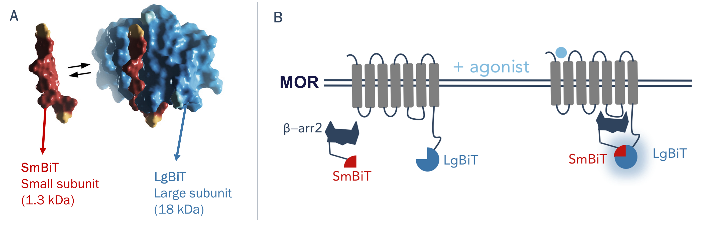
Materials and Methods
The developed bio-assay is based on the NanoBiT® Technology (Promega), which uses structural complementation of Nanoluciferase (NLuc) to detect protein-protein interactions.
Two inactive NLuc subunits (SmBiT/LgBiT) are fused to either the µ-opioid receptor (MOR) or the β-arrestin 2 (β-arr2) protein.
Activation of the receptor results in recruitment of β-arr2, resulting in structural complementation of NLuc and restoration of its activity. Following addition of a luciferase substrate, a bioluminescent signal is elicited that can be easily monitored.

Slide 5
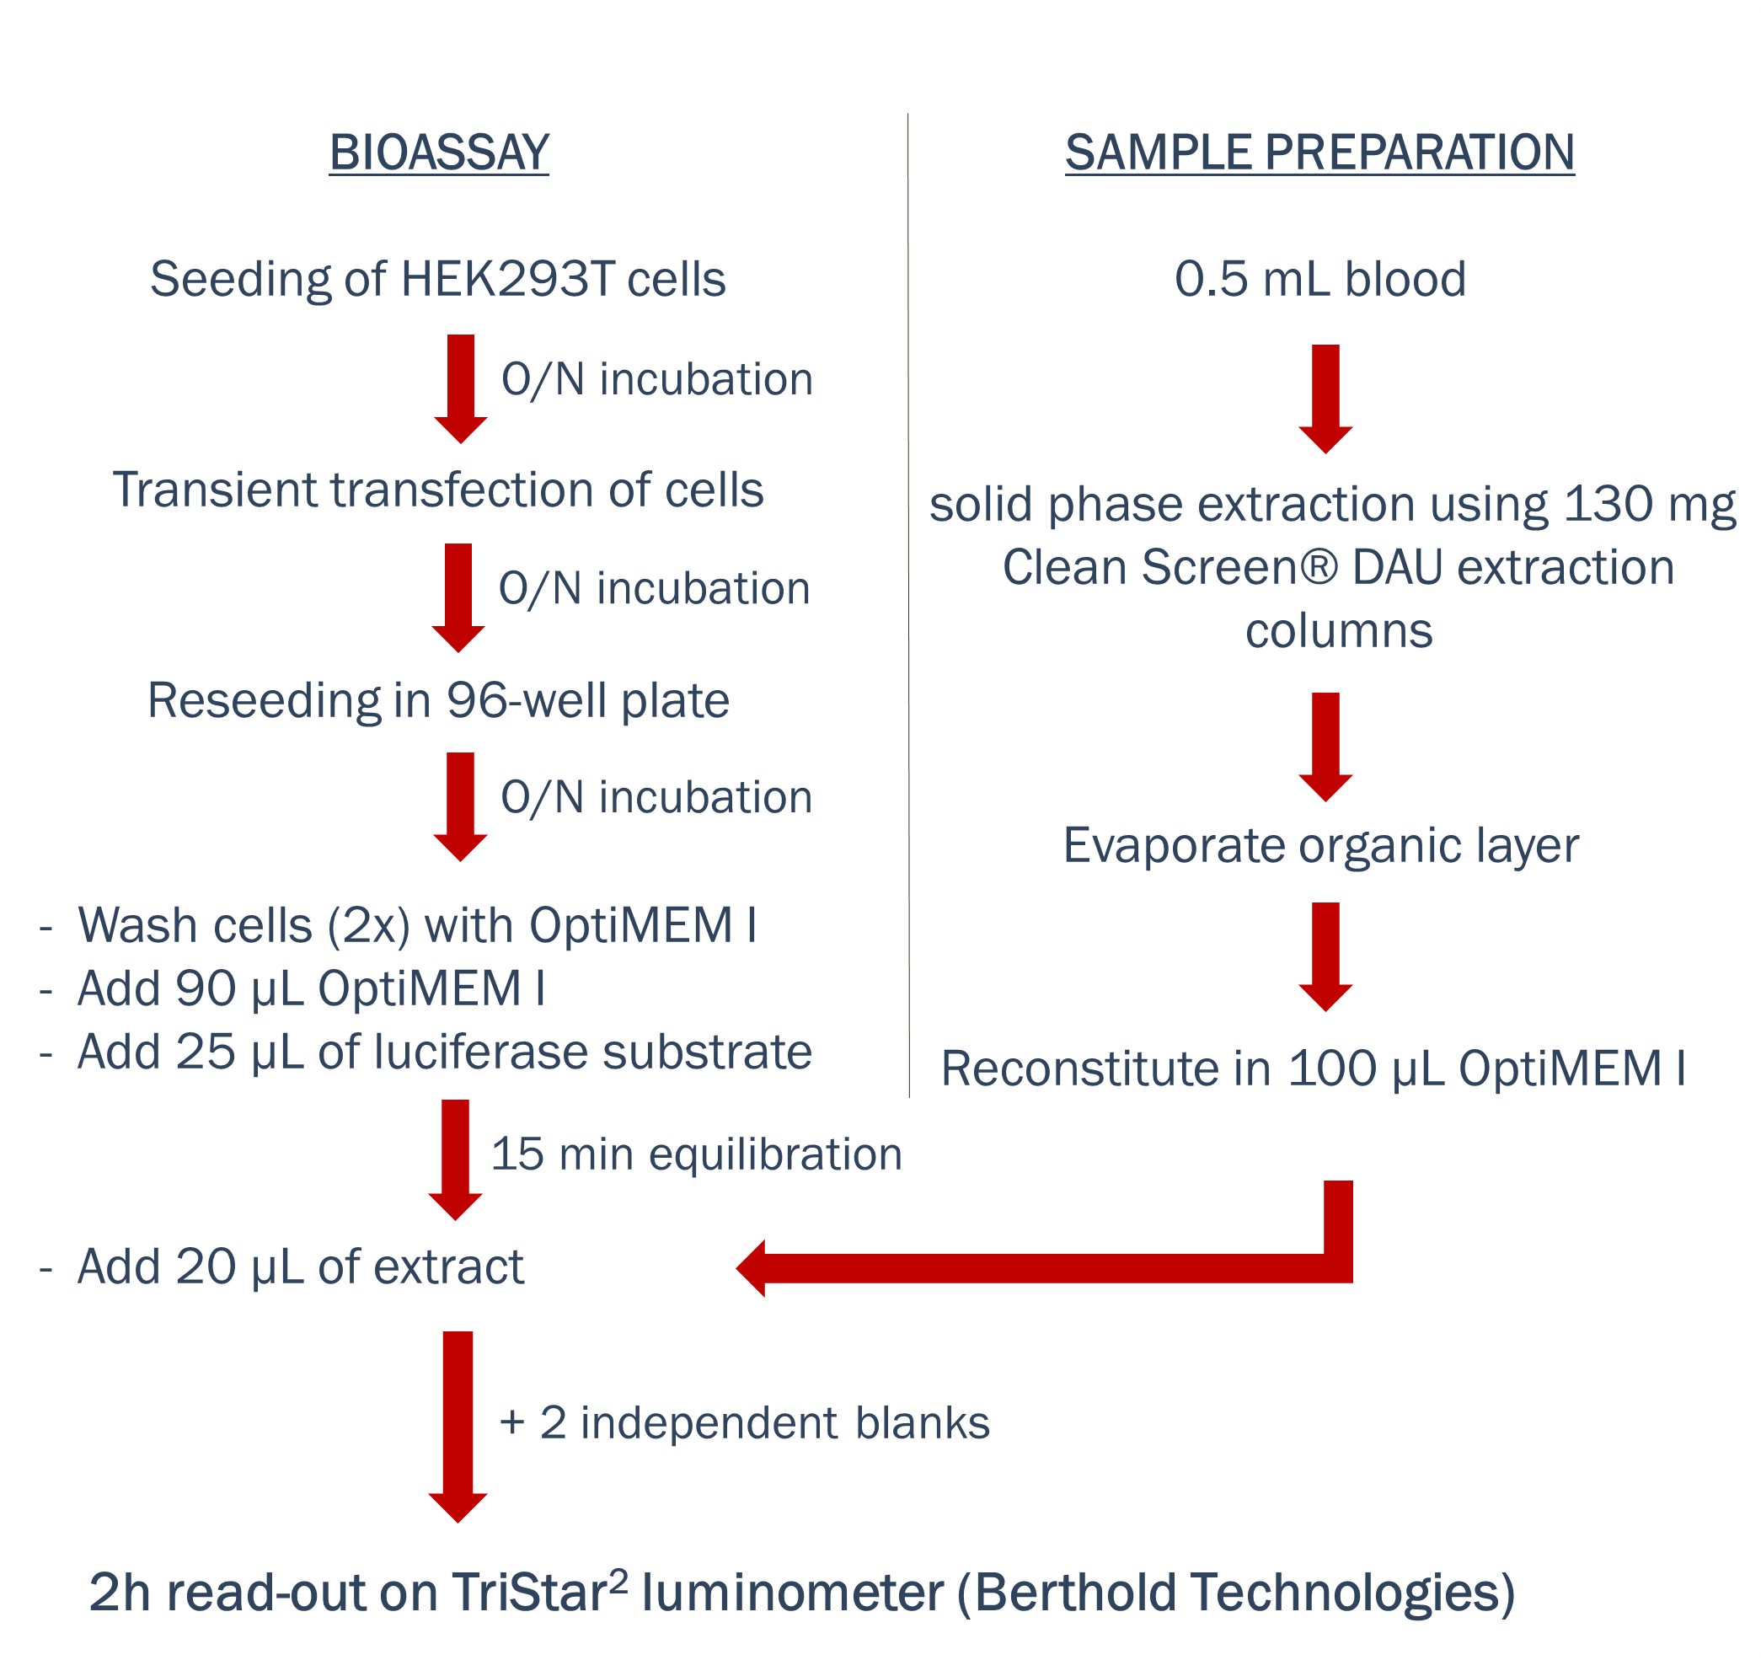
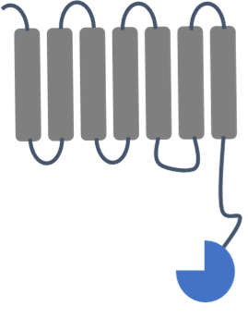





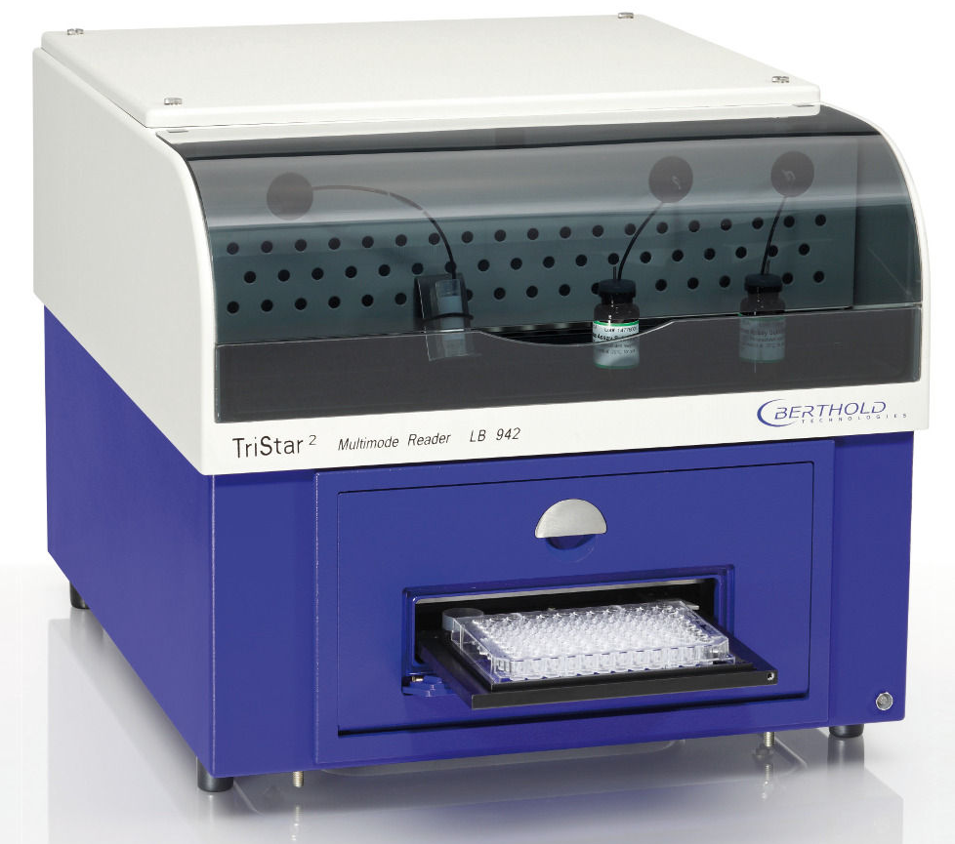
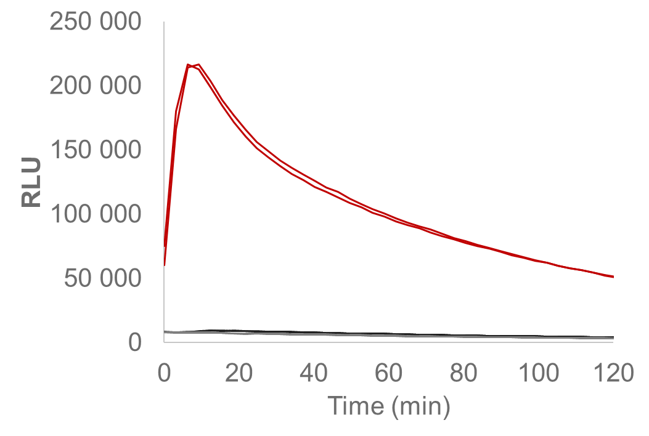
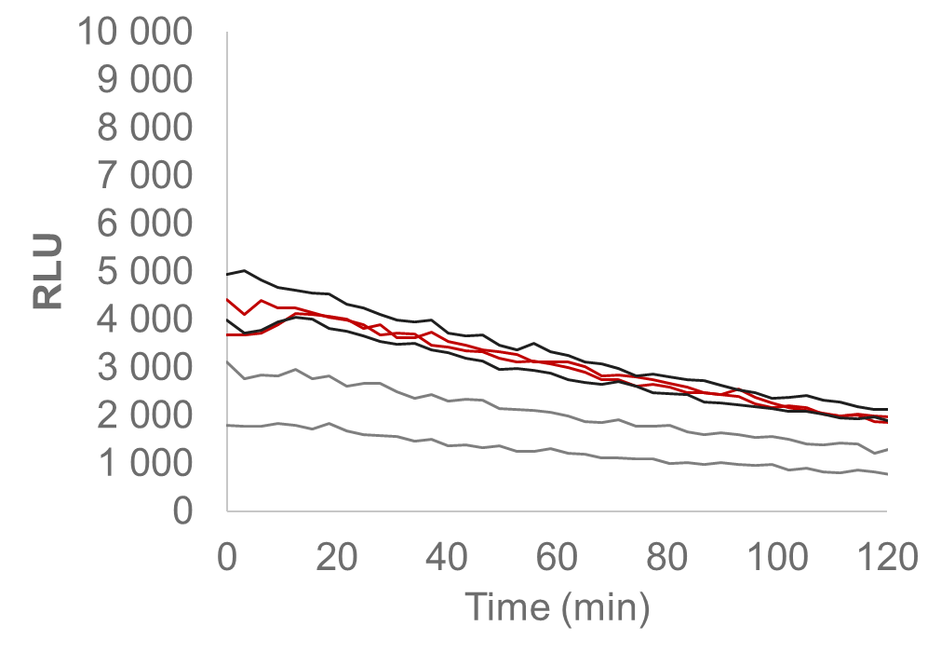
Materials and Methods
Bringing the fusion constructs in the cell <=
+
or
+
or
Blank sample
Positive sample

Slide 6
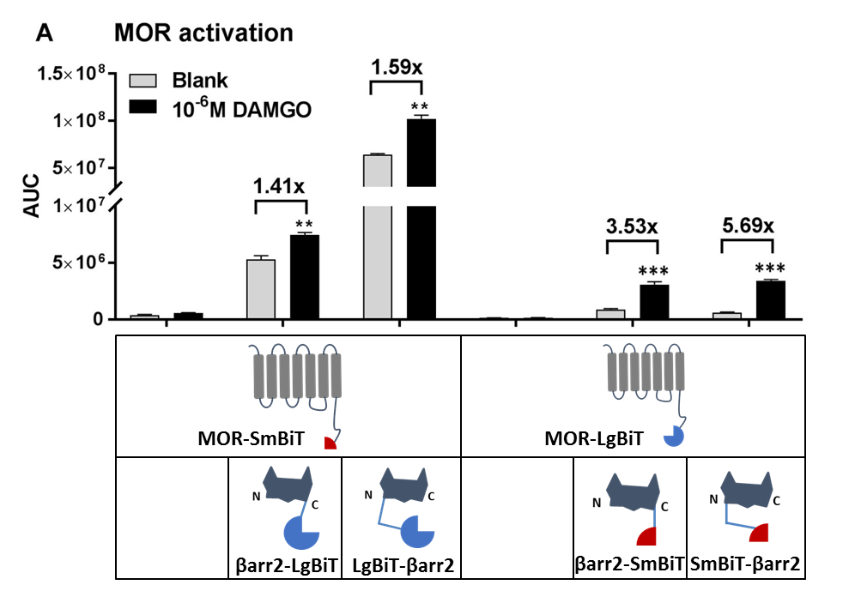
Results
Selection of the optimal configuration for the MOR reporter assay

Slide 7
Results
Screening of biological matrices requires optimal sensitivity:
Effect of co-expression of G protein-coupled receptor kinase 2 (GRK2)
Sensitivity

Slide 8



Results
Evaluation of MOR reporter assay on 107 authentic postmortem blood samples
107
LC-MS/MS and QTOF analysis:
presence or absence of the
synthetic opioids U-47700
and furanyl fentanyl
and other drugs of abuse
MOR reporter assay
Sensitivity and specificity

Slide 9
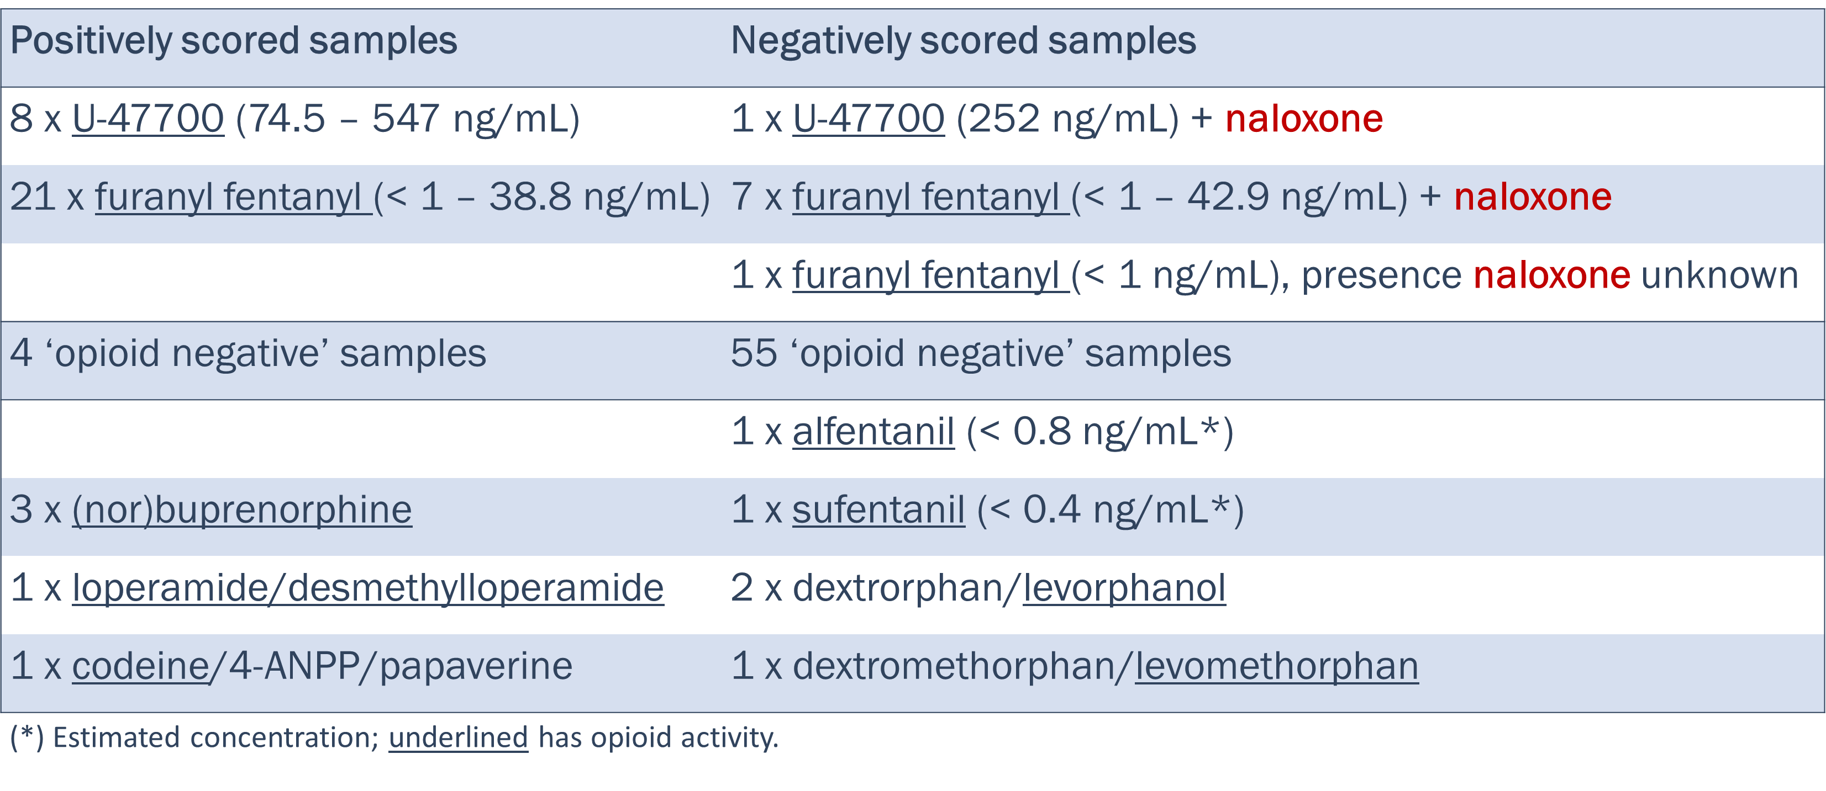
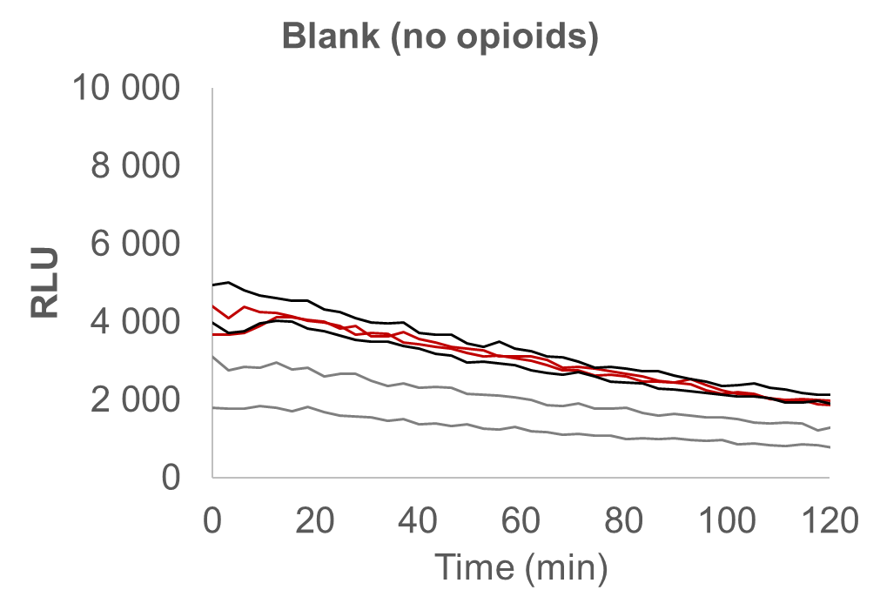
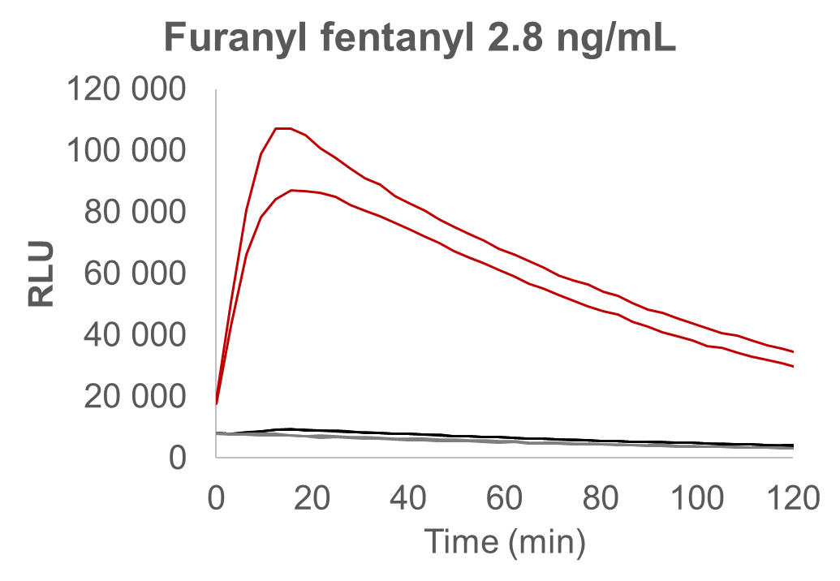
Results
Evaluation of MOR reporter assay on 107 authentic postmortem blood samples
Effect of µ-opioid receptor antagonist naloxone

Slide 10
Results
Evaluation of MOR reporter assay on 107 authentic postmortem blood samples
Upon exclusion of naloxone positive samples:
Sensitivity 100% (8/8 for U-47700)
Specificity 93% (55/59)
Sensitivity 95% (21/22 for furanyl fentanyl)

Slide 11
Results
Evaluation of MOR reporter assay on 107 authentic postmortem blood samples
Other compounds with opiate/opioid activity were detected
Other compounds with opiate/opioid
activity were not detected:
Very low concentrations (alfentanil, sufentanil)
No differentiation possible between active and inactive enantiomer

Slide 12
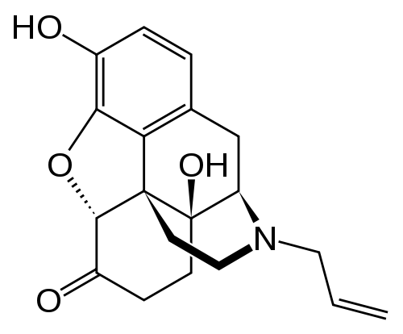
Question
What is an intrinsic limitation of the activity-based screening approach encountered in this study (which was not a problem for the cannabinoid activity screening, published before (Cannaert et al., Clin Chem, March 2018)?
Presence of antidote in some biological samples:
MOR antagonist naloxone

Slide 13
Conclusion
An alternative untargeted screening approach was developed for the detection of opiates and (synthetic) opioids, based on their activity rather than their structure
The bio-assay only screens for opioid activity; mass spectrometry is still needed to confirm and identify the opiate/opioid
Currently, an intrinsic limitation is the (co-)presence of MOR antagonists (e.g. naloxone), which are administered as an antidote in opiate/opioid intoxications and can block the receptor activation

